Slide 1
Include a Charity
2021 Gifts in Wills Conference
15 September 2021

Slide 3
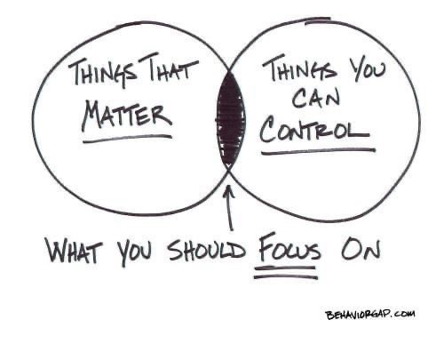
Channels with Impact
Maximise revenue for cause and account for every dollar spent.
Notes:
Fundraising Institute Australia is the national peak body representing professional fundraising in Australia.
Our members including charities of all sizes and types as well as suppliers to the sector. Fundraising is worth $10.5 billion in Australia.
Founded over 50 years ago, FIA’s mission is to advance professional fundraising to ensure the future sustainability of fundraising into the future. We do this via a self-regulatory Code of Conduct, the FIA Code, and through providing professional development, education and training. We also lobby government at all levels on the issues critical to the fundraising sector.

Slide 4
Channel Strategic Choices
1. Near-term revenue and age
2. Quality over quantity
3. Residual priority
4. Increase known bequestors
Notes:
Fundraising Institute Australia is the national peak body representing professional fundraising in Australia.
Our members including charities of all sizes and types as well as suppliers to the sector. Fundraising is worth $10.5 billion in Australia.
Founded over 50 years ago, FIA’s mission is to advance professional fundraising to ensure the future sustainability of fundraising into the future. We do this via a self-regulatory Code of Conduct, the FIA Code, and through providing professional development, education and training. We also lobby government at all levels on the issues critical to the fundraising sector.

Slide 5
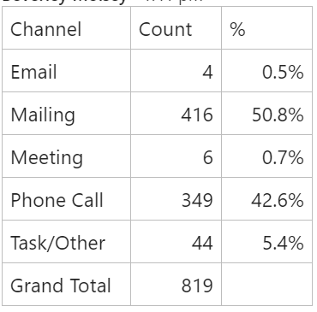
Leads and Channels
Organisation-wide planning and shared KPIs
Beware the self-fulfilling channel prophecy
Profile your leads/prospects from your best realized
DM, response mechs and surveys
Other channels

Slide 6
Conversions and Channels
Telephone, telephone, telephone
Agency, staff team split
Early pipeline to agency
Staff Team confirm, upgrade and retain
Notes:
Fundraising Institute Australia is the national peak body representing professional fundraising in Australia.
Our members including charities of all sizes and types as well as suppliers to the sector. Fundraising is worth $10.5 billion in Australia.
Founded over 50 years ago, FIA’s mission is to advance professional fundraising to ensure the future sustainability of fundraising into the future. We do this via a self-regulatory Code of Conduct, the FIA Code, and through providing professional development, education and training. We also lobby government at all levels on the issues critical to the fundraising sector.

Slide 7
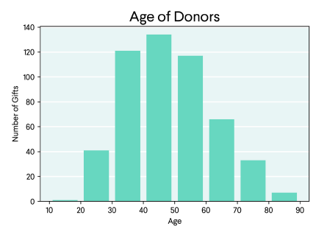
Online Wills
Commercial Clash
Age/Residual
Notes:
Fundraising Institute Australia is the national peak body representing professional fundraising in Australia.
Our members including charities of all sizes and types as well as suppliers to the sector. Fundraising is worth $10.5 billion in Australia.
Founded over 50 years ago, FIA’s mission is to advance professional fundraising to ensure the future sustainability of fundraising into the future. We do this via a self-regulatory Code of Conduct, the FIA Code, and through providing professional development, education and training. We also lobby government at all levels on the issues critical to the fundraising sector.

Slide 8
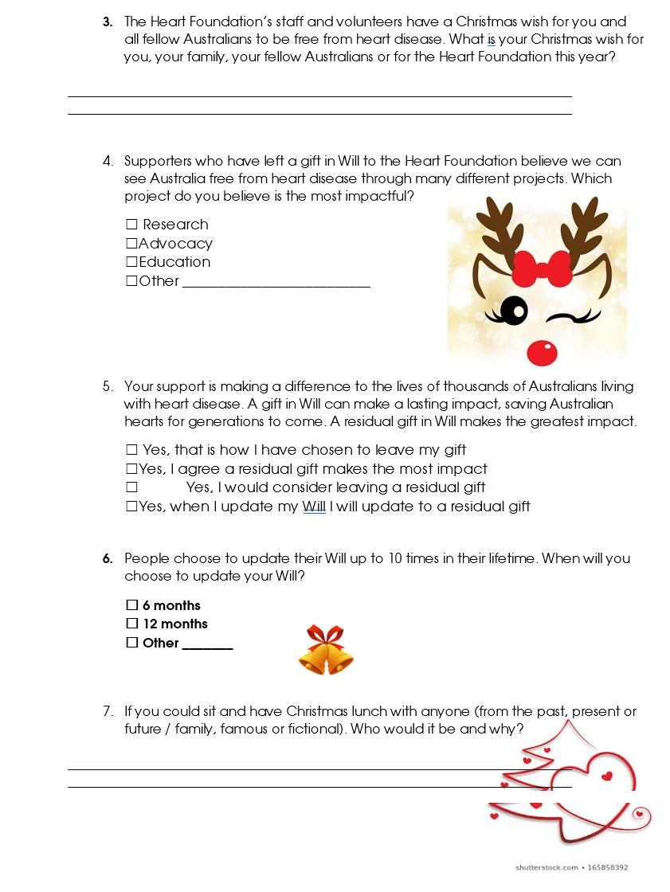
DM that worked a treat
Notes:
Fundraising Institute Australia is the national peak body representing professional fundraising in Australia.
Our members including charities of all sizes and types as well as suppliers to the sector. Fundraising is worth $10.5 billion in Australia.
Founded over 50 years ago, FIA’s mission is to advance professional fundraising to ensure the future sustainability of fundraising into the future. We do this via a self-regulatory Code of Conduct, the FIA Code, and through providing professional development, education and training. We also lobby government at all levels on the issues critical to the fundraising sector.

Slide 9
Questions?
Notes:
Fundraising Institute Australia is the national peak body representing professional fundraising in Australia.
Our members including charities of all sizes and types as well as suppliers to the sector. Fundraising is worth $10.5 billion in Australia.
Founded over 50 years ago, FIA’s mission is to advance professional fundraising to ensure the future sustainability of fundraising into the future. We do this via a self-regulatory Code of Conduct, the FIA Code, and through providing professional development, education and training. We also lobby government at all levels on the issues critical to the fundraising sector.

Slide 10
THANK YOU
Notes:
Fundraising Institute Australia is the national peak body representing professional fundraising in Australia.
Our members including charities of all sizes and types as well as suppliers to the sector. Fundraising is worth $10.5 billion in Australia.
Founded over 50 years ago, FIA’s mission is to advance professional fundraising to ensure the future sustainability of fundraising into the future. We do this via a self-regulatory Code of Conduct, the FIA Code, and through providing professional development, education and training. We also lobby government at all levels on the issues critical to the fundraising sector.

Slide 11
Be part of a movement
www.includeacharity.com.au

