Slide 1
Include a Charity Exchange
Increasing movement from consideration to confirmed.

Slide 2
Agenda
Item | Time | Responsible
Welcome | 12.30-12.35 | Helen Beeby
Goals & Attitudes | 12.35 – 12.45 | Karen Armstrong
Poll/Break-out 1 | 12.45-1.00 | Groups & Feedback
Trust & messaging | 1.00 – 1.10 | Karen Armstrong
Break-out 2 | 1.10 – 1.22 | Groups
Share ideas | 1.22- 1.32 | Lead from groups
Influencers | 1.32 – 1.45 | Rohani Bixler
Close |  | Helen Beeby

Slide 3
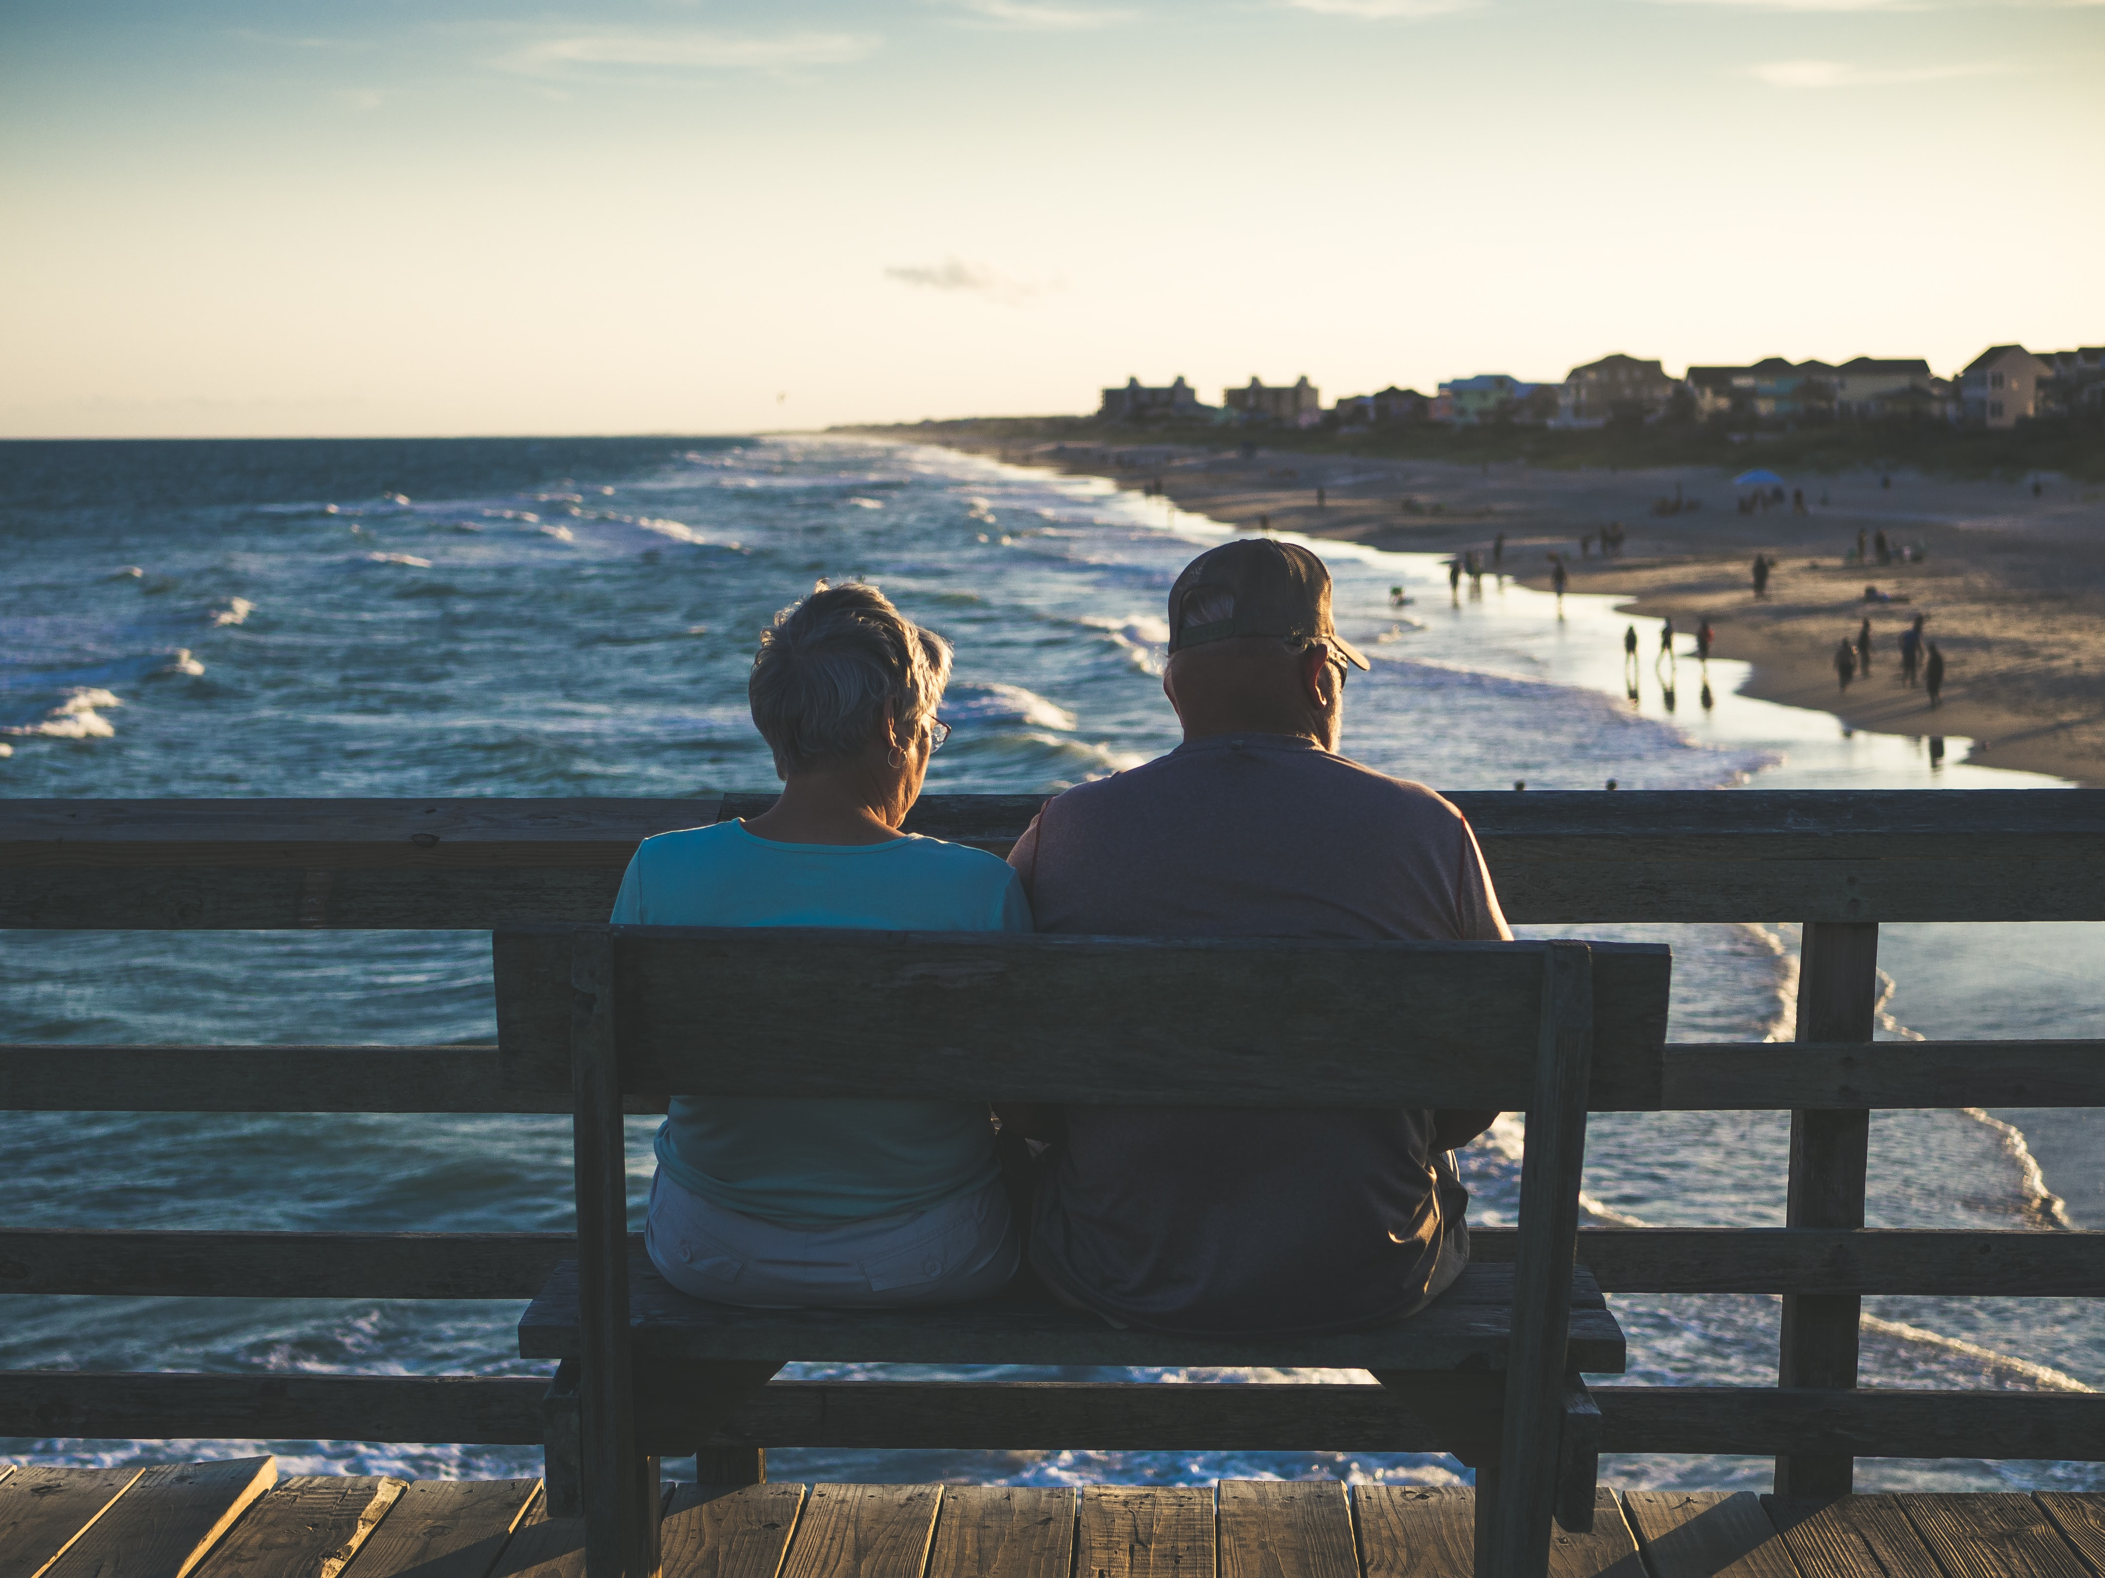
23% of Australians have considered leaving a Will. Of these 3% and 13% of Australians will “definitely” or “probably” leave a gift in Will respectively. A potential of 2.6m Australians More Strategic Public Survey Nov 22 n=1,031
Notes:
If we could transition 5% of this group to include a gift they are worth 12BN to the sector

Slide 4
If 5% were converted to confirmed bequestors it would equate to an estimated $12BN in gifts
Notes:
If we could transition 5% of this group to include a gift they are worth 12BN to the sector

Slide 5
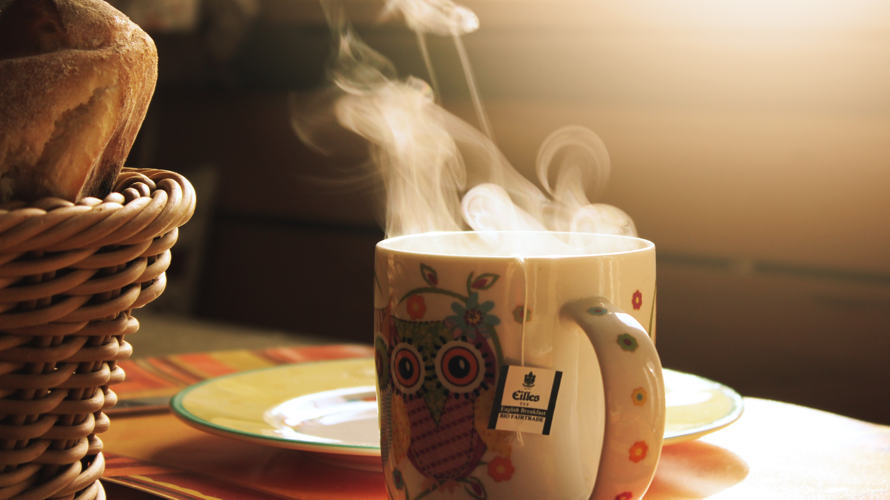
Charities are on average stewarding 1k confirmed and over 2k intenders/considerers. 14% growth in pipeline size over last 5 years, driven by ‘More Information’ category. Include a Charity benchmark 2022

Slide 6
Let’s convert the average pipeline considerers: 3% intenders: 7%. $7.5m Include a Charity benchmark 2022

Slide 7
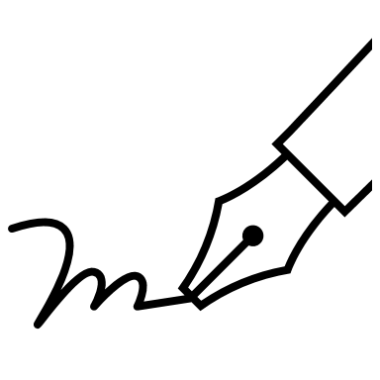
Incidence of gift in Will
There change between 19-22 while positive is insignificant, however, confirms the positive growth retained since 2016.
 | 2016 | 2019 | 2022
Yes | 8% | 11% | 12%
Q2.6 - Have you left a donation to a charity or not-for-profit organisation in your Will?
Base: All respondents, n=1521

Slide 8
Inform the charity of Will donation?
Telling charities is quite a polarizing position which is likely driving our continued high % of unknown bequestors. This % unlikely to shift until the attitude shifts. Considerers may be the most likely to influence.

Slide 9
Consideration if GIW
There has been no significant increase in consideration overall. There has been a significant decline for those with a Will.
Goal: 25%
Not Achieved: 19%
 | 2016 | 2019 | 2022
All | 17% | 20.1% | 19.0%
With Will |  | 21.1% | 17.9%
Q3.1 - Have you ever considered leaving a donation to a charity or not-for-profit organisation in your Will?
Base: All respondents, n=1371
(excludes those who have left a gift in their Will)

Slide 10
Consideration of GIW
The main shift in consideration is driven by the older audience declining from 22% to 17%.

Slide 11
Consideration of GIW
The effect of age and growing appeal with younger audiences
Study 2: Public Research

Slide 12
Poll time

Slide 13
Discussion: Who did you have the conversation with and the outcome – positive or negative. Share learnings. (talking about considerers)

Slide 14
I trust charities to spend donations wisely
Confirmed supporters have highest trust levels followed by considerers.
High trust scores for donors may be a signal for a bequest ask.

Slide 15
Satisfaction of how charities engage with you
Confirmed most satisfied with how charities engage with them.
Consider lower satisfaction level compared to donors. Opportunity to review engagement tactics in pipeline journeys.

Slide 16
I’d prefer to give donations to charities during my lifetime
Donors’ high preference to leave donation during lifetime. Education piece is needed to illustrate huge impact a gift in Will can make compared to one off donation.

Slide 17
I think I will have enough to be able to include a charity
Confirmed are the most financially optimistic. Aim to address this barrier when converting donor/non-donor segment to leads.

Slide 18
My family would be pleased if I left a gift to charity
Family remains large barrier for leaving a gift in Will. Large need to normalise this in non-donor and donor groups.

Slide 19
I’d only consider leaving a donation to charity in my Will in my family is doing well financially and I did not think they really need money
Consider, Donor and Non-Donor segments have high agreeance with statement, illustrating key barrier is ensuring family is taken care of.

Slide 20
Any gift, big or small, in your Will can make a difference for your favourite charity
Increases likelihood to give a gift in Will across all segments.
Recommendation to focus on this key message.

Slide 21
Once you’ve taken care of your family you can leave some of what is remaining to charity.
Donor, Non-Donor and Considerer resonate with this statement the most, further supporting family is a barrier to leaving gift in Will.

Slide 22
Discussion 2: 1. How can we increase trust and satisfaction with charities? 2. How do we consistently use the winning messages to address the attitudinal differences of considerers? “Any gift, big or small, in your Will can make a difference for your favourite charity” “Once you’ve taken care of your family you can leave some of what is remaining to charity.”

Slide 23
Report Back

Slide 24
Welcome Rohani Bixler The role of influencers Q&A

Slide 25
Discuss making a Will?
Confirmed and considered bequestors are more likely to discuss their Will with spouse/partner

Slide 26
Who knows the Will details?
Confirmed and considered bequestors are likely to tell their spouse the details of their Will but more considered bequestors will tell their children than confirmed.

Slide 27
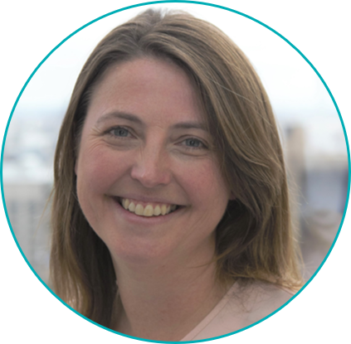
Questions
Please get in touch with
Karen Armstrong karen@morestrategic.com.au
+61402450451

