Slide 1
One Call Away Making GIW calls with Confidence
Frances Schepisi

Slide 2
Welcome to Country
“I would like to begin by acknowledging the Traditional Owners of the land on which we meet today, the Wurundjeri people of the Kulin Nation and pay my respects to their Elders past, present and emerging. I would also like to pay my respects to any Elders from other communities who may be here today.”

Slide 3
POLL s
When you make the GIW call to a new prospect do you get nervous? Yes No
Have you received training on how to make your GIW calls? Yes No
Do you know techniques to control your conversation Yes No
Have you been taught how to use your Rapport to guide your conversation? Yes No
Do you let your supporter know that you will call back, regardless of the time frame Yes No

Slide 4
Telemarketing – Is not always a bad thing
There are difference between What we do as GIW people and Telemarketing companies that fundraise for us.
There are also similarities. Trust me when I tell you that a good telemarketer never sounds like a telemarketer. It is all about skill, confidence, control and technique.
Today I will share some tips that may help you in the future or understand your needs for later. I will be sharing my personal favourite strategies.

Slide 5
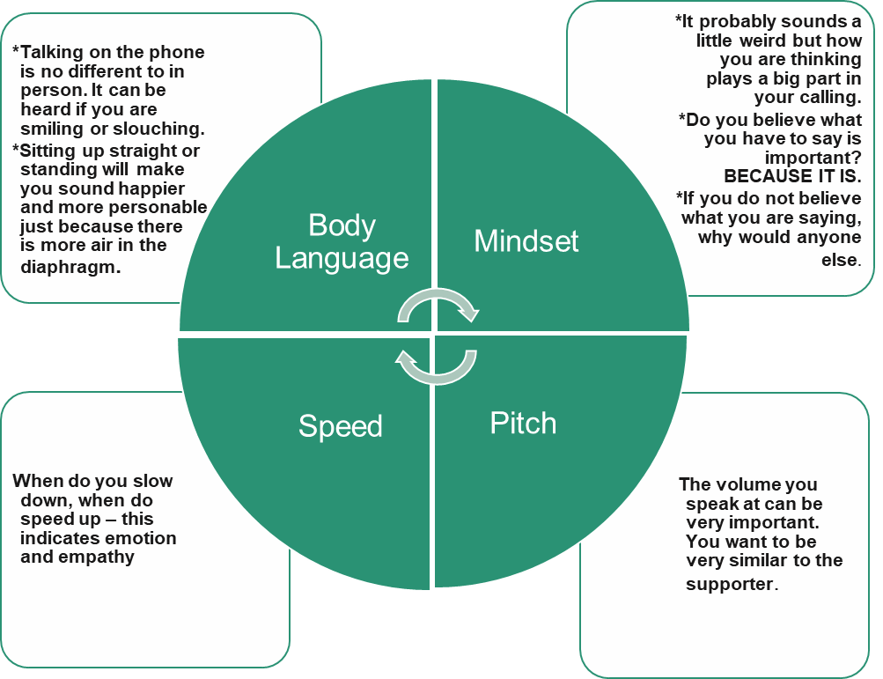
Where to Start

Slide 6
Lets Start the call.
Did you know that we can decide we do not like someone face to face in 1/10th of a second?
It takes around 30 seconds on the phone to decide if you want to talk to someone. You have a small window to make a good impression.
I use the straight line theory when making calls together with purpose based calling to aid in the GIW Nudge theory for moves management.
I realise that these are sales techniques but the also work for GIW calling
Jordan Belfort- Straight Line Theory

Slide 7
First 30 seconds….
Clearly and calmly introduce yourself, your organisation (if the call is recorded) the purpose of the call. THEN ask the supporter how they are.
“Hello, is that …...? It is Frankiie calling from the Stroke Foundation. I would like to let you know the call maybe recorded for training and quality. I was just calling to……….
How are you?”
In straight line theory, you are establishing a scenario where you have expertise, enthusiasm and confidence in yourself. You are creating the tone for the call.
Remember the first step was mindset

Slide 8
Objections and when to handle them.
We have all had that call when the supporter says they do not have time or they can’t afford a donation at the moment. These are clear objections.
Example.. I can not afford a donation
There are 3 steps to handling objections.
1 Validate the objection – I understand, and I wanted to thank you for your support
2 Diffuse the objection- In fact I was not looking for a donation today
3 Move on- Take the conversation in another direction. It is important that you feel confident

Slide 9
Objections and when to handle them.
NEVER pre-empt an objection handle.
What you have to say is important. You need to believe that.
When we pre-empt an objection, we risk sounding desperate to be allowed to speak.
If you ask someone “How are you?” And they reply “Busy” it is not necessarily an objection, they maybe answering your question.

Slide 10
Parameters
Understand how your conversation should go.
Know when to turn the conversation to where you need it to go.
Stay within Parameters.

Slide 11
Rapport
‘a close and harmonious relationship in which the people or groups concerned understand each other's feelings or ideas and communicate well:’
Quality Rapport
1 Ask open questions
2 Active listening
3 Create shared experiences. It needs be both ways to grow the story
Strategic Rapport
1 Create the dialogue
2 Ask open questions
3 Active listening
4 Create shared experiences. It needs be both ways tp grow the story

Slide 12
WHY is it IMPORTANT We all have a STORY, and they are different
We measure an intangible concept.
We inspire an emotional connection
We create pathways for the connection
We express our gratitude
AND
We plant seeds and then nurture this thought process
WE JOURNEY TOGETHER
This Photo by Unknown Author is licensed under CC BY-NC

Slide 13
Inspire
Plant the thought seed
Active Listening.
Engage
Re-inspire
Fact finding for supporters' story
Journey
Find the connection
Build the inspiration
Build stronger connections
Active listening
Outcome for purpose
Active listening
Consent for future contact and time frame to continue Journey
Purpose of call
Gentle nudge
Recap
Gratitude for the journey

Slide 14
Close
When you close the call, always recap the top line items. If you are sending more information, how it is being sent, change of details etc.
The next step is to reaffirm the relationship and set up the expectation of further contact.
This is just to let the supporter know they are important to you.
Hint, the time frame is not important

Slide 15
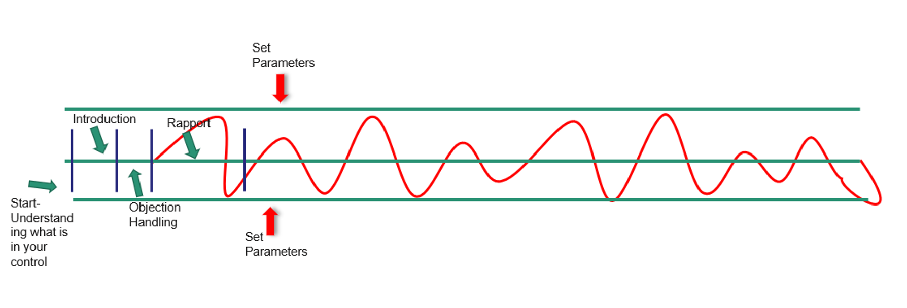
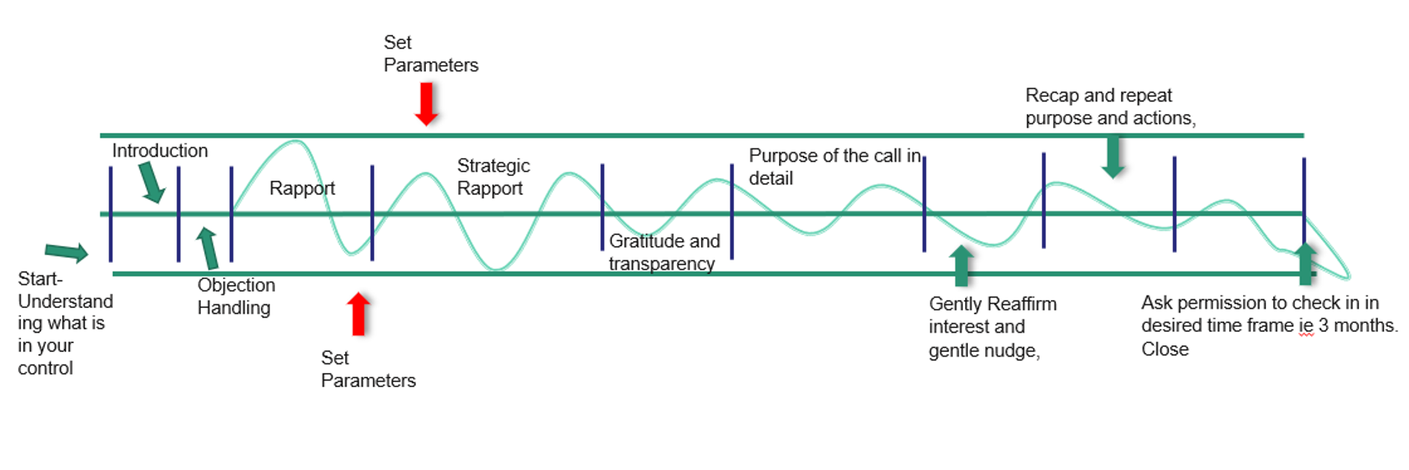

Slide 16
Questions?

Slide 17
Contact Me
Until April (for now) I will still be at the Stroke Foundation. Please feel free to contact me .
fschepisi@strokefoundation.org.au

Slide 18
“I never knew a simple health check could have prevented my stroke” - Stephen stroke survivor

