Slide 1
Include a Charity
2023 Gifts in Wills Conference
Bequest Assist
20 July 2023

Slide 2
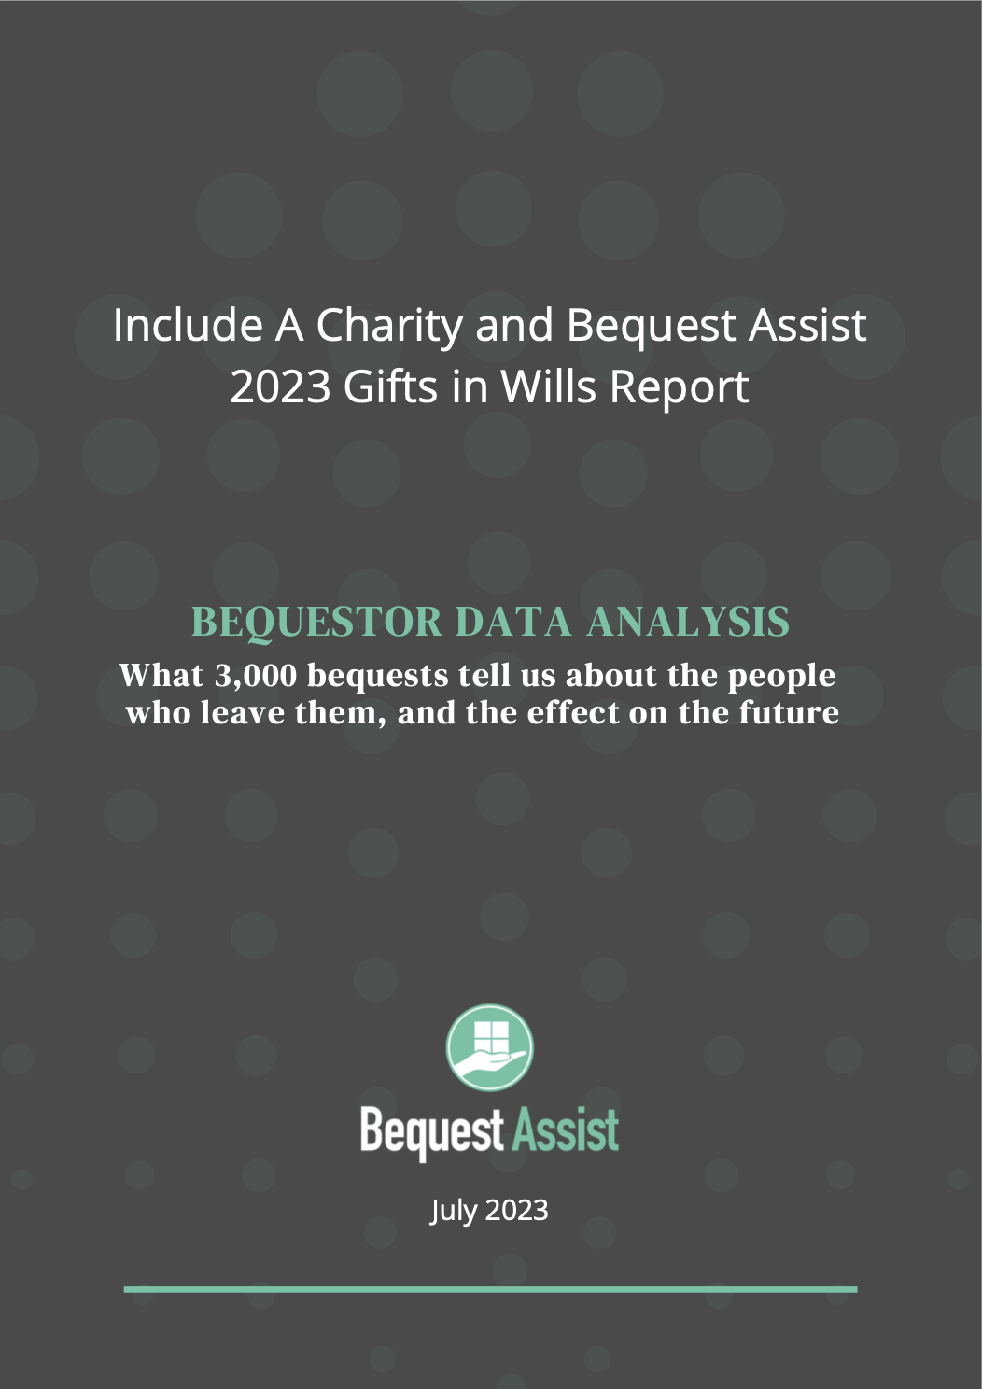
Notes:
+ Acknowledgement of country
+ Introduce MM and MK
+ Introduce Bequest Assist – charities outsource all of their estate management work to us so they can focus on living potential bequestors and we handle the process with solicitors
+ Introduce the research - all IAC members will be sent a copy, new people who join

Slide 3
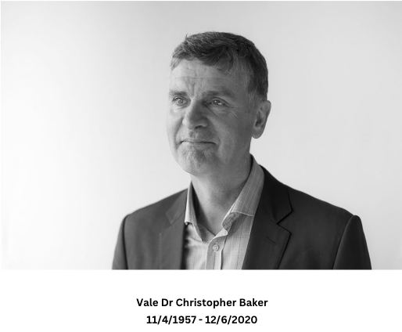
Notes:
MK

Slide 4
Data Collection
Data is collected as part of Bequest Assist’s estate administration
20 Australian charitable entities
Excluded some records
Report covers 2958 bequests from 2596 estates
Analyses differences based on size of bequest program, location and focus area
Notes:
MK

Slide 5
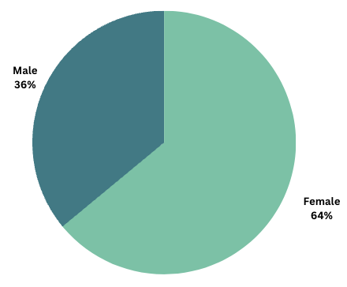
Bequestor profile - gender
Notes:
+ First, bequestor profile
+ As expected, more bequestors are female than male. Women live longer than men, which we’ll talk about in the next slide.
+ Median vs mean – skewed throughout
+ Domestic animal and conservation charities had a more stronger slant towards female bequestors than health based charities
+ Men leave slightly higher value gifts
+ But overall, women are responsible for 62% of estate income for charities – total of all money for GIW

Slide 6
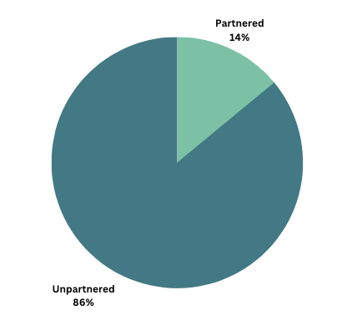
Bequestor profile – partnership status
Notes:
+ Note this is partnered status at time of death – includes widowed and divorced individuals
+ Individuals without spouses left 86% of the gifts received
+ It has been commented previously that one of the reasons that women leave more bequests than men is that they live longer, so the male is the first spouse to die, leaving it to their female partner who in turn leaves it to charities.
+ The mean and median are lower for partnered individuals – because they are more likely to leave lower value pecuniary gifts than unpartnered individuals
+ Ultimately unpartnered individuals were responsible for 86% of total estate income. If we exclude very large gifts that are skewing the data (for example where someone had enough funds to share between their spouse and favourite charities) that amount climbs to 89% of total estate income being earned from people without a spouse.
MM UPDATE TABLE

Slide 7
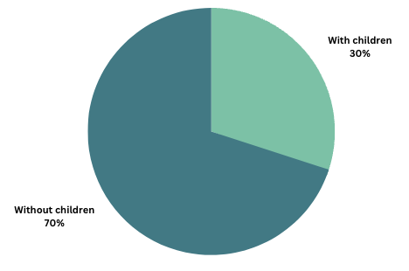
Bequestor profile – parenting status
Notes:
+ Note this is children at time of death and includes step children
+ Similarly, having children diminishes both the likelihood and size of a gift
+ In our research, the mean gift size from an individual without children was 4.5x that of someone with children
+ Bequestors with children make up 30% of bequests received, but only 12% of the total estate income received
+ This trend is so strong that at BA, if we see charities getting a larger gift than children (like the residuary estate), we earmark that bequest as a potential FPC.
+ Notably though, Dr Baker commented that in the general pool of wills probated, only 30% of individuals without children left their gift to charity – the other 70% left it to friends and family. That is a very big pool of potential bequestors not currently leaving a gift in their will to charity, but how to connect with them is a question we can’t answer for you.

Slide 8
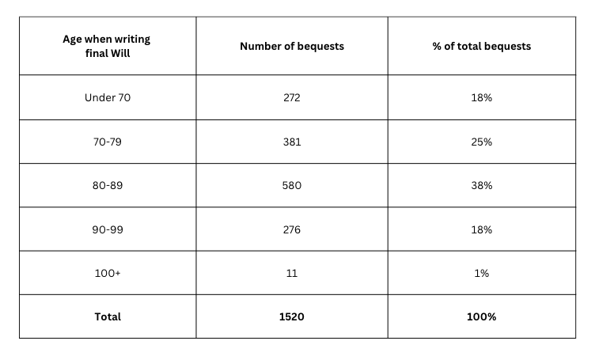
Bequestor profile – testator age at final will
Notes:
+ A person who writes a will is called a “testator” and this slide is all about what age individuals were writing their final will.
+ We don’t always have birthdate, so this covers 1520 bequest total.
+ We don’t see prior wills most of the time, just the final will – a previous study in the USA has found that most people on average make their first Will at 44 and then update it two to three times with only 12% of individuals never updating their will
+ On mean average people were 79.5 when executing their final will and only 18% of individuals wrote their final will before the age of 70. This marries up with earlier data collected on the subject.
+ One of the questions we get all the time at BA is what we’re seeing in terms of online wills in our system – and we’ve included some commentary on that in the report. With over 3000 bequests in our system, so far we have seen one online will, and it is yet to be probated. The reason for that is this statistic – people are writing their final will late in life and passing away later than the Aus average (as we will see in a moment) – and this is not the group of individuals who are utilising online wills. We’re not saying that we won’t see more online wills in the future – but it is far, far away based on the data of what age of individuals are using those programs.

Slide 9
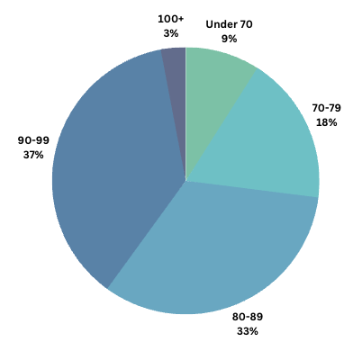
Bequestor profile – bequestor age at death
Notes:
+ This slide is looking not at the age when people wrote their will, but when they died
+ The Aus average is 83 years, but bequestors live longer
+ Charities received 73% of bequests from people who lived to be 80 or older
+ With 40% being over the age of 90, the average age at death was 84.7.
+ Only 9% of bequests came from people under the age of 70

Slide 10
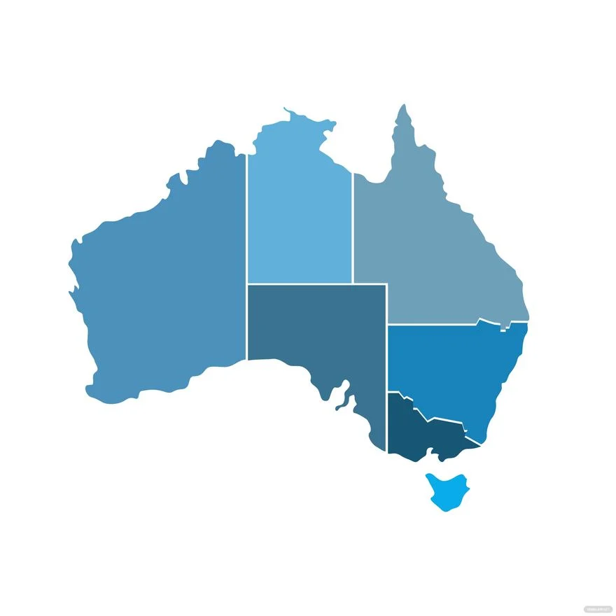
Bequestor profile – location
Notes:
+ On the theme of places - we looked at whether individuals lived in urban or rural areas
+ This data comes from the postcode where they were living at the time of writing their will and if we didn’t have that, where they were living at the time of death, Previously we have looked at how close those two postcodes are and found that on average it is within 10 kms.
+ We used the Modified Monash Model from 2019 for our analysis. Based on their data, 70% of the general Aus population lived in the “urban” classification in 2019.
+ We found that 76% of bequests come from urban areas totalling 82% of total estate income earned – this means that urban bequests are overrepresented
+ This differed significantly across charities and the analysis is worth performing at an individual level

Slide 11
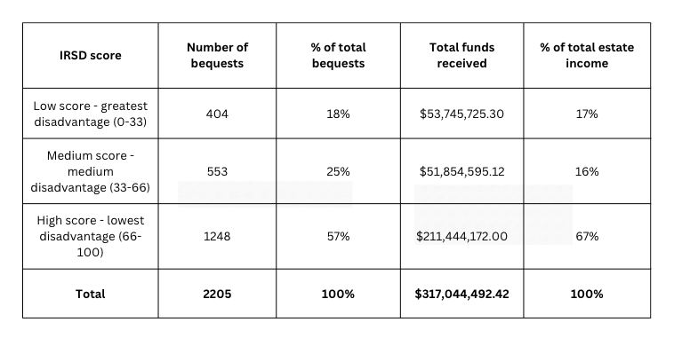
Bequestor profile – IRSD
Notes:
+ Looked at the Index of Relative Socio-economic Disadvantage (IRSD) which classes postcodes into areas of high, medium or low disadvantage (income level, qualifications, occupations)
+ Of course, this isn’t about an individual’s circumstances, but about what the socio-economic situation of their suburb is
+ You would expect that bequests would come from high scoring areas, and they do – 57% of bequests representing 67% of total estate income
+ BUT there is more coming from medium and low scoring suburbs than you might think – and fairly evenly spread between those two places.
+ There was significant variation between charities – ranging from 35% from the high scoring area all the way up to 74%. This analysis is worth doing on an individual charity level to understand what suburbs your GIW program might want to target.

Slide 12
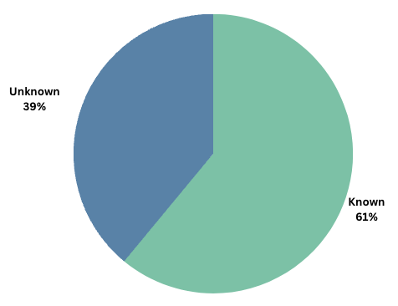
Bequestor relationship to charity beneficiary
Notes:
+ We looked at what percent of bequestors were known to the charity in some way – that could be from being in the bequestor pipeline, being a donor, member, volunteer, etc
+ 61% were known in some way
+ This differs from previous finding in the IAC 2022 benchmarking that found only 48% were known to the charity. The difference could be from our sample size being larger, but I believe this has more to do with accurate data keeping than anything else and that big variations between charities represent that.
+ For example, our charities ranged from knowing as little as 41% all the way up to 80% - think small differences in the spelling of names, or perhaps the individual never donated but had signed a petition. For example, two health based charities who have really robust data in our system knew 71% and 80%.

Slide 13
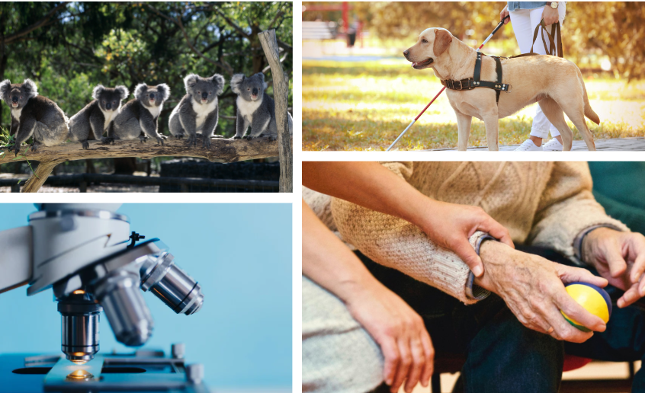
Charities in the Will
Notes:
+ When one charity is in the Will, others are likely there as well
+ Our charity clients were the sole charity in the will only 17% of the time (this does not mean they received 100% of the gift – something we’ll report on in the future)
+ The mean number of charities in the Will was 5.4 and the median was 4
+ Dr Baker’s research differed to us significantly here – he found 47% of wills that had a charitable beneficiary were the only charity in there. We think the difference is that his analysis included universities, schools and religious institutions (such as churches) vs we don’t have any of those sorts of charities in ours. Our sample size is also larger.
+ In future years we hope to look at what charities and causes track together – but this is really worthwhile for individual charities to understand about themselves

Slide 14
Gift type and value
Average bequest = $134,501.55
Notes:
+ The average gift size of any type of gift was $134,501.55
+ Pecuniary are slightly more common that residuary (52% pecun, vs 45% resid) but make up only 8% of total estate income (the remaining 2% = other types of gifts)
+ Residuary are worth on average 12x that of a pecuniary gift and make up 85% of total estate income
+ There is a lot more on this in the written report

Slide 15
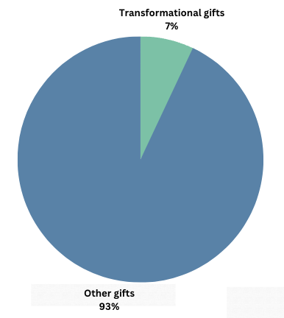
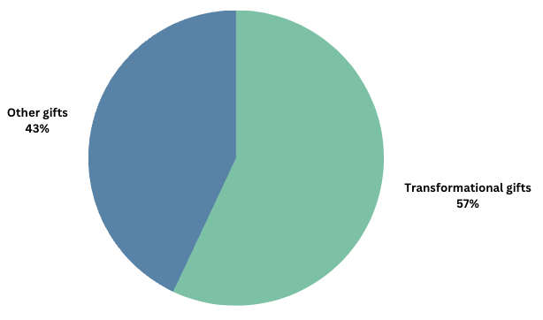
“Transformational gifts”
Number of bequests:
GIW income:
Notes:
+ When we’ve done analysis for charity clients in the past, one of the things that they’ve been keen to understand is how much of their GIW income comes from very large bequests.
+ In the past, we’ve classified “transformational gifts” size anywhere from $400k to $1m – it depends on the size of the charity’s bequest program, but for this exercise we classified it as $500k
+ A gift of this size might come from a very large estate, or because a charity was a high percent residuary beneficiary of a normal sized estate (eg 100% beneficiary of a $600k estate). Estate size averages is something the report includes.
+ While gifts over $500k make up only 7% of gifts received, they are responsible for 57% of total estates income
+ This is why we often look to the median – because the mean gets pulled out towards these higher value gifts.
+ For our charity clients, no client had more than 11% of their gifts be higher than $500k, but the amount of their total income it represents range from 14-72%. Generally it sits around the 50% mark.
+ Female bequestors gave more transformational gifts and of a higher value – 66% came from women and 34% from men.
+ This is really important to understand for forecasting – the variability of GIW income year on year can often be attributed to very large gifts.

Slide 16
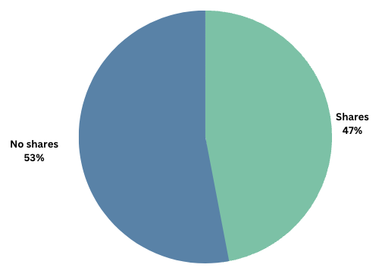
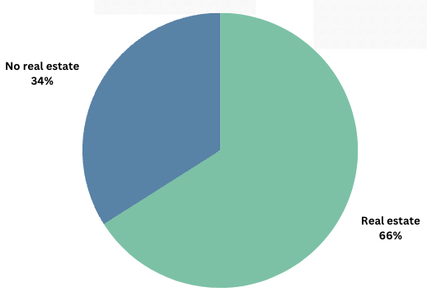
Commonality of estate assets
Notes:
+ At BA, we track not only the total value of an estate, but the specific assets that comprise it (note this is mainly from residuary gifts). There are a few key reasons for this:
It allows better forecasting as different assets take longer to administer
It provides greater oversight to check the final statement and ensure all property was called in
Most important: It highlights assets where CGT might be handled improperly resulting in loss to the charity, so we proactively contact solicitors to get advice
+ We also track international assets and superannuation. We didn’t traditionally see superannuation but it is on the rise as it became mandatory for people working past 1992 – so we will continue to see more of that in years to come. Super needs to be handled really carefully and is a topic in itself.
+ 47% of estates had shares and 66% had real estate. Both can have CGT implications and need to be watched carefully.
+ BA knows that CGT incorrectly handled is a huge loss to charities through the estate administration process – we are currently investigating this for a future report.

Slide 17
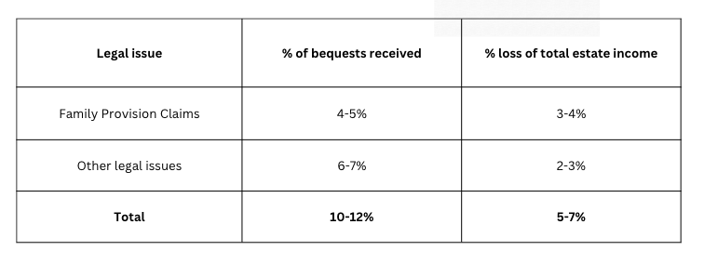
Legal issues
Notes:
+ We track legal issues of all types and how much is lost to charity beneficiaries (including settlements and costs spent on solicitors)
+ Note that when we say there is a legal issue – we’re not saying that it went to court, it was raised and may have been handled informally. Sometimes no loss happens.
+ Across 2116 bequests, FPC were raised around 4-5% and charities lost around 3-4% of their total GIW income. That is 3-4% of the total pot of GIW income.
+ Charities often report that they feel like the number is higher than this but the data doesn’t support it – imagine a small charity where 2 FPCs come up in a year and take up all of the bequest manager’s time – it might feel like a much bigger issue than it is
+ Other legal issues includes any opportunity for loss (exec unable to act, testamentary capacity, informal will or codicil, life estate). These are 6-7% of estates outside of those FPC but only take 2-3% of total estate income.

Slide 18
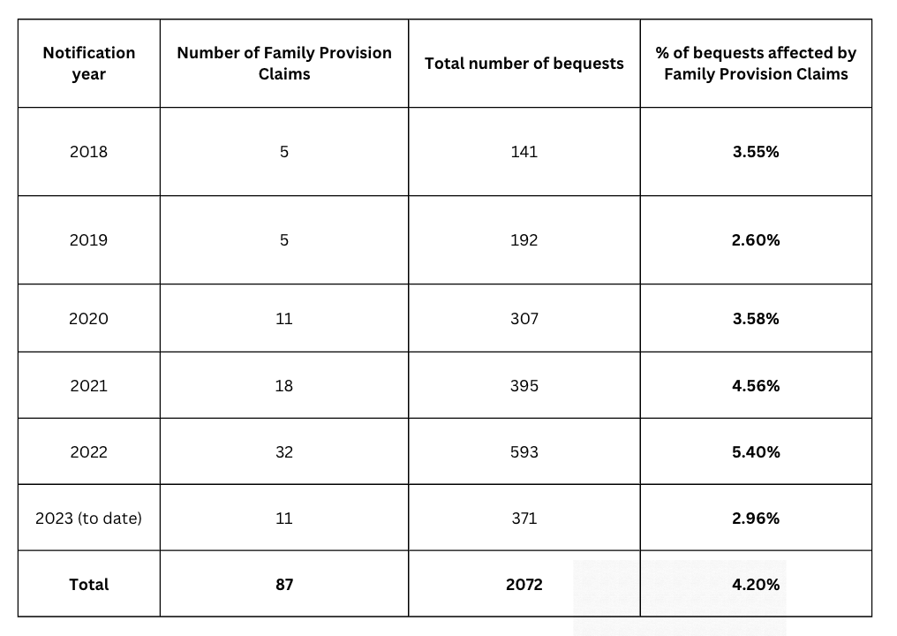
Are Family Provision Claims on the rise?
Notes:
+ Charities often report they feel FPC is on the rise and there has been reporting in the media that they are on the rise in general probate files because of rising cost of living
+ We have been suspicious of this at BA – our feeling is that while people might be more motivated to fight amongst their siblings right now, if there was ANY scope for a FPC where the residuary estate is going to charity, a person was raising it 5 years ago just as much as they are raising it today
+ Ignore numbers, pay attention to percentages
+ There is a slight uptick in the numbers from 2021 and 2022 estates, but not significant enough to draw a conclusion. So far in 2023, we are not seeing that continue, but this is only so far (because this is estates notified in that year – there is still more time on the claims period). Note this is a small data set so we still want more data before making a determination.
+ We will continue to monitor this in future years

Slide 19
Key takeaways
Analyse how your charity’s data sits against this benchmark
You need all estate documents to know this data
5.4 charities on average in the Will – who do you track with?
Understanding CGT is essential
Clean donor data is essential for good bequestor data
Notes:
+ Report has summary and future areas we are interested in exploring – but let’s talk about key takeaways (above).
+ We hope to continue producing these reports and diving into other pieces of data that went beyond the scope of this report – we’ve detailed those in the report but would love feedback on what would be helpful to see.
+ If this has made you think that you or your team could benefit from understanding more about estate administration, please be in touch. Bequest Assist can do that for you and we have an upcoming Estate Administration 101 training in October.
+ As a reminder, the full report will be available to IAC members including those renewing memberships
+ We hope it’s been informative and welcome any questions

Slide 20
Thank you
www.includeacharity.com.au

