Slide 1



Include a Charity
2023 Gifts in Wills Conference
Dr Claire Routley
20 July 2023

Slide 2


Creative connection and communication to drive your purpose
Notes:
Fundraising Institute Australia is the national peak body representing professional fundraising in Australia.
Our members including charities of all sizes and types as well as suppliers to the sector. Fundraising is worth $10.5 billion in Australia.
Founded over 50 years ago, FIA’s mission is to advance professional fundraising to ensure the future sustainability of fundraising into the future. We do this via a self-regulatory Code of Conduct, the FIA Code, and through providing professional development, education and training. We also lobby government at all levels on the issues critical to the fundraising sector.

Slide 3
This session
How do we communicate well about gifts in wills to:
Firstly, find supporters
Secondly, keep supporters
Notes:
Fundraising Institute Australia is the national peak body representing professional fundraising in Australia.
Our members including charities of all sizes and types as well as suppliers to the sector. Fundraising is worth $10.5 billion in Australia.
Founded over 50 years ago, FIA’s mission is to advance professional fundraising to ensure the future sustainability of fundraising into the future. We do this via a self-regulatory Code of Conduct, the FIA Code, and through providing professional development, education and training. We also lobby government at all levels on the issues critical to the fundraising sector.

Slide 4

Finding supporters

Slide 5
Draw on motives in your messaging
Looking around
Looking back
Looking forwards
Notes:
Fundraising Institute Australia is the national peak body representing professional fundraising in Australia.
Our members including charities of all sizes and types as well as suppliers to the sector. Fundraising is worth $10.5 billion in Australia.
Founded over 50 years ago, FIA’s mission is to advance professional fundraising to ensure the future sustainability of fundraising into the future. We do this via a self-regulatory Code of Conduct, the FIA Code, and through providing professional development, education and training. We also lobby government at all levels on the issues critical to the fundraising sector.

Slide 6
Use optimal language
Bigger picture
  Create a just world, not buy 20 ploughs
Family language
  Make a gift, not transfer assets
  A gift in a will, not a bequest
Positive future
  Vision for the future, rather than need
Storytelling
  Living donor stories
  Images of people like me
Notes:
Fundraising Institute Australia is the national peak body representing professional fundraising in Australia.
Our members including charities of all sizes and types as well as suppliers to the sector. Fundraising is worth $10.5 billion in Australia.
Founded over 50 years ago, FIA’s mission is to advance professional fundraising to ensure the future sustainability of fundraising into the future. We do this via a self-regulatory Code of Conduct, the FIA Code, and through providing professional development, education and training. We also lobby government at all levels on the issues critical to the fundraising sector.

Slide 7
Develop your gifts in wills proposition
“A clear, focused explanation of what you want supporters to do, why they should do it, who they will help and how leaving a legacy will bring meaning to the supporter.”
Based on Anwar 2019
Notes:
Fundraising Institute Australia is the national peak body representing professional fundraising in Australia.
Our members including charities of all sizes and types as well as suppliers to the sector. Fundraising is worth $10.5 billion in Australia.
Founded over 50 years ago, FIA’s mission is to advance professional fundraising to ensure the future sustainability of fundraising into the future. We do this via a self-regulatory Code of Conduct, the FIA Code, and through providing professional development, education and training. We also lobby government at all levels on the issues critical to the fundraising sector.

Slide 8
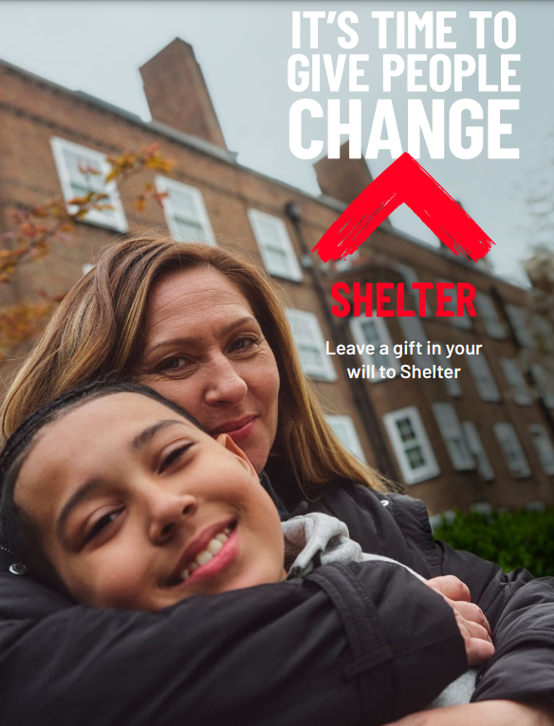
Notes:
Fundraising Institute Australia is the national peak body representing professional fundraising in Australia.
Our members including charities of all sizes and types as well as suppliers to the sector. Fundraising is worth $10.5 billion in Australia.
Founded over 50 years ago, FIA’s mission is to advance professional fundraising to ensure the future sustainability of fundraising into the future. We do this via a self-regulatory Code of Conduct, the FIA Code, and through providing professional development, education and training. We also lobby government at all levels on the issues critical to the fundraising sector.

Slide 9
Who we want you to help: people
What we want you to do: give
Why we want you to help: need for change
What it’ll mean for you: ability to change the future
Notes:
Fundraising Institute Australia is the national peak body representing professional fundraising in Australia.
Our members including charities of all sizes and types as well as suppliers to the sector. Fundraising is worth $10.5 billion in Australia.
Founded over 50 years ago, FIA’s mission is to advance professional fundraising to ensure the future sustainability of fundraising into the future. We do this via a self-regulatory Code of Conduct, the FIA Code, and through providing professional development, education and training. We also lobby government at all levels on the issues critical to the fundraising sector.

Slide 10

Notes:
Fundraising Institute Australia is the national peak body representing professional fundraising in Australia.
Our members including charities of all sizes and types as well as suppliers to the sector. Fundraising is worth $10.5 billion in Australia.
Founded over 50 years ago, FIA’s mission is to advance professional fundraising to ensure the future sustainability of fundraising into the future. We do this via a self-regulatory Code of Conduct, the FIA Code, and through providing professional development, education and training. We also lobby government at all levels on the issues critical to the fundraising sector.

Slide 11

Notes:
Fundraising Institute Australia is the national peak body representing professional fundraising in Australia.
Our members including charities of all sizes and types as well as suppliers to the sector. Fundraising is worth $10.5 billion in Australia.
Founded over 50 years ago, FIA’s mission is to advance professional fundraising to ensure the future sustainability of fundraising into the future. We do this via a self-regulatory Code of Conduct, the FIA Code, and through providing professional development, education and training. We also lobby government at all levels on the issues critical to the fundraising sector.

Slide 12
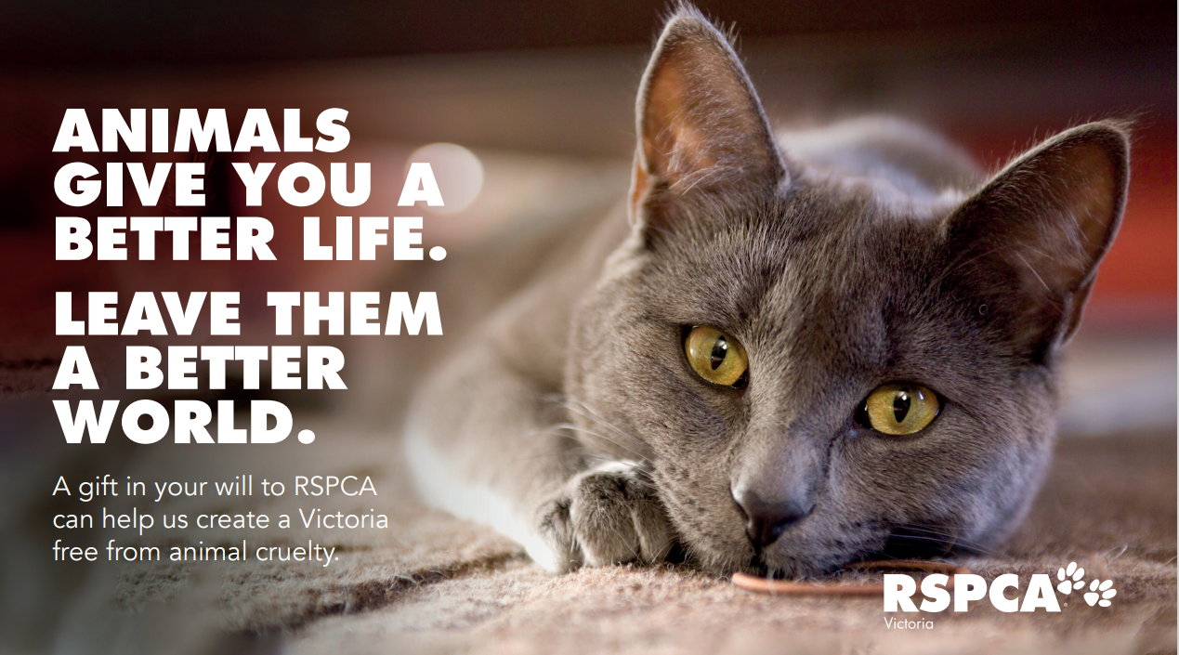
Notes:
Fundraising Institute Australia is the national peak body representing professional fundraising in Australia.
Our members including charities of all sizes and types as well as suppliers to the sector. Fundraising is worth $10.5 billion in Australia.
Founded over 50 years ago, FIA’s mission is to advance professional fundraising to ensure the future sustainability of fundraising into the future. We do this via a self-regulatory Code of Conduct, the FIA Code, and through providing professional development, education and training. We also lobby government at all levels on the issues critical to the fundraising sector.

Slide 13
Using your proposition in practice: the five I’s
Implementation Getting the basics right
Impact Quality and originality of design and visual imagery
Inspiration Reflecting bequest motives and encouraging donors to make a gift
Integrity Demonstrating that the organisation is a trustworthy recipient of bequest gifts
Information Providing clear and relevant information about how to leave a gift.

Slide 14
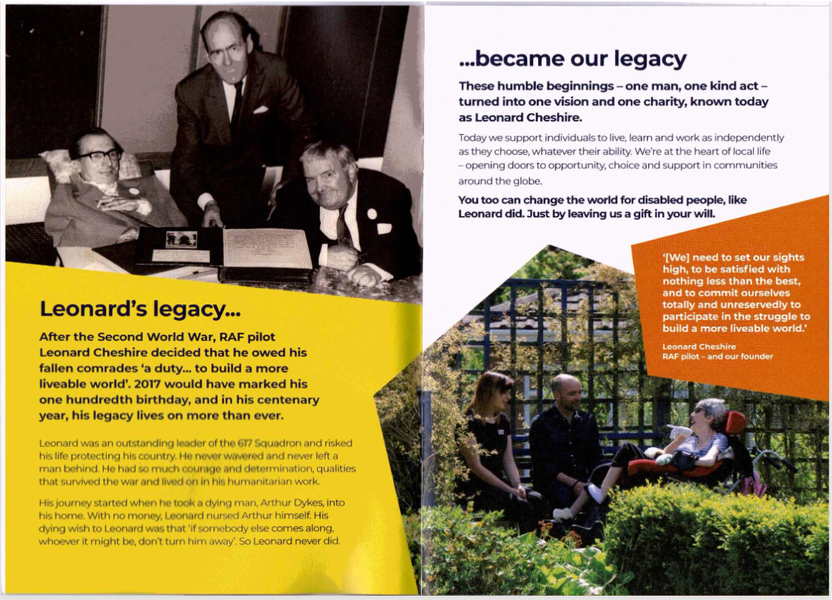
Impact

Slide 15
Inspiration
“You may have been affected by cancer yourself, cared for a loved one with cancer or have friends and family affected by a diagnosis. Whatever your connection, you’ll know how much it can turn someone’s life upside down…”

Slide 16
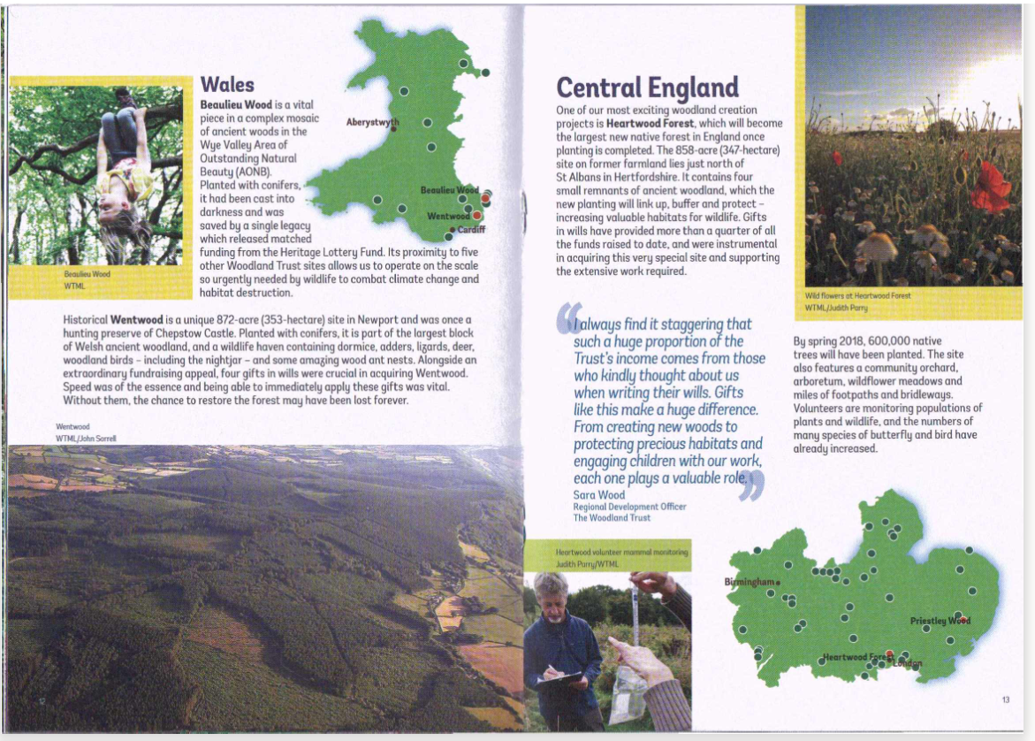
Integrity

Slide 17

Keeping supporters

Slide 18
Keep communicating
“Wishart and James (2021) analysed deceased supporter data from ten Australian charities to explore whether those people who had expressed interest in bequest giving actually left a legacy. They were able to analyse which supporters had received communications from their charities in their last two years of life; amongst these who had received such communications, 76 per cent gave an estate gift, whilst amongst those who hadn’t, 52 per cent generated an estate gift.”

Slide 19

What supporters like

Slide 20

Show people they’re valued
“I'm a bit of a coffee snob. So I've been going to coffee shops quite a bit. I'm just trying to think again, in the past, I think one thing that really got me…I'm talking four or five years back and I remember walking into a Cafe Nero and the assistant said to me, ‘oh I remember your drink, you want abc’. And I just thought wow. So that, that was a really lovely surprise. The fact that somebody's actually remembered you, remembered what you like.”

Slide 21
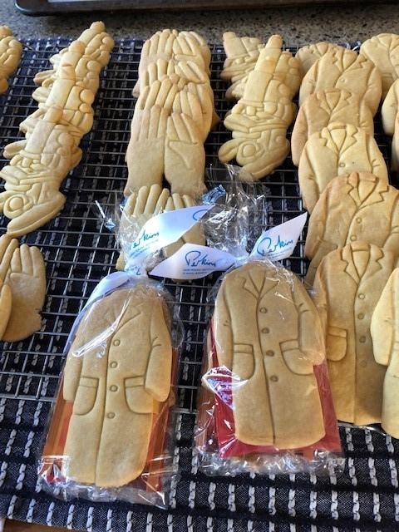
Add a touch of magic

Slide 22
Designing memorable experiences
Faizan Ali et al 2014
Notes:
CR
Study from tourism looking at four dimensions of what makes experiences memorable – found that all drive memory, and memory drives loyalty. Perhaps not directly applicable to our sector, but interesting
Strong memories lead to customer loyalty
Based on Pine and Gilmore’s book:
Pine and Gilmore (1998) provided five key points for which they called experience-design principles: theme the experience, harmonize impressions with positive cues, eliminate negative cues, mix in memorabilia, and engage all five senses.

Slide 23
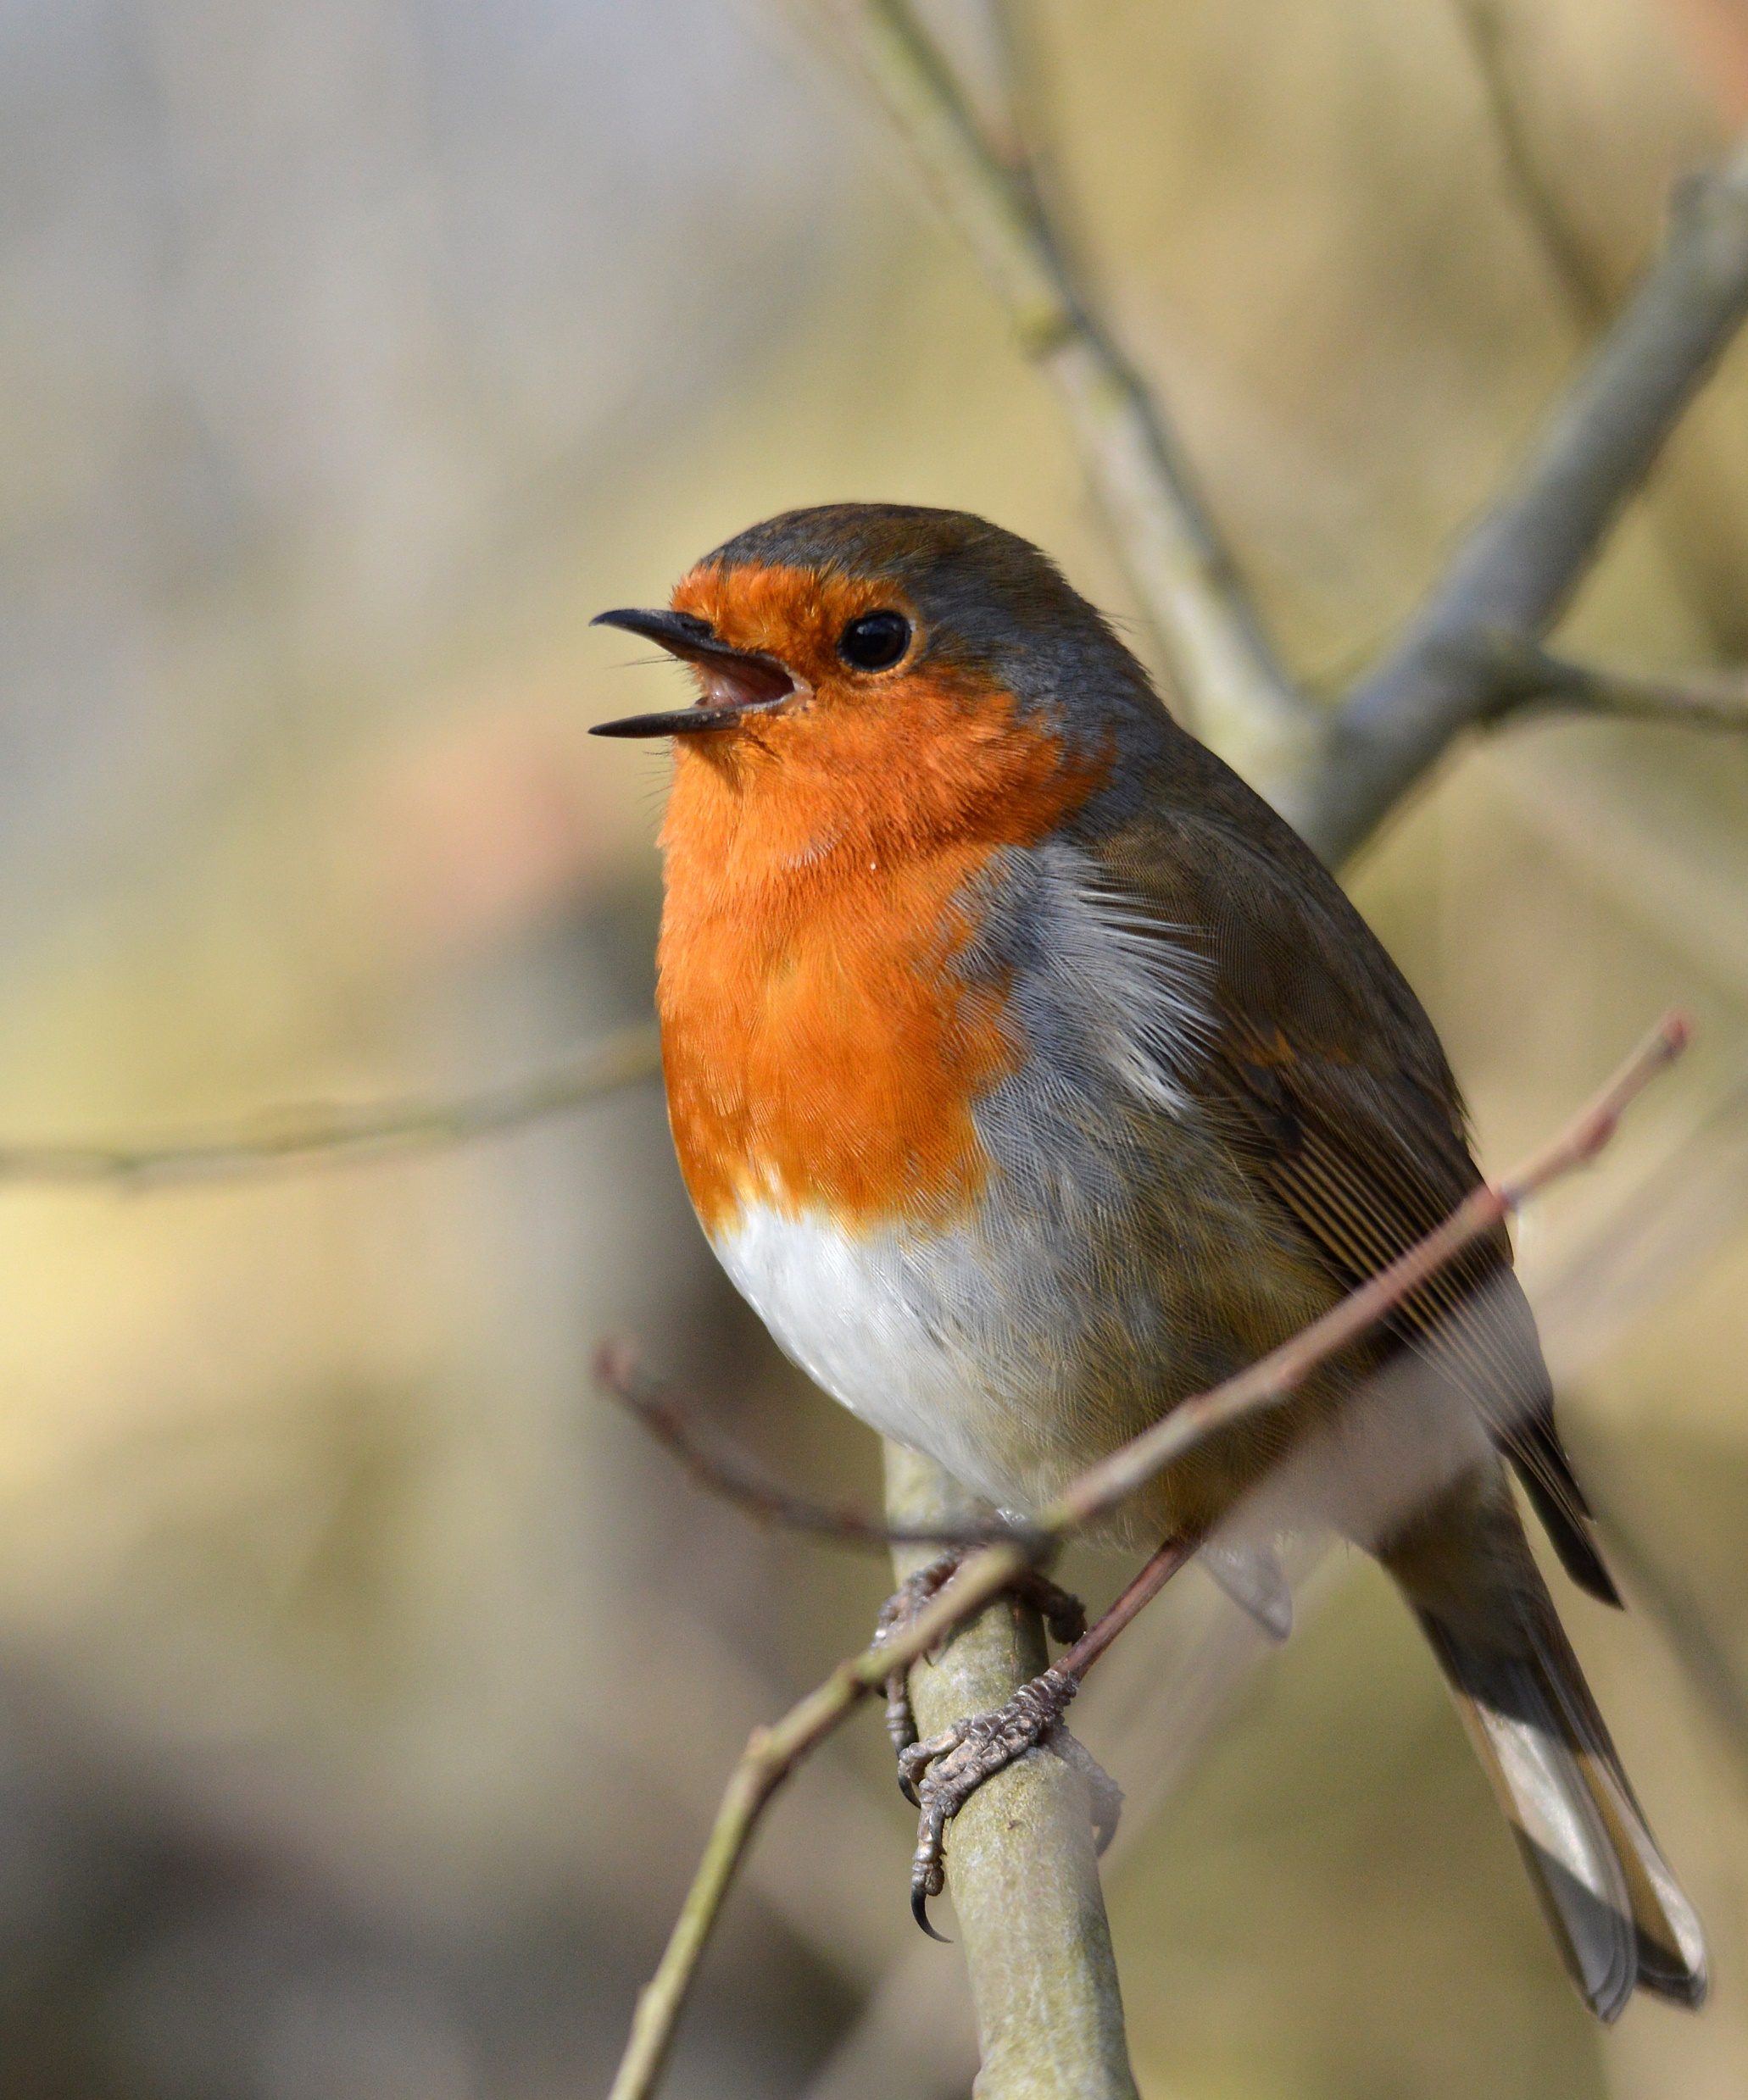
Create memories for loved ones

Slide 24
Questions?

Slide 25
Places, purpose and payment: bringing everything together
Notes:
Finish with round up of places and purposes leading to payments down the line

Slide 26
Thank you
Be part of the movement
www.includeacharity.com.au

