Slide 1
Welcome Members
Ethics & Buy-in:
Strengthening policies and cross-team support in Gifts in Wills
Wednesday 25th October 2023

Slide 2
Agenda
10.30am to 11.30pm Building an internal Buy-in Strategy, Cristina Caamano (RFDS SE Section)
11.30am to 12.00pm Special guest: Bill Edgar
12.00pm to 1.30pm Lunch & Networking
1.30pm to 1.45pm Gifts Acceptance Policy with Sharon Wangman (St Vincent de Paul Society)
2.00pm to 3.00pm Panel session: Ethics Policy with Sally Biles (Guide Dogs); Sharon Wangman (St Vincent de Paul Society); Rebecca Stalenberg (MS Plus Ltd) and Cristina Caamano (RFDS SE Section)
3.00pm to 3.25pm Q&A
3.30pm Close

Slide 3
Bill Edgar
Bill Edgar, also known as ‘The Coffin Confessor’, is a counsellor, author, and one of Australia’s leading private detectives. He has gained notoriety for crashing the funerals of his clients to carry out their last wishes and speak for those who can no longer speak for themselves. He will be joining us to give us some insight into his work and passion for advocating and protecting his client’s legacies.

Slide 4
Sharon Wangman
Gift Acceptance Policy
Whilst we would love to take all items,
not all items can be taken.

Slide 6
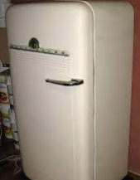
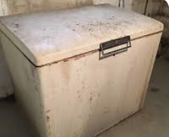
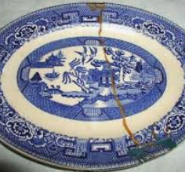
Items that cannot be donated
It takes a lot of money and volunteer hours for the thousands of tonnes of items we get that aren’t sellable. These are also state and federal laws and legislation that make it illegal for us to sell particular items.
Please do not donate/receive any of the following items.
Ripped, torn, soiled or stained clothing
Broken, ripped or stained furniture
Cracked or broken homewares
Stained bedding including mattresses
Green waste
Restricted items we cannot sell in our shops unless standards are met
Baby walkers
bunk beds
change tables
strollers and other childcare products
Wire based beds
Electrical appliances with a heating element.

Slide 7
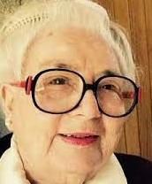
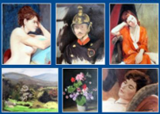
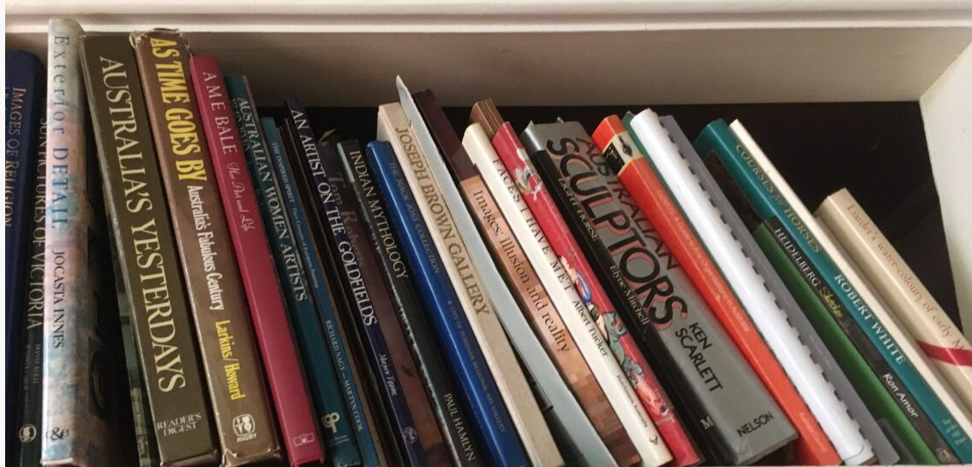
Meet Joyce
Beauty is in the eye of the beholder

Slide 8
Unique Donations
Joyce McGrath OAM - well-known Victorian artist.
In 2018 Joyce’s executor contacted Sharon
90 paintings as well as a large collection of valuable art books were gifted to the Society.
It was decided to auction her works of art with the proceeds going to Vinnies.
All art was sold through an Auction House.
Joyce’s works will continue to be displayed bringing a legacy of joy to everyone viewing it.
300 art books also donated – sold in one lot to an adoring fan of Joyce’s art

Slide 12
Thank You
Wednesday 25th October 2023

