Slide 1
Estate Administration Guidebook Launch

Slide 2
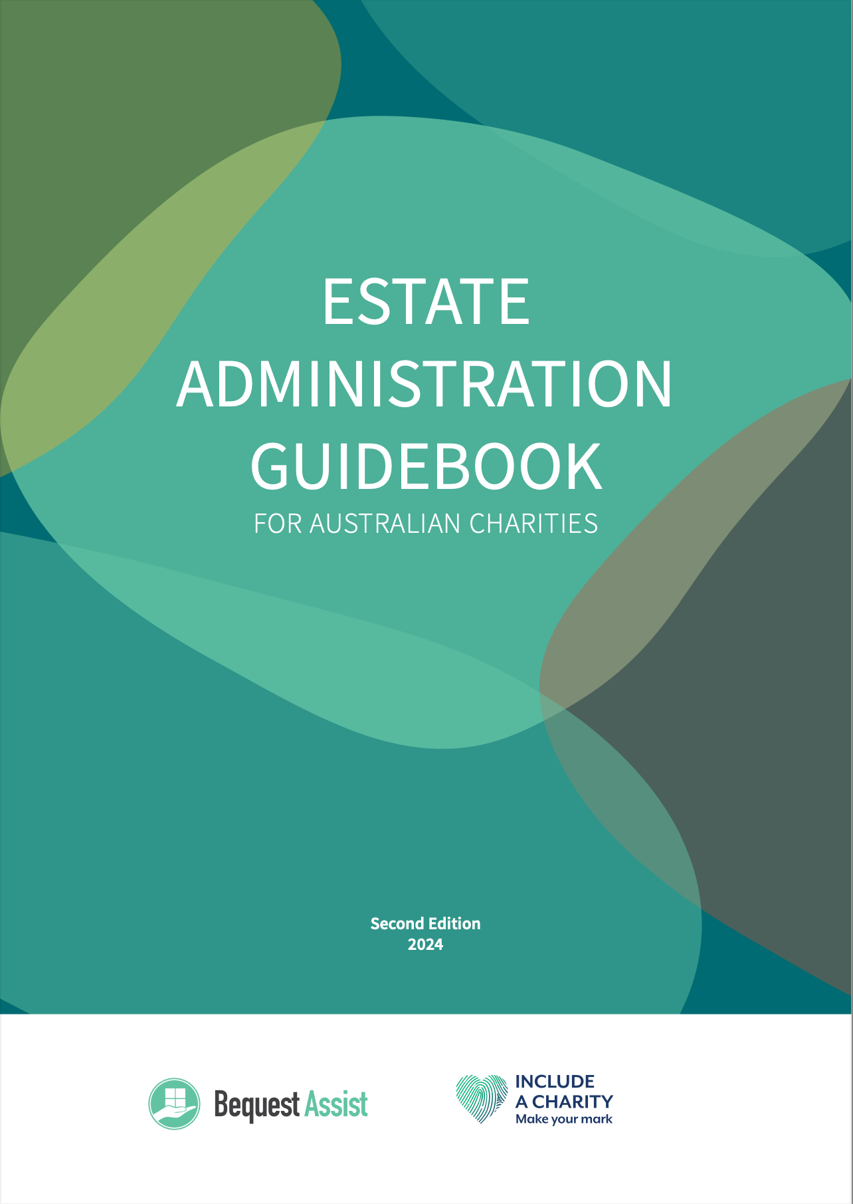

Slide 3
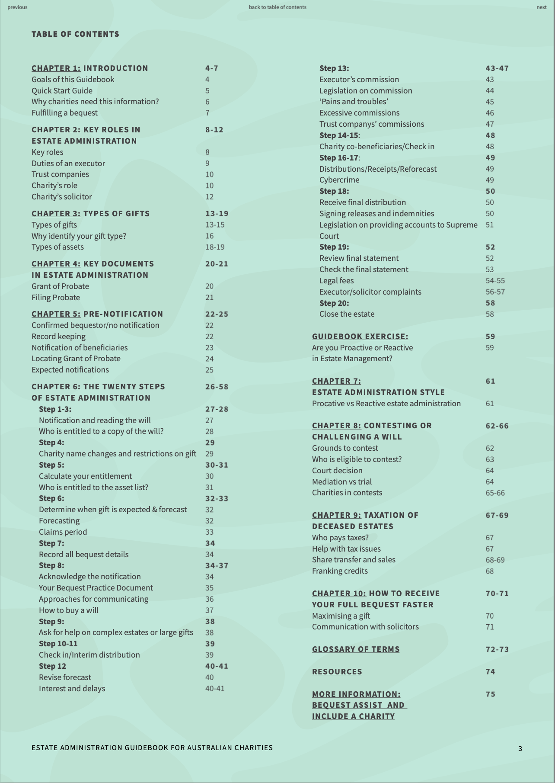

Slide 4
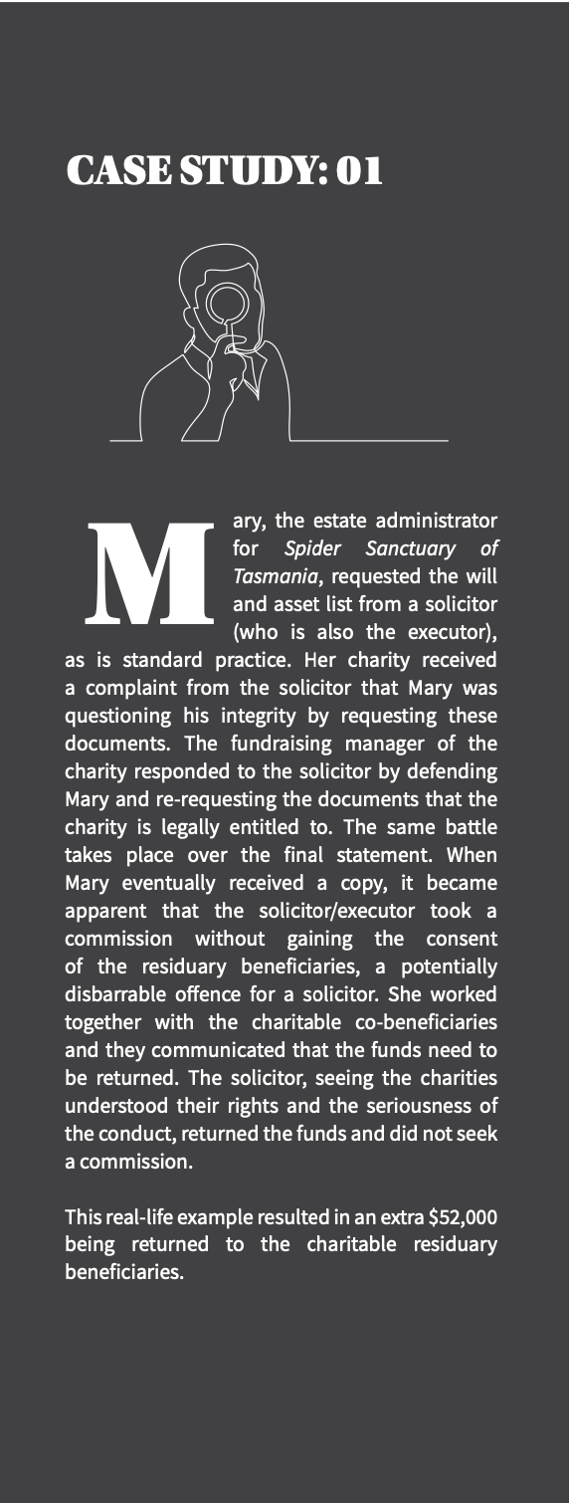

Slide 5
Life interests
Often worth a substantial amount to charity
Chronically mismanaged
High risk of loss of GIW income

Slide 6
Differ in whether your gift can be forecasted
Occur in 4% of bequests
2 in 10 are “at risk”

Slide 7
Tips
Make a plan for keeping these active even if you move on
Actively manage – check in every 1-2 years
Share a list with co-beneficiaries
Seek advice on “at risk” life estates

Slide 8
Superannuation
Becoming a more common asset
Can impact forecasting of a gift

Slide 9
Of estates with a gift to charity include superannuation
20%

Slide 10
The median value of superannuation in an estate with a gift to charity is
$298,394

Slide 11
Currently there is unavoidable taxation on superannuation flowing to charities
Adjust your forecasts
Be prepared for difficult cases

Slide 12
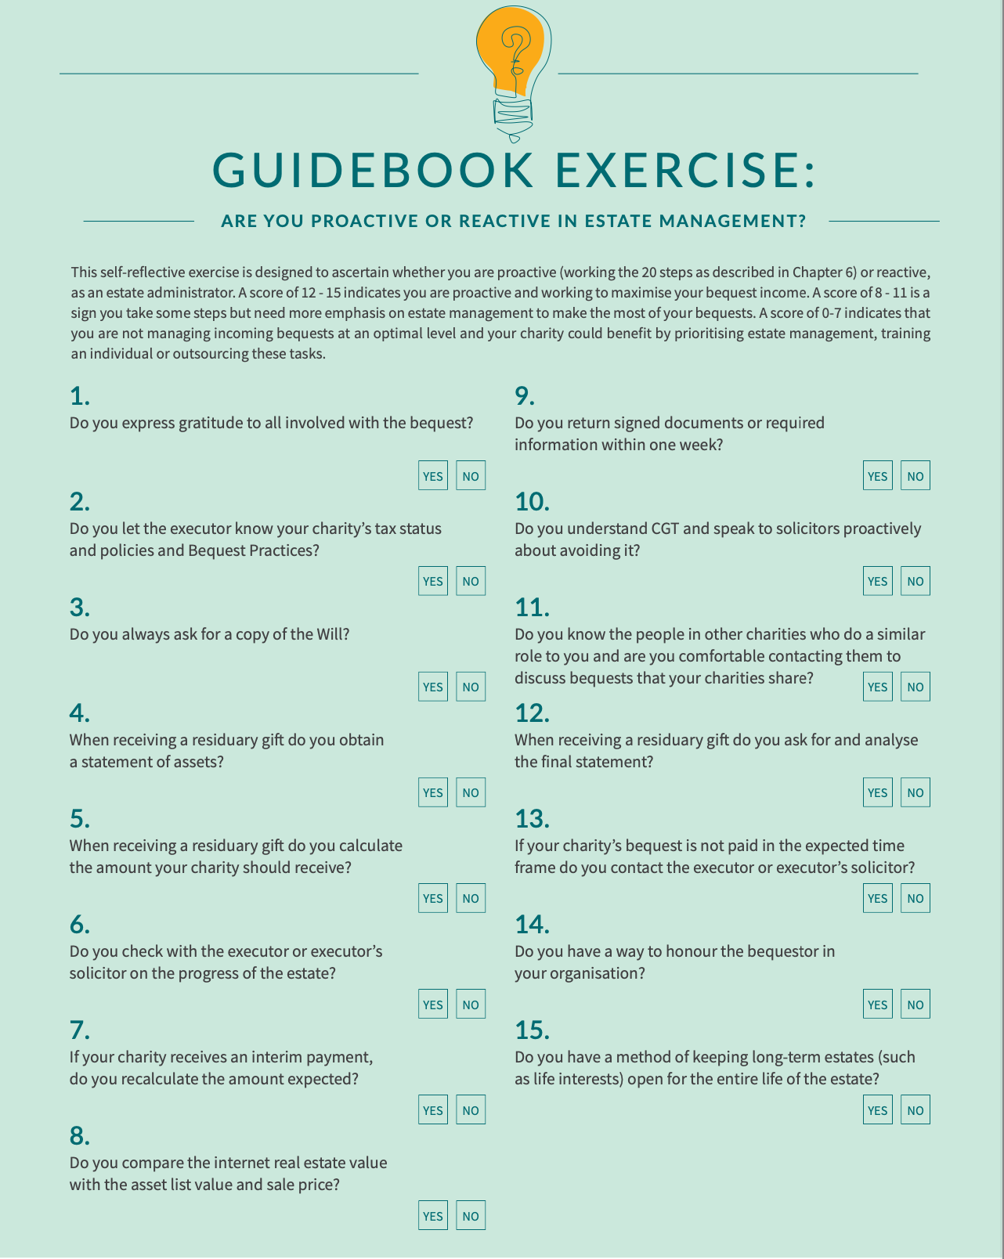

Slide 13
Additional Gifts in Wills income
10-15%
When moving from reactive to proactive estate management.

Slide 14
Annual Gifts in Wills income of $500,000 = an extra $50,000-$75,000
Annual Gifts in Wills income of $1 million = an extra $100,000-$150,000
Annual Gifts in Wills income of $5 million = an extra $500,000-$750,000
Annual Gifts in Wills income of $15 million = an extra $1.5 million -$2.25 million

Slide 15
What are the sources of loss?
Family Provision Claims
Missing Gifts
High fees and commissions
Opportunities for savings on administration
Unnecessary taxes

Slide 16
Case Study #1
5 bank accounts on asset list
Only 4 listed on final statement
Honest errors by solicitors cost charities money

Slide 17
Case Study #2
$200,000 lost to unnecessary Capital Gains Tax
Organised a tax objection
Better to prevent incorrect taxation than correct it later

Slide 18
These losses can be avoided but charities need three things to act.

Slide 19
Time
Tool
Knowledge

Slide 20
Bequest Assist at FIA Conference:
Where did all the gifts go?
1st March 2024

Slide 21
Include A Charity and Bequest Assist webinar: 10 tips for speaking with living donors about leaving a bequest from an estate administration perspective
14th March 2024

