Slide 1
2023 Analytics
Social Media and Website

Slide 2
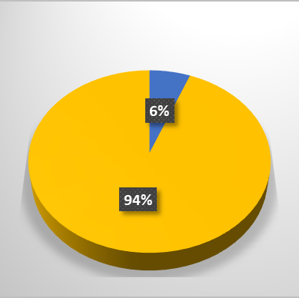
Where impressions come from:
307,721 impressions
889 page views
394 unique visitors
644 reactions
54 comments
69 reposts
Organic
Sponsored

Slide 3
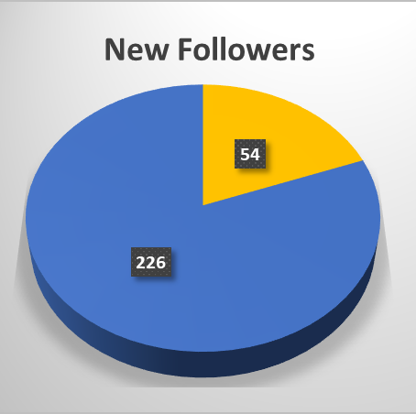
Followers
Acquired from sponsored posts
1,076 followers
280 new followers in 2023
17 followers in the Legal sector
Acquired organically

Slide 4
impact of sponsored posts
IAC Week sponsored posts

Slide 5
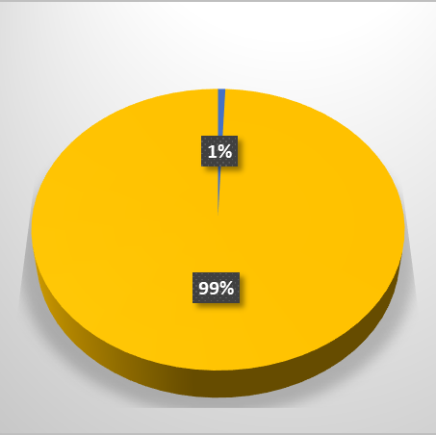
Facebook
Reach breakdown
Reach | 402,700
Visits | 2421
Content interactions | 641
Page likes | 43
Link clicks | 4400
Organic
Ads

Slide 6
Impact of Facebook ads
IAC Week sponsored posts

Slide 7
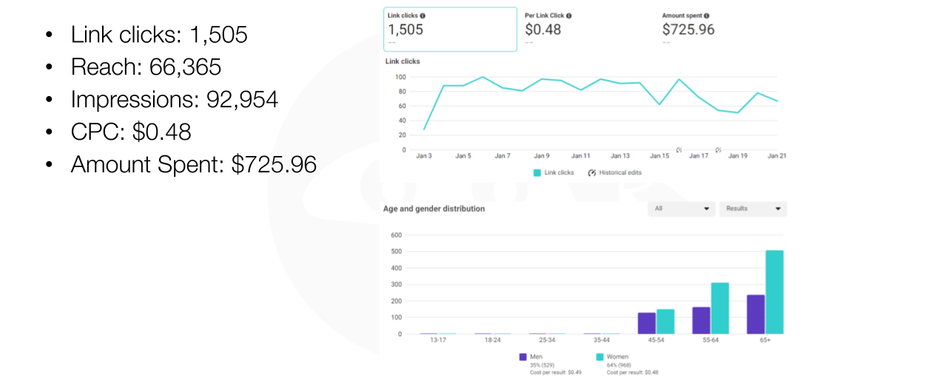
Jan 2024 blog campaign

Slide 8
Jan 2024 blog campaign

Slide 9
Jan 2024 blog campaign

Slide 10
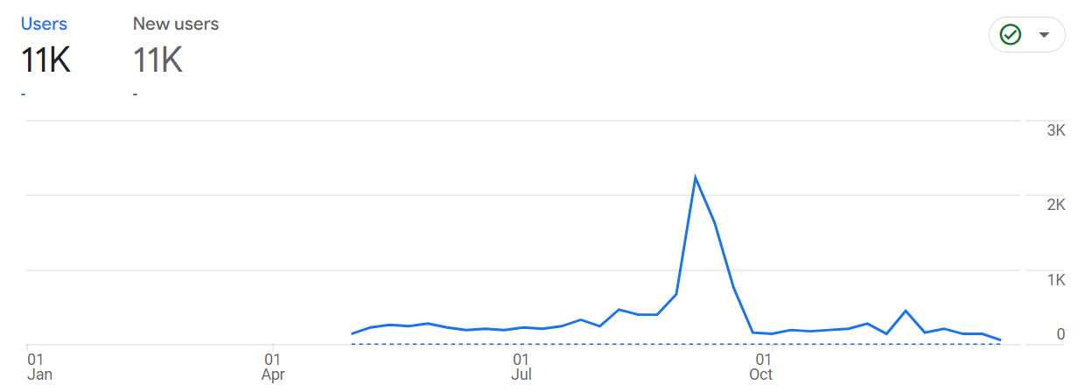
IAC Website — 2023 (April – present)
2023 total users 15.6K | Average engagement time 1m 14s
As e

Slide 11
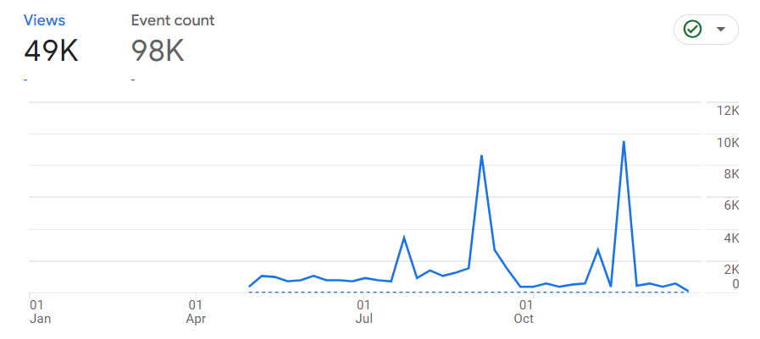
IAC Website — 2023
Events include page views, link and email clicks, file downloads and scrolls
As e
Blog post
IAC Week

Slide 12
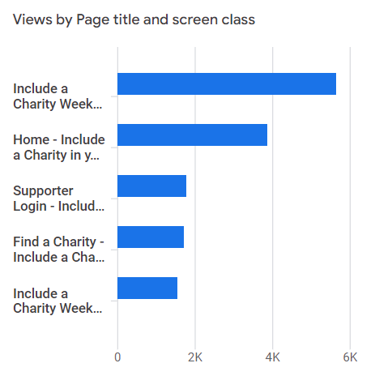
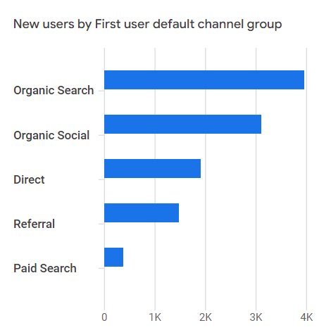
IAC Website – 2023 statistics
Most viewed pages
User source
IAC Week 2023
Home page
Supporter login
Find a Charity
IAC Week
Organic search
Organic social
Direct
Referral
Paid search

Slide 13
Event attendees
We put on 28 events | And sent out 20 IAC Loops
Training Days (4) 282 attendees | Webinars (7) 462 attendees
One Day Conference 211 attendees | IAC Week & Roadshow 191 attendees

