Slide 1
Include a Charity
Training day | March 26th 2024

Slide 2
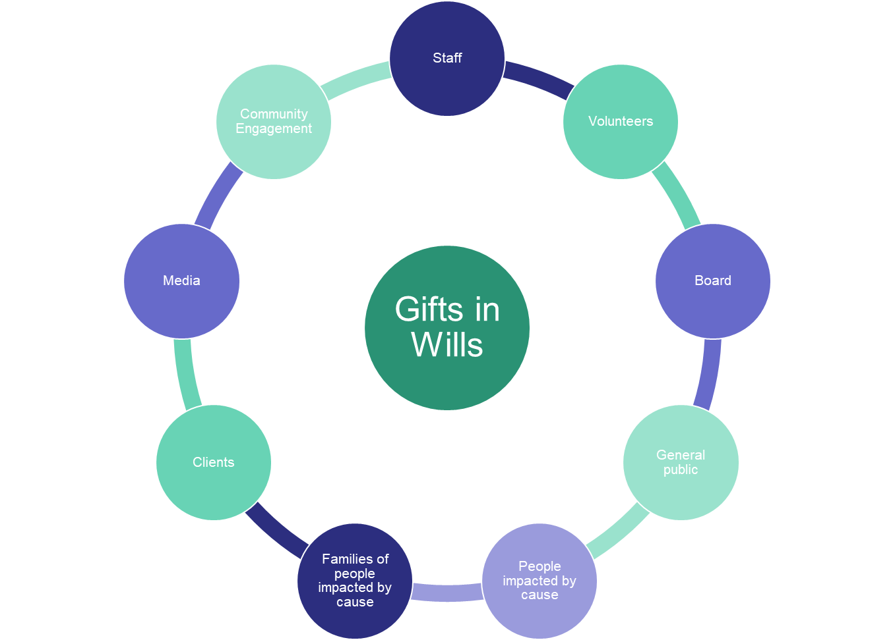
Board Engagement

Slide 3
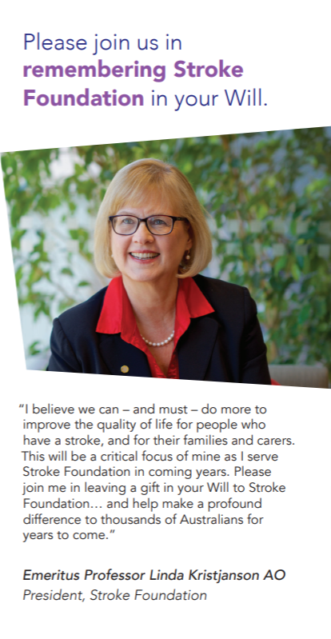
Together, we can make a difference
Protect what matter most. Remember Stroke Foundation in your Will. (youtube.com)

Slide 4
GIW Calling
Rewind and Reflection
Notes:
Fundraising Institute Australia is the national peak body representing professional fundraising in Australia.
Our members including charities of all sizes and types as well as suppliers to the sector. Fundraising is worth $10.5 billion in Australia.
Founded over 50 years ago, FIA’s mission is to advance professional fundraising to ensure the future sustainability of fundraising into the future. We do this via a self-regulatory Code of Conduct, the FIA Code, and through providing professional development, education and training. We also lobby government at all levels on the issues critical to the fundraising sector.

Slide 5
My previous work history is in planning and development, specialising in project development, implementation and evaluation and I have worked with some very special, inspiring communities over the years. I learned and used many philosophies that I still use
What I learned– stop relax, breath and listen

Slide 6
Community development is all about being the vehicle for change, not the driver. It is about the community collective to deciding on the direction.

Slide 7
A Community Development Process

Slide 8
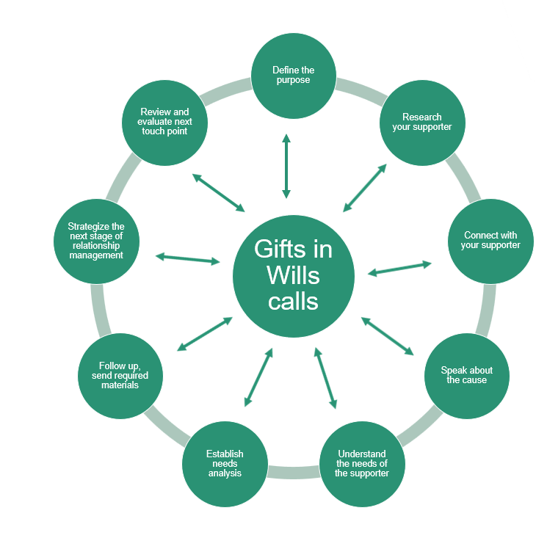
Gifts in Wills Calling

Slide 9
Mistakes I have made along the way.
I had this one call.
Lovely 80-year-old gentleman
We had a fantastic chat, 20 minutes felt like I was talking to my own grandfather. We talked about all kinds of things that he wanted to.
Then he said goodbye and I just said Bye. That was it.
NO GIW Question. Opportunity lost.

Slide 10
Mistakes I have made along the way continued.
Becoming too sympathetic to the struggles of the supporter instead of being empathetic. Unless we are trained professionals, we can not solve the problems of the world and it is ok to create boundaries.

Slide 12
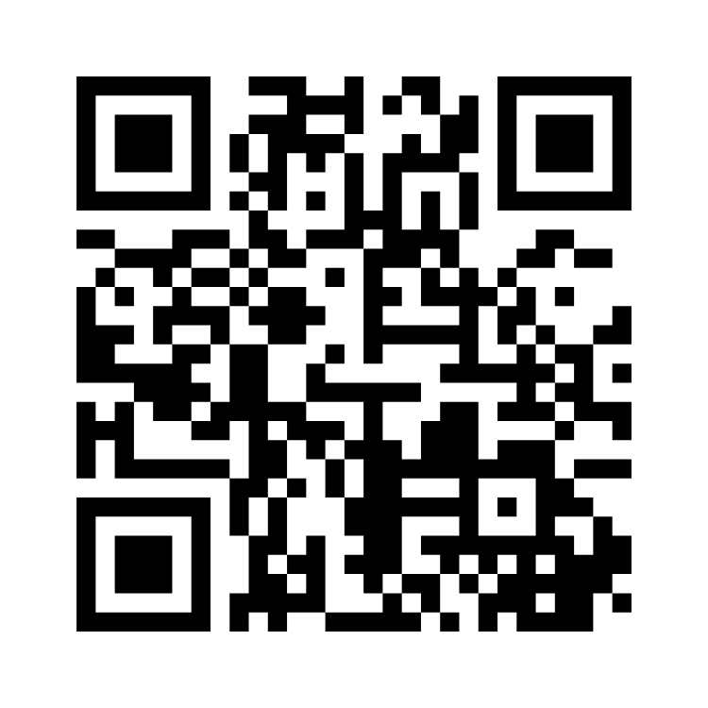
Now it is your turn
https://www.menti.com/al8mr32pg74v
Think about the ‘I’ Sentences.
My example is
I have nothing to leave and minimize as much as possible to “nothing to leave

Slide 13
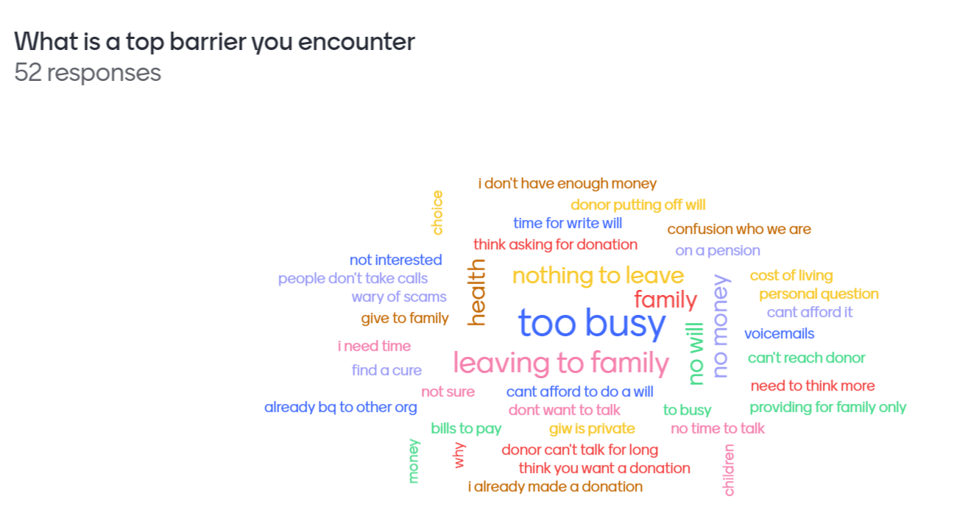

Slide 14
Plan for obstacles
Prepare responses for common objections
Study which ones are effective
Implement effective barrier conversion

Slide 15
Barrier Conversion
Validate
Grow
Inspire
Notes:
In your groups pick one of your barriers and use the Plan, do, Study and Act model to come up with barrier conversions that will work for you

Slide 16
One of the values of Stroke Foundation is Courage
Let's have the courage to share.

Slide 17
Example “I have nothing to leave”
You have no idea just how often we hear that from our incredible supporters. One of the most common things we hear is that you need to be a millionaire to support a charity in your Will.
That is furthest from the truth, it is usually regular people like you and me who are passionate about this that make the biggest difference.
You are important to us; I want to show you the impact that you would be a part of and send you our latest stroke research grant round. Can I email that to you?
Validate
Inspire
Grow

Slide 18
Q&A

Slide 19
Thank you

