Slide 1



Include a Charity
Training day | March 26th 2024
STARTS AT 10.30

Slide 2


Acknowledgment of country
&
Introduction

Slide 3
How to convince the board and internal stakeholders to invest in your Gifts in Wills program

Slide 4
Agenda
Getting the board on board
  Why
  How
      This is marketing!
      Integration
      Brand
      Confidence
      Making a good case for support
      Elevator pitch & discussion
  What
Notes:
Ask people: Who has tried to get more investment? Who has failed? Why/what were the blockers?
Who has succeed? Please share your tips as well this is a sharing forum more than anything.

Slide 5
1.a - Why
More investment = More gifts
Integration = more gifts
Access to HNI
Longevity of investment
Role-models
Ambassadors
No-brainer
20% income worldwide - 2% investment
ROIs
Cultural change
Systemic change
Notes:
Integration
Important because we want those HNI to give GIWs, we don’t have them at GPAP. ALso alignment of vision and GIW timeframes.
Need more $$$ (20% of income, 2% investment -> Pareto principle).
Blended giving

Slide 6
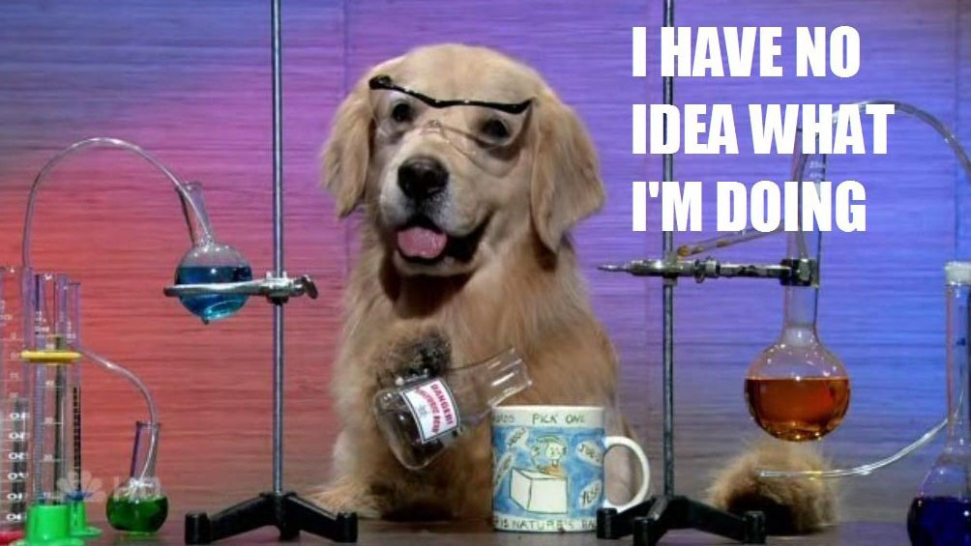
1.b - How
Notes:
This is me 6 years ago

Slide 7
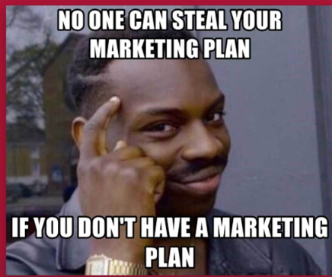
1.b.i - This is marketing
Notes:
Think about it as any activity you do to acquire more people in your gifts in WIlls pipeline

Slide 8
1.b.ii - Integration
Advocating
Building relationships and finding allies
Changing the culture
Creating systemic change
Notes:
Integration: This is a topic I am very passionate about. Ongoing work at GPAP (tiring but necessary to build allies,. Use people on your team, aka your bosse and boss’s boss.), inspired by NSPCC an Alan Clayton work in the UK. Systemic change, breaking down taboos, culture of awareness. Using GG brand, events and ambassadors, reporting often, humanising bequestors.
Walk the talk: Do your board members (or at least director) have a GIW?
Board induction pack
Get your CEO or Board director on board first

Slide 9
1.b.ii - Integration: Changing the culture
Values and storytelling
Benefits
Humanising GIW and breaking down taboos
Conversation training
Make your program exciting
Talk it up, share with your org

Slide 10
GIW circle,
ambassadors and social normalisation
LEADERS
(Ambassadors)
Staff & Volunteers
Board
High-propensity prospects
Portfolio of high-capacity prospects
Supporters
Notes:
GIW circle and social normalisation: Use of GIW circle to find leaders and advocates aside from you. It is good to have diverse voices (cultural diversity) - And you can use the circle as a ‘brand’ and make it even cooler, people will want to be part of this amazing community.

Slide 11

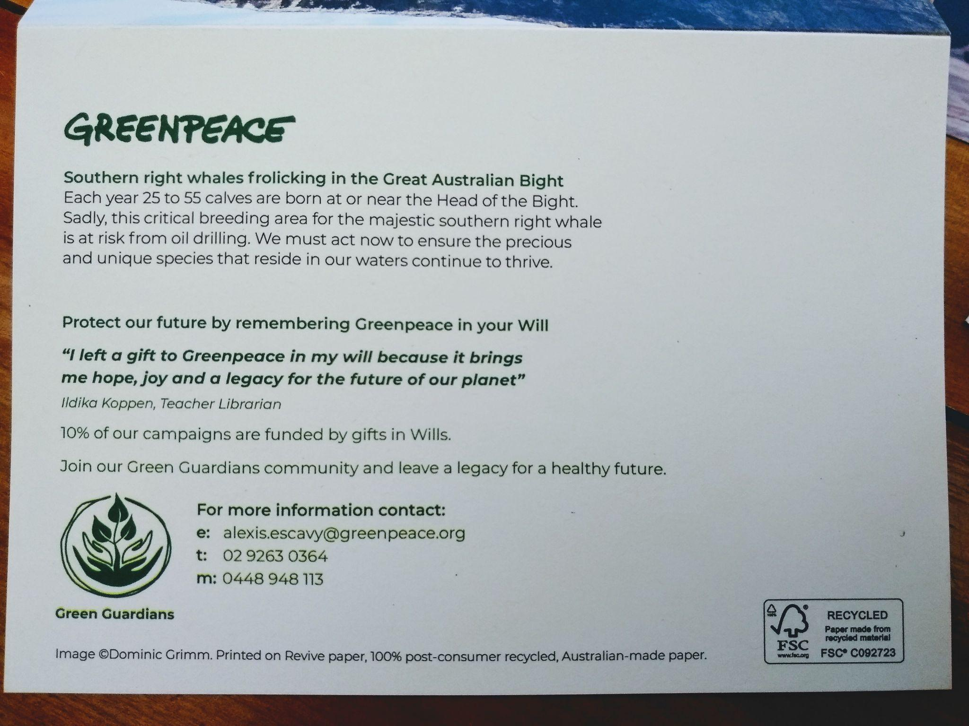
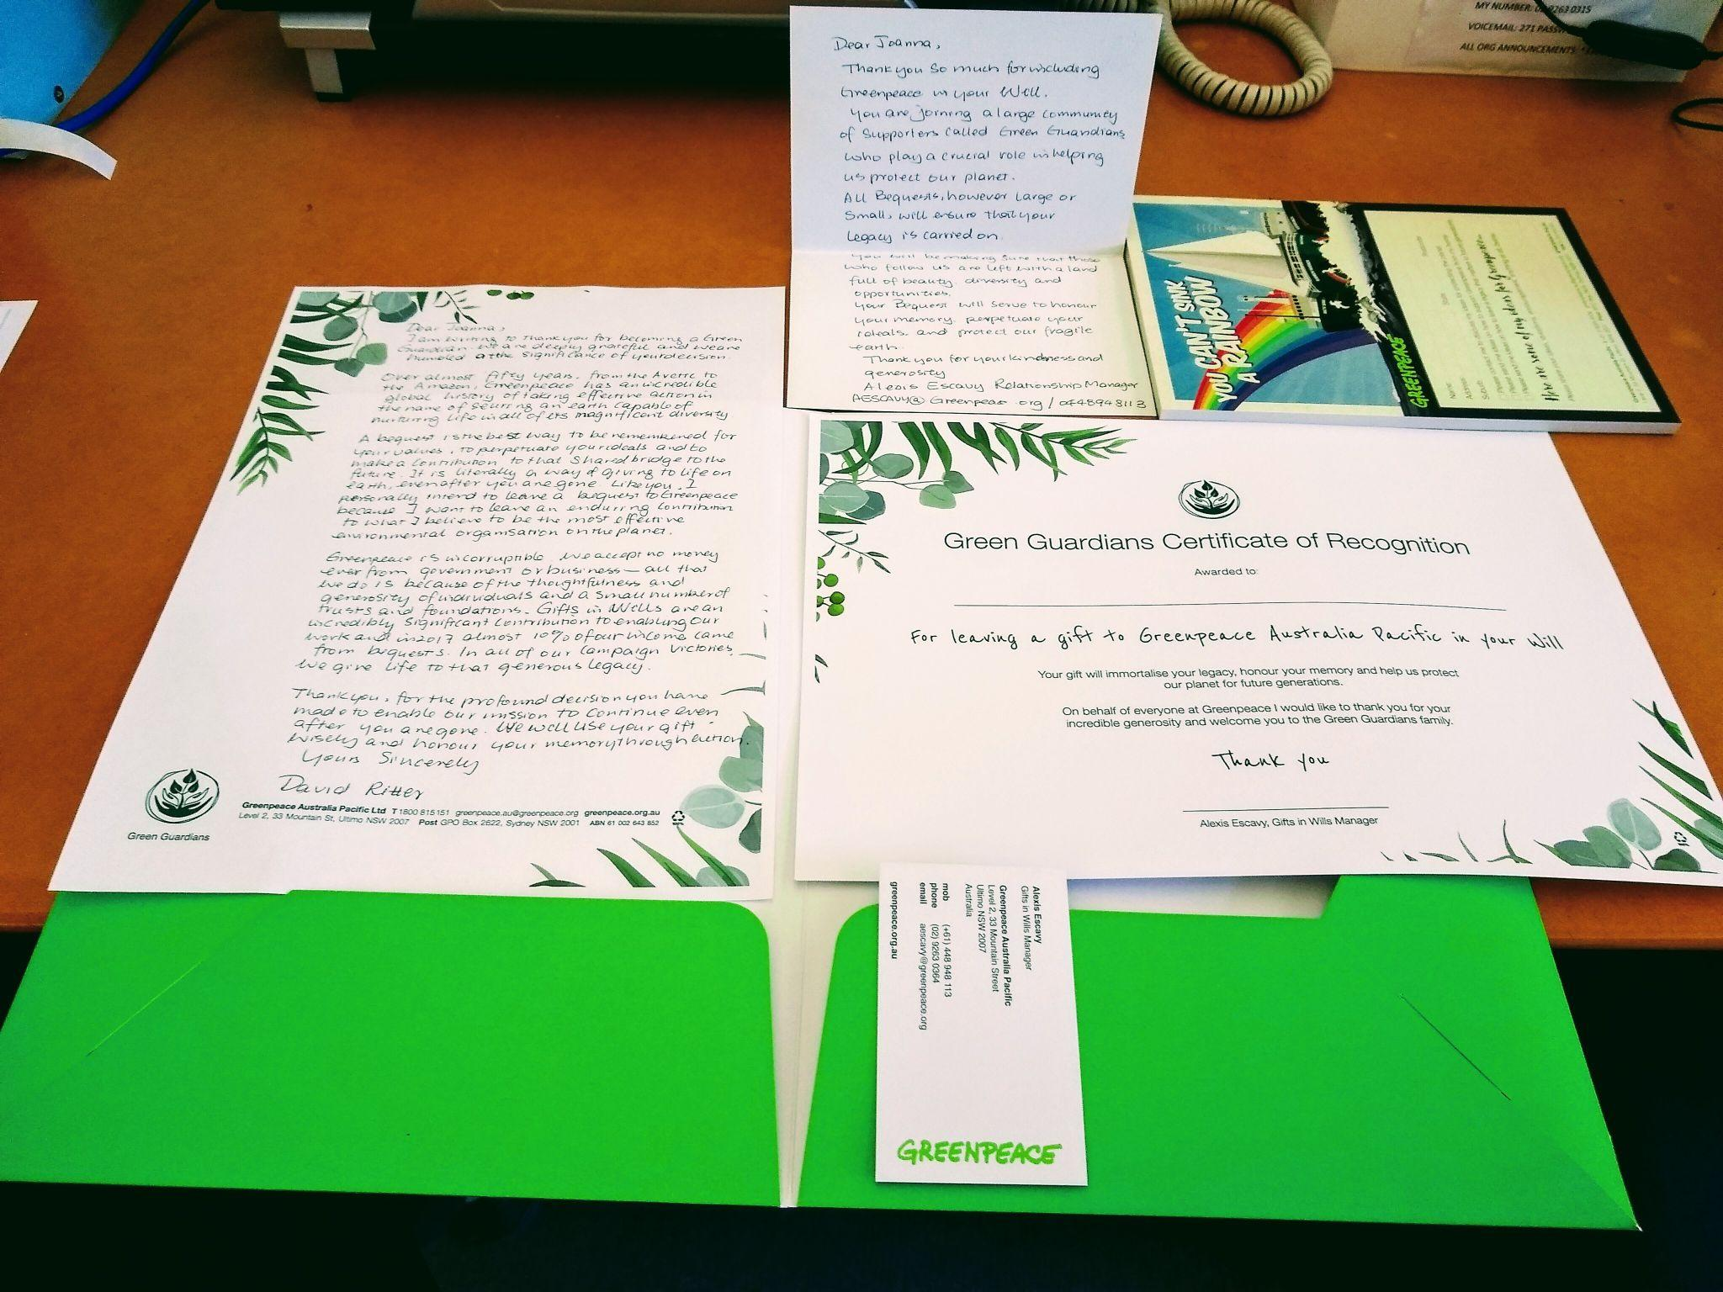




1.b.iii - Brand
“Warriors of today, Heroes of tomorrow”
Notes:
Having a brand gives you an edge. It helps you to spread your message, and the more you talk about your program the more likely you are to create cultural change.
You need to start with that if you have not, it will be even more difficult to make a good case for support.

Slide 12
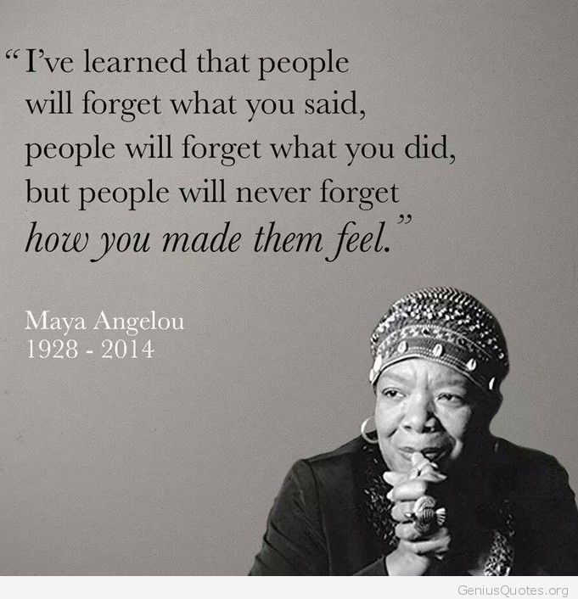
1.b.iv - Confidence (& persistence)
Charisma has nothing to do with energy; it comes from a clarity of WHY. It comes from absolute conviction in an ideal bigger than oneself (...) Only charisma can inspire. Charisma commands loyalty”
― Simon Sinek, Start with Why: How Great Leaders Inspire Everyone to Take Action
Notes:
Insist, it won't happen overnight
Believe in the data

Slide 13
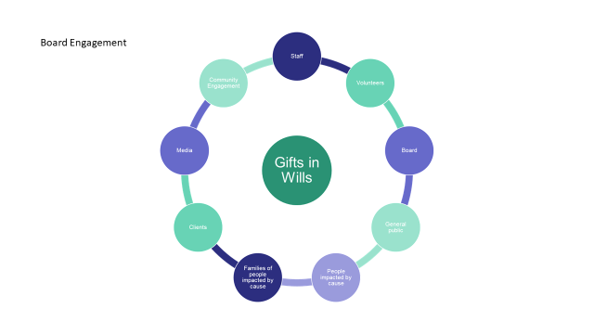
1.b.v - Case for support
Notes:
Ask Frances to share
Groups of 5: take 5 minutes to write some short bullet points as their personal case for support we will use it in our elevator pitch.
Online jam board

Slide 14
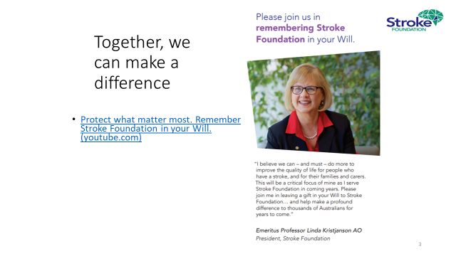
1.b.v - Case for support
Notes:
Ask Frances to share
Groups of 5: take 5 minutes to write some short bullet points as their personal case for support we will use it in our elevator pitch.
Online jam board

Slide 15
1.b.v - Case for support
Possible income & income loss & ROI
Importance of board putting a long term strategy
Or your org will not benefit from GIW income set to double in the next 20 years
Intergenerational transfer of wealth
Urgency
Time it well, after a big win
Who is on the board, how long is their tenure
Put it all into a badass powerpoint presentation
Don’t drown the lead under unnecessary data
Know your org strategic priorities & ToC
Use real life examples: Donkey sanctuary
Notes:
Ask Frances to share
Groups of 5: take 5 minutes to write some short bullet points as their personal case for support we will use it in our elevator pitch.
Online jam board

Slide 16
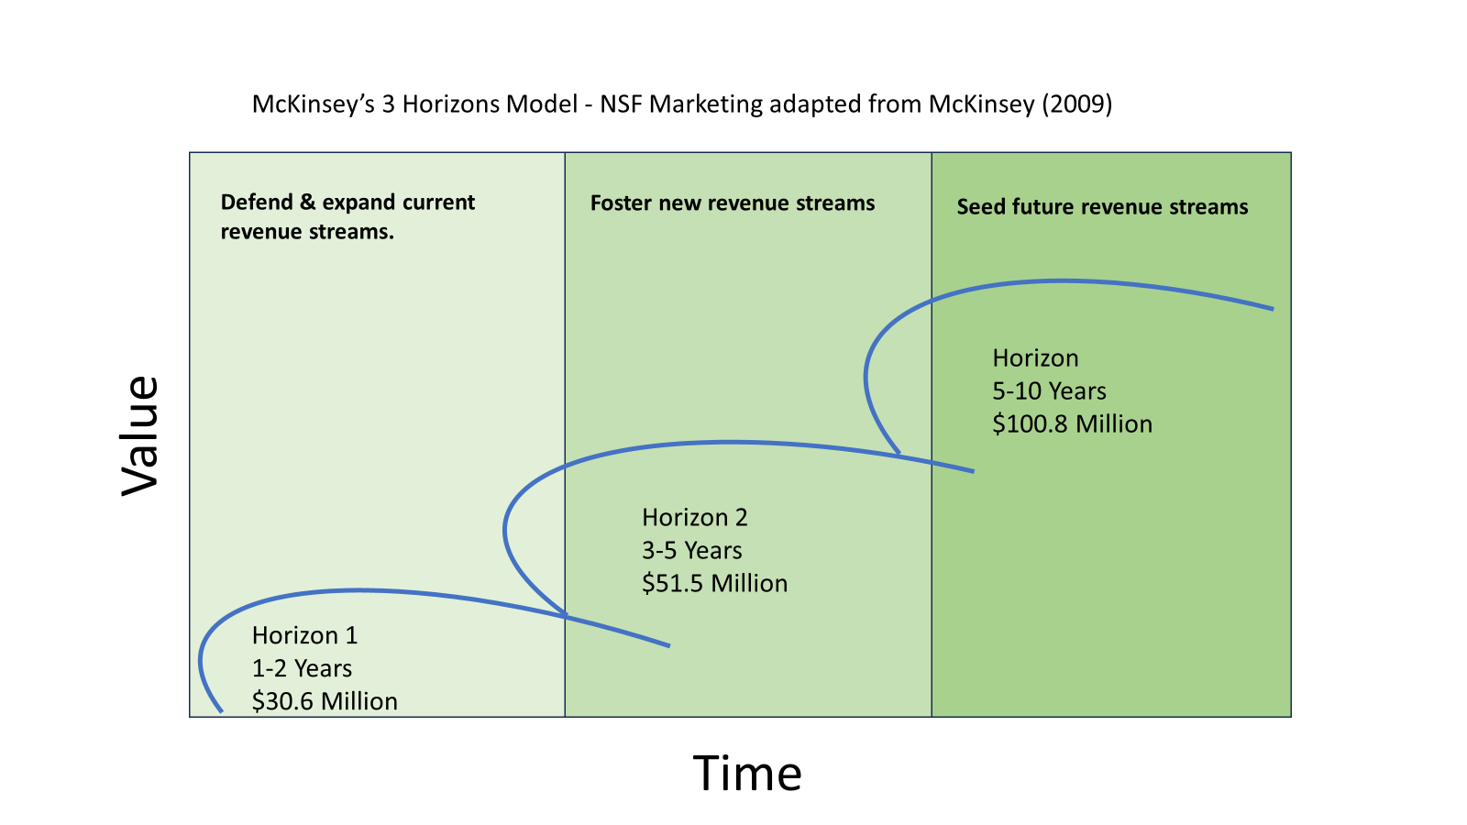

Slide 17
1.b.vi - Elevator pitch
1 on 1 roleplay
Answer the question:
“Why do you need more budget for your gift in Wills program?”
Then
Finish with a discussion around your experience:
  What has worked for you
  What have you tried
  What will you try
  What is holding you back
Notes:
COntains your value proposition

Slide 18
Next session at 12.45
Summary - the 7 pillars
A good case for support
Full of good arguments
In a good presentation
With a good elevator pitch
And good timing
Alongside good allies
Notes:
ASlexis to ask: Anyone would like to share their elevator pitch?

Slide 19
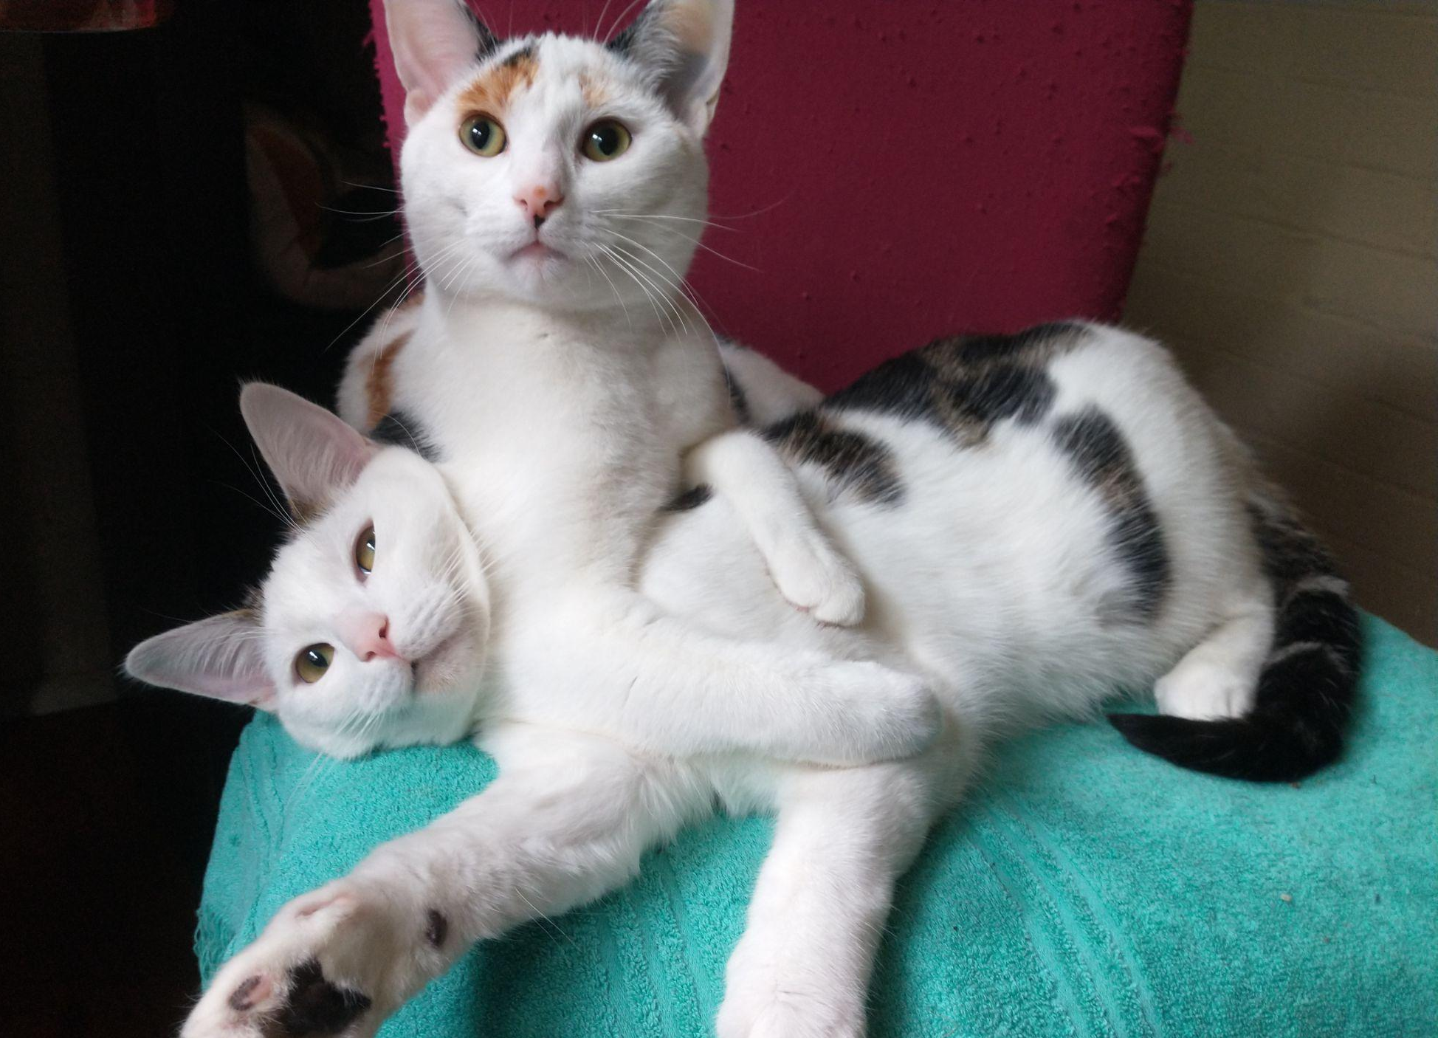
Questions

Slide 20
Thank you

