Slide 1
The Benchmarking Project: Gifts in Wills
www.benchmarkingproject.org

Slide 2
Gifts in Wills 25% of income, 0.04% of gifts 39% of income from donors giving 10+ years
20% increase in Gifts in Wills income over 5 years. A Compound Average Growth rate of 6.8% over 5 years, and 2.8% over 8 years
The volume of intending and confirmed Gifts in Wills donors continues to grow year on year, with 0.8% of all active donors in 2023 having confirmed a Gift in Will
53% of all Confirmed Gifts in Wills are still active donors
For every Gift in Will received from a Confirmed Gift in Will donors 3 donors will realise a Gift in Will
High value and higher IRSAD decile donors are more likely to confirm a Gift in Will and realise at higher average Gift in Wills
2% of Single Giving recruits giving $250+ have a Confirmed Gift in Will compared to just 0.5% of those giving <$250
Residual Gifts in Wills generate higher averages than Pecuniary
The average age of a Confirmed Gift in Will donor is decreasing – average age of a new confirm in 2023 was 67
The potential for deeper analysis into who realised Gifts in Wills income is coming from is high to improve individual organisation insight into who has been motivated to leave past Gifts in Wills from outside and within donor bases
Average Gifts in Wills Giving income per charity in 2023: $8.6m

Slide 3
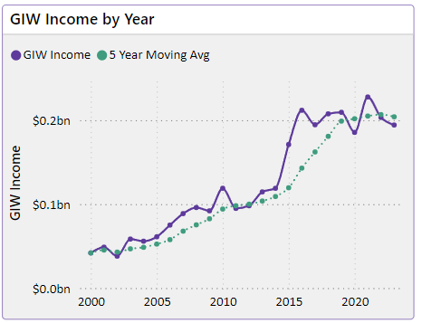
Gifts in Wills income continued to grow year on year
We observed a 20% increase in Gifts in Wills income over the past 5 years.
This is a Compound Average Growth rate of 6.8% over the past 5 years, and 2.8% over the past 8 years.
The 5 year moving average suggest a potential flattening in growth in the past 5 years.

Slide 4
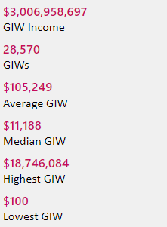
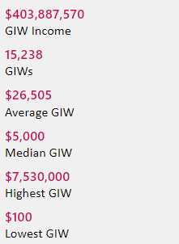
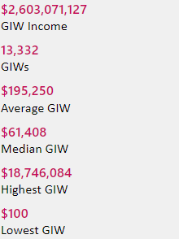
Gifts in Wills averages (2014 to 2023 data)
All
Pecuniary
Residuary
Five-year trend
$3,006,958,697
GIW Income
28,570
GIWs
$105,249
Average GIW
$11,188
Median GIW
$18,746,084
Highest GIW
$100
Lowest GIW
$403,887,570
GIW Income
15,238
GIWs
$26,505
Average GIW
$5,000
Median GIW
$7,530,000
Highest GIW
$100
Lowest GIW
$2,603,071,127
GIW Income
13,332
GIWs
$195,250
Average GIW
$61,408
Median GIW
$18,746,084
Highest GIW
$100
Lowest GIW
Residuary
Average GiW $223,233
Median GiW $71,000
Pecuniary
Average GiW $41,027
Median GiW $5,000

