Slide 1


Creating a Life of Meaning to Fulfill
The Meaning of Life

Slide 2

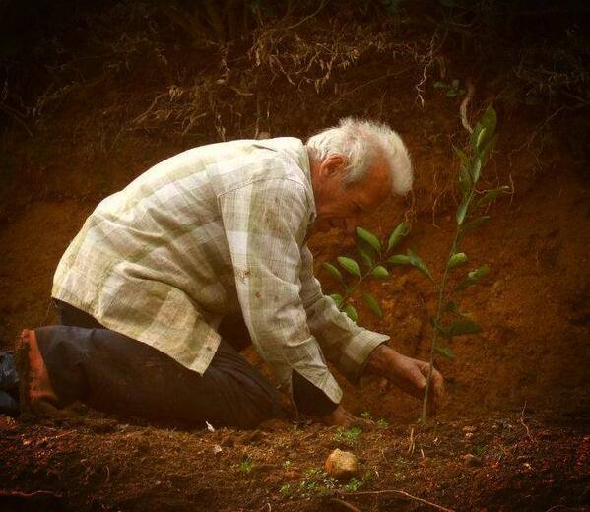
“A society grows great when old men plant trees in whose shade they know they shall never sit”

Slide 3
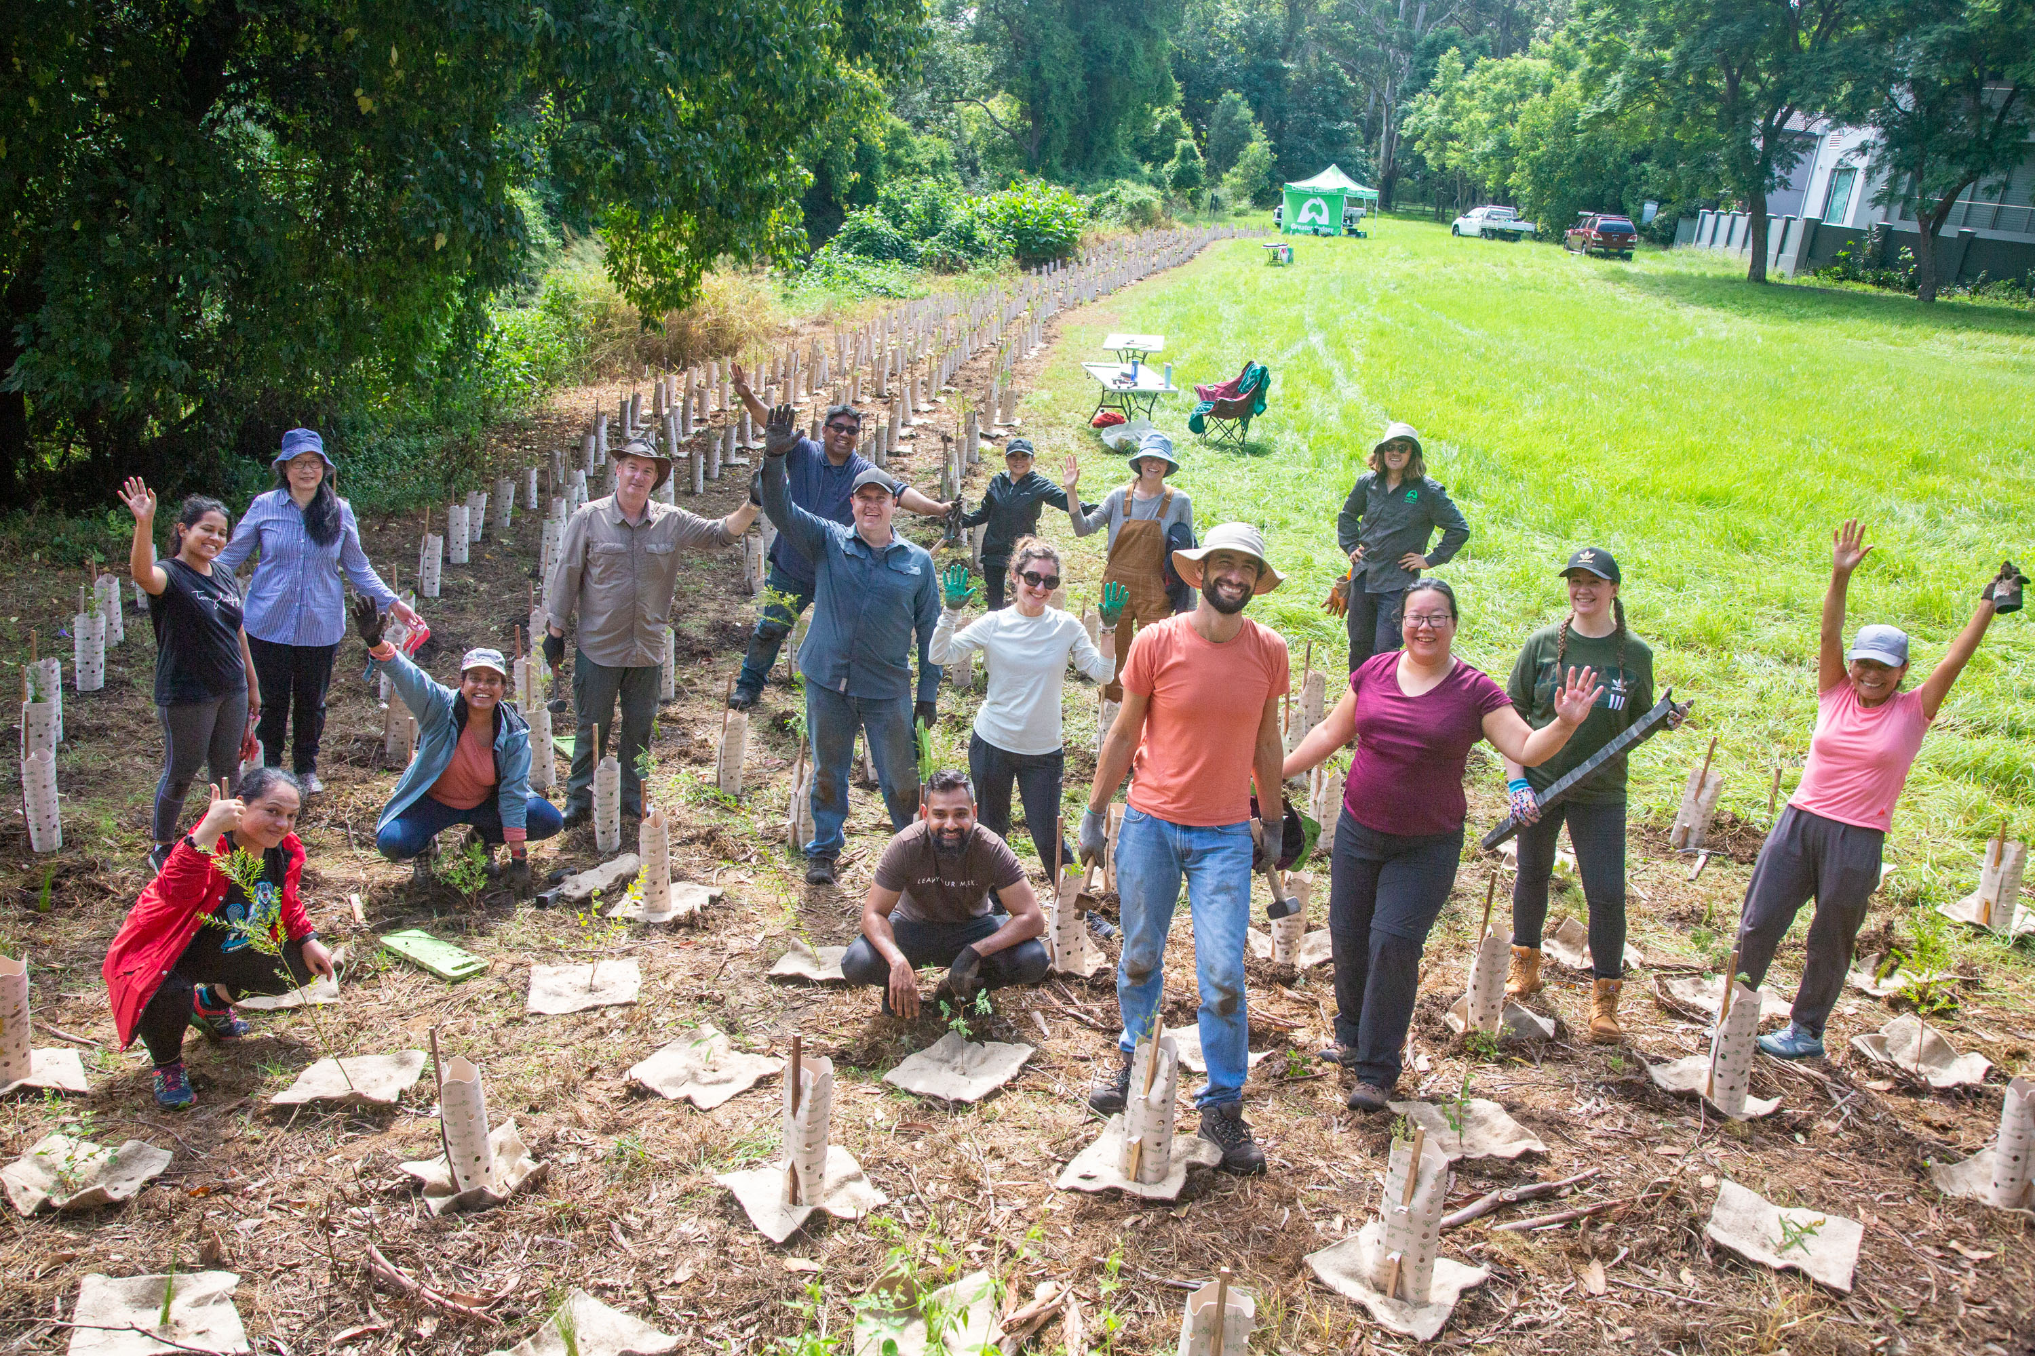
“A society grows great when everyone plants trees in whose shade they know they shall never sit!”
Photo Credit – Greater Sydney Landcare ‘Creating Canopies’ Project

Slide 4
Before I go –
Living a Life of Meaning

Slide 5
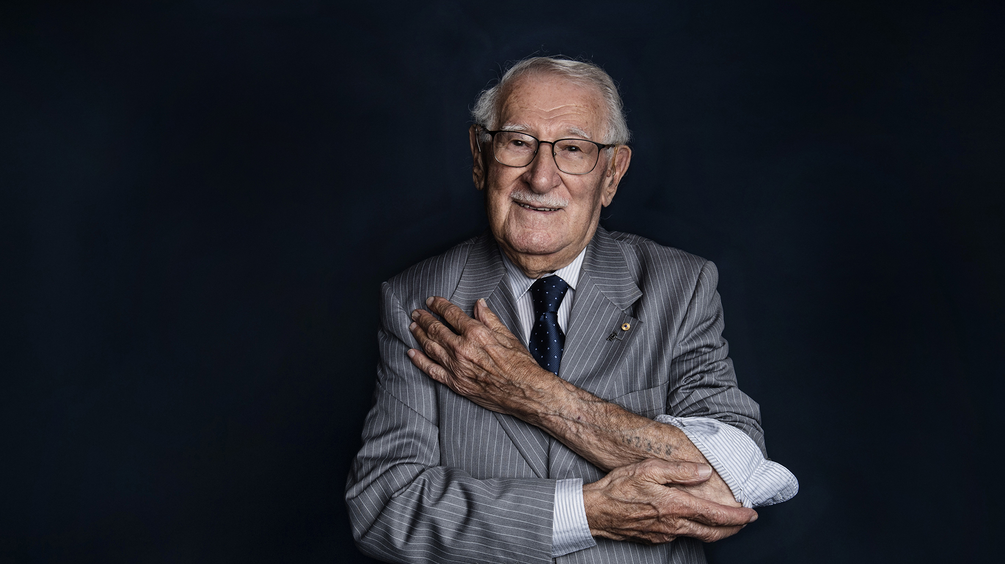
“Your efforts today will affect people you will never know. It is your choice whether that effect is positive or negative. The choice is easy, and it is yours to make.”

Slide 6
Flipping the Lid on Our Charitable Brain……
through the Power of Story

Slide 7
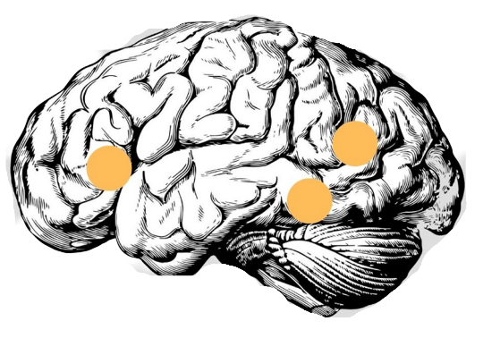
Your Brain on Facts* and Data*
(and lots of numbers and bullet points!)
Words & Concepts
Language Formation
Word Meanings
  *unless they have significance and meaning that evokes an emotional response

Slide 8
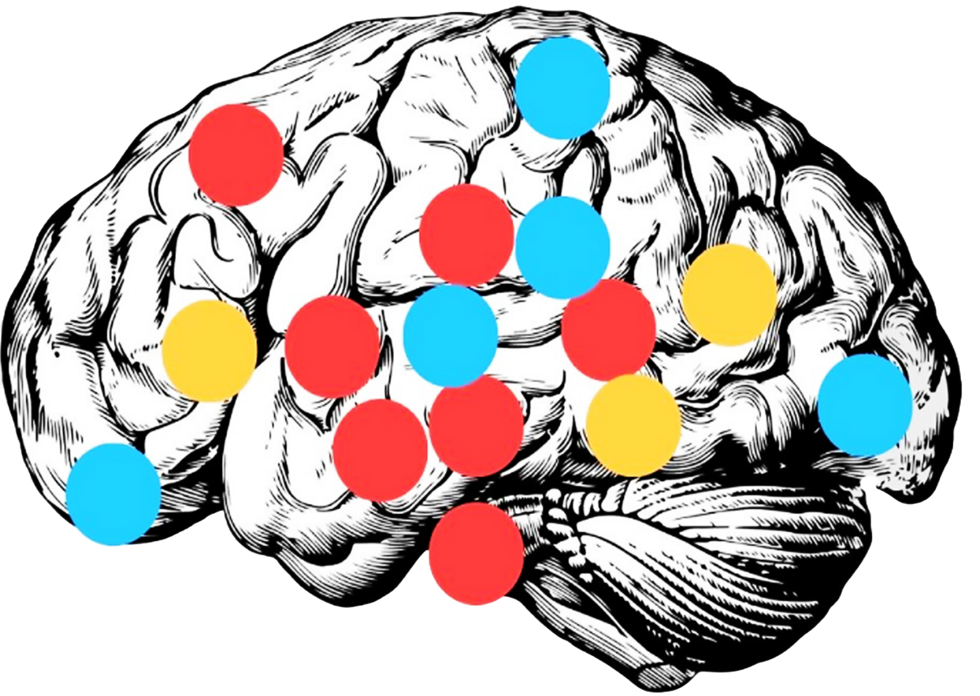
Your Brain on Story
Touch
Body awareness
Emotions
Taste
Movement
Words & Concepts
Language Formation
Word Meanings
Emotional Responses
Emotional Context
Smell
Sight
Sound
Memory & Learning
Emotional Processing
Memories of experiences as you put yourself in the storyteller’s shoes

Slide 9
The Secret CODE to a Journey from
Reality to Possibility
Cortisol (Attention) – released through an attention-grabbing opening using sensory language
Oxytocin (Connection) – released with stories of lived experience, connection, empathy and compassion
Dopamine (Motivation) – released with stories of hope for the future, motivating us into action
Endorphins (Wellbeing) – released with stories of success, the happy ending we all want ☺

Slide 10
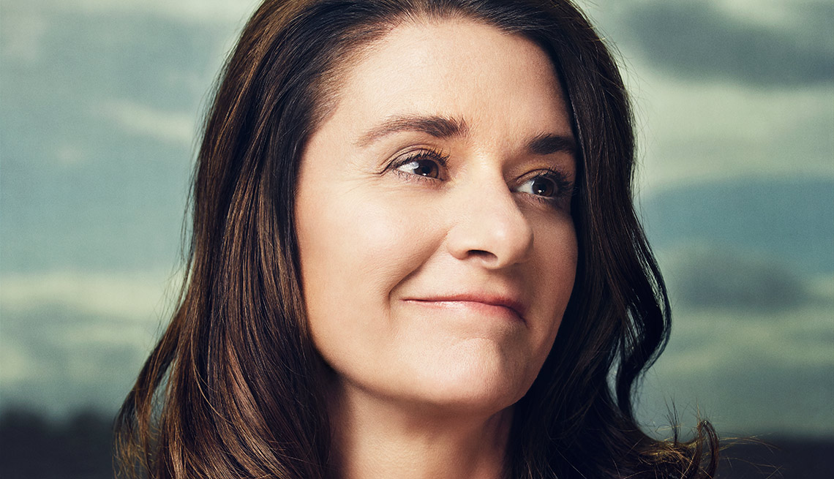
“If you want people to open their wallets,
start with the heart”
Melinda Gates

Slide 11
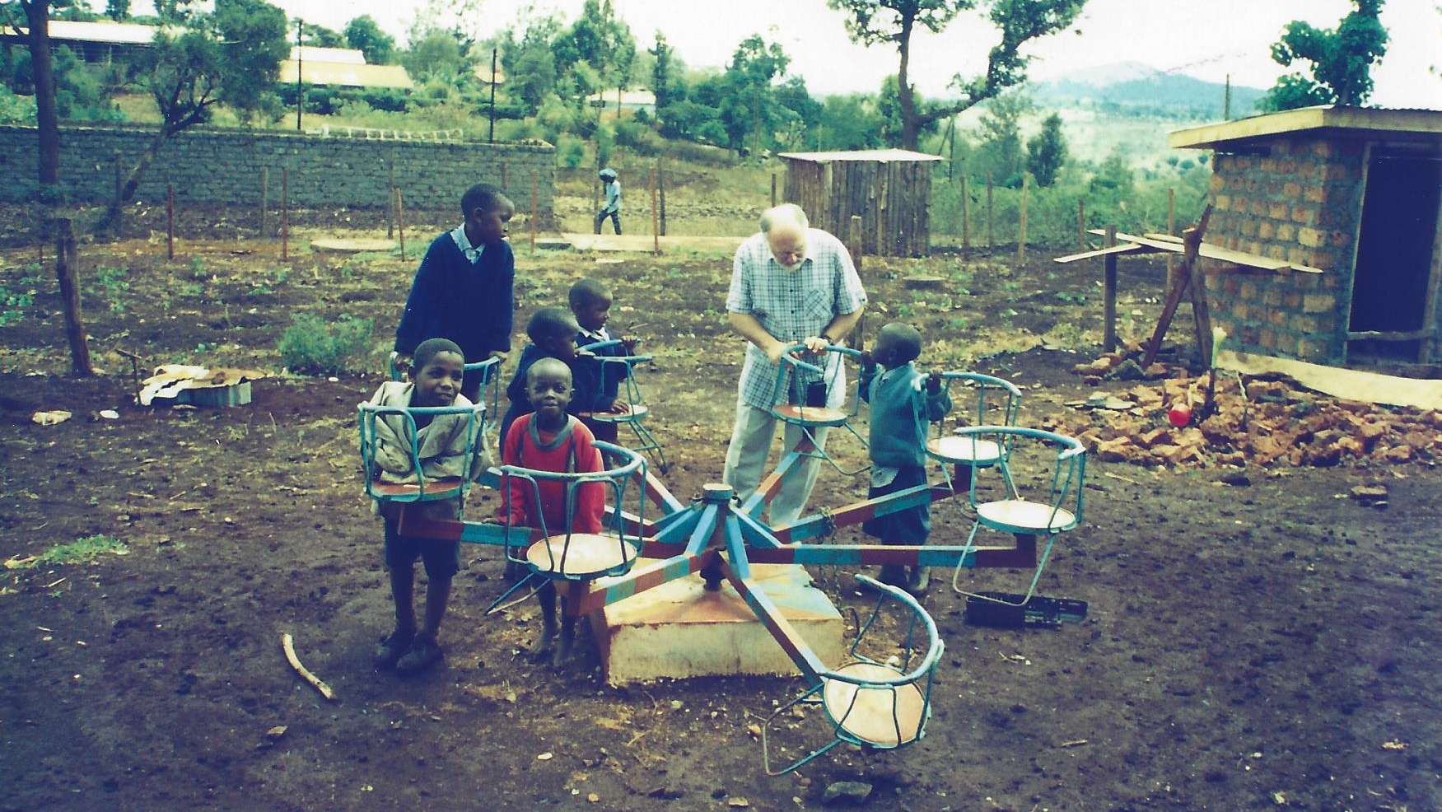

Slide 12
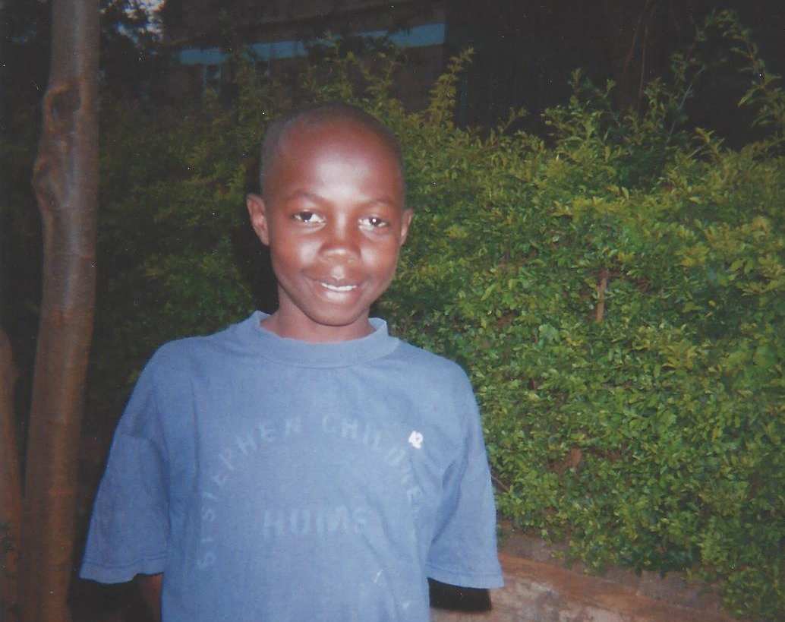
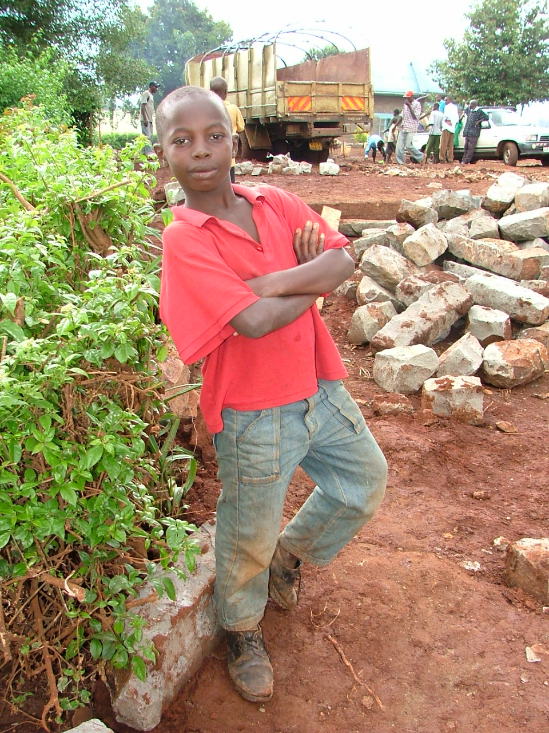
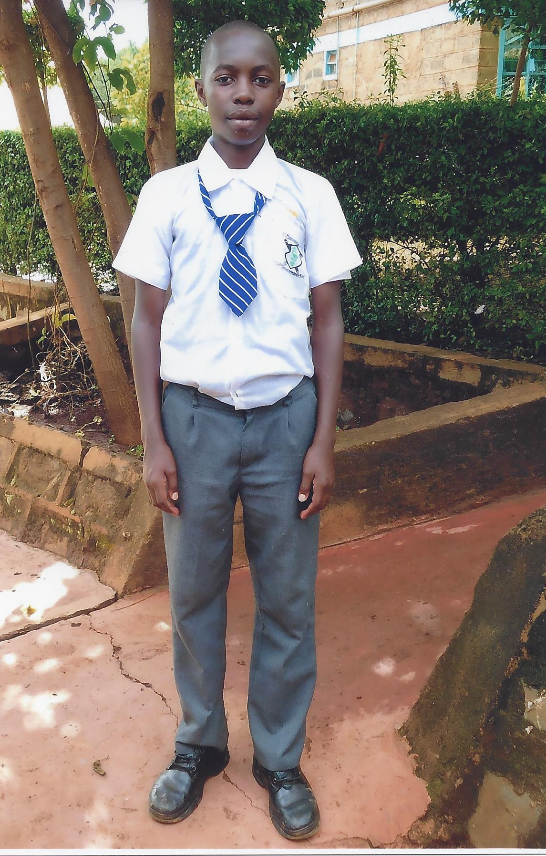
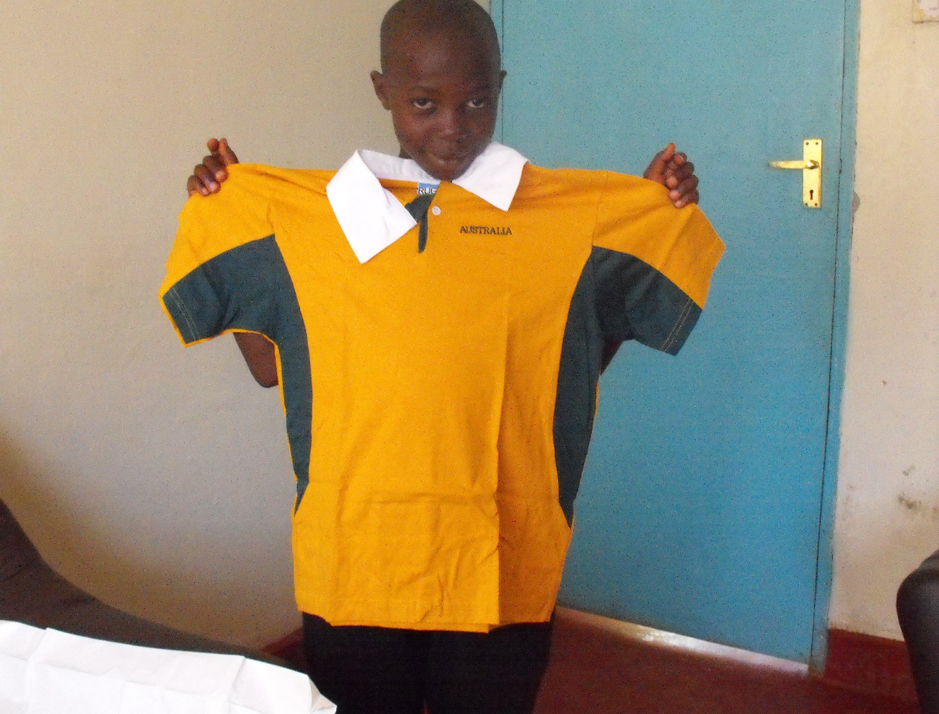

Slide 14
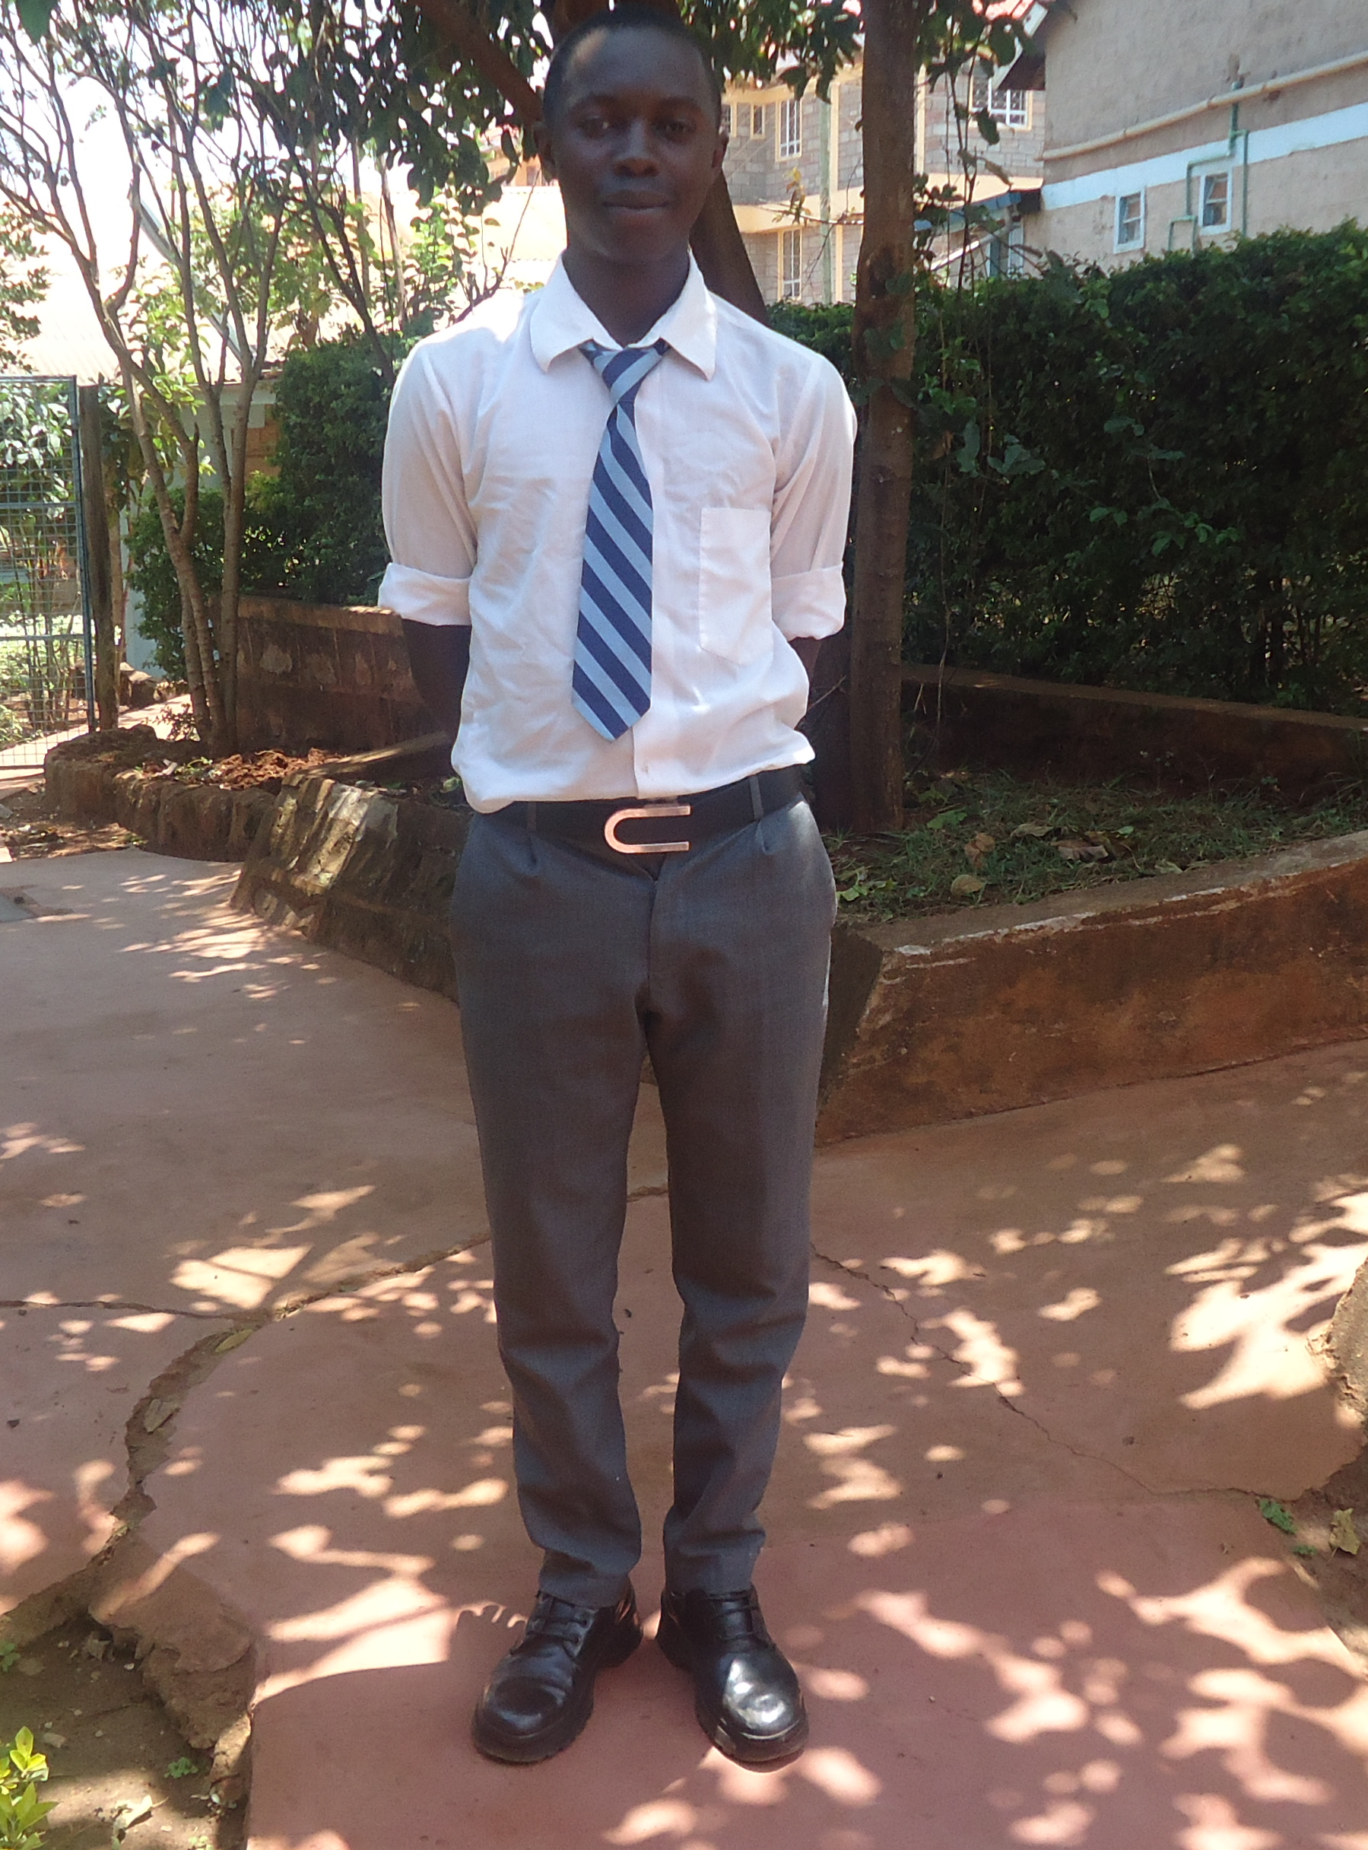

Slide 15




Slide 16
When I’m Dead and Gone –
Leaving Lasting Legacies

Slide 17
From the Ridiculous
to the Sublime
Two Very Important
Tales of Bequest

Slide 18
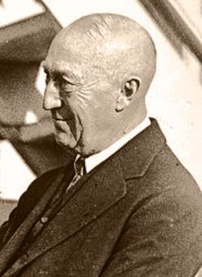
Charles
Vance
Millar
1854 - 1926
A Cautionary
Tale

Slide 19
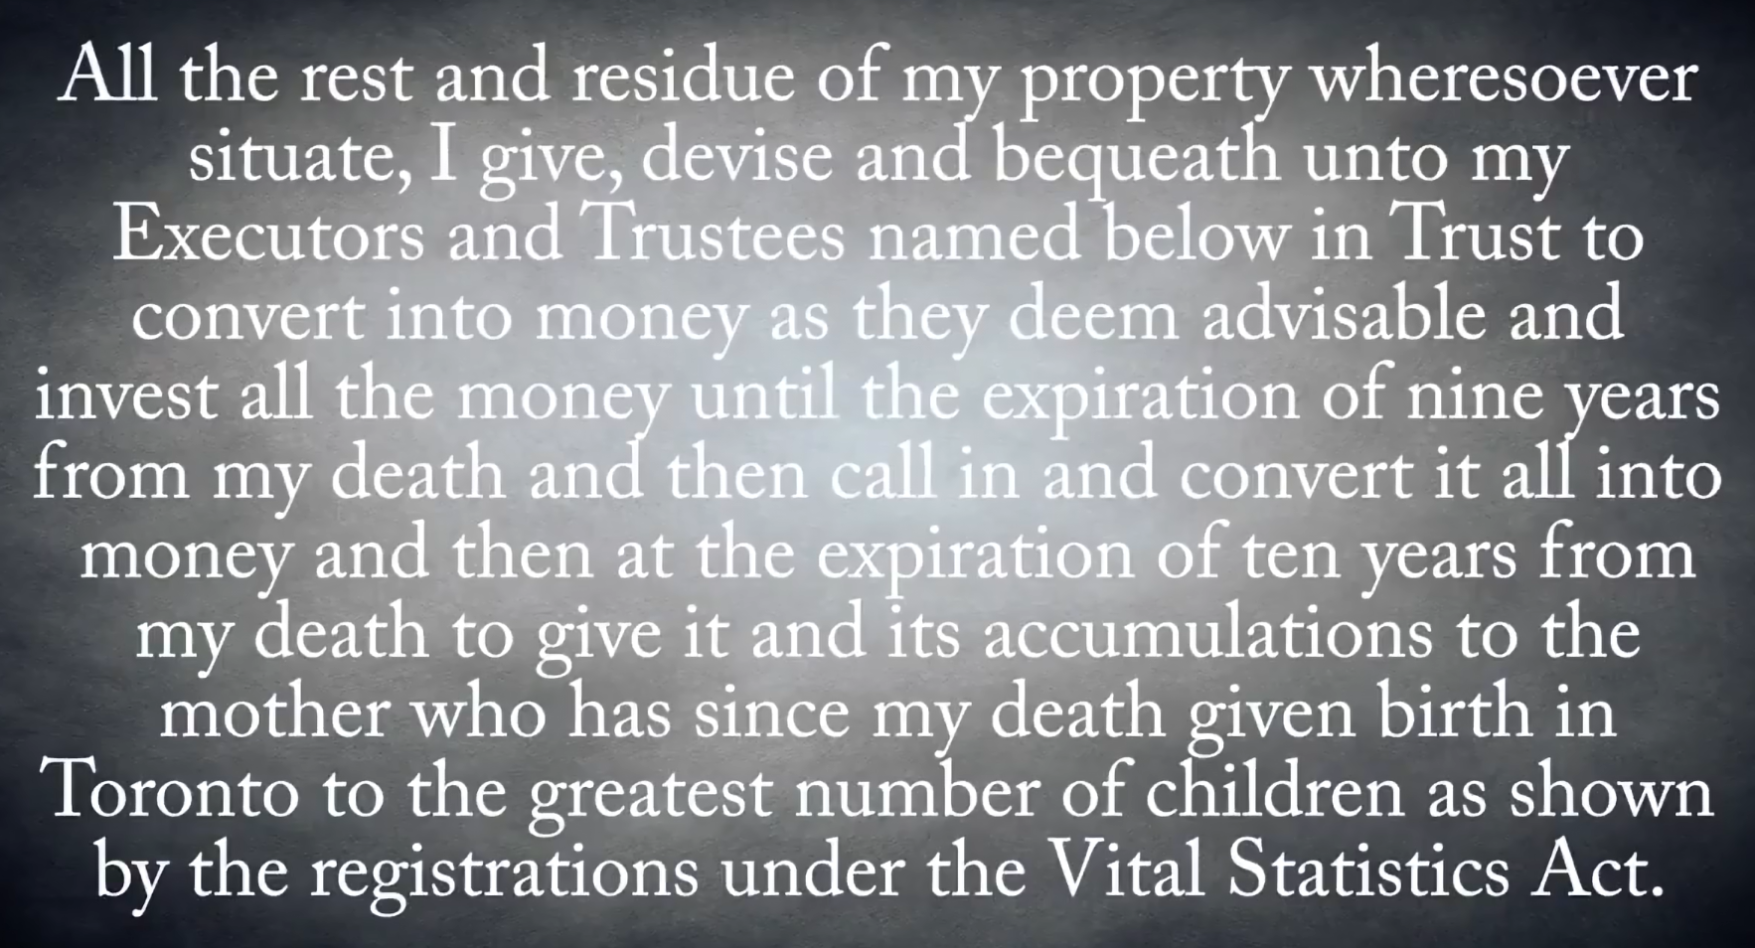

Slide 20


Slide 21
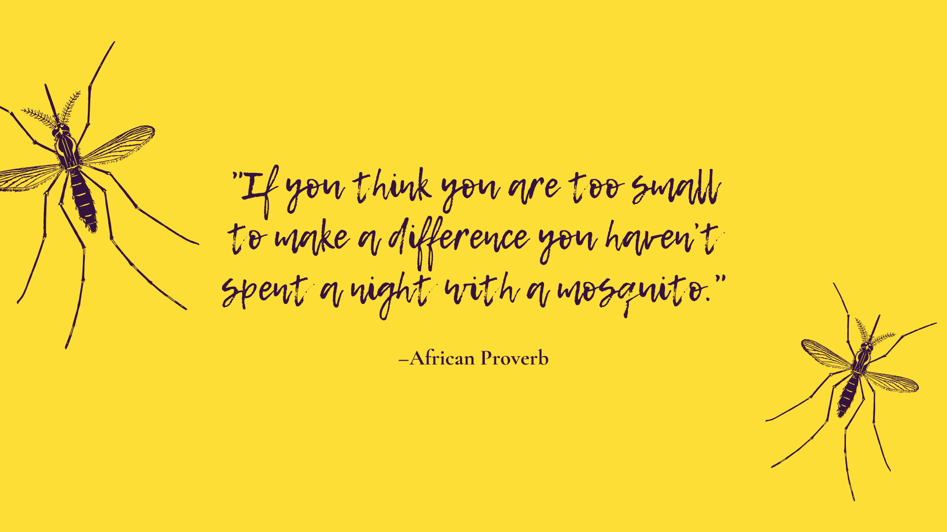

Slide 22
Culture is healing: The making of a Possum Skin Cloak

Slide 23


Slide 24

Edna Davis

Slide 25

“The two most important days in your life are the day you are born and the day you find out why.” Mark Twain

Slide 26
Thank you!
www.includeacharity.com.au

