Slide 1
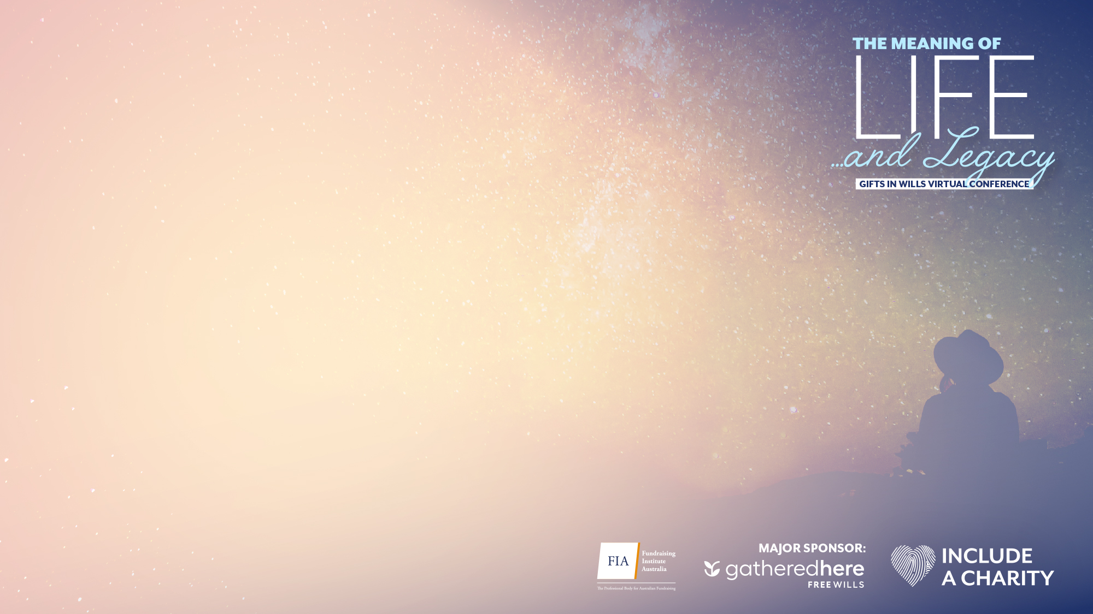
From first gift to a lasting legacy:
The life and times of a gift in Will donor
Karen Armstrong
Megan Maya

Slide 2



What are our goals for today?
GiW Sweet Spot
Intention to Action
Life Events
What are the demographics and attitudes of potential GiW supporters in Australia?
Understanding the steps to include a charity
How do life experiences connect with leaving a gift in Will?

Slide 3
GIW Sweet Spot
What are the demographics and attitudes of potential GiW supporters in Australia?

Slide 4

16%
5%
Confirmed and Considerers give over $1,000
Rejectors give over $1,000
(7% neutral)
Actual data
Notes:
Key life events play a pivotal role in shaping an individuals’ identity, values, and charitable engagement. These experiences can be the driver for their connection with your cause. We know that on average there is 12 years from a first gift and a realised gift in Will. This may not be surprising but what is, is that nurturing a supporter for a lifetime is just as important for everyone in the organisation as TBP found 36% of income came from supporters who’s first gift was 10yrs+.

Slide 5
28
41%
MONTHS
Active in Last Two Years
Average Time Since Last Gift
Actual data
Notes:
Key life events play a pivotal role in shaping an individuals’ identity, values, and charitable engagement. These experiences can be the driver for their connection with your cause. We know that on average there is 12 years from a first gift and a realised gift in Will. This may not be surprising but what is, is that nurturing a supporter for a lifetime is just as important for everyone in the organisation as TBP found 36% of income came from supporters who’s first gift was 10yrs+.

Slide 6


Active Regular Givers
Active Cash
Actual data
Notes:
3 % mids and under 1% major

Slide 7
Confirmed
Gifts in Wills

Slide 8
Consideration
Gifts in Wills
Definitely/Probably likely to leave a gift

Slide 9
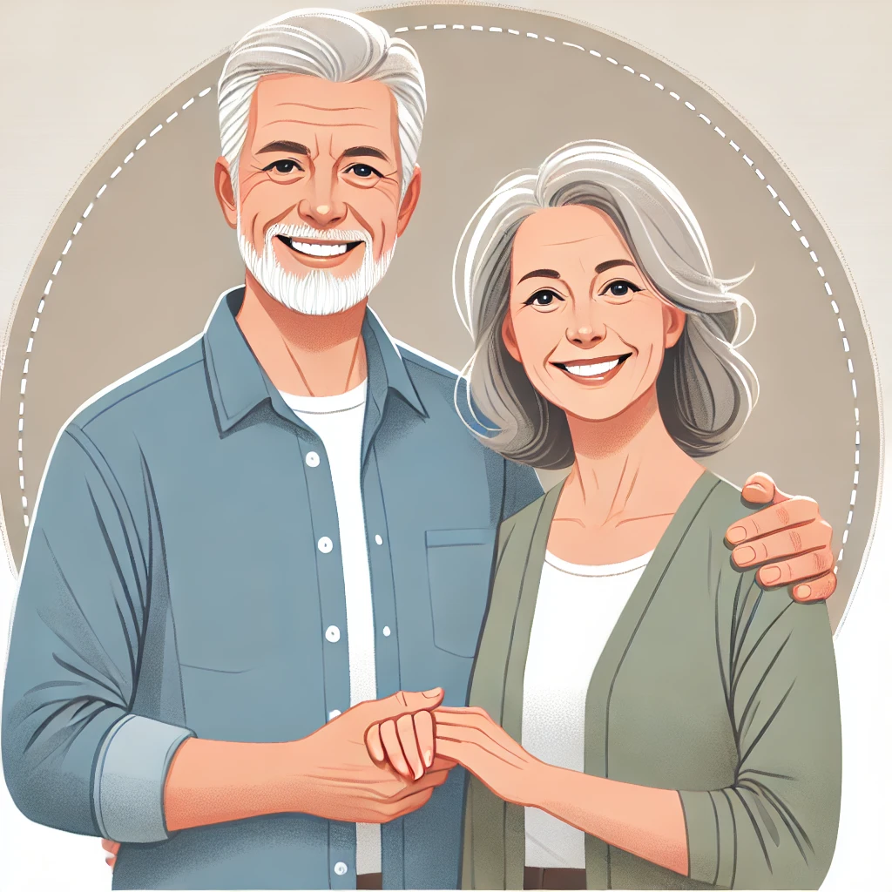




GiWs segments: 4100 over 4 waves
Our audience segments
CONFIRMED
CONSIDER
NEUTRAL
REJECT
All responders
4,100
743
628
1151
1578
55yrs +
1519
174
116
379
850
Donors $20+
3511
650
545
1005
1311

Slide 10
CONFIRMED
CONSIDER
NEUTRAL
REJECT
Donated more
38%
36%
18%
10%
Donated less
26%
29%
24%
19%
Thinking about your charitable giving, did you donate more, less, or about the same amount of money to charity this year compared to last year?

Slide 11
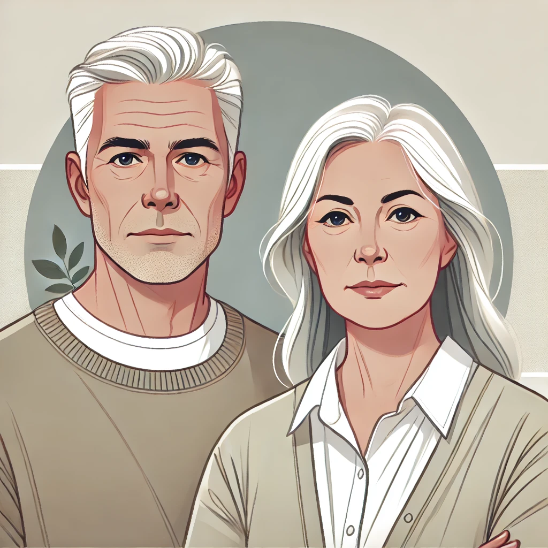
1
My living costs have gone up, so I just can't spare the money for donations right now.
(50%, 64%, 80%, 79%)
2
I've been overwhelmed by too many requests for donations..
(29%, 4%, 4%, 8%)
Donated less

Slide 12




Financial Outlooks (Donors $20-$5,000)
Economy
Personal
Giving
No. Orgs

Slide 13
Financial Outlooks (Donors $20-$5,000 / split age)
Economy
Personal
Giving
No. Orgs

Slide 14
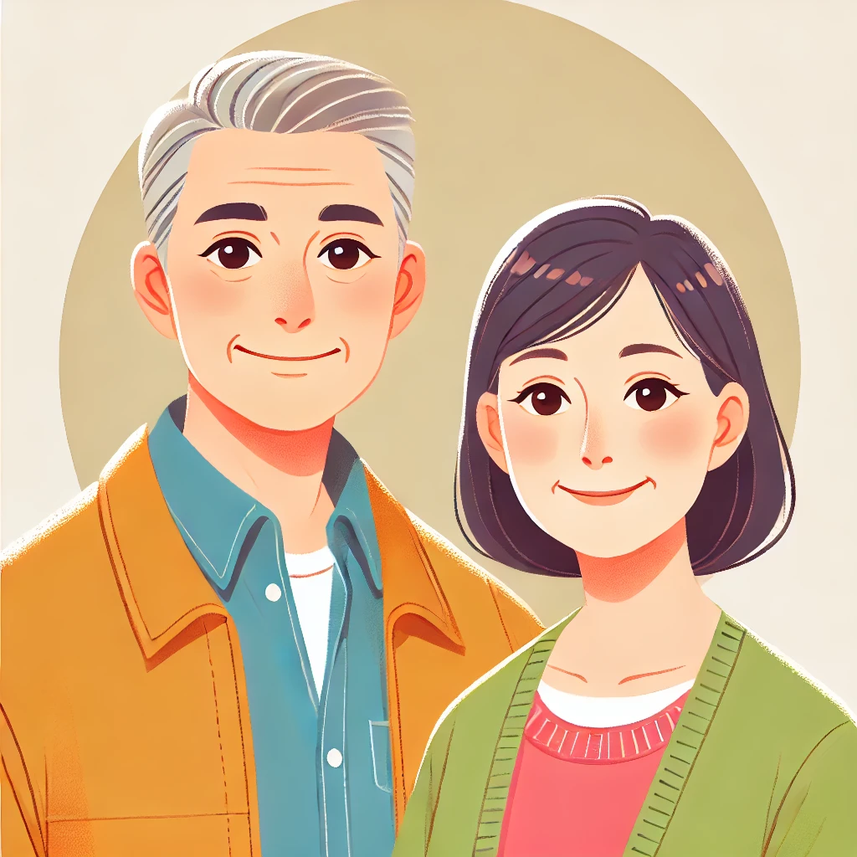
Two Speed Stewardship

Slide 15


23%
After every donation.
19%
Special recognition after a certain number of donations has a specific impact.
31%
For confirmed
37%
For confirmed
Notes:
This is the most important thank you moment

Slide 16
1
Yes, I have recommended a/multiple charities to others. (NPS)
(65%, 58%, 38%, 24%)
Have you ever recommended organisations or brands to family, friends or colleagues for each of the following? Often/All the time
(73%, 61%, 44%, 27%)
2
They are talkers
(Under 55yrs)
Older confirmed/considerers are only stronger than rejectors 55yrs+

Slide 17

Attitudes to GiW
We need to close the attitude gap for <55Y especially “Anyone can include a charity in their Will”

Slide 18



GIW Sweet Spot
What are the demographics and attitudes of potential GiW supporters in Australia?
Run your campaign on 2-speeds by age
Build Trust
Continue to Normalise!
Our 55yrs + and under 55yrs are dramatically different audiences in terms of financial optimism, giving and sharing.
Keep building trust with your audience. They need to know you will use their gift wisely.
They are talkers. Utilise this to promote the idea that including charities in wills is accessible for everyone and it’s EASY.

Slide 19
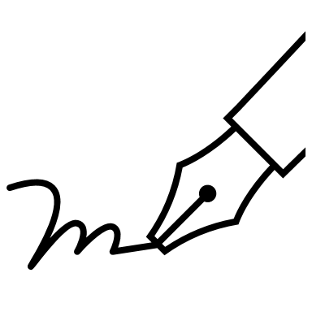
From Intention to Action
Understanding the steps to include a charity

Slide 20
Will Writing
Investigate Partnerships
Reflects the growth of online Wills with the sector

Slide 21
Their Age: Confirmed

Slide 22
How many charities included
Share the LOVE!

Slide 23
Type of gift

Slide 24
Impact of gift?
Opportunity to Improve

Slide 25
Impact of gift?
Huge job to educate our older intenders /
considerers

Slide 26
Influence the Impact:
Confirmed

Slide 27
More Strategic Public Research
Residual Gift Deep Dive
21%
19%
18%
Leaving a proportion of your estate to a charity, rather than a fixed amount reduces concerns as to whether you will have enough to support family, friends and the causes you are passionate about.
Irrespective of how much or how little you share, everyone is looked after fairly.
Leaving a percentage of your estate to charity ensures that you will have the greatest impact with your charitable giving.
You may wish to provide for your family and friends first and leave what is left (the residue) to a charity.
Doing this, your gift to the charity is likely to increase in value . If you leave a cash sum it will be eroded by inflation over time.
Leaving a share (residue) of your estate means your gift can achieve/ be used in the way you had intended it to and more.
Everyone Looked After Fairly
Greatest Impact
Increase Value

Slide 28
Information they sought: Confirmed
Notes:
Might just need to. Break this down by confirmed and consider.

Slide 29

Reason for updating your Will
Changes in Personal Wishes
They’ll update their Will to include you

Slide 30




Reason to Include a charity
Further Research ‘Reasons to Update’

Slide 31
Is there a risk of being removed?
Confirmed Bequestors appear to be much more likely to change their Will

Slide 32
Why did they change?
Caution: Small sample size

Slide 33



From Intention to Action
Understanding the steps to include a charity
Provide EDUCATION content
Partner with Solicitors
Once Won steward them well
They engage with it!
Partner with financial advisors and solicitors to encourage discussions about including charities in Wills, and to build trust.
Our confirmed Bequestors are likely to change their mind. This is a reflection of their life values and they want to make the right decision that expresses their personal wishes.
Provide clear, easy-to-follow guides on the different types of bequests and their benefits. Especially older considerers.

Slide 34
Life Events
How do life experience connect with leaving a gift in Will?

Slide 35
Connection
Connection
Importance
Trust
Long Term Focus
Recommendation
Family Tradition
Values
Charity Information
Donors $20+

Slide 36
Cause Connection
Causes they are most likely to support with a charitable donation:
Public
Bequestors
1. Children’s Charities
1. Animal Charities
2. Health & Medical Research
2. Children’s Charities
3. Animal Charities
3. Australian Welfare Charities
4. Australian Welfare Charities
4. Health & Medical Research
5. Mental Health Organisations
5. Aged Care Services
Notes:
Full 3000

Slide 37
Life Experiences: Confirmed
Immediate family
Extended family
Friends / Colleagues
1. Cancer
2. Heart Disease
2. Heart Disease
3. MND
4. Low vision/Blindness
4. Low vision/Blindness
5. Stroke & Mental Health – only to rejectors
5. Mental Health – only to rejectors
6. Low vision/Blindness
6. Low vision/Blindness – only to rejectors
7. Alzheimer's/Dementia
7. Alzheimer's/Dementia
8. Intellectual disability
8. Intellectual disability
9. Physical Disability
10. Homelessness – only to rejectors
10. Homelessness
10. Homelessness
11. Domestic violence
11. Domestic violence – only to rejectors
12. Natural disaster – only to rejectors
12. Natural disaster
12. Natural disaster
13. Immigrant or refugee status
13. Immigrant or refugee status

Slide 38
More Strategic Public Research
Life Events and Cause Connection
People often give to charities during life events occasions to…
GiW
Potential
N= 2,448

Slide 39
Supporter Engagement for a Lifetime
When it comes to hearing from charities you support, which of the following occasions or milestones would you appreciate receiving updates or hearing from them?

Slide 40

29%
People would like to hear from charities for their birthday.
21%
Have given to charity to celebrate their birthday.
44%
Would consider giving to charity to celebrate their birthday.
32%
For confirmed
50%
For confirmed
37%
For confirmed
Notes:
This presents an opportunity to connect and engage with supporters, whether to celebrate, request support, or express gratitude. It's becoming increasingly common for brands in the commercial sector to acknowledge birthdays, and we can do the same in a authentic and impactful manner.

Slide 41


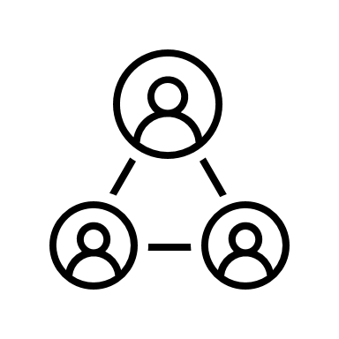
Life Events
How do life experience connect with leaving a gift in Will?
Experience you create counts
Connect with Key Moments
Do we need to rethink cause connection?
It’s their lifetime of experiences with your charity that creates the emotional connections. Nurturing for a long time. ​
Key moments – In memory, birthdays, holidays and windfalls – create engagement opportunities.
Have we understood the intricacies of personal connection and relevant life experiences?

Slide 42






Our Key Insights CHEAT SHEET
WILL WRITING:
Nearly half of Australians (48.8%) do not have a will.
Among those with wills, 29.6% use solicitors, 9.6% prefer DIY will kits, and 4.4% opt for online platforms.
CHARITY INCLUSIONS:
Most donors include a limited
number of charities in their wills, with 75.2% naming between one to
three charities. Although in reality we’ve seen this can be higher in our charitable study.
TYPES OF GIFTS:
Fixed monetary gifts are the most common type of bequest, preferred by 57% of donors, while 32% allocate a percentage of their estate.
MOTIVATIONS:
Personal connections (22%) and alignment with causes (17%) are the primary motivations for giWs.
Trust in the charity’s reputation and long-term sustainability also plays a role.
TRIGGERS:
Updating a will often prompts
donors to consider including charities (33%), Additionally, professional advice from financial advisors (15%) and meaningful conversations with charities (14%) influence the decision to leave a giW.
RISK FACTORS :
Financial circumstances (35%) and professional recommendations (27%) are the top reasons for altering Wills,
Despite these potential changes, 69% of donors have not altered the beneficiaries or charities in their wills.

Slide 43
Be part of
the movement
www.includeacharity.com.au

