Slide 1


Reading Deceased Estate Documents
Notes:
Acknowledgement
Intro self and BA
Thanks to IAC

Slide 2

Disclaimer
This presentation contains general advice only. The advice contained within should not be relied upon without seeking professional advice pertaining to your unique circumstances.
Notes:
What is the law and how things work in practice are not always the same. You might have a right to something, but if someone doesn’t adhere to that right, are you going to take it to court to have your right enforced?

Slide 3

Notes:
Might feel like this – or might feel like you don’t have the documents you need.
Today is all about demystifying the docs and talking about the key information you want to pull out of each.

Slide 4
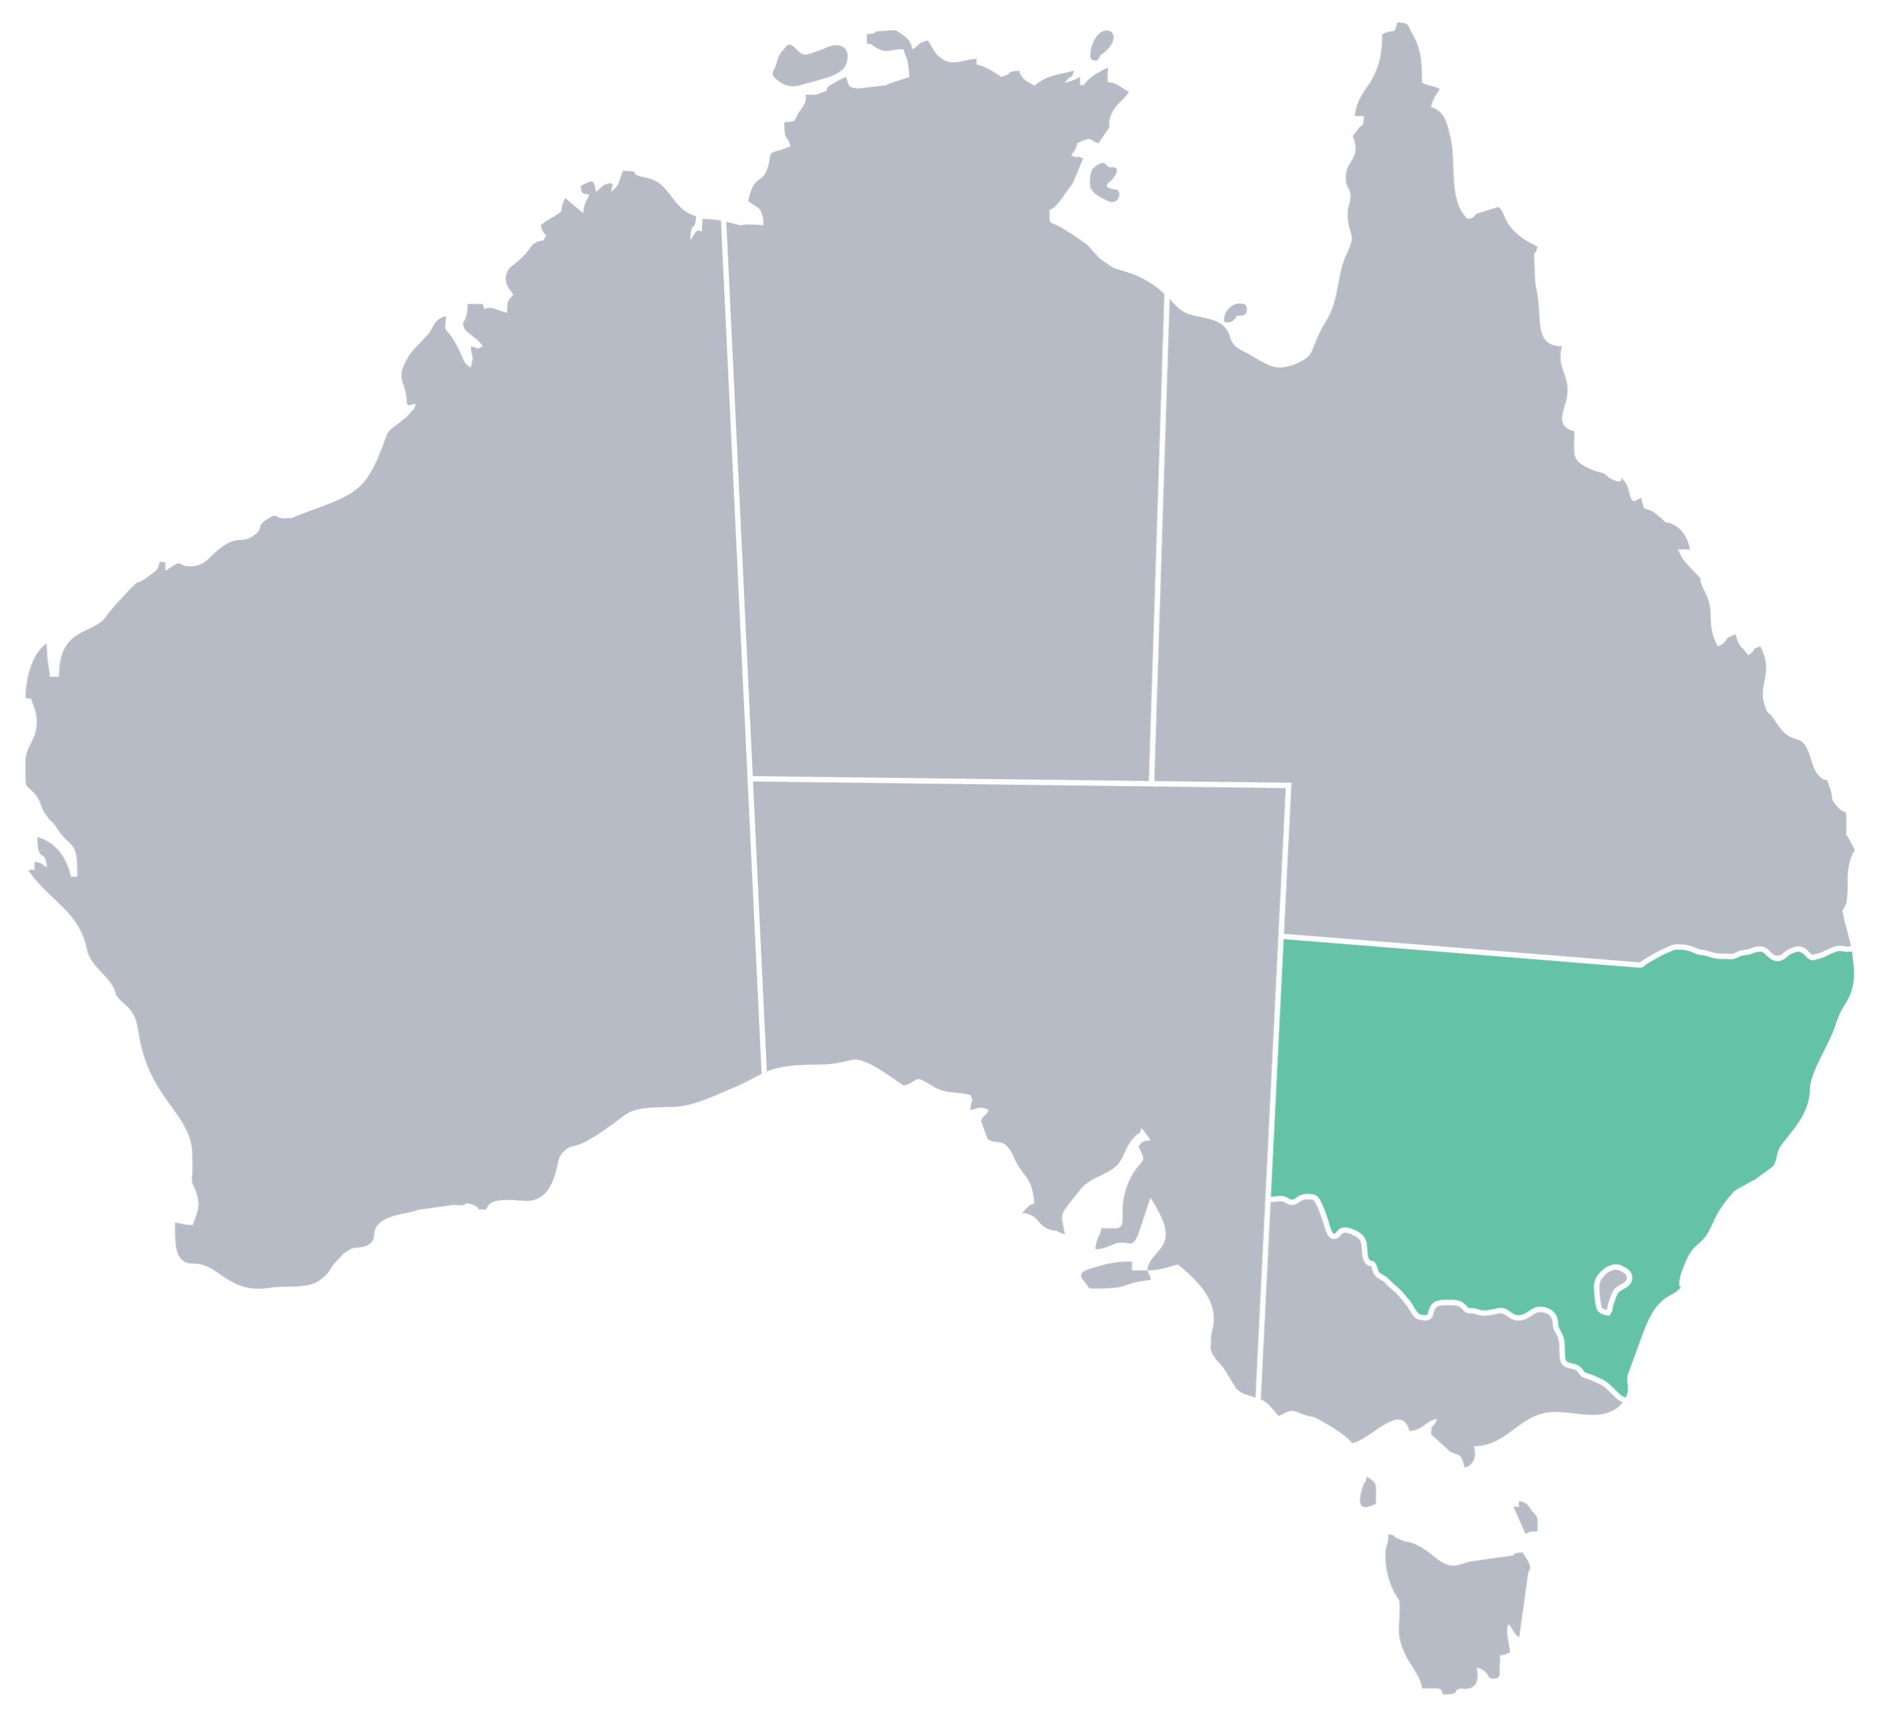
Applying for probate
The legal process whereby the court recognises that the will is valid and the Executor has the right to administer the estate.
Each state has their own court and processes.
Notes:
A little bit of background to when the docs come about…

Slide 5

What relevant documents are part of probate?
Will
Codicil (if there is one)
Asset list (not in Qld)
Notes:
There might also be other docs like a death cert but you don’t really need that

Slide 6

What documents do I need to review?

Slide 7

Notification communications
Will
Asset list
Final statement
Notes:
+ Other things throughout: emails, death cert, notice of claim, real estate valuations – but these are the core ones we’ll focus on today

Slide 8
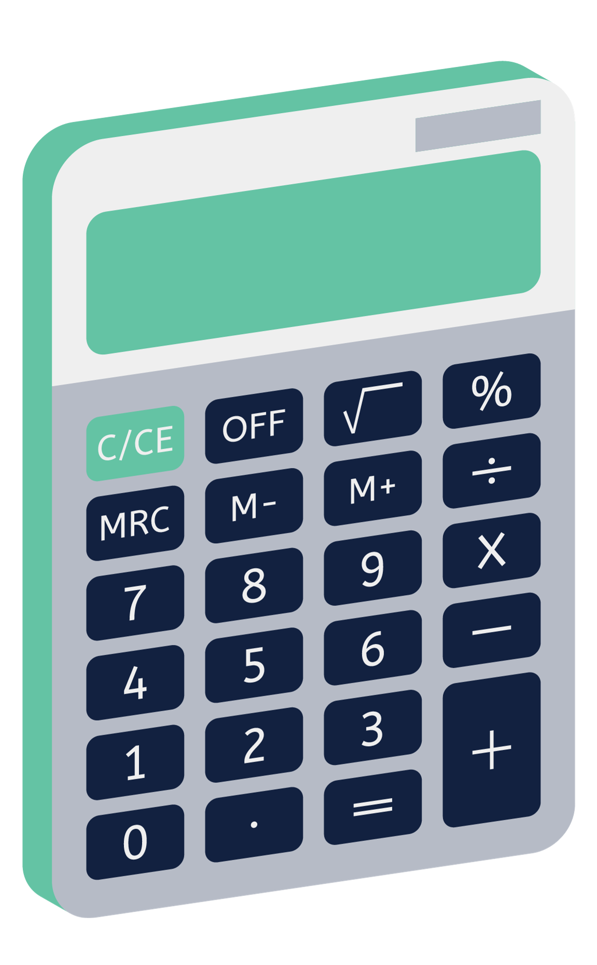
Pecuniary gift = Will or clause
Residuary gift = Will, asset list and final statement
Notes:
What docs do you need for different types of gifts

Slide 9
ESTATE ASSETS
LIABILITIES of DECEASED
PECUNIARY GIFTS
SPECIFIC GIFTS
LEGAL FEES
TAXES
RESIDUARY GIFTS
Notes:
Here is why you need those extra docs for residuary gifts

Slide 10

  Notification communications
Phone call, letter, email
Varying amounts of information
Varying timeframe
Notes:
Might be a phone call, letter, email
Sometimes there are all the documents you need and lots of information. Sometimes there is very little. Your job is to put the puzzle pieces together and work out what you still need.
Sometimes notification comes right after the person dies, other times the whole estate has been administered and they are just sending you the cheque or asking for bank details. They are allowed to do this but there are issues.

Slide 11
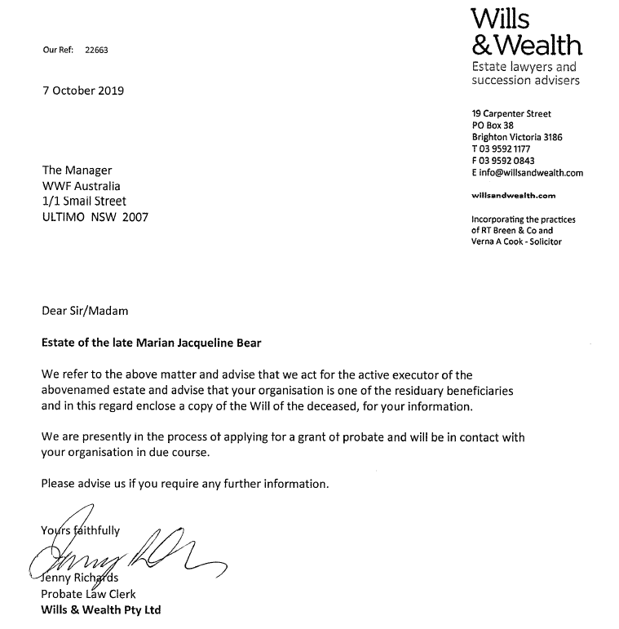
Typical notification
Key names and contact info
What stage they are at
Copy of the will enclosed
Notes:
Some information but not everything you need. You’ll become clear in a moment what other information you need.

Slide 12

Start collecting key info
Name of the deceased
Name of the executor
Name of the solicitor
Date of death
Date of probate
Date of expected distribution
Info on assets
Info on issues with estate (eg contest)
Notes:
+ When we receive notification, we read every word and enter in the data as we find it. Sometimes we have to wait for more docs, but with each communication you should be filling in the puzzle pieces.
+ Your system needs to be able to record this info and more.

Slide 13

Who is notifying me?
What information is included with the notification?
What else do I need to know?
Notes:
When you receive a notification, these are the three things you should be thinking about.

Slide 14

Will
Wills are public documents
Sometimes arrive with notification
Need several key pieces of information
Notes:
+ A reminder that wills are public documents – they might feel private to the executor but anyone in Australia can purchase a will, even if they’re not in it. Anyone who is in it has a right to receive a copy from the executor.
+ Sometimes the will will come with notification, sometimes you’ll have to ask for it.
+ There are a few key pieces of information you are looking for in the will that we’ll go through step by step

Slide 15
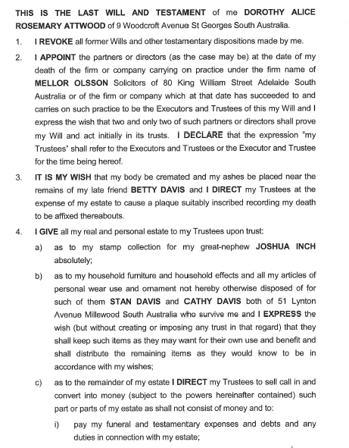
Read the will
Information found in a will
A
B
C
Name of deceased
Revocation
Appointment of executor
Actions required
Distributions
Other legal issues
D
E
Notes:
A. Name of the Will writer and their address at the time they wrote the Will and often their former occupation. (Testator)
B. Revocation of all former Wills and a declaration that this is their last will and testament.
C. The name of the appointed executor(s), Family/Friend, Solicitor or Trust Company
D. Actions required of the Trustee (Executor)
For example; funeral wishes, etc.
To sell, call in, and convert my estate into money,
To pay from the estate debts, funeral and testamentary expenses, probate, death duties, taxes etc.
To undertake any specific requests, for example, care of animals, distribution of chattels.
E. The Distribution of Assets.
This will usually commence with specific items; jewellery, books, paintings etc. but may include property/real estate and other large items, perhaps even a business.
Pecuniary recipients and their gifts will then be itemized.
The break up of Residual estate is then described. This may be in the form of percentages or fractions. It may list individuals and charities and indicate that each get an equal share.
It may indicate what should occur if an individual is deceased or a charity ceased to operate.
F. The final section will often be legal issues again about responsibilities of Trustees/executors and whether they may receive a commission or a solicitor be paid for any actions normal to their professional duties.

Slide 16
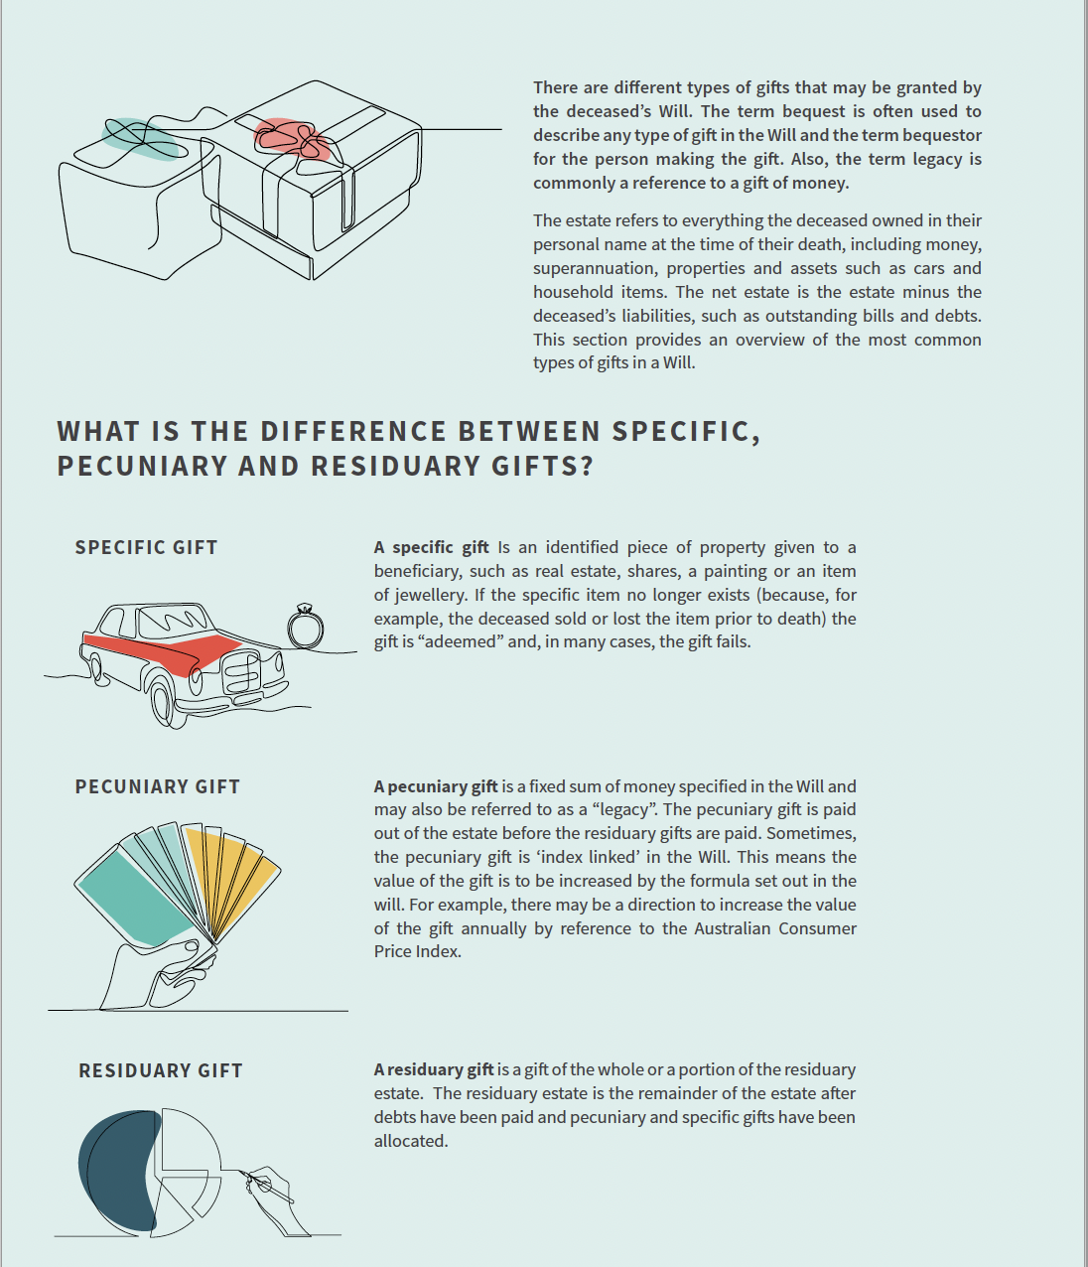
Confirm type of gift
Specific gift
Pecuniary gift
Residuary gift
Notes:
When you read will, looking for what type of gift you have been left
This is page in book – 3 types: S, P, R

Slide 17
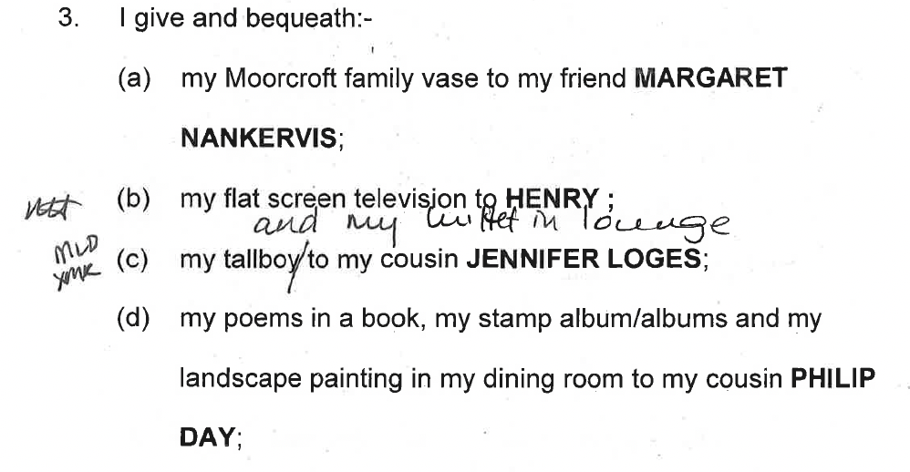
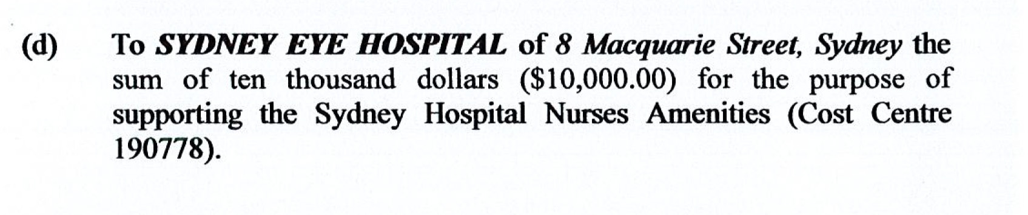
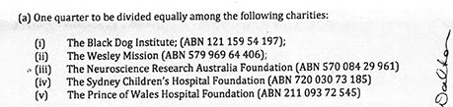
Confirm type of gift
Specific gift
    (an item) i.e. house, jewellery
    The relevant clause in the Will
Pecuniary gift
    (a specific cash gift) i.e. $20,000
    The relevant clause in the Will
Residuary gift
    (% of the residue of the estate) i.e. 25%
    The Will
    The list of assets & liabilities
    The final statement
Notes:
Most common = pecuniary and residual
Residual – anywhere from 1% to 100%
If the gift you are receiving is a pecuniary gift the only document you need to see is the will or the clause in the will that pertains to your charity. It does not matter to you how much the total estate is worth or what amounts of commission or legal fees are being charged in that estate. But if you receive a residuary bequest you want to examine the asset list to understand the total value of the estate (assets – liabilities) and you need to read the will to understand what pecuniary gifts were made, and whether an executor’s commission is allowed.

Slide 18
What type of gift is that?
Notes:
Specific

Slide 19
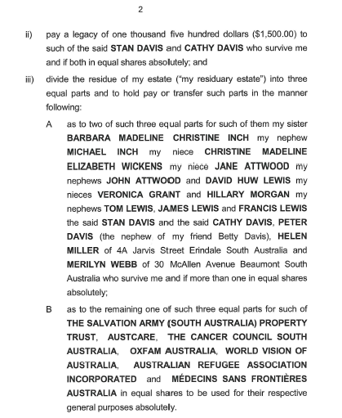
What type of gift is that?
Notes:
Pecuniary

Slide 20
What type of gift is that?
Notes:
Residuary

Slide 21
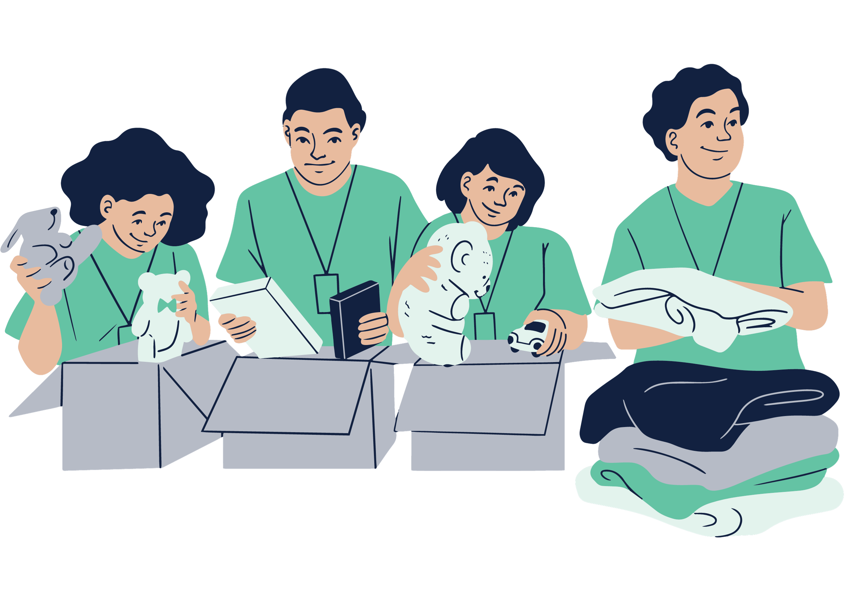
Confirm charity name
Amalgamations
Different branches
Name changes
Notes:
The will lists the beneficiary’s name. If your charity name is not correct you must notify the solicitor. Often if years have passed since the Will was written your org may have changed their name. You will want to have the legal documents ready to prove your charity is the same as the one named in the Will. Some of the trustee companies and solicitors are sticklers for this.
There can be some complexity with federated structures that you should have a procedure for.

Slide 22
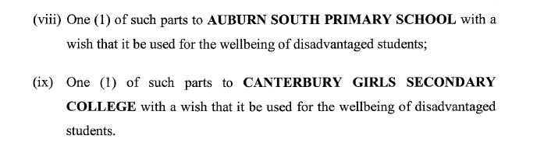
Gift restrictions
Notes:
The Will also tells you if the gift is restricted. While most bequests are for a charity’s general purposes, some charities may receive gifts for specific geographic areas or for example certain types of medical research programs. You need to make certain that your charity can use the gift in the way it was intended. Accepting a gift in a will with restrictions comes with legal obligations.
Maybe they won’t ever ask – but if they do, be ready.

Slide 23

Reading the will: summary
Type and amount of gift
What other documents do I need?
Is the charity name correct?
Is the gift use restricted?
Is executors’ commission allowed?
Are other charities co-beneficiaries?
Are there family members not included?

Slide 24

Reviewing the asset list
Required to understand a residuary gift
Helps establish size of gift and timing
Reveals assets with potential CGT implications

Slide 25
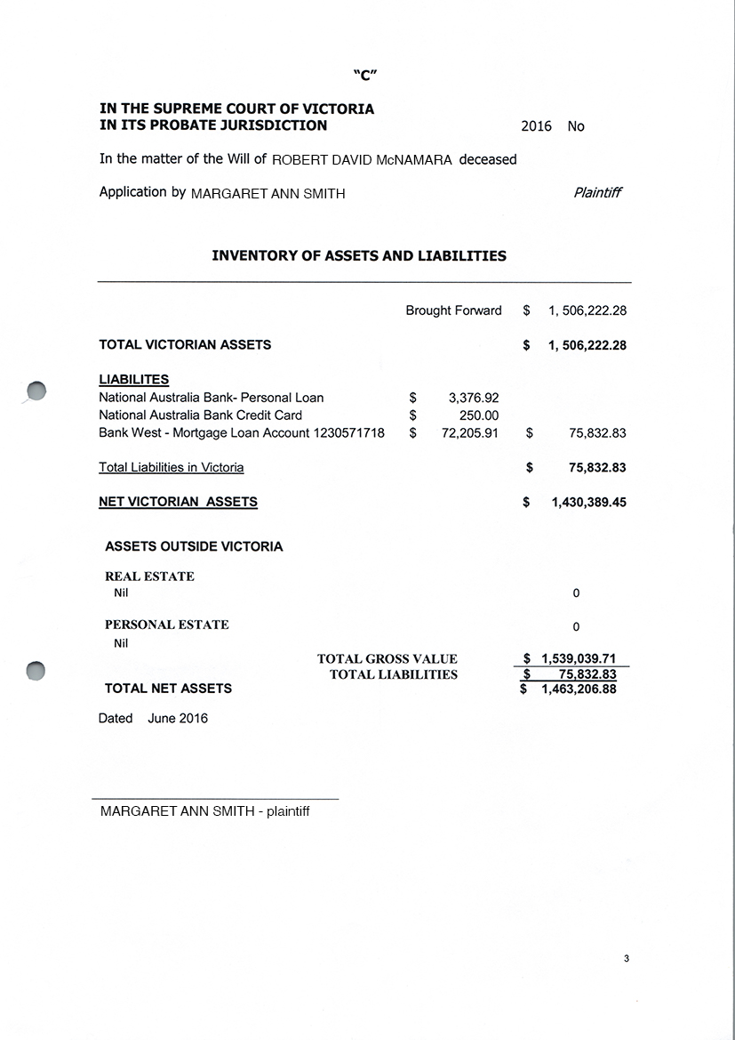
Notes:
+ Asset list is called different things in different states and territories – eg statement of assets and liabilities
+ Only state that does not require it with probate is Qld (but often they create it)
+ Lists all assets at time of death (estimate)
+ In some states, includes liabilities (eg mortgage or debts)
+ This is what tells you the value of your gift with a residuary gift – eg 25% of this value

Slide 26
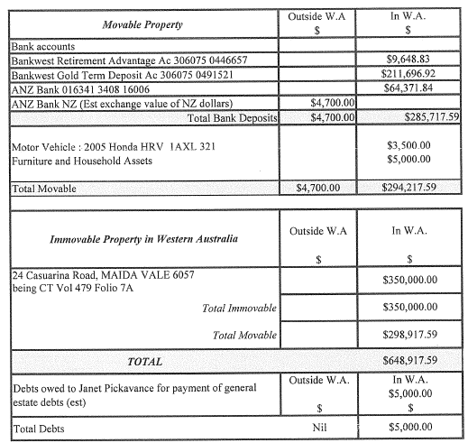
Notes:
+ Example from WA where they split it into movable and immovable
+ What type of assets do we see here?
+ Real estate is a really key one – often a large portion of the estate, how it gets sold impacts your gift. Remember asset list is an estimate but things can change that you should be aware of. We check realestate.com to see if the estimate is accurate. They might be aware of condition that you are not.

Slide 27

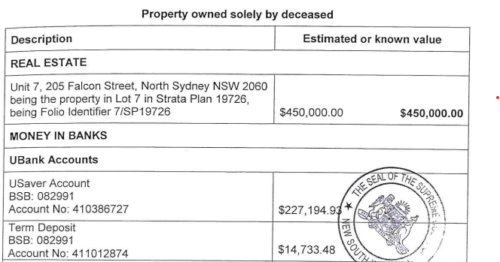
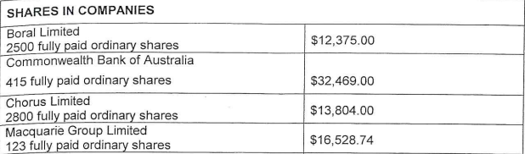
Notes:
+ What type of assets do we see here?
+ Shares are another key asset that you must be aware of. We’re going to talk about Capital Gains Tax and how you might want shares handled differently in a moment. CGT is something we go into in greater detail in 201.

Slide 28
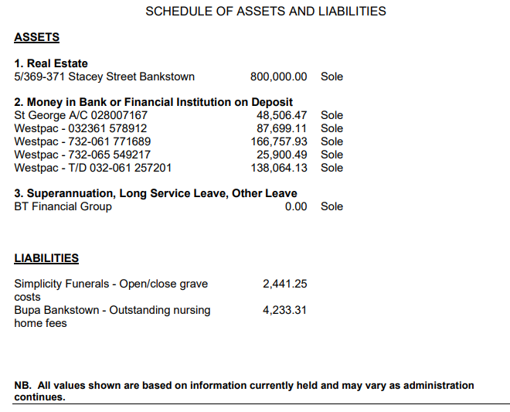
4. Account held in foreign bank
Bank of America 476,322 USD
Notes:
+ A final example
+ Note superannuation
+ Note overseas assets
+ Note liabilities – sometimes included, sometimes not (depends on state and solicitor)

Slide 29
Residuary gifts
Received 12-36 months after date of death
Timeframe affected by several factors
Pecuniary gifts
Received within 1 year of date of death
Interest due if paid more than 1 year after date of death
Notes:
The type of gift you are to receive will play a big part in when the gift is paid. As a general rule you will expect a Pecuniary gift 12 months from the date of death, after that interest is due on that type of gift. Pecuniary gifts are the easy ones to forecast as it’s straight forward with dollars and time.
With residuary gifts the time frame is complicated by several factors.

Slide 30

Get the asset list early!
Notes:
+ The asset list is created to file for probate, so you usually receive it after probate has been granted. (Qld is different)
+ We ask for it right away and then follow up once probate is granted
+ Benefit: for you to forecast
+ Other benefit: see assets that you might want to watch for CGT on.

Slide 31

Final statement
Did we receive amount listed?
Total value equal or exceed asset list?
Were all assets called in?
What charges were there?
What percent of estate paid in legal fees?
Notes:
+ Can be daunting, would have to hire forensic accountant

Slide 32
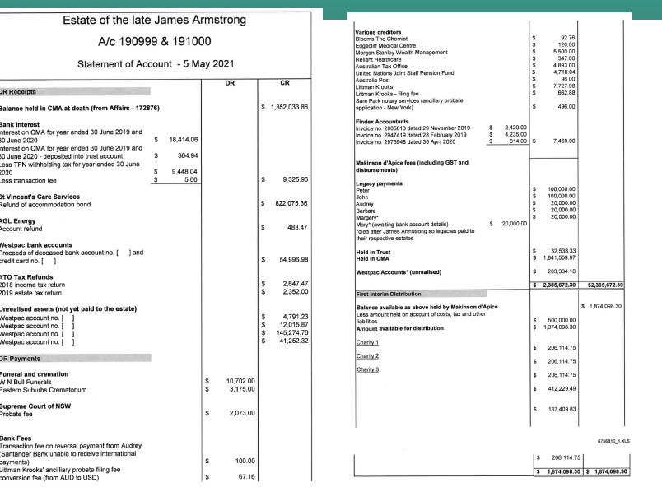
Read the will
Notes:
Ideal statement

Slide 33
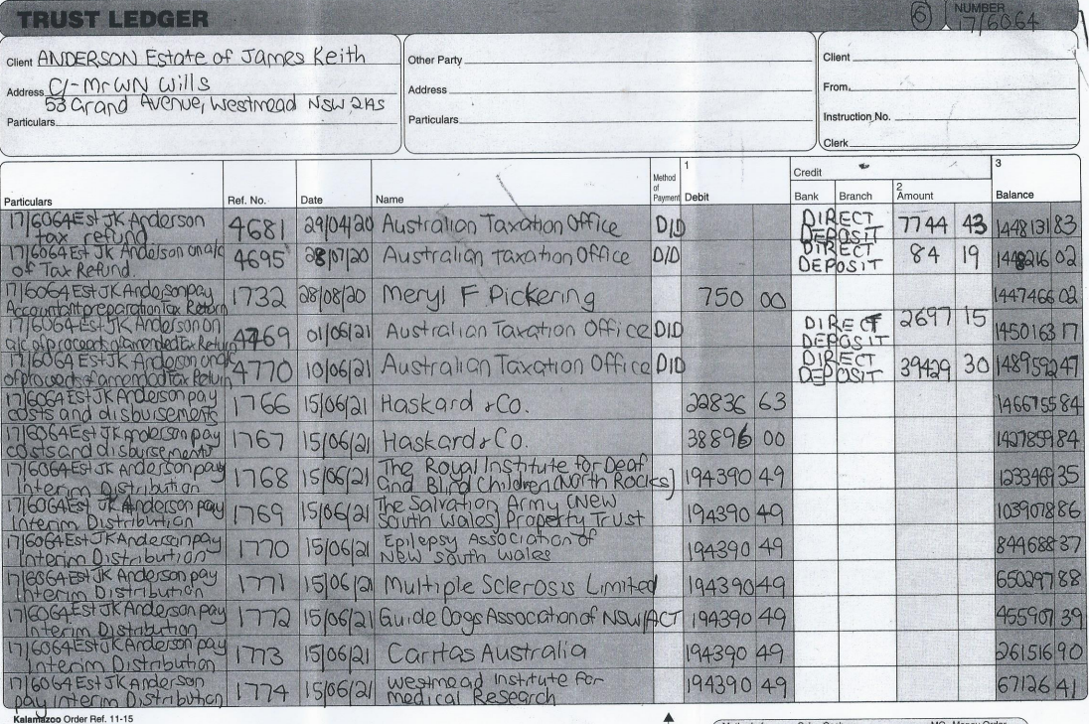
Read the will
Notes:
Not ideal statement

Slide 34

Pushing back and asking questions
Question anything you don’t understand
Do not assume it is correct
High fees - itemised invoices
Notes:
+ Don’t assume correct: commission charged without permission and missing assets

Slide 35

What if an executor/solicitor won’t supply documents?

Slide 36

Asking for documents
Different templates for different administrators
How many times will you ask?
Have a policy to back you up
Solicitors answer to solicitors

Slide 37
Tread carefully with lay executors
May be grieving
May not know you are entitled
May feel it’s an invasion of privacy
May not have files ready to send
Notes:
+ Remember you can get docs from the probate court

Slide 38

Why do beneficiaries need document?
Check gift restrictions
Check that you are the correct charity
Be ready for auditing
ALSO:
Forecast
Learn about bequestor
Who is executor?

Slide 39
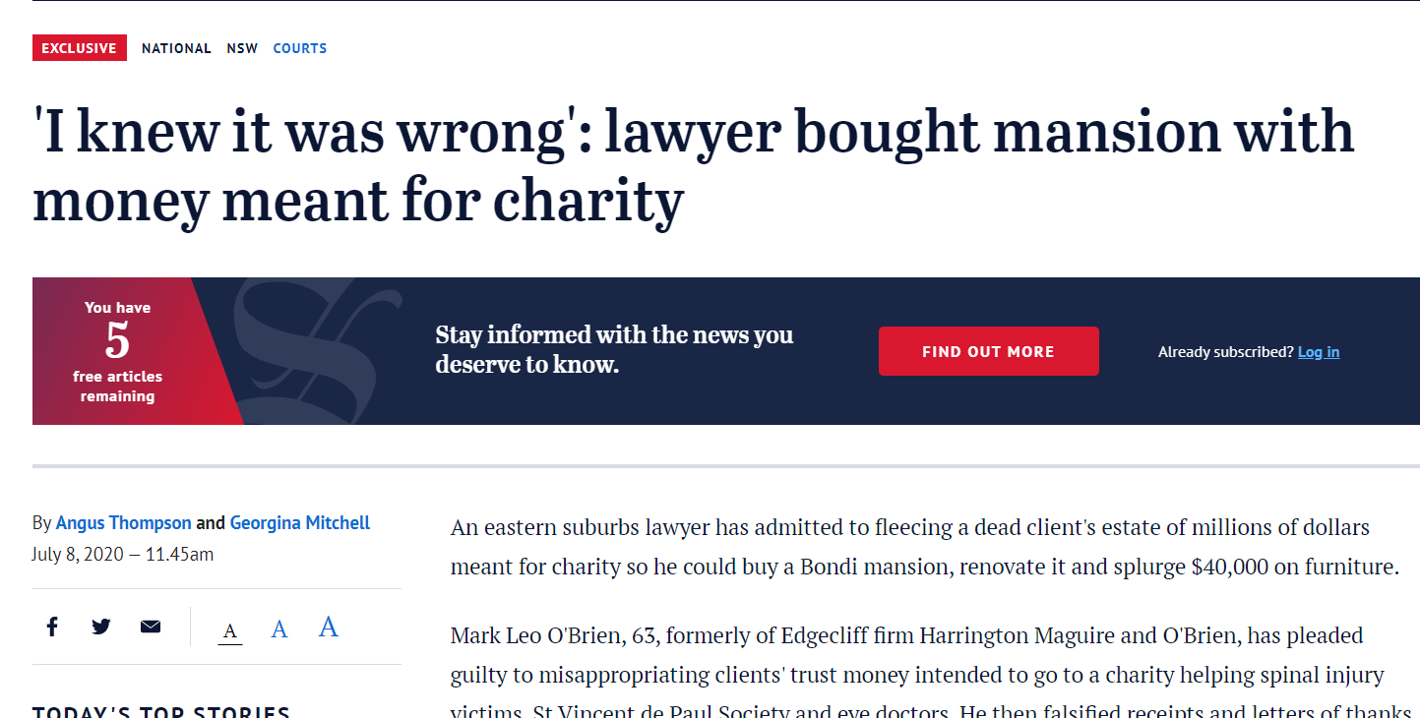
Why do beneficiaries need documents?
Notes:
Would never say to exec/solic – but you also need docs because people do the wrong thing
+ $15k actually residuary
+ $10k, actually $100k

Slide 40

When documents are missing or unclear:
Ask the estate solicitor
Contact other charities in the estate
Consult your friendly solicitor
Notes:
+ If you get a doc and things are unclear (complicated will, confusing asset list, long final statement) – ask questions. Don’t assume that all is good. People make mistakes and some solics/execs do the wrong thing.
+ The bequestor trusted you their wealth to further your cause so we owe it to them to raise the issue.
+ Don’t be bullied by solics that suggest you are the only charity asking for docs or asking questions. We have seen this happen when it was untrue and there was a genuine issue.
+ Seek support from a solic or talk to other charity co-beneficiaries. How do they interpret will or a certain charge?

Slide 41
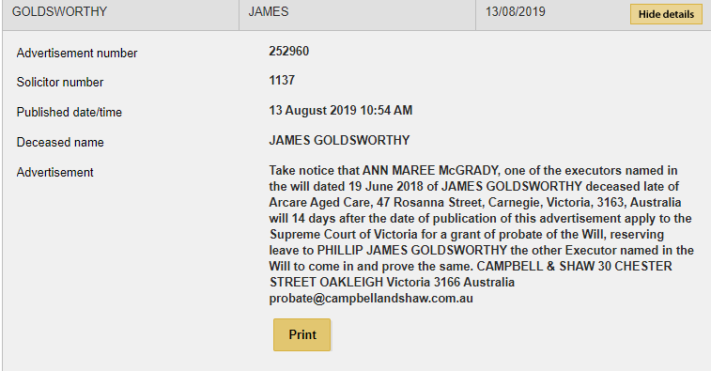
Information in probate
Probate date
Probate status
Date of death
Date of Will
Executor
Deceased address
Solicitor details
Notes:
+ If they won’t share docs, can still get a lot of info out of probate and you will need to search this if you want to purchase.

Slide 42
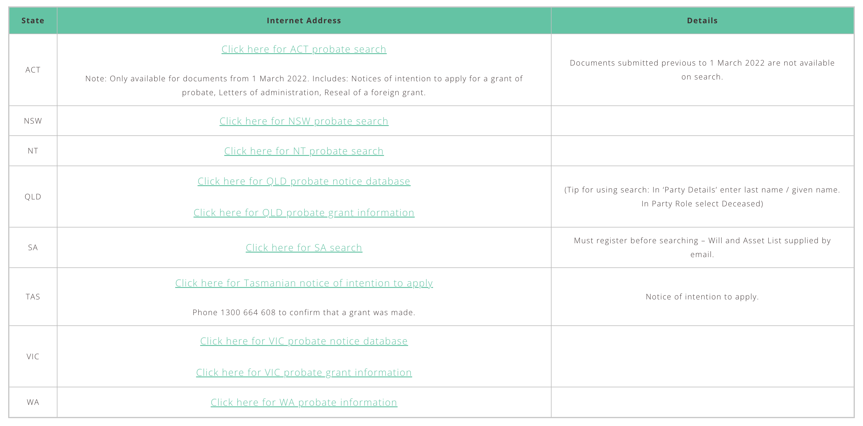
How do I search probate?
Notes:
Website is up to date and free. Go to info sharing then “online probate information”
In some states, search one database for notice and another for grant

Slide 43
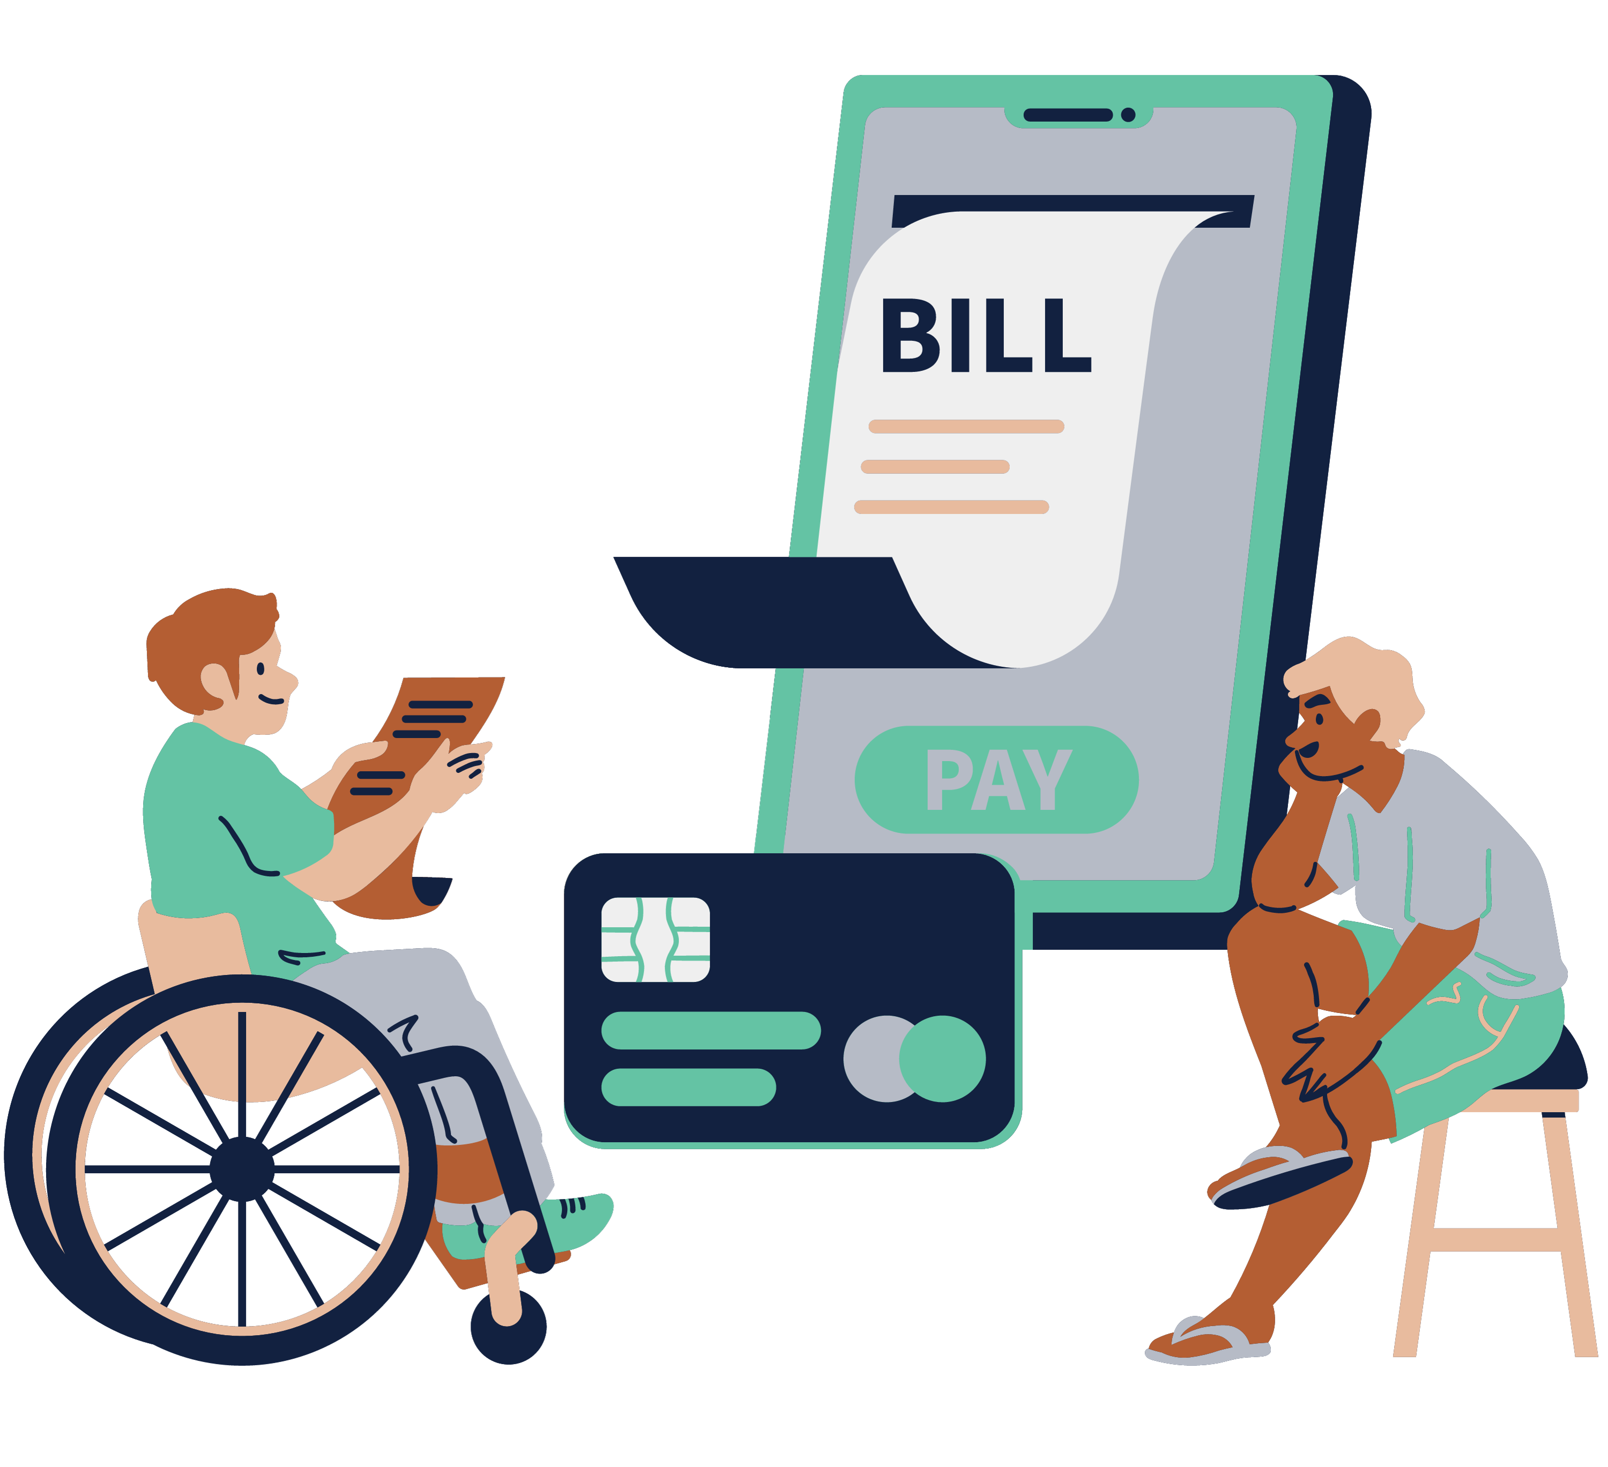
Obtaining documents from probate court:
Cost varies
No asset list in Qld
Check with co-beneficiaries first
Notes:
+ The cost varies, will is free in SA
+ No asset list in Qld
+ Check if co-beneficiaries have a copy first

Slide 44
Stay tuned!
Bequests Promised vs Bequests Realised 2024 research paper released in February
More Where There’s A Will webinars next year!

Slide 45
Questions?

