Slide 1
Donor Surveys That Work
Professor Russell James Texas Tech University

Slide 2
Socratic Fundraising in Bulk
Donor surveys that work
Professor Russell James
Texas Tech University

Slide 3
Asking questions
Sometimes face-to-face, one-on-one conversations aren’t feasible because of personnel, cost, time, volume, distance, etc.

Slide 4
Asking questions still
Donor telephone conversations (one-on-one but not face-to-face)
Donor focus groups (face-to-face but not one-on-one)
Donor surveys (neither one-on-one nor face-to-face)

Slide 5
Universal steps
Connect the donor’s identity (history, people, and values) with the cause, the charity, or the project [Original Identity → Challenge]
Define a personally meaningful victory [Victory → Enhanced Identity]
Make a challenge that promises the victory [Challenge → Victory]

Slide 6
Questions won’t work if people won’t answer
Justify asking questions:
I need your help or advice because
I’m new here
We have a problem
We have an idea
You’re in charge
You’re important
I can help or advise you
I’m interested in your story

Slide 7
If you don’t actually care, then don’t ask
Reasons must also appear legitimate
Don’t add a donation request to a survey
Don’t ask a question with a forced answer
“Should we continue our award-winning work that is transforming the lives of so many in desperate need?”

Slide 8
Connect with original identity
Questions can connect the donor’s identity (values, people, or life story) with the cause, charity, or project
The reason for asking can be because of the donor’s identity:
“Your insight is especially important because we need input from … [women, Baby boomers, loyal donors, alumni from the 80s, people who care about X, etc.]

Slide 9
Values identity questions (Environmental cause)
1) Zaval, L., Markowitz, E. M., & Weber, E. U. (2015). How will I be remembered? Conserving the environment for the sake of one’s legacy. Psychological Science, 26(2), 231-236.
Writing what they wanted to be remembered for by future generations increased donations to an environmental charity by 45%.¹
Reminders of values such as love or religious beliefs increased donations for other causes.²
2) Gueguen, N., & Lamy, L. (2011). The effect of the word “love” on compliance to a request for humanitarian aid: An evaluation in a field setting. Social Influence, 6(4), 249-258; Shariff, A. F., & Norenzayan, A. (2007). God is watching you: Priming God concepts increases prosocial behavior in an anonymous economic game. Psychological Science, 18(9), 803-809.

Slide 10
Learn something
Leaders at a charity focused on women’s reproductive rights in the developing world assumed the key value was women’s rights. Survey results revealed many donors cared only about population control.

Slide 11
Life story identity questions (environmental cause)
In one experiment, using the first two sets of questions increased donation likelihood for an environmental charity, especially for bequest gifts
At what age did you first begin to think about the importance of conserving the natural environment?
__ In childhood __ In high school __ In my 20s __ In my 30s or later
Comments:
Which of the following have been important in your life?
__ Time I have spent outdoors __ Time I have spent on a river
__ Time I have spent in a forest __ Time I have spent on a lake
__ My life experiences with wildlife __ My life experiences with wild birds
__ My life experiences with trees and plants
Comments:
When did you first learn about [org]? __ Within the last year __ Within the last five years __ Within the last ten years __ More than ten years ago

Slide 12
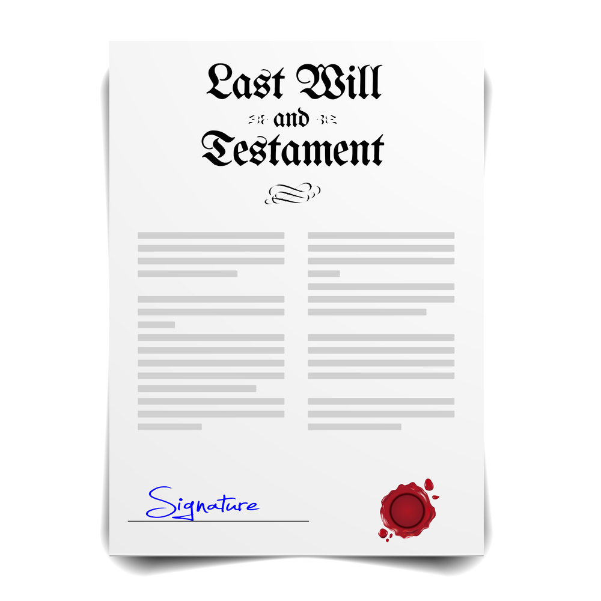
Life story connections are key for charitable bequests
A key result from interviews, neuroimaging, and phrasing experiments
Ex: The phrase “to support causes that have been important in your life” maximized interest in a bequest gift
James, R. N., III. (2016). Phrasing the charitable bequest inquiry. VOLUNTAS: International Journal of Voluntary and Nonprofit Organizations, 27(2), 998-1011; James, R. N., III., & O’Boyle, M. W. (2014). Charitable estate planning as visualized autobiography: An fMRI study of its neural correlates. Nonprofit and Voluntary Sector Quarterly, 43(2), 355-373; Routley, C., & Sargeant, A. (2015). Leaving a bequest: Living on through charitable gifts. Nonprofit and Voluntary Sector Quarterly, 44(5), 869-885.

Slide 13
Learn something
Answers are a great starting point for follow up questions (“Tell me more …”)
Messaging might be informed by knowing that donations were most likely for those noting “life experiences with wild birds,” and least likely for those referencing time “spent on a lake.”

Slide 14
People identity questions (environmental cause)
First two questions also link to later question about honoring a family member with a gift in a will
Answers are great starting point for follow up questions (“Tell me more …”)
Do you have more or less than two family members who consider conserving the natural environment to be important?
__ About 2 __ More than 2 __ Less than 2
Were there any family members in your life who were particularly influential in shaping your views on the importance of nature conservation?
__ Grandmother __Grandfather __ Aunt __Uncle __Mother __Father __Sibling __Other family member
Comments:
We love to recognize our outstanding team members at [org]! Please share any memorable experiences you’ve had with anyone you’ve met at [org]. Comments:

Slide 15
Identity questions: Nudge towards more positive answers
The most negative answer might be “probably not” or “unlikely,” but omit “definitely not” or “never”
The lowest group is “less than 2,” omitting the “none” response
Relationship started within the last year, five years, or ten years are not exclusive categories: Uncertainty nudges towards “safer” answer of longer category

Slide 16
Victory questions (environmental cause)
Help the donor define a personally meaningful victory with a “victory menu”
On a scale from 0 = Absolutely no importance to 100 = Absolutely the greatest importance, please rate the importance of the work of [org] in the following areas
___ Environmental conservation
___ Preserve wetlands for wild ducks and other migrating birds
___ Protect and restore ancient sequoia and redwood forests in the U.S.
___ Protect sensitive coral reefs around the globe

Slide 17
Victory questions (all causes research)
One experiment tested ten charities from five causes with three projects per cause. Average giving likelihood was:
14% when reading about causes
15% when reading about causes and projects
19% when rating the importance of causes
21% when rating the importance of causes and projects
James, R. N., III. (2018). Increasing charitable donation intentions with preliminary importance ratings. International Review of Public and Nonprofit Marketing, 15(3), 393-411.

Slide 18
Victory questions (environmental cause)
Using the cause and 3 projects below, donation likelihood to The Nature Conservancy [or World Wildlife Fund] was
11% [or 13%] when reading about causes
12% [or 13%] when reading about causes and projects
15% [or 16%] when rating causes
18% [or 19%] when rating causes and projects
On a scale from 0 = Absolutely no importance to 100 = Absolutely the greatest importance, please rate the importance of the work of [org] in the following areas
___ Environmental conservation
___ Preserve wetlands for wild ducks and other migrating birds
___ Protect and restore ancient sequoia and redwood forests in the U.S.
___ Protect sensitive coral reefs around the globe

Slide 19
Victory questions (university)
A) “Annual alumni giving through the Penn Fund directly supports these priorities of undergraduate education.
🗹 Student financial aid
🗹 Student and academic life
🗹 Residential life
🗹 Special campus initiatives”
“Rich”: $192 avg; “Powerful”: $158 avg
B) Remove the checks from the boxes and add, “Tell us which is most important to you. (Please check one box)”
“Rich”: $463 avg; “Powerful”: $714 avg
Kessler, J. B., Milkman, K. L., & Zhang, C. Y. (2019). Getting the rich and powerful to give. Management Science, 65(9), 4049-4062, Table 1.

Slide 20
Questions can turn a victory into the donor’s victory
First giving people the chance to vote on a project increases donations and volunteering
Describing a potential victory as important can help but asking works better than telling
Mertins, V., & Walter, C. (2021). In absence of money: a field experiment on volunteer work motivation. Experimental Economics, 1-33; Zarghamee, H. S., Messer, K. D., Fooks, J. R., Schulze, W. D., Wu, S., & Yan, J. (2017). Nudging charitable giving: Three field experiments. Journal of Behavioral and Experimental Economics, 66, 137-149.

Slide 21
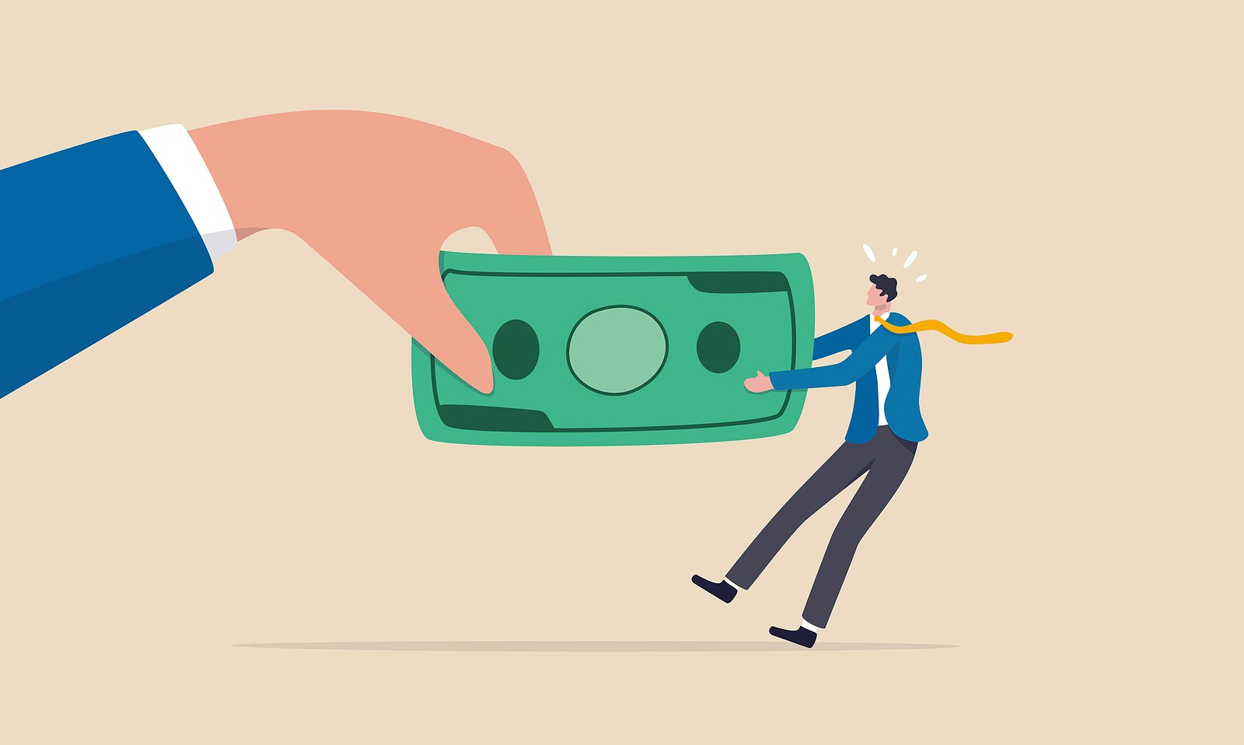
Challenge questions: Theory
Problem: A survey shouldn’t ask for an immediate donation. (Doing this can de-legitimize the questions.)
Solution: The goal is to get the donor to predict a gift. It’s still in the realm of opinion gathering, but it’s surprisingly powerful.

Slide 22
The “Question-Behavior Effect” (QBE)
People are less likely to do a pro-social act if asked than to predict they will do it, but once people predict they will act, they then change their future behavior to match their prediction

Slide 23
Asking for the prediction first increases pro-social behavior
In experiments, this works with:
Blood donations
Volunteering
Voting
Recycling
Buying environmentally friendly products
Charitable donations
Godin, G., Germain, M., Conner, M., Delage, G., & Sheeran, P. (2014). Promoting the return of lapsed blood donors: A seven-arm randomized controlled trial of the question–behavior effect. Health Psychology, 33(7), 646-655; Godin, G., Sheeran, P., Conner, M., & Germain, M. (2008). Asking questions changes behavior: Mere measurement effects on frequency of blood donation. Health Psychology, 27(2), 179-184. Sherman, S. J. (1980). On the self-erasing nature of errors of prediction. Journal of Personality and Social Psychology, 39(2), 211-221; Spangenberg, E. R., Sprott, D. E., Grohmann, B., & Smith, R. J. (2003). Mass-communicated prediction requests: Practical application and a cognitive dissonance explanation for self-prophecy. Journal of Marketing, 67(3), 47-62. Greenwald, A. G., Carnot, C. G., Beach, R., & Young, B. (1987). Increasing voting behavior by asking people if they expect to vote. Journal of Applied Psychology, 72(2), 315-318. Sprott, D. E., Spangenberg, E. R., & Perkins, A. W. (1999). Two more self-prophecy experiments. In E. J. Arnould & L. M. Scott (Eds.), NA - Advances in Consumer Research: Vol. 26 (pp. 621-626). Association for Consumer Research; Bodur, H. O., Duval, K. M., & Grohmann, B. (2015). Will you purchase environmentally friendly products? Using prediction requests to increase choice of sustainable products. Journal of Business Ethics, 129(1), 59-75; Obermiller, C., & Spangenberg, E. (2000). Improving telephone fundraising by use of self-prophecy. International Journal of Nonprofit and Voluntary Sector Marketing, 5(4), 365-372.

Slide 24
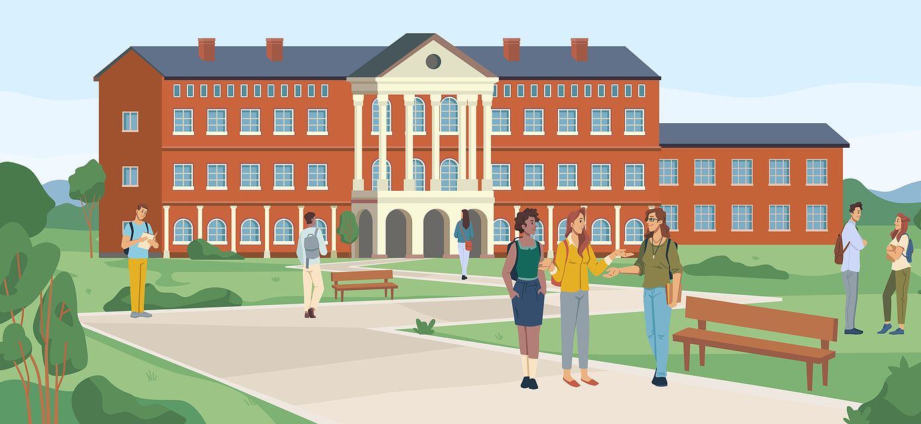
QBE Experiment
Asking “If you were contacted by your high school or college and asked to donate money, would you do so?” a few days before a fundraising request increased the share donating to their college by half
Obermiller, C., & Spangenberg, E. (2000). Improving telephone fundraising by use of self-prophecy. International Journal of Nonprofit and Voluntary Sector Marketing, 5(4), 365-372.

Slide 25
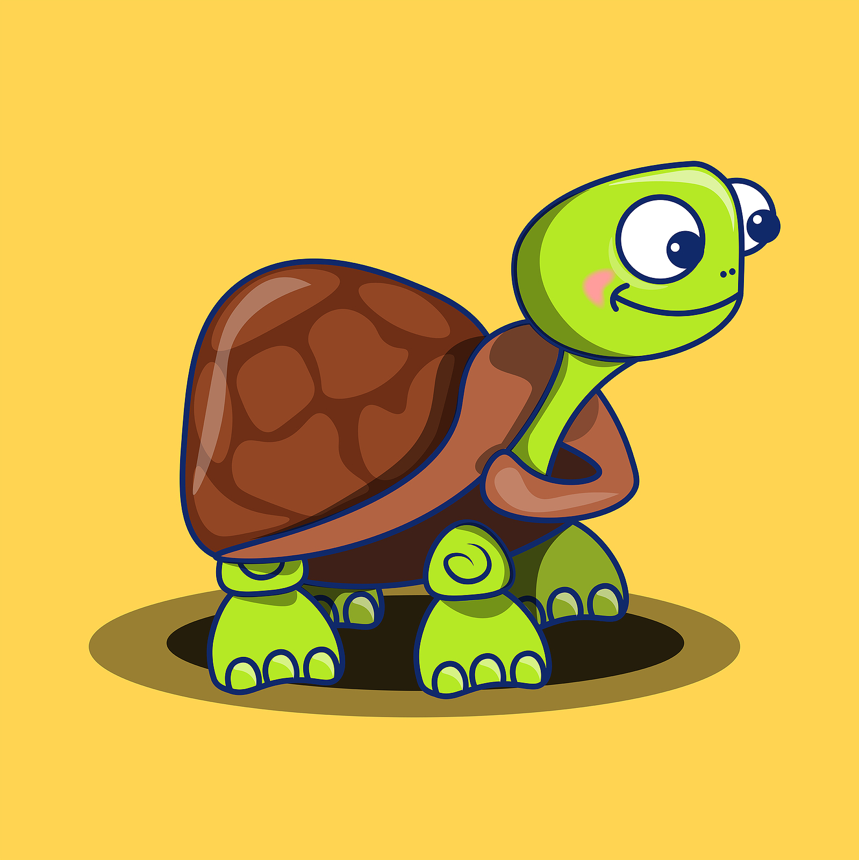
QBE Experiment
First asking how much people would “hypothetically” donate to a project increased actual donation 43% for a project helping turtles and 25% for one helping elephants.
Johansson-Stenman, O., & Svedsäter, H. (2008). Measuring hypothetical bias in choice experiments: the importance of cognitive consistency. The BE Journal of Economic Analysis & Policy, 8(1), 1-10, 6

Slide 26
Goal: Get a positive donation prediction
QBE shows that people tend to change their behavior to match their predictions
Lead-up questions showing identity connections and defining a meaningful victory can increase the giving prediction
So, the gift prediction should come towards the end of the survey

Slide 27
Many people who care about this cause like to give in different ways. How likely is it that you would consider any of the following gifts in the next six months? |  |  |  | Have already done so | Would like more info
Gift by volunteering time
Gift by check or credit card
Gift as an automatic monthly withdrawal
Gift in a will (if you happened to sign a new will)
Gift in a will in honor or memory of a loved one
Gift that pays you income for life
Gift of stocks, bonds, or mutual funds that avoids taxes
Gift of real estate that avoids capital gains taxes
Gift from an IRA/401(k) that avoids income taxes
Definitely
Somewhat likely
Unlikely
Challenge question examples

Slide 28
Challenge questions: Introduction
[Social norm statement] “Many people who care about this cause like to give in different ways.”
“People like me do things like this” is a powerful message.
In experiments, adding that they “like to” do it is even more powerful. Adding that they “care about” the cause helps, too.
James, R. N., III. (2016). Phrasing the charitable bequest inquiry. VOLUNTAS: International Journal of Voluntary and Nonprofit Organizations, 27(2), 998-1011.

Slide 29
Challenge questions: Introduction
Armitage, C. J., Norman, P., Alganem, S., & Conner, M. (2015). Expectations are more predictive of behavior than behavioral intentions: Evidence from two prospective studies. Annals of Behavioral Medicine, 49(2), 239-246, 240.
[Prediction request] “How likely is it that you would consider any of the following gifts in the next six months?”
In experiments, asking, “how likely is it that you will do X” influences behavior more than asking if a person “intends to” act
It’s soft and easy. It’s an opinion, not a pledge (“might consider”). It’s about the future (“in the next six months”).

Slide 30
Challenge questions: Volunteering
In one experiment, first asking about volunteering led to a 50% increase in donation intentions
Volunteering questions trigger a social-emotional mindset which then encourages donations
Liu, W., & Aaker, J. (2008). The happiness of giving: The time-ask effect. Journal of Consumer Research, 35(3), 543-557.

Slide 31
Challenge options: Check, credit card, automatic withdrawal
Beginning with an easy answer creates inclusion in the group
The donor is the kind of person who makes gifts “like these.”
Next moves to the simplest upgrade – the automatic monthly donor
For some great examples of follow up for the monthly donor, see The Monthly Giving Communications Template Kit by DonorPerfect at https://uploads.donorperfect.com/pdf/monthly-giving-template-kit.pdf

Slide 32
Challenge options: Bequest
Requests that “lead with death” have low response rates
The survey “buries” the “death” question
The list starts with the most familiar ways to give
The estate gift is in the middle of the list, worded just the same as every other gift
It’s just another way to give

Slide 33
Estate-focused survey? Use permanence language!
Wade-Benzoni, K. A., Tost, L. P., Hernandez, M., & Larrick, R. P. (2012). It’s only a matter of time: Death, legacies, and intergenerational decisions. Psychological Science, 23(7), 704-709.
Describing a charity as “Creating lasting improvements that would benefit people in the future” rather than “Meeting the immediate needs of people” normally reduced donations, but it more than doubled gifts for those reminded of their mortality
Use permanence language: “protect” becomes “Lasting protection,” “Permanently protect,” “Protect forever,” or “Protect for future generations”

Slide 34
Challenge options: Memorial bequest
In one experiment, mentioning this option increased interest in an estate gift for about one out of four people

Slide 35
Challenge options: A survey can teach!
It can ask about a “gift that pays you income for life,” a gift of inheritance rights (house or farmland) with an immediate income tax deduction, a named scholarship fund, a lectureship, an endowed professorship, a virtual endowment, etc.
Curiosity leads to conversations

Slide 36
Challenge options: IRA Gifts
1. Heirs inheriting any amount of IRA money pay income taxes on it but leaving to charity avoids these taxes.
2. Donors over age 70½ can give directly from their IRA. (At 72+ this also offsets required distributions.)

Slide 37
Challenge options: Asset gifts & taxes
James, R. N., III. (2018). Describing complex charitable giving instruments: Experimental tests of technical finance terms and tax benefits. Nonprofit Management and Leadership, 28(4), 437-452, 447.
The final three questions lead with tax benefit. In one experiment, only 14% were “interested now” in pursuing a gift described as,
“Make a gift of stocks or bonds to charity.”
This increased to 20% when it was described as,
“Avoid capital gains tax by making a gift of stocks or bonds to charity”

Slide 38
Challenge options: Asset gifts & taxes
In one study of over 5,000 people, the share “definitely” or “might be” interested in reading more was:
16% for “Giving stocks”
16% for “Giving stocks, bonds, or real estate”
24% for “Avoiding capital gains taxes by giving stocks”
28% for “Avoiding taxes by giving stocks”

Slide 39
Challenge options: Gifts of assets
Asset gift questions reveal capacity because a person wanting information about gifts of real estate, stocks, or bonds likely has these available to give
Just reminding people of their wealth (assets) triggers a larger reference point and increases giving

Slide 40
Challenge answers: What’s missing
There isn’t a hard “no” option, just “unlikely.” Predictions are powerful. We don’t want donors committing to a hard “no.”
There isn’t a “don’t know” option. Forcing a choice requires more thinking about gifts of assets.
A “don’t know” doesn’t invite follow up, but a “somewhat likely” does

Slide 41
Challenge answers: “Have already done so”
We want this information about the gift in a will. Including it for all gifts prevents the will question from standing out.
Answering yes to initial questions (check, credit card) creates inclusion: “I am the type of person who makes gifts like these.”

Slide 42
Survey outcomes: Follow up
A donor might check, “Would like more information” or “Definitely” or “Somewhat likely” for an asset gift
These give a reason for a follow-up contact
This can lead to permission to present options (i.e., to make the ask)

Slide 43
Follow up phone call: 1. Thank you / reminder
1
“Hello Sara? Hi, this is [name] from [charity]. Don’t worry, I’m not calling to ask for a gift today. I wanted to thank you for your years of support of [cause]. Your gifts have really made a difference for [beneficiaries].”
“Also, I wanted to thank you for completing our survey a few days ago. This really helps our leadership. It’s important for them to know what matters to loyal donors like you. So, thanks for that!” …

Slide 44
Follow up phone call: 2. Tell me more / I help donors
2
“I also wanted to follow up with you on one thing. You mentioned in the survey that you [would like more information about / might be considering] a gift [of real estate / of stocks, bonds, or mutual funds / from an IRA]. I work with many donors like you who’ve made these types of gifts. The extra tax benefits really make it a smarter way to give. Would you mind telling me if anything in particular prompted you to [request that information / consider this type of a gift]?”…

Slide 45
Follow up phone call: 3. Can I show you some options?
“I’d love to share some examples of what others like you are doing. I think you’ll find some of the options interesting. This can also help with your giving to other causes, not just ours. I’ll be in your area next Tuesday. Would your calendar allow us to meet at 2pm?”…
3

Slide 46
Follow up phone call: 4. Details?
“Great! I’ll put together some options for you. Before we meet, is there anything you want me to know about the [real estate / investments / IRA]? I know sometimes there are special issues with [property / certain types of investments].”
4

Slide 47
Survey outcomes: Follow up conversations
Follow up conversations can lead to permission to present options
This soft proposal gives examples of smart gifts and shows their impact in the areas most important to the donor (shown in the survey)

Slide 48
Survey outcomes: Follow up calculations
Good follow up can’t work with big mailings
How many follow up contacts can you make in a short time?
Divide this by the expected response rate then divide by the expected share of surveys with positive answers to key questions
Ex: (50 follow-up calls / .12 response rate) / .20 positive answers = 2,083 surveys MAX

Slide 49
Survey outcomes: Teach something about the donor
Questions can help a donor learn something about herself
They can help the donor to connect her values, people, and history with the charity and to define a personally meaningful victory
This personal discover process can increase interest in giving

Slide 50
Survey outcomes: Teach something about the charity
Rating the importance of a project requires learning about it
“I didn’t know they protected coral reefs, too.”
“I didn’t know they had conservation centers. Maybe I should visit?”

Slide 51
Survey outcomes: Teach something about giving
I didn’t know that other people …
Save taxes by making gifts of stocks or real estate
Make estate gifts in memory of a loved one
Make gifts that pay them
income
Avoid taxes by making gifts from an IRA
Rating the likelihood of making a gift requires thinking about it

Slide 52
Survey outcomes: Teach something by asking for guidance
“Please compare the two stories and select which of the two stories made you feel the following.
Made me value the work of [charity] even more.
Increased my connection to the cause.
Moved me emotionally.”
Davis, L. & Biles, S. (2019, February 28-March 1). Reinventing an established gifts in wills program. [Slide deck]. Fundraising Institute of Australia Conference 2019, Melbourne, Australia.

Slide 53
Survey outcomes: Teach something by asking for guidance
“It would be most helpful to me if when you read the booklet you note how it’s written. Do you like the style? Are the examples clear? Do you have any suggestions on how we might improve it?”
Which of these ads about giving stocks do you think others will find most compelling?
Ciconte, B. L. & Jacob, J. G. (2009). Fundraising basics: A complete guide. Jones & Bartlett Learning. p. 421.

Slide 54
Survey outcomes: Teach something by asking for guidance
“We need your help! Estate gifts have always been critical for [this charity]. But this is a sensitive topic. So, we need your advice. We’re considering using one of these two brochures. Would you share your thoughts by answering a few questions about them?”

Slide 55
Survey outcomes: Timely reminders
Being “top of the mind” is particularly important for rare event gifts such as before the sale of stocks or real estate or the drafting a new will
A survey can remind donors of these gift ideas and sometimes the reminder will come at just the right time

Slide 56
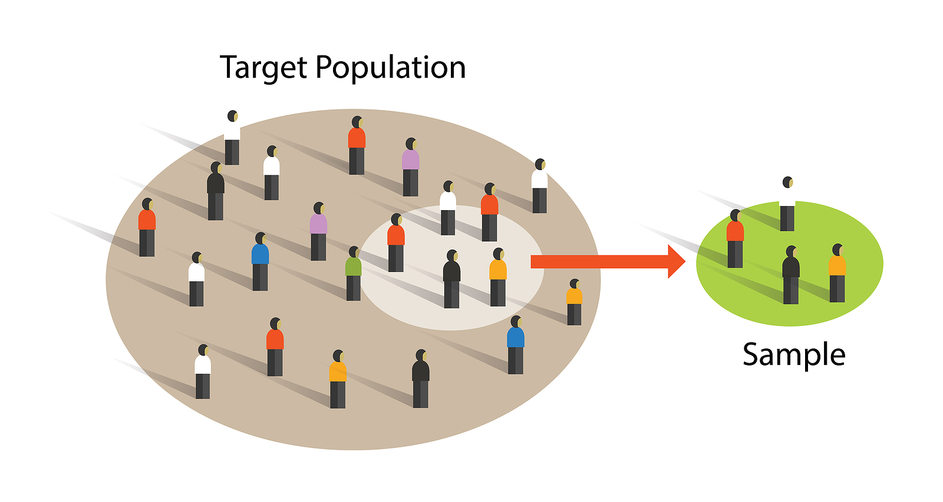
Survey outcomes: Learn something
First, a warning: This isn’t survey research, it’s Socratic fundraising.
“A good [donor] survey is not about information. It’s about self-reflection. It’s a conversation on paper.”
-Aimée Lindenberger
Lindenberger, A. (2019, March 31). Why your donor doesn’t want to meet and what you can do about it. [Slide deck]. AFP ICON 2019, San Antonio, TX. Slide 23.

Slide 57
Survey outcomes: Learn something
These are persuasive surveys. The responses are intentionally biased. This means relative levels will be more meaningful.
How does interest in project X compare with project Y or Z?
Relative increases in estate gift interest reflect progress.

Slide 58
Survey outcomes: Learn something
Appeal letters can test words and phrases for small gifts, but this is harder for major gifts of assets
A survey can help because phrases or questions that increase predictions will also tend to increase donations

Slide 59
Other survey issues: Print or online?
The online survey is the cheapest
Reaching more people requires more channels
Ex: Mailing to the online non-responders then calling the online and mail non-responders

Slide 60
Other survey issues: How long should it be?
Some donor surveys use just a few questions. (An appeal reply card might add just one or two.) Others are several pages long.
Which is better? It’s a tradeoff.

Slide 61
When more is better
One experiment used some of the previous questions about the donor’s (1) people, (2) values, and (3) life story connections
Using all three types worked better than using any one or two alone
3>2
3>1

Slide 62
When more is better
Another experiment found reading seven planned gift donor stories worked better than reading four, which worked better than reading none
7>4
4>0
James, R. N., III., & Routley, C. (2016). We the living: the effects of living and deceased donor stories on charitable bequest giving intentions. International Journal of Nonprofit and Voluntary Sector Marketing, 21(2), 109-117.

Slide 63
When more is better
In experiments, triggering more expressions of an attitude increases commitment to the underlying belief and also actions that match those beliefs
Descheemaeker, M., Spruy, A., Faxio, R. H., & Hermans, D. (2017). On the generalization of attitude accessibility after repeated attitude expression. European Journal of Social Psychology, 47, 97-104; Downing, J. W., Judd, C. M., & Brauer, M. (1992). Effects of repeated expressions on attitude extremity. Journal of Personality and Social Psychology, 63(1), 17-29; Holland, R. W., Verplanken, B., & van Knippenberg, A. (2003). From repetition to conviction: Attitude accessibility as a determinant of attitude certainty. Journal of Experimental Social Psychology, 39(6), 594-601.

Slide 64
The tradeoff: The longer the survey, the less likely it is to be completed
But “length” here isn’t just about page numbers or word count
It’s about how easy it feels to take the survey
Simple words, short sentences, and active verbs help
So does attractive design
Rolstad, S., Adler, J., & Rydén, A. (2011). Response burden and questionnaire length: is shorter better? A review and meta-analysis. Value in Health, 14(8), 1101-1108.

Slide 65
Attractive design increases response rates
One study showed the positive effects of
“Use of accent color.
Additional navigation cues to call out section headings.
More than one blank line between survey questions.
White space between survey question-response option block is larger than white space between a survey question and response options associated with the question.
One or more blank lines between end of survey question and start of response options.
A line or other demarcation between columns of survey questions.
Visible or extra white space on the survey page”
Burkhart, Q., Orr, N., Brown, J. A., Hays, R. D., Cleary, P. D., Beckett, M. K., ... & Elliott, M. N. (2021). Associations of mail survey length and layout with response rates. Medical Care Research and Review

Slide 66
Attractive design increases response rates
Most of these increase the physical length of the survey, but they make it feel easier and inviting
These increased responses the most from the oldest respondents
Burkhart, Q., Orr, N., Brown, J. A., Hays, R. D., Cleary, P. D., Beckett, M. K., ... & Elliott, M. N. (2021). Associations of mail survey length and layout with response rates. Medical Care Research and Review

Slide 67
Conclusion
Asking questions is powerful. It might start with a social conversation, a formal campaign feasibility study, a focus group, a phone survey, or a paper or electronic survey, but the steps are the same.
Appreciative inquiry is compelling. Socratic fundraising works.

Slide 68
Socratic Fundraising in Bulk
Donor surveys that work
Professor Russell James
Texas Tech University

Slide 69
Be part of the movement
www.includeacharity.com.au

