Slide 1
Affairs of the Heart:
Where does family fit into the bigger picture
John McLeod
JBWere Family Advisory and Philanthropic Services

Slide 2
It’s a simple formula
Number of people passing away
What were their net assets
How much was left for charitable causes
Amount left to charity

Slide 3
Annual deaths are rising
The number of annual deaths has doubled over the last 60 years
It will double again in another 50 years
Numbers then plateau by 2090
Others such as the UK and New Zealand are further along this trajectory

Slide 4
The value of inheritances is rising even faster
The rising value of inheritances is compounded by increasing death numbers and growing asset values
Over $150 Billion will transfer this year alone, just below the total charity sectors income
This rises to over $1 Trillion annually by 2062 and a total of $5.4 Trillion is expected to transfer over the next 20 years

Slide 5
The one part of the formula that isn’t working well enough
Charities receive just 1% of these inheritances, well below the 4-5% seen in the US and UK

Slide 6
But it is happening at the very top levels of giving
Of the 50 largest donors in Australia, 22 are now deceased
This is a combination of Foundations established during their lifetime and large one off bequests
It mirrors a larger % of big estates giving to charity in the US and UK

Slide 7
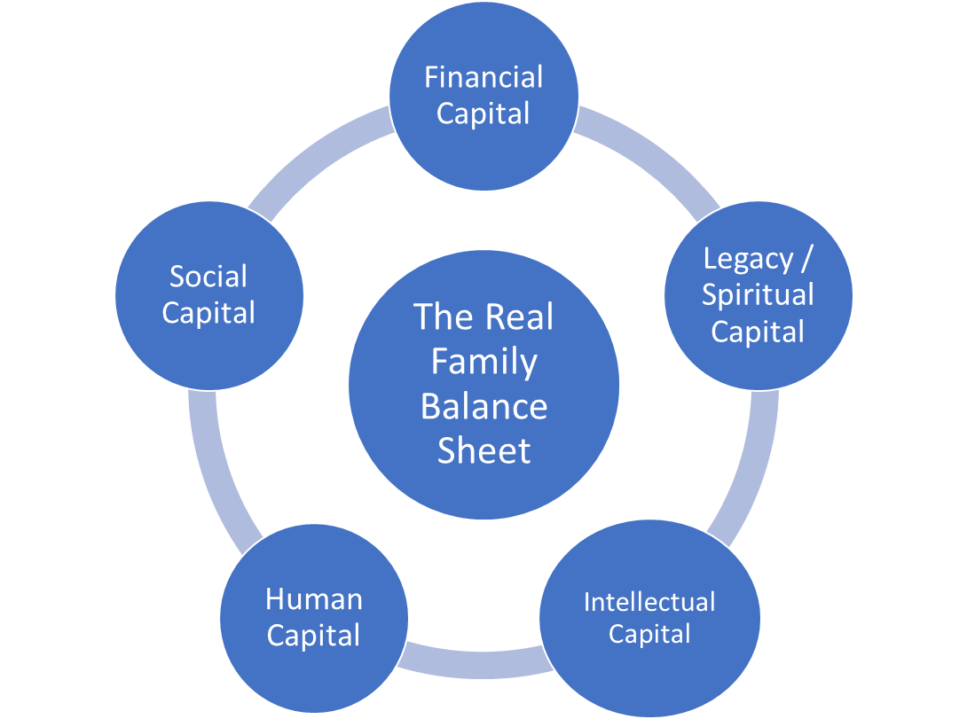
Transferring more than assets
What do we value as individuals and as a family?
What unifies the family?
What does our shared vision look like?
How do we integrate and empower our rising generation?
Where will conflict lie, and how to build structure around it?

Slide 8
What do people want to pass on?
We all know the Warren Buffett line …
We are seeing more clients raising these issues and acting on them
Most desire not having family values stop with them and the way wealth transfer is handled can guide the pursuit of purpose for the next generation
Putting in place broader society support through inheritance can be the common thread that stitches future generations together
Not having a plan almost ensures conflict and having one but not communicating it risks conflict – PLAN & COMMUNICATE

Slide 9
Even for those just wanting to maintain generational wealth
Studies (Uni. Of Adelaide) show families involved in community support, maintained wealth better through generations
Practical learning in business, financials and investments for kids
Develop longer term thinking and alignment of values
Younger generations demonstrate leadership skills and develop relationships beyond the normal circle
A psychological boost and a builder of emotional intelligence

Slide 10
Thoughts for GiW professionals …
Many are already thinking about legacy, they just haven’t linked that to GiW’s
How to raise topic, they probably haven’t considered it (not said no)
The female voice. Life expectancy is 4 years higher for females widening that gap over time. The oldest daughter is 50% more likely to control family inheritances than the oldest son
Focus on the wealthy

Slide 11
… more thoughts
Involve family early and often. They’ll still hold 90%+ of the wealth
…and if the US trend of adding to existing Foundations grows here, they will be guiding them
Don’t ignore your asset rich but income poor volunteers
Use their peers who are confirmed bequestors
Do your research about the family dynamics, they are all different

Slide 12
Why this is important
If nothing changes we’ll go from $1.5B to $4B in GiW’s over 20 years
If we can normalize this action, the return is the single largest increase in charitable giving available to the sector
Groundwork and preparation is needed for an increased focus on inheritance tax
Focus on the opportunity you are providing to the potential donor. It’s a positive about legacy, not a negative about mortality

