Slide 1
Closing the loop: Monitoring whether your GIW pipeline eventuates
Morgan Koegel – Managing Director, Bequest Assist
Notes:
+ Acknowledgement
+ Intro self and BA
+ So much work goes into acquisition and retention: we’re going to talk about the final piece of the puzzle being what should be done after someone from your GIW pipeline passes away

Slide 2
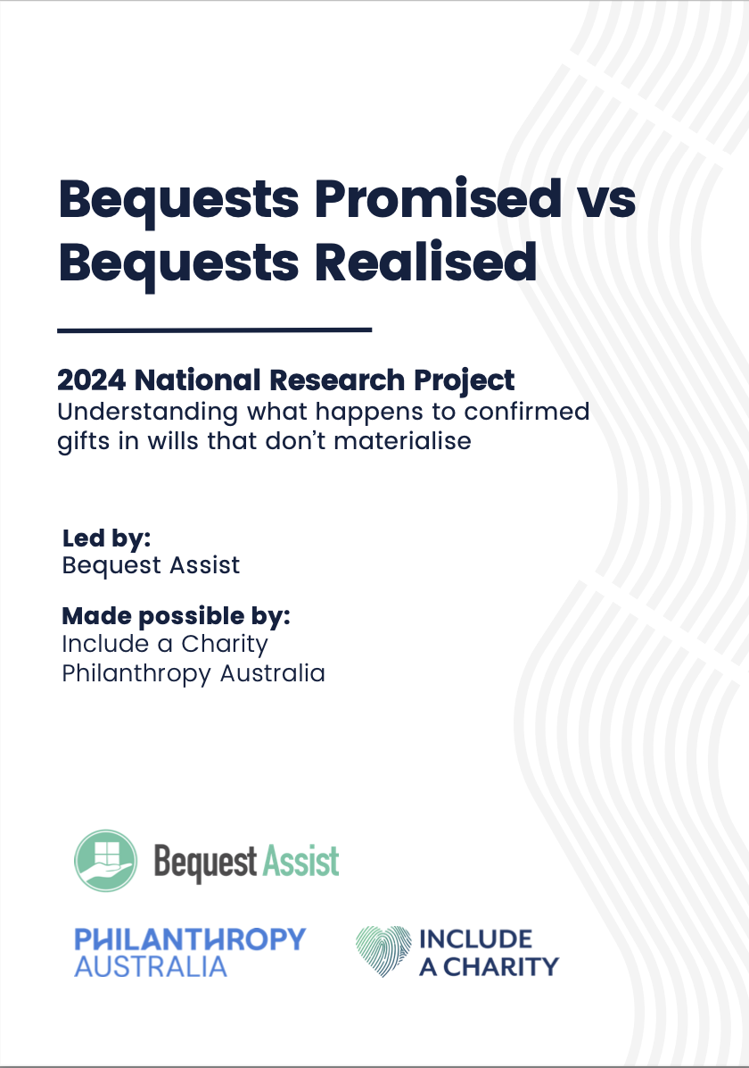
Notes:
+ What I’m speaking about based on this report – made possible by IAC, PA and 27 participating charities
+ Research into confirmed bequests that never materialized
+ Can charities rely on their “confirmed bequestor pipeline? How big of a problem are missing gifts? (where charity never notified or paid)

Slide 3
Summary of findings
Majority of the time, no gift for charity
Approx 45% of the time, left ONLY to individuals
2.8% of the time = missing gift
Most charities are not ”closing the loop”
Messy data is holding charities back from doing this work

Slide 4
What does closing the loop mean?
Identify the accuracy of your GIW pipeline
Check if confirmed gifts materialise
Prevent missing gifts
Take learnings back to living pipeline
Notes:
Story: had long relationship with Janet, confirmed multiple times, invested time/money into cultivating, Janet died, marked record as deceased and that was it. This project happened 7 years later- looked into it and there WAS a gift for charity in the Will that the executor did not pay.
In the same way that not all acquisition and retention work pays off, not all checking on potential bequests will pay off – but the charity needs to make a decision and have a process.

Slide 5
Steps to take pre-death
Take a critical eye to your GIW pipeline
Define and educate whole team about pipeline definitions
Draw distinction between unqualified and qualified confirmed bequestors
Take good notes
Consider data retention risks

Slide 6
Who becomes a bequestor?
Only 1/3rd of bequests come from confirmed bequestors
Lifetime giving ability not indicative of bequest capacity
Biggest factor = lack of immediate family

Slide 7
Steps to take post-death
Consider using the Australian Death Check
Procedure for tracking promised gifts
Which records should you check?
Relationships with spouses

Slide 8
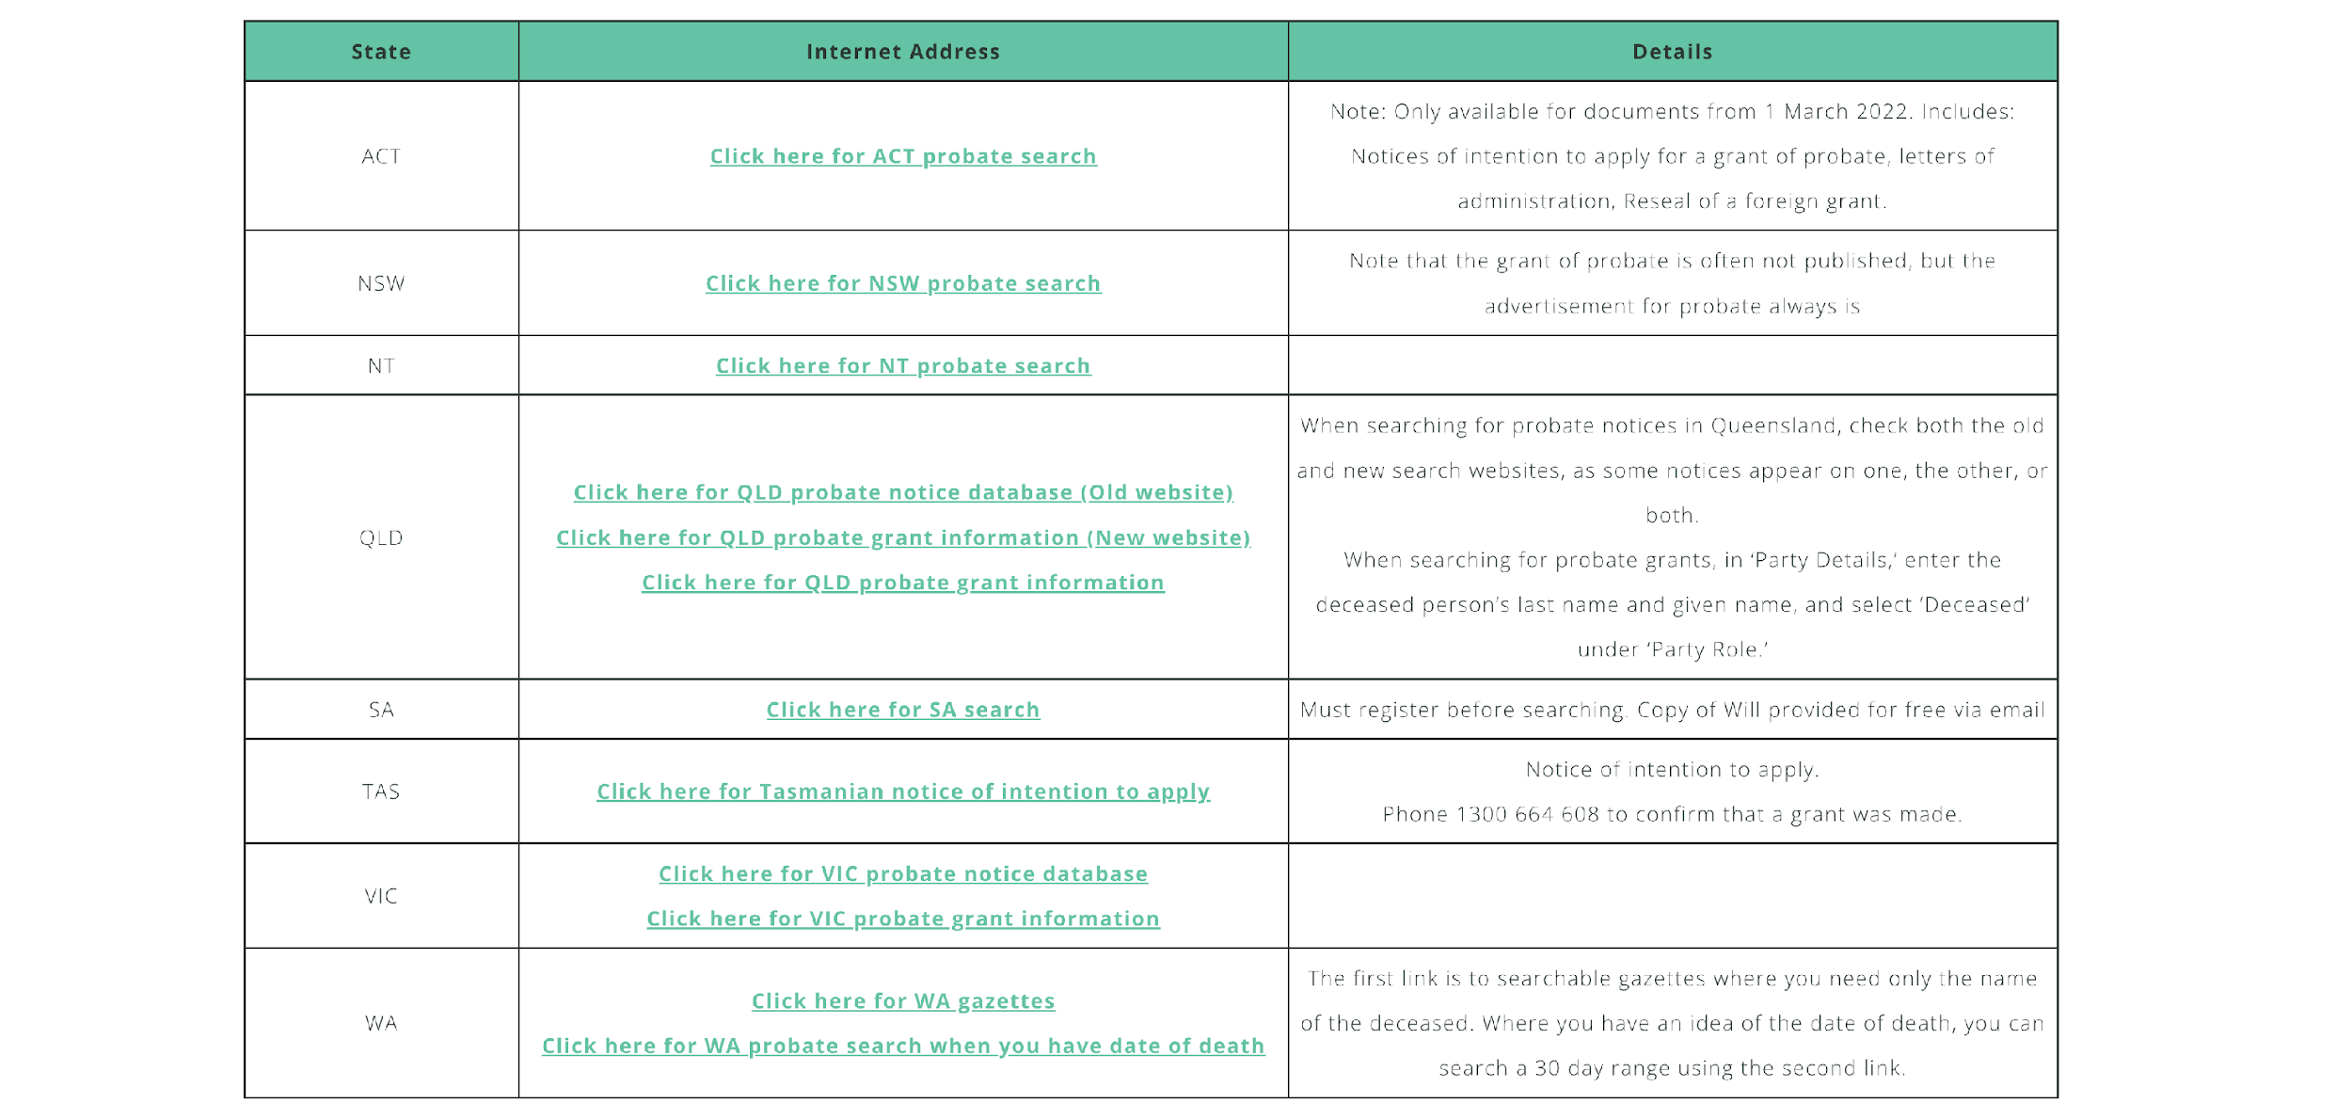

Slide 9
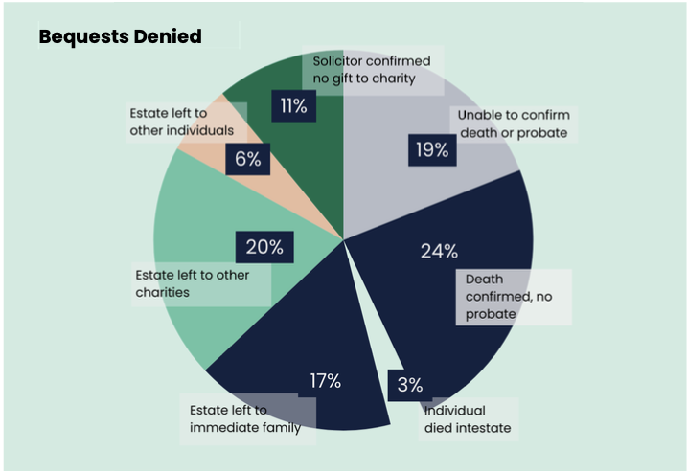
Notes:
Solicitor confirmed no gift to charity = 11% (have to rely because of cost of buying wills)
Unable to confirm death or probate = 19% (maybe still alive, maybe name was wrong)
Death confirmed, no probate = 24% (spouse with joint assets or estate too small – could be missing gifts in there)
Intestate = 3% (should be zero if they are confirmed bequestors. Could will be missing?)
Left to immediate family = 17%
Left to other individuals = 6% (adding together no probate + immediate family + other individuals = 47% likely left all to individuals)
Left to other charities = 20%

Slide 10
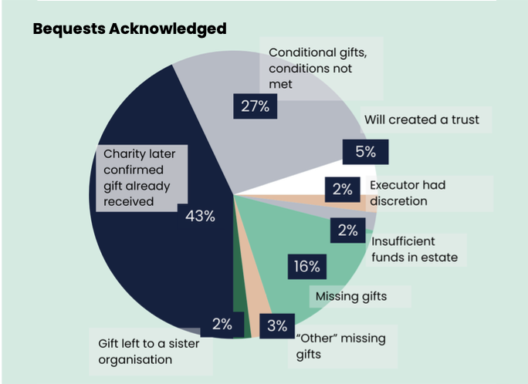
Notes:
Charity confirmed gift was received = 43% (some charities had no issue, others had lots – makes it really hard for you to track)
Conditional gifts, conditions not met = 27% (huge jump from Vic study – some charities must have been having these conversations)
Will created trust = 5%
Executor had discretion = 2% (could be seen as missing gifts)
Insufficient funds or adeemed = 2%
Gift to sister org = 2% (but no communication between them)
Missing gifts = 16%
Other missing gifts = 3%

