Slide 1
Remember me: Building an integrative in-memory program into bequest fundraising
Kate Jenkinson
Senior Strategist, Legacy Futures

Slide 2
What two things …

Slide 3
What two things …
Can be polls apart …

Slide 4
What two things …
Can be polls apart …
Can inspire each other ...

Slide 5
What two things …
Can be polls apart …
Can inspire each other ...
And can be one and the same?

Slide 6
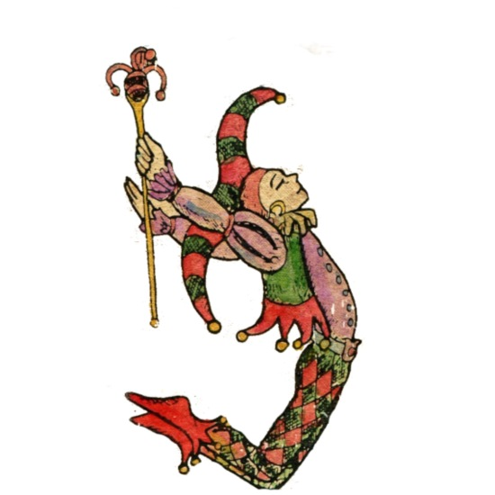
What two things …
In-memory giving
and gifts in Wills

Slide 7
1
2
What’s different about in-memory giving and gifts in Wills? What do they both have in common?
Why should we think of them as two parts of the same conversation?
5 ways to give your gifts in Wills fundraising an in-memory make-over!

Slide 8
What’s different about in-memory giving and gifts in Wills? What do they both have in common?

Slide 9
What exactly do we mean by both?
In-memory giving
Donating or fundraising to remember someone special
Gifts in Wills
Funeral gifts
One-off or regular gifts
Campaigns and appeals
Bequests
Collections from events
Commemoratives
Personal dedications

Slide 10
How are they (usually) different?
Gifts in Wills
An act on my own behalf….
Driven by symbolic immortality – me, my values, the influence I can have
Focused on a wider cause, community, or long-term challenge
Glancing back, but with the lens trained firmly on the future
Prescriptive mechanism (never much fun)
Strong engagement and tenure with the charity
The biggest gift I’ll ever make?
But my pledge unlikely to be my final act
When I die, I can still do some good. You can still continue to make a difference to somebody, it’s not over. You can be immortal!
Bequest supporter, Legacy Futures research

Slide 11
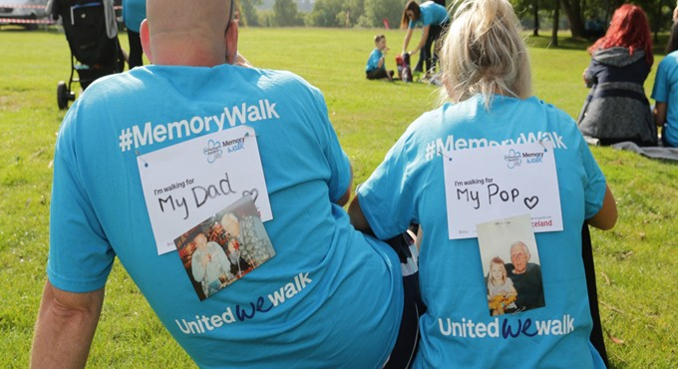
How are they (usually) different?
In-memory gifts
An act ‘for’ somebody else
Focused on one special person
More about looking back than forward
Choice of charity made in the moment
… often by somebody else
No prior engagement required with the charity
Anything goes with channel or product
Gifts can be very low value
Often a ‘one and done’ act
It’s all been for Karen, to keep her memory alive. Every mountain I climb, she is always at the forefront of my mind.
In-memory supporter, Legacy Futures research

Slide 12
Why should we think of these as two parts of the same conversation?

Slide 13
Both can be highly loaded
with decisions that involve deep consideration of the values that matter most
… to the person who was special to me, embodied in the way that they lived, loved (or died).
… to me, for what I stand for – for the kind of world I want to imagine.
or
It was something I was able to talk to her about, right up to the end, looking out of the window at the birds and talking about the animals. It was something deep that triggered her memories. So when I arranged the funeral and they said, ‘would you like to give it to Dementia?’ I said ‘no, she would have wanted it to go to the animals.
In-memory supporter, Legacy Futures research
When the day comes when I finally pop my clogs, I know that my £10,000 or whatever is going to be used wisely, if you can see ongoing projects that are really making a difference to people’s lives.
Joyce, bequest supporter, Claire Routley’s PhD!

Slide 14
One can inspire the other
In-memory giving
Gifts in Wills

Slide 15
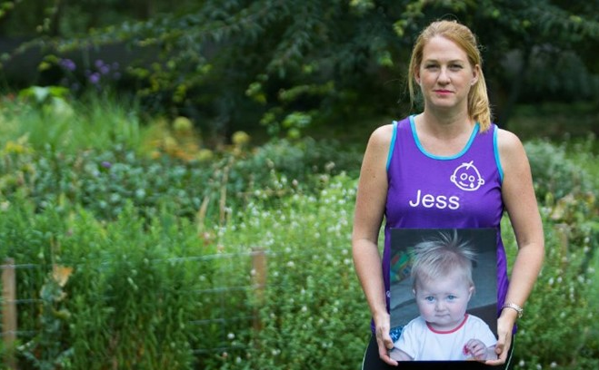
They can converge
when an in-memory bequest is created
It makes sense, and the gift has almost become a part of who we are now. It’s there, it’s almost a comfort. There’s that last thing, that even when we’re not here to remember him, something else will be.
In-memory bequest supporter, Legacy Futures research

Slide 16
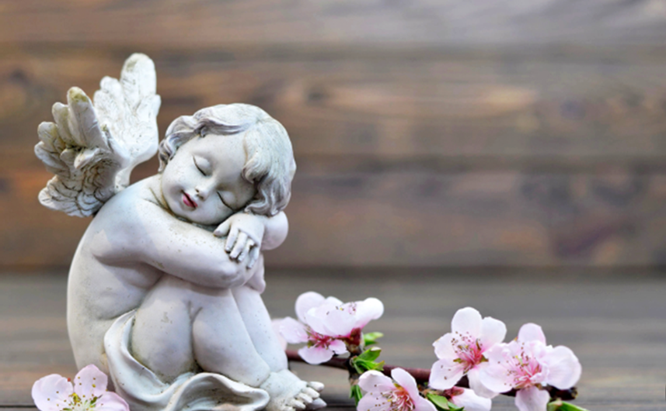
In-memory bequests are always about the loved one
The good that they achieve reflects directly back on that person
It sounds selfish to say Patrick deserves his own name up there, but it would make a difference because you’d feel he’d had some purpose to his life, and that he was personally overseeing some work done in the future. It would make a difference.
In-memory bequest supporter, Legacy Futures research

Slide 17
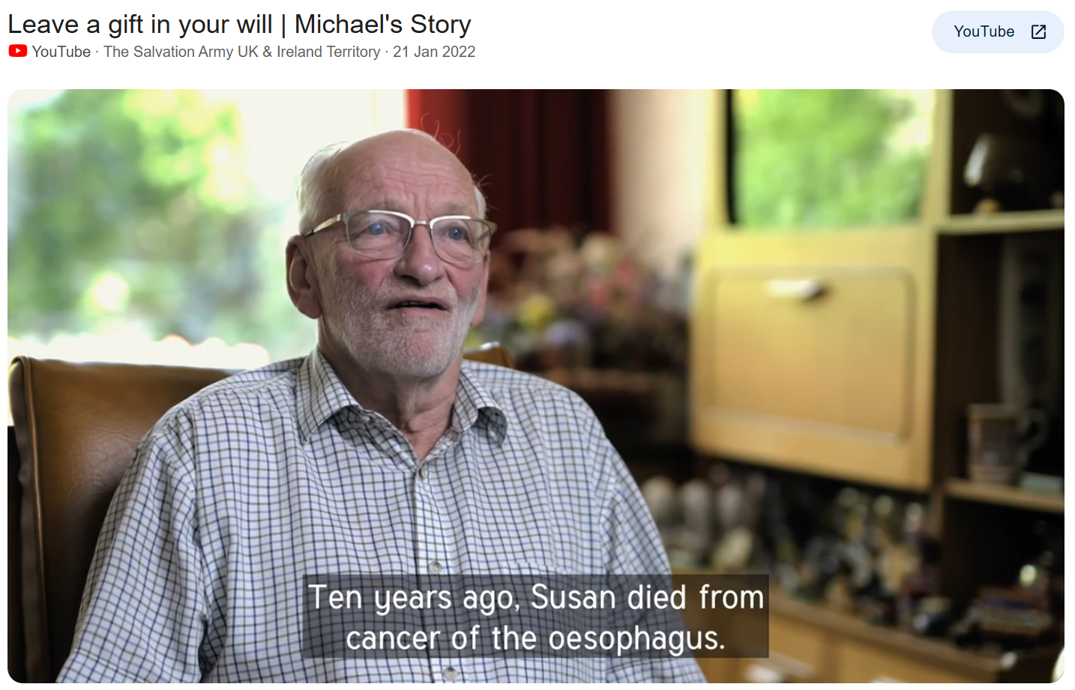
Remembering someone special is a key motivation for gifts in Wills
40%
of legacy donors already had at least one in-memory motivated gift in their Will

Slide 18
In-memory giving drives bequest propensity
x3
In-memory donors were three times more likely to leave a gift in their will than standard regular givers

Slide 19
In-memory-motivated bequests are worth a lot more
60%
Residual gifts worth 60% more (equiv: AUD 181k vs 113k)
Pecuniary gifts worth twice as much (equiv: AUD 17k vs 8.4k)

Slide 20
People have stronger feelings about bequests that are ‘in memory’
I’m never likely to take them out of my Will and if anything, I’ll probably increase the gift. I’ll never forget what they did. They will always have a place in our hearts.
In-memory bequest supporter, Legacy Futures research

Slide 21
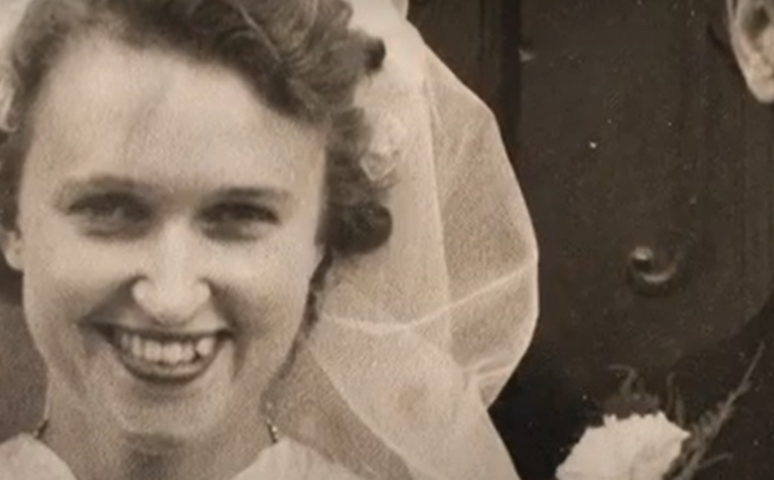
Most people with in-memory gifts in their Will do not think of their bequest charity as ‘theirs’
Mum left a legacy, because Dad did. I think Mum’s legacy was really a tribute to my Dad.
In-memory bequest supporter, Legacy Futures research

Slide 22
The big challenge with in-memory bequests?
Our perceptions of both the past and the future can change
It’s your whole life, isn’t it? The framework of your life, as it matures.
In-memory bequest supporter, Legacy Futures research

Slide 23
5 ways to give your gifts in Wills fundraising an in-memory makeover!

Slide 24
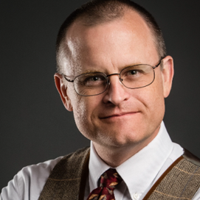
Increase interest by offering ‘in-memory bequests’
1
James (2015) found that offering people the opportunity to leave a bequest in memory of a loved one – in particular an ascendant such as a parent or grandparent – was particularly compelling.
Measured on a 100-point scale, interest in a tribute bequest was 10 points higher than initial interest in leaving a traditional bequest gift to the same organisation.

Slide 25
Create inspiration around loved ones as a reason for a gift in a Will
2

Slide 26
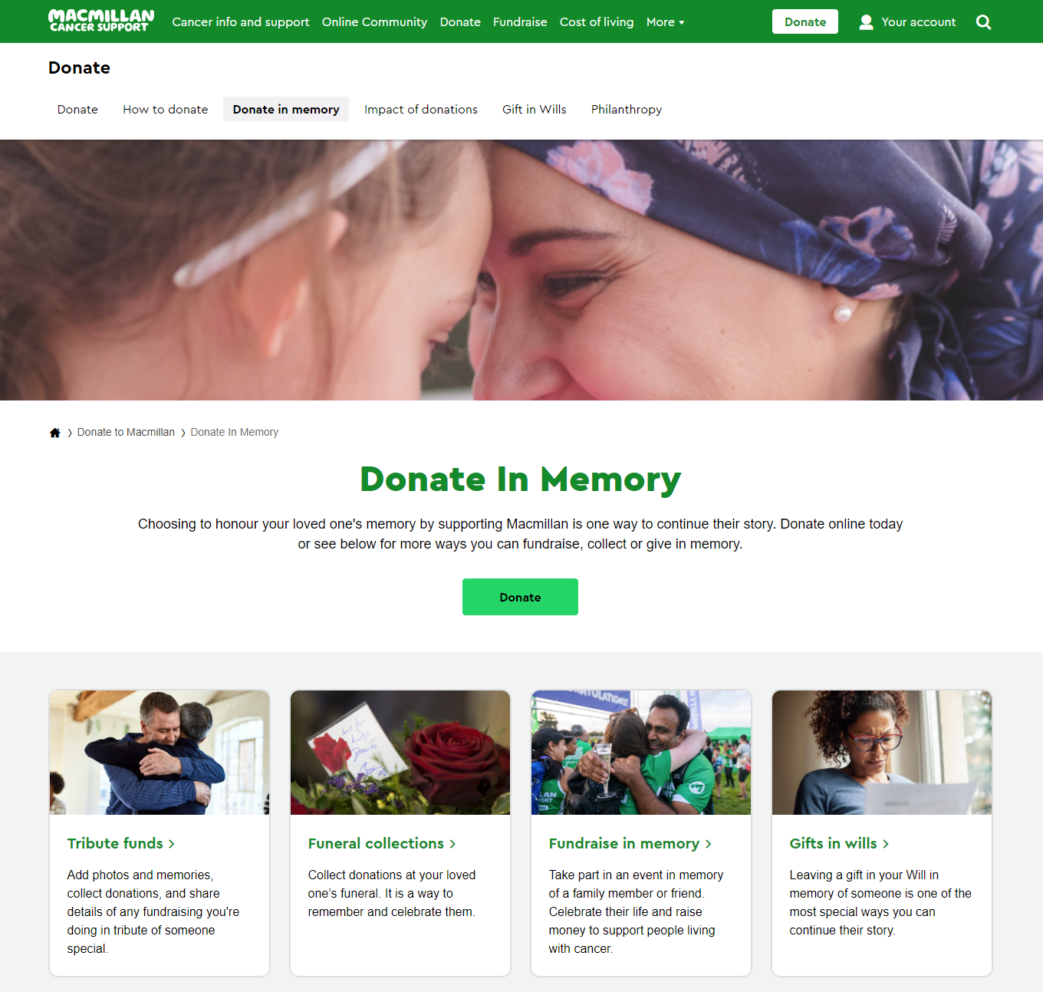
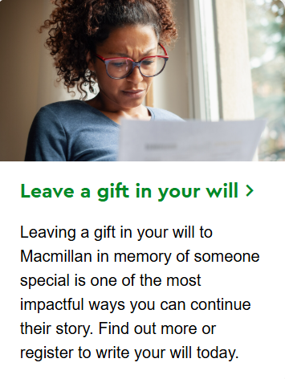
Flip this: Promote giWs as an in-memory offer in their own right
3

Slide 27
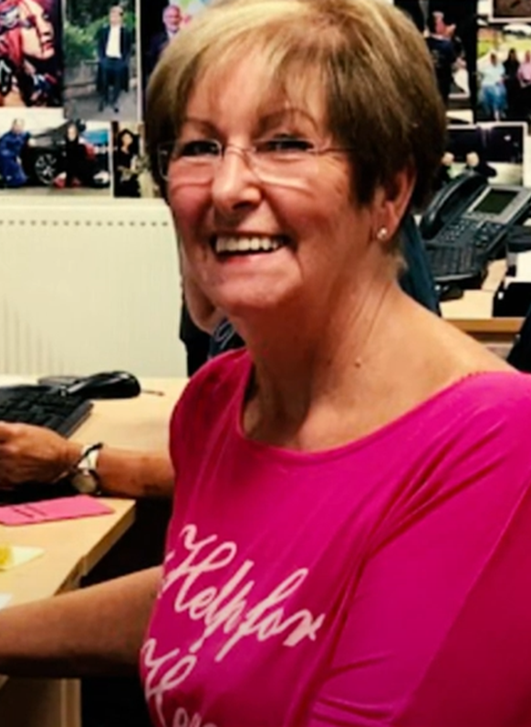
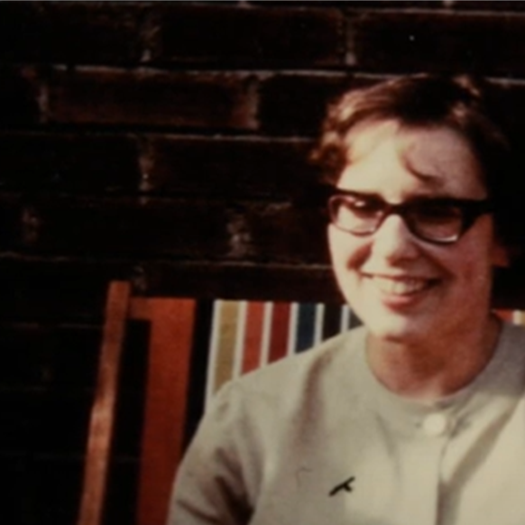
Celebrate your charity’s own ‘legacy heroes’
4
We never had the chance to thank Celia in person, but we honour her memory by carrying out the work she cared for. I’m proud to be part of Celia’s legacy.
Barbara, Help for Heroes office volunteer, remembering Legacy hero Celia Williams

Slide 28
If you know about an in-memory motivation, act on it… with some best practice principles
5
Remember their ‘why’
Offer them other ways to remember and give
Give them a place to go to remember
Make this feel as personal as possible

Slide 29
Summary
Increase interest in gifts in Wils by offering ‘in-memory bequests’
Create inspiration around loved ones as a reason for a gift in a Will
Flip this: Promote giWs as an in-memory offer in their own right
Celebrate your charity’s own ‘legacy heroes’
If you know about an in-memory motivation, act on it… with some best practice principles.

Slide 30
Thanks for being here! Any questions?
Kate.Jenkinson@legacyfutures.com

