Slide 1
Giving back: Positioning gifts in wills as a gift to the donor
Dr Claire Routley, Consultancy Director, Legacy Voice

Slide 2
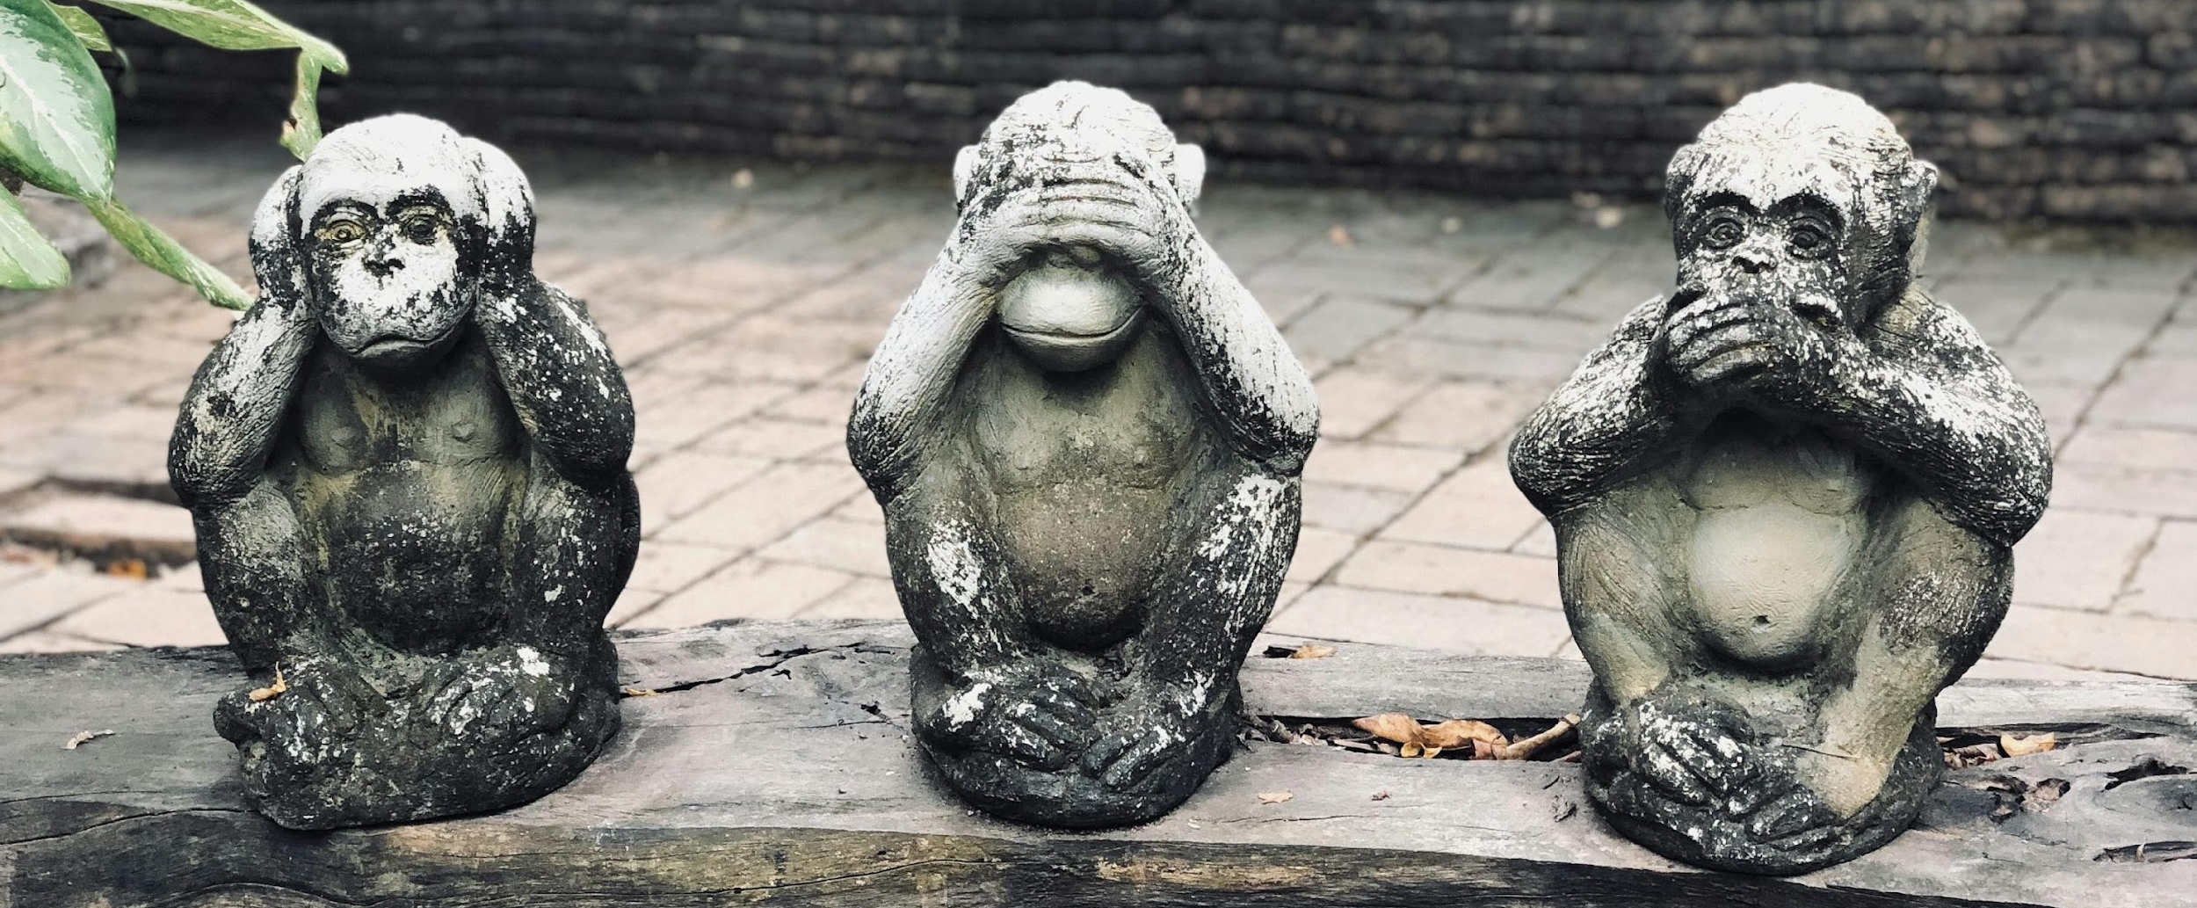
Gifts in wills can be scary – to us
Notes:
Pic from unsplash
Deepest taboos in society – death and money
But top reason that older people don’t talk about end of life is because other people won’t talk to them
Peak fear of death is in our twenties

Slide 3
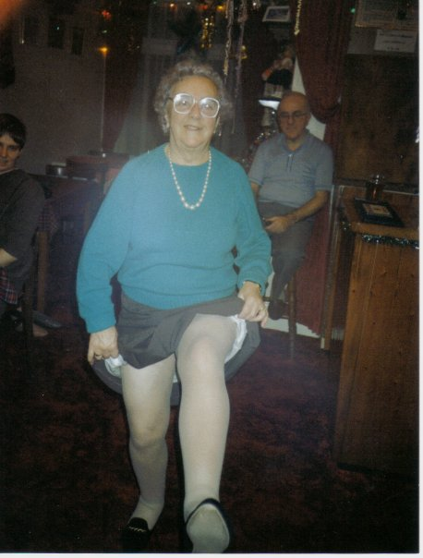
But (mostly) not to our supporters

Slide 4
Giving makes us happier and being happier makes us give
Happiness
Giving
Anik et al 2009; Albers 2022; Whillans 2023
Notes:
First, we review the evidence linking charitable behavior and happiness. We present research from a variety of samples (adults, children and primates) and methods (correlational and experimental) demonstrating that happier people give more, that giving indeed causes increased happiness, and that these two relationships may operate in a circular fashion.
At the most basic level, functional magnetic resonance imaging (fMRI) evidence shows that giving money to charity leads to similar brain activity in regions implicated in the experience of pleasure and reward. [Serotonin: mood regulator; dopamine: pleasure; oxytocin: connection with others; release endorphins – helpers high]. [Particularly powerful when we freely choose to give]
Further support for a causal link comes from recent work by Lyubomirsky, Tkach, and Sheldon (2004), which shows that simply asking people to commit random acts of kindness can significantly increase happiness levels for several weeks. [Toddlers happier when they give treats to a puppet rather than get treats themselves]
Tested by giving people an amount of money to spend on themselves or others. As predicted, participants asked to spend their windfall in a prosocial fashion were happier at the end of the day than were participants in the personal spending condition.
These data confirmed our hypothesis that prosocial spending and happiness fuel each other in a circular fashion.
Whillans 2023: Study participants also routinely expressed more happiness when their prosocial spending was tied to a specific outcome that showed the impact that they made, which acted as a sign of success and connection with those they helped. More happy when told buying a meal for a child in Africa than when told giving to a charity’s general fund.
Why don’t people just do it more? If you act them to predict what makes people happier, they imagine spending money on themselves

Slide 5
It can even lengthen our lives
Giving
Reduced stress
Stronger immune system
Better health
Longer life
Yörük 2014
Notes:
On the other hand, a growing body of literature documents that giving to others reduces stress and strengthens the immune system, which results in better health and longer life expectancy. These findings imply that tax subsidies for charitable giving may have positive spillover effects on health.
Giving can act as a buffer between stress and death! People who report highly stressful events – more likely to die in following years – IF they didn’t report helping others
The mechanism might be reduced inflammation?
Giving can lower blood pressure
High volunteers had 63% lower mortality than non volunteers
Volunteers had lower levels of cortisol

Slide 6
Gifts in wills are motivated by
Looking backwards
Looking around
Looking forwards
Giving to charities that reflect or have impacted their own life stories
Often linked to remembering a loved one
Social influence and social norming are important in legacy giving
People will often research their chosen charity to ensure that their gift will be spend effectively
Opportunity to live on beyond their own lifespan by associating themselves with a charity whose services and values will carry on into the future
Routley, Sargeant and Lowthian 2022
Notes:
Reminiscence – if we encourage people to look back they can potentially find all of the above:
Serves lots of functions for us as humans (beating boredom, helping us solve problems)
Teaching informing and death preparation – helps us to gain a sense of meaning in life
Encourages generative behaviour – which again boosts meaning in life
Fulfilling basic human needs = greater life satisfaction = greater ego integrity = lower fear of death
Nostalgia is subtly different from pure memory in that a) it involves looking at the past through rose-tinted spectacles, and b) is a bittersweet emotion which can invoke happy memories, but also a sense of longing for the past (Seehusen, et al., 2013). On balance, however, nostalgic memories tend to be more positive than negative, perhaps because the memory of positive emotions outlasts negative ones (Sedikides, et al., 2015).
Mention that nostalgia was seen as something negative: a disease, a psychological disorder
That’s because it’s associated with difficult experience – one of the first descriptions was in troops away at war
But that’s because we use it as a coping mechanism
Benefits of nostalgia:
self-positivity
perceptions that the future will be positive
social connectedness
approach motivation (or action to achieve a desired result)
a sense of youthfulness
growth orientation
intrinsic motivation
AND:
increase prosocial behaviour
drive higher levels of donation
buffer death anxiety
protect against perception time is limited
maintain psychological wellbeing in later life

Slide 7
Gifts in wills are motivated by
Looking backwards
Looking around
Looking forwards
Giving to charities that reflect or have impacted their own life stories
Often linked to remembering a loved one
Social influence and social norming are important in legacy giving
People will often research their chosen charity to ensure that their gift will be spend effectively
Opportunity to live on beyond their own lifespan by associating themselves with a charity whose services and values will carry on into the future
…is good for you!
Routley, Sargeant and Lowthian 2022
Notes:
Reminiscence – if we encourage people to look back they can potentially find all of the above:
Serves lots of functions for us as humans (beating boredom, helping us solve problems)
Teaching informing and death preparation – helps us to gain a sense of meaning in life
Encourages generative behaviour – which again boosts meaning in life
Fulfilling basic human needs = greater life satisfaction = greater ego integrity = lower fear of death
Nostalgia is subtly different from pure memory in that a) it involves looking at the past through rose-tinted spectacles, and b) is a bittersweet emotion which can invoke happy memories, but also a sense of longing for the past (Seehusen, et al., 2013). On balance, however, nostalgic memories tend to be more positive than negative, perhaps because the memory of positive emotions outlasts negative ones (Sedikides, et al., 2015).
Mention that nostalgia was seen as something negative: a disease, a psychological disorder
That’s because it’s associated with difficult experience – one of the first descriptions was in troops away at war
But that’s because we use it as a coping mechanism
Benefits of nostalgia:
self-positivity
perceptions that the future will be positive
social connectedness
approach motivation (or action to achieve a desired result)
a sense of youthfulness
growth orientation
intrinsic motivation
AND:
increase prosocial behaviour
drive higher levels of donation
buffer death anxiety
protect against perception time is limited
maintain psychological wellbeing in later life

Slide 8
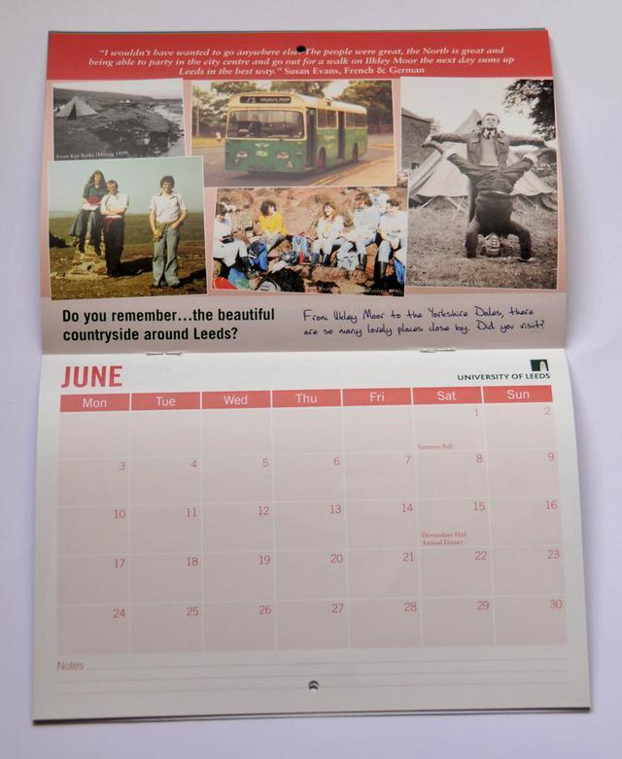
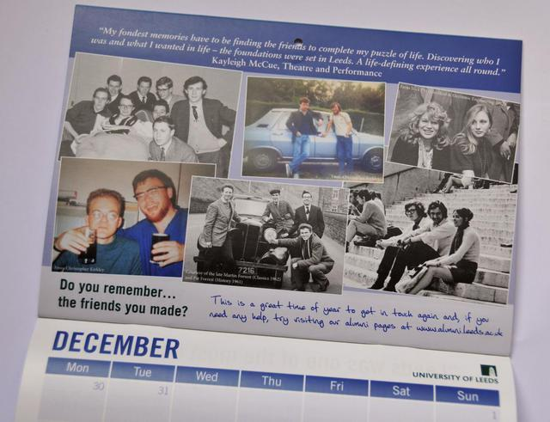
Harness the power of nostalgia

Slide 9
Make it easy to give in memory

Slide 10
Gifts in wills are motivated by
Looking backwards
Looking around
Looking forwards
Giving to charities that reflect or have impacted their own life stories
Often linked to remembering a loved one
Social influence and social norming are important in legacy giving
People will often research their chosen charity to ensure that their gift will be spend effectively
Opportunity to live on beyond their own lifespan by associating themselves with a charity whose services and values will carry on into the future
…is good for you!
Routley, Sargeant and Lowthian 2022
Notes:
Adhering to social norms help us to cope with thoughts of death

Slide 11
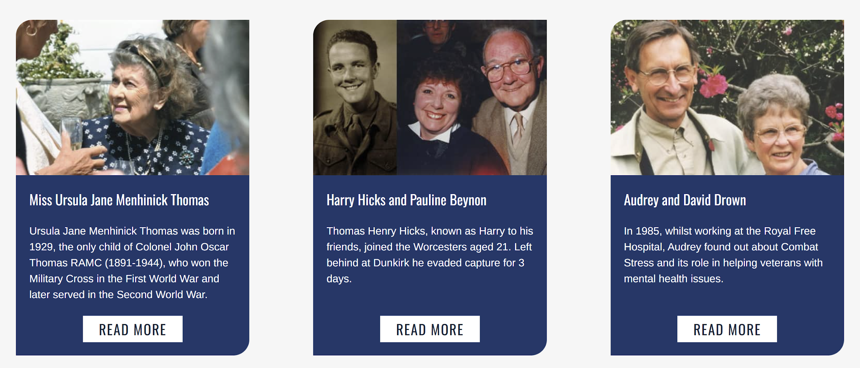
Tell stories

Slide 12
Gifts in wills are motivated by
Looking backwards
Looking around
Looking forwards
Giving to charities that reflect or have impacted their own life stories
Often linked to remembering a loved one
Social influence and social norming are important in legacy giving
People will often research their chosen charity to ensure that their gift will be spend effectively
Opportunity to live on beyond their own lifespan by associating themselves with a charity whose services and values will carry on into the future
…is good for you!
Routley, Sargeant and Lowthian 2022
Notes:
Looking forwards – generativity or creating something which will live on after you. Another study (Moienia, et al., 2020) asked older women asked to write down their wisdom and advice for the following generation i.e. to undertake a generative activity. Participants in the test condition reported psychological and social benefits including:
increased participation in social activities,
less psychological distress and
more positive expectations regarding physical health and ageing.
Intriguingly, however, they also showed a physical improvement with blood tests showing a decrease in pro-inflammatory gene expression
There is even research to suggest that generativity helps people to feel a greater sense of death acceptance, through providing an increased sense of meaning in life (Fung, et al., 2019).
Busch et al (2018), in a cross-cultural study. They found that generativity/creating something which will live on beyond you helped to develop a sense of ego-integrity, which, in turn was related to less fear of death (see also Busch (2021)).
They say that through generativity, an individual can find meaning, believe that their life has been well-lived and that they will leave a legacy. This can enable them to come to terms with mortality, again, pointing to potential psychological benefits that may be associated with legacy giving.

Slide 13
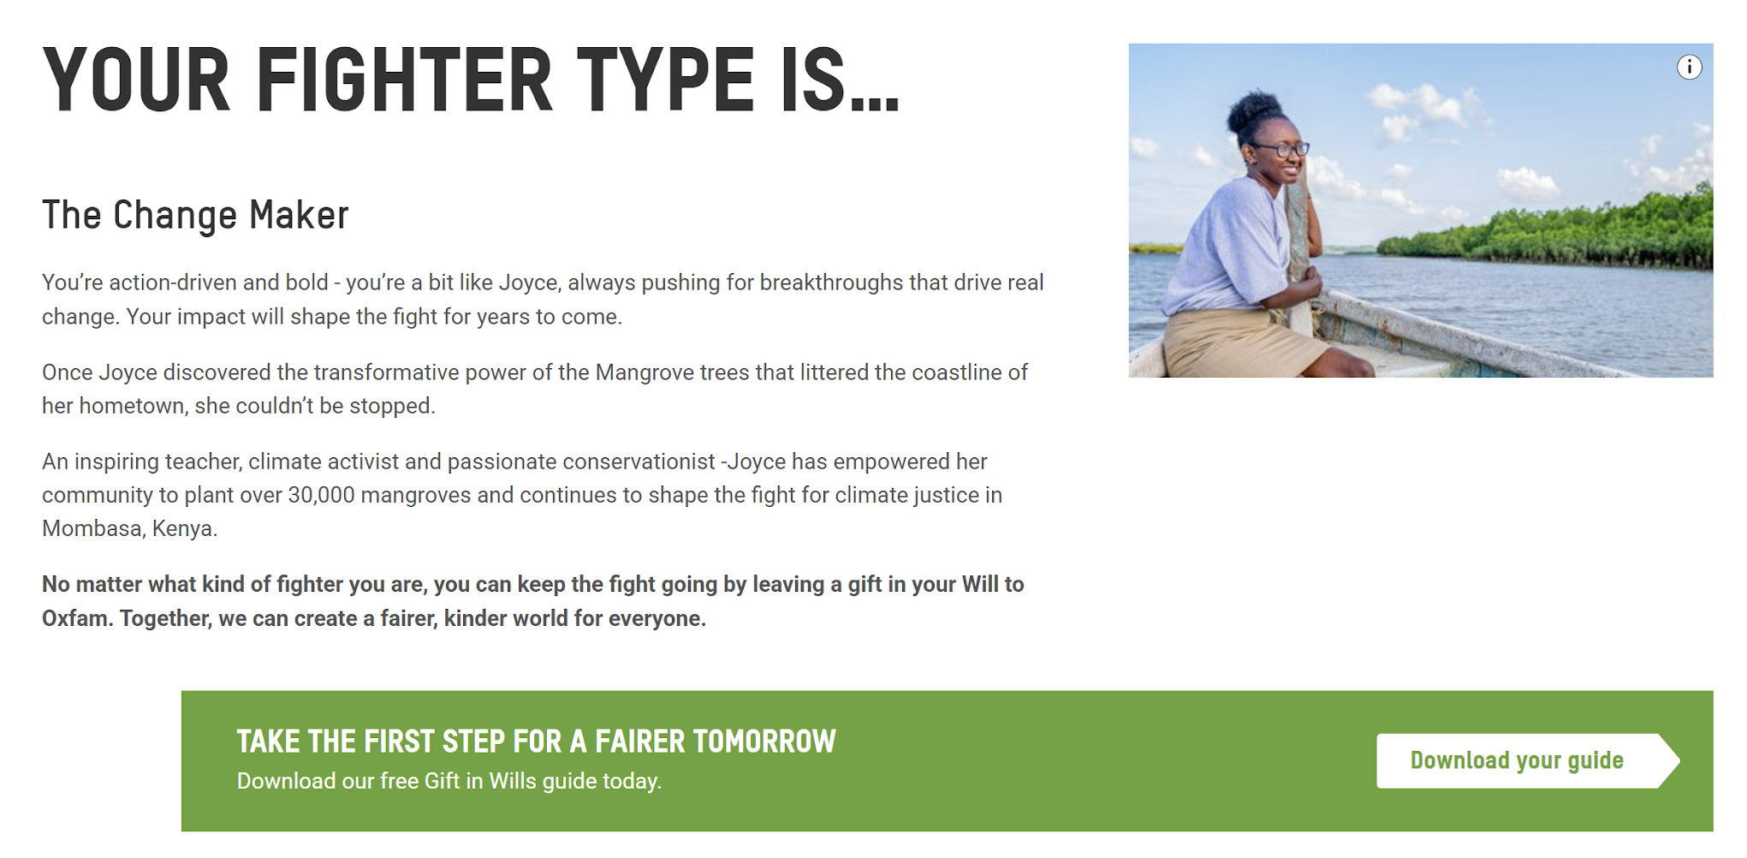
Point to future impact

Slide 14
A virtuous circle
Supporters feel better about selves
More likely to consider legacy
More able to engage with death
Notes:
Can we enhance these fundamental needs? RJ – advance the donors’ hero story; prime these feelings e.g. showing they’re connected to others or getting them to recognise that they’re more connected to others; that they’ll make a difference; that the choice is theirs
“When individuals experience a sense of harmony and completeness in their identity, they may more easily consider their death as an integral and unchangeable part of life. In contrast, despair over a misspent life is likely to contribute to fear of death because the time to correct unresolved problems or undo made decisions is running out.”
Make the donor feel better about themselves = potentially more able to cope with death related subjects = leaves a legacy = feels better about themselves

Slide 15
Multiple wins
Supporter
Our cause
Legacy team
Colleagues
Notes:
Win for the supporter if we can help them to fulfil their fundamental human needs
It’s a win for our colleagues whom we might want to involve in legacy if we can show them how legacy may have a whole range of psychological benefits
It’s a win for us if a supporter is more likely to engage with legacy; and for us if we can make people feel better about themselves – LFs are nice people who want to do good
And it’s all good for our cause!
Ethical imperative

Slide 16
Thank you!
What questions do you have?

