Slide 1
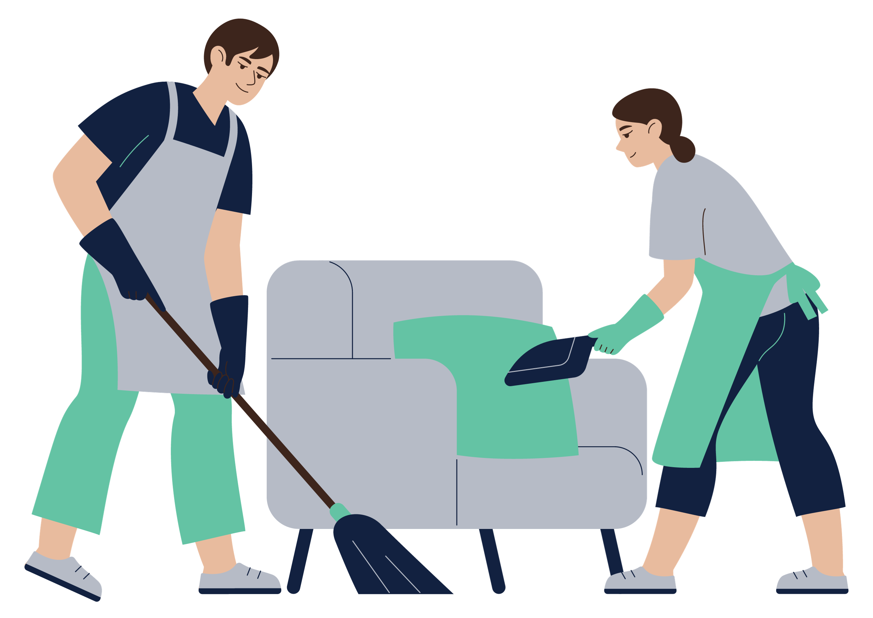
Data best practice for GIW
Notes:
+ Acknowledgement
+ Intro MM and BA
+ My work is after someone has died, so sharing tips about what robust data practices look like from a deceased estate perspective. I’ll break this into while a person is alive and then after they are deceased.

Slide 2

Disclaimer
This presentation contains general advice only. The advice contained within should not be relied upon without seeking professional advice pertaining to your unique circumstances.

Slide 3

Your interactions with the bequestor
Notes:
+ While people are alive

Slide 4

Get the Will right!
Full name, ABN and address
Keep it simple!

Slide 5

Bequestor pipeline data
Current
Clear definitions
Consistency
Notes matter!
Notes:
+ Accuracy of pipeline varies significantly charity to charity
+ Notes matter: individual dying intestacy

Slide 6

What notes?
When and where Will written/stored
Family dynamics
What they are leaving you/indications of estate size
Notes:
You are taking notes for acquisition and retention – these are notes relevant beyond that

Slide 7

Storing data
GIW are a long game
32% of the time, last donation was 5 years before bequest notification
Case study: which charity?
Case study: confirming identity
Notes:
Which charity – receiving gift because they had a record of relationship with charity (named in a confusing way in the will)
Confirming identity – online will, asked if they could confirm the identity of the person they spoke to about the online will

Slide 8

How confident are you about your pipeline’s accuracy?
Are the whole team on the same page about terminology?
When was the last time you interacted with your pipeline?

Slide 9

Buy-in from the fundraising team
Consistent use of terminology
Talking about GIW is everyone’s responsibility!
Notes:
+ 66% of bequestors known to you – but only half of them will be confirmed. 1/3 come from broader network (eg donors)

Slide 10

Estate administration
Notes:
After the person is deceased

Slide 11

The basics
Generalised bequest email and phone number
Past names listed
Be professional and efficient
Notes:
Professional and efficient: estate admin cannot be an afterthought. Efficiency = thinking about exec comms, signing docs, receipts

Slide 12

Closing the loop on your pipeline
Test the accuracy of your pipeline
Prevent missing gifts

Slide 13

Determine which records you will track
Marking as deceased triggers process
Estate administrator checks for probate every six months
Reach out to solicitor or purchase will

Slide 14
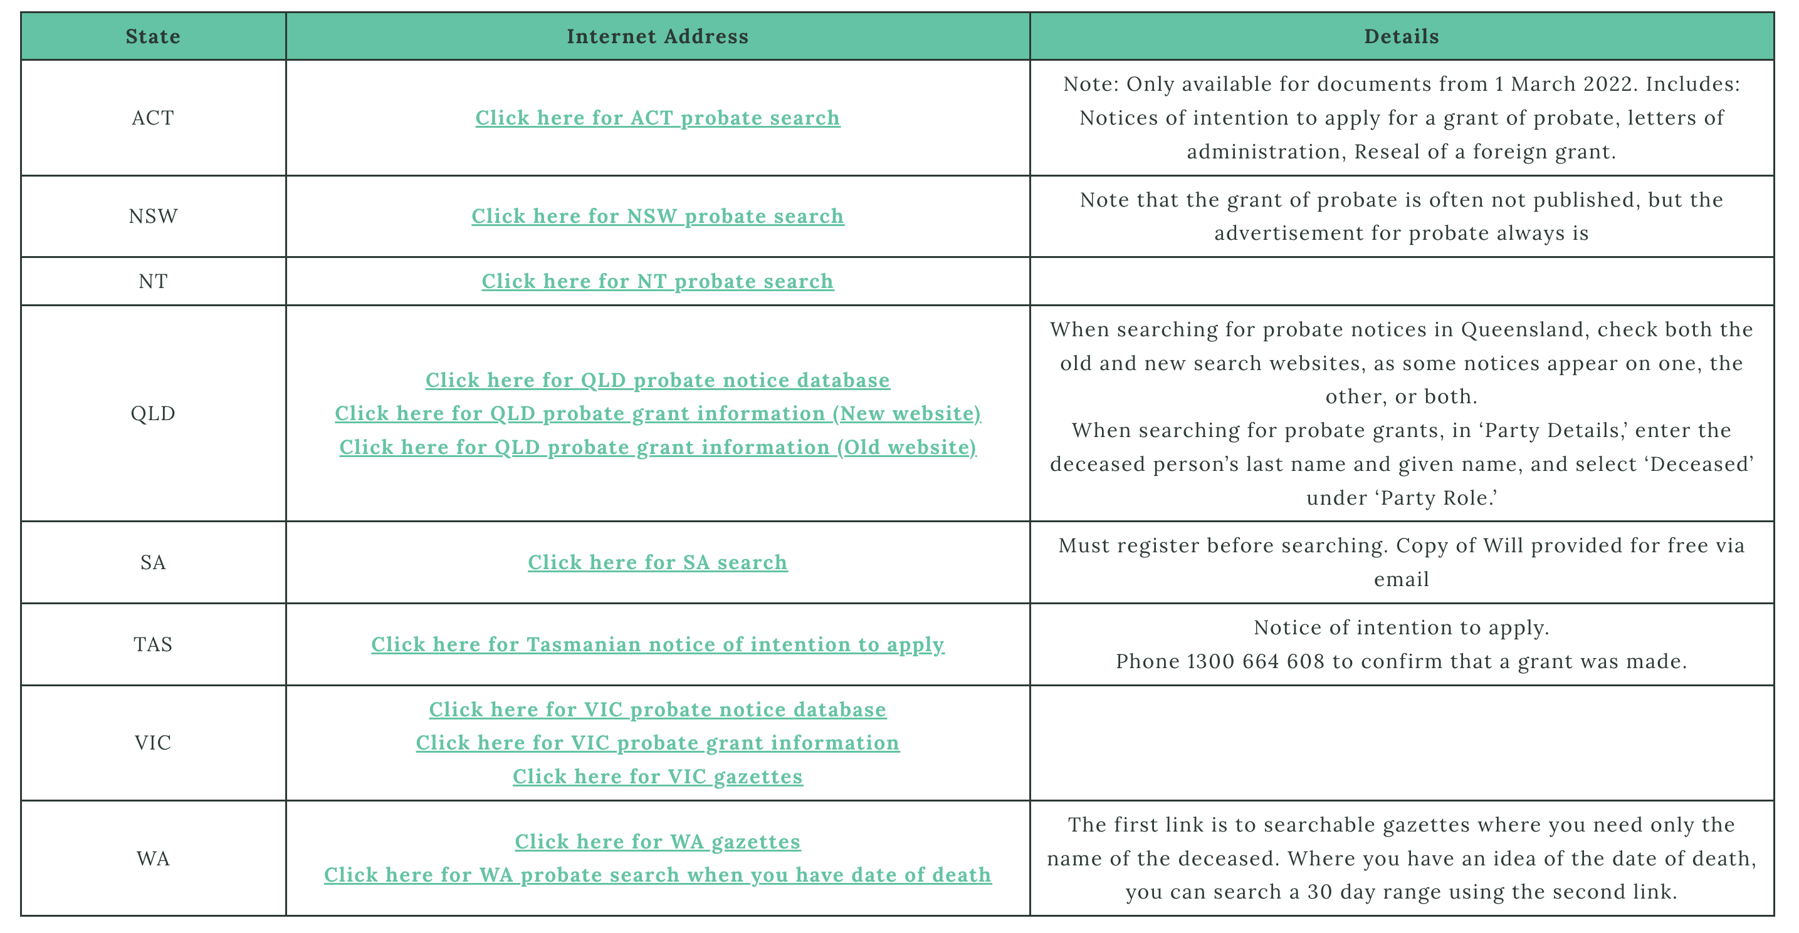

Slide 15

Why does clean estate administration data matter?
Save time and resources
Reduces costs
Income forecast
Impression of solicitor and executor
Auditing
Improve future bequest prospecting
Receive full entitlement
Prevent missing gifts

Slide 16

Understand your bequestors:
Profile – location, gender, etc
Relationship to the charity
Other charities you track with
Notes:
Surprises for charities:
Bequestors not coming from suburbs they expected – moved their events
Deprioritizing acquisition of bequestors with children. Others choosing to invite spouses to events.
Looking at the programs run by charities they track with.

Slide 17
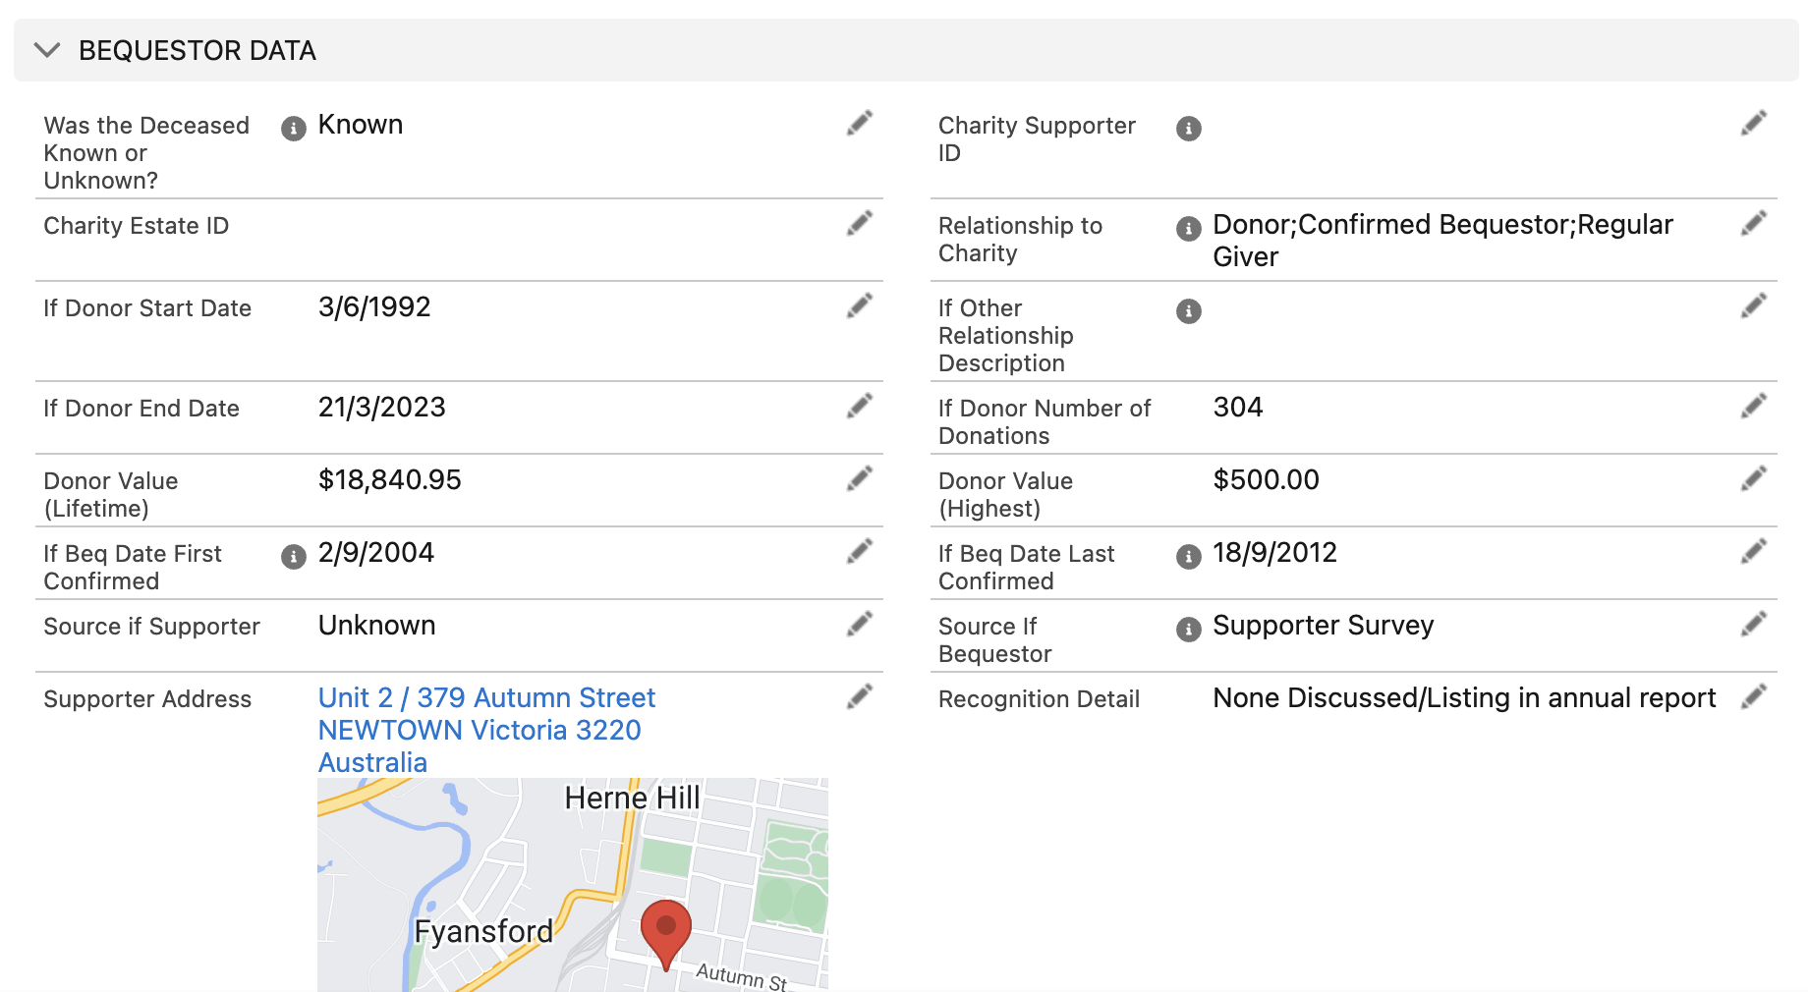
Notes:
Designed our system so we fill out data as it becomes available to us – note that for estate management you might be using an excel. Think about what should go into excel vs your CRM.

Slide 18
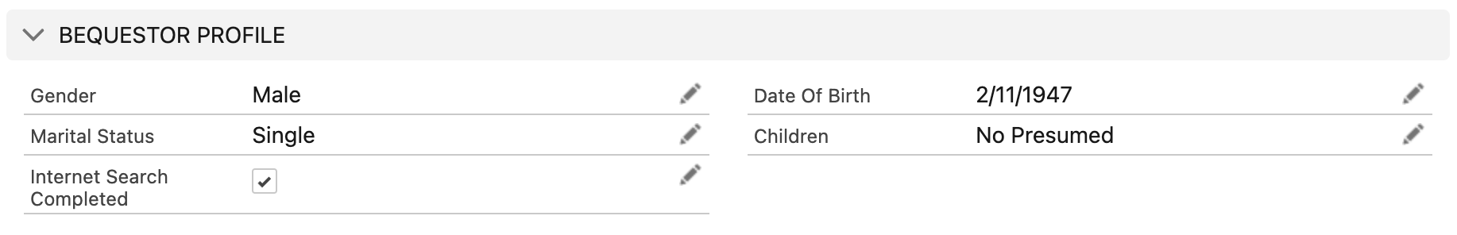
Notes:
Profile data we capture

Slide 19

Name of the deceased
Name of the executor
Name of the solicitor
Date of death
Date of probate
Date of expected distribution
Info on assets
Info on issues with estate (eg contest)
Notes:
+ When we receive notification, we read every word and enter in the data as we find it. Sometimes we have to wait for more docs, but with each communication you should be filling in the puzzle pieces.
+ Your system needs to be able to record this info and more.

Slide 20
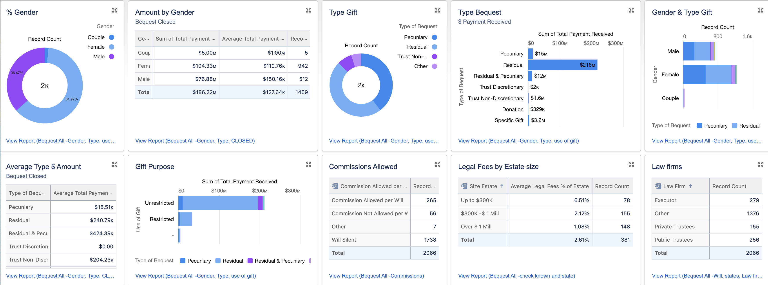
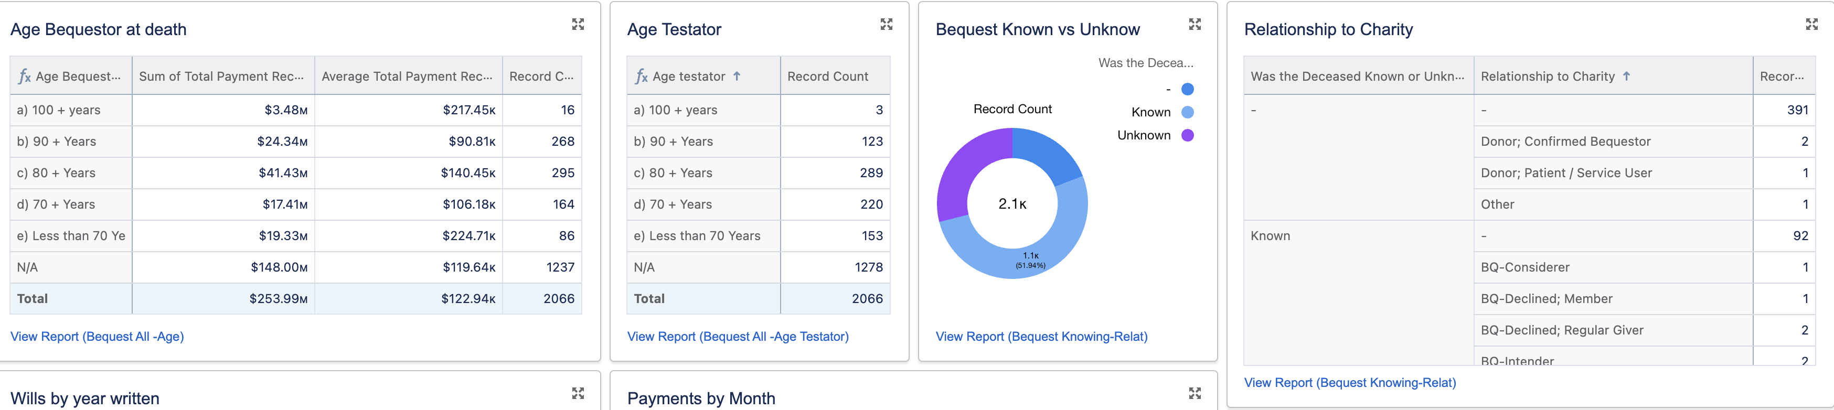
Notes:
Having the system collect all the data points allows us to do this

Slide 21

How will you stop bequests from falling between the cracks?
How will you ensure that you match living donors to deceased bequestors?
How can you make your estate admin more efficient?
Notes:
3 questions to ask about your system
1. Examples of life interests
2. Examples from Bequests Promised – so you won’t know your rate of success, might go looking for why you didn’t receive gifts and you might not properly engage the family properly
3. Estate admin can take up a lot of time – your handling of data can improve this. Charities often can’t say how many bequests they receive per year – you’ll get asked for annual report.

Slide 22
Q and A

