Slide 1
Discretionary, or not? Trusts, lingo and hopefully useful stuff
It’s a two-way chat
Lorelle Lake, Senior Manager Philanthropy, Burnet Institute

Slide 2
CV
LinkedIn
Started work life as graphic designer
Fell into fundraising when I was doing a Masters in Marketing
Fundraising for around 24 years
I’ve done a bit everything e.g. events, write copy, volunteer, funding proposals/applications, employ awesome people, prepare and attend an estate mediation, use external consultants etc.
Tiny and large orgs

Slide 3
Who’s here?
What do you do? GIW, T&F? Everything?

Slide 4

Where does it all come from? Where to?
Trusts
  Charitable Trusts
  Testamentary Trusts
  Deceased estate
  In perpetuity
  Trustees
  Bequeath
  Residual
  Pecuniary (what's that again?)
  One off distribution from an estate?
Foundations
Charitable Fund
Deed
Public Benevolent Institution
Private ancillary funds
Public ancillary funds
Grants
Donations
Disbursements
Discretionary
Non discretionary
Tied funding
Untied funding
Submissions
Does it go under Gifts in Wills or T&F?
Who cares?
Should I tell the program staff about this?
Do I apply for it?
Do I have to report back?
Are we entitled to money?
What's the money in the bank from Equity Trustees for – where does it go?
Who do I talk to?
Do I need to talk to a lawyer?
Joe White Bequest – hang on – who looks after that?

Slide 5
Bequest notification
You’ve been notified of an estate. Now what?
Awesome.
How much is it?
Did we know them?
What’s in the Will?
Can we get a copy?
When are we going to get the money?
This budget or next?
Did we budget for it?
Is it 10% of 5%?
Are we sharing it with other charities?
Is anyone contesting it?
Is it tied?
Is it shares?
Do we sell them?
Who does that?

Slide 6
Revenue already in the GIW pipeline?
You’ve got money already coming in on a regular basis from an Estate (disbursements)
Awesome.
Who’s sending it?
Are we in the Will?
What does it say?
Do we have a copy of it?
Which program does it go to?
Is it still going to the right place – do we still do the work?
Do we have to receipt it?
How do we record it?
Can we get more?
Or is it being managed by the Trusts and Foundations person?
Is that you too?
Do we budget for it?
Who do I talk to?

Slide 7
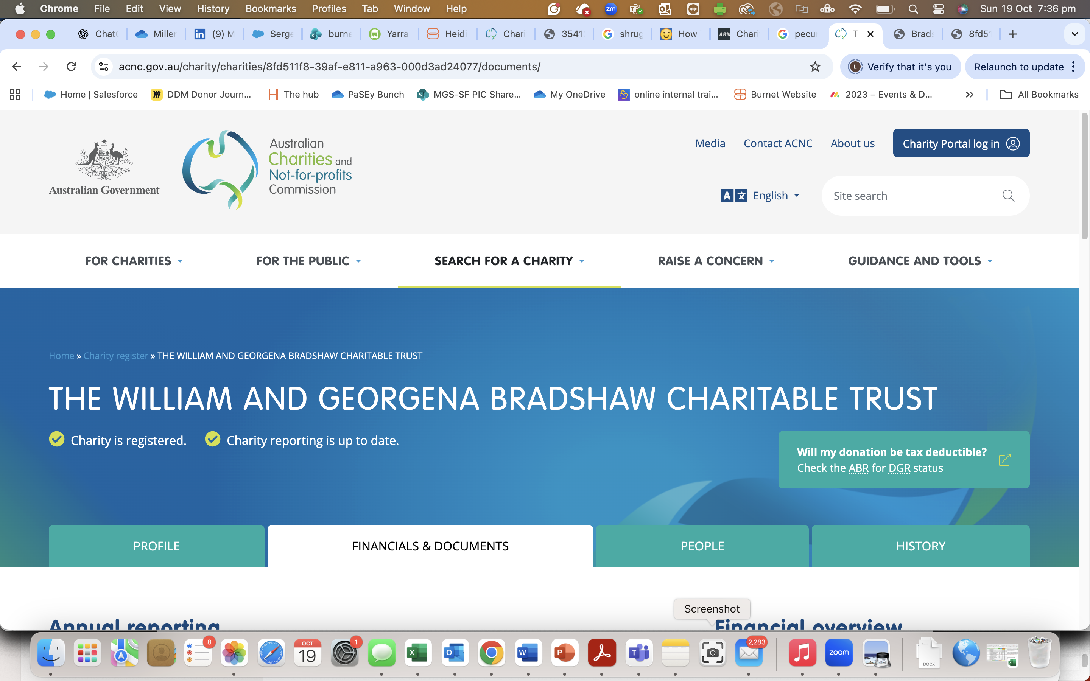
Charitable Trust – is it on the ACNC?

Slide 8
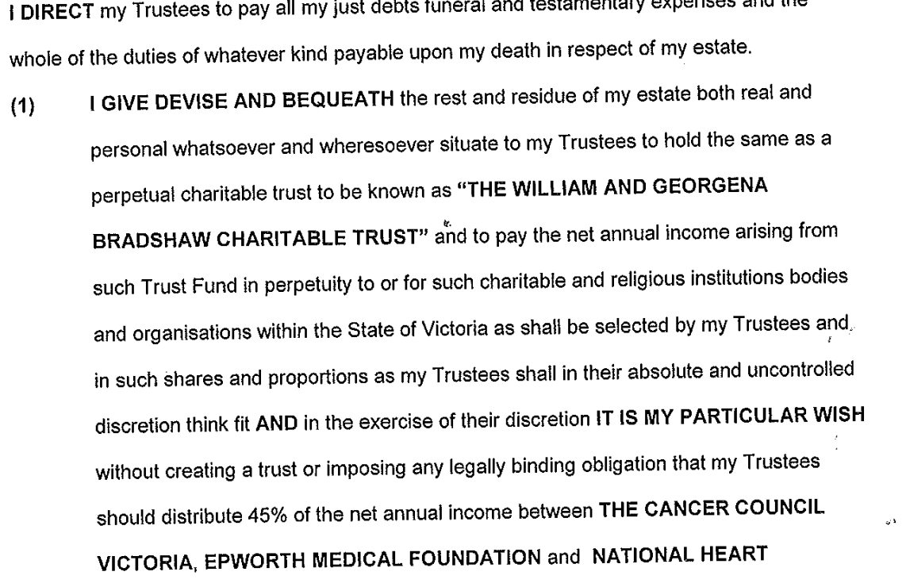








William and Georgena Bradshaw Charitable Trust
What the Will says

Slide 9
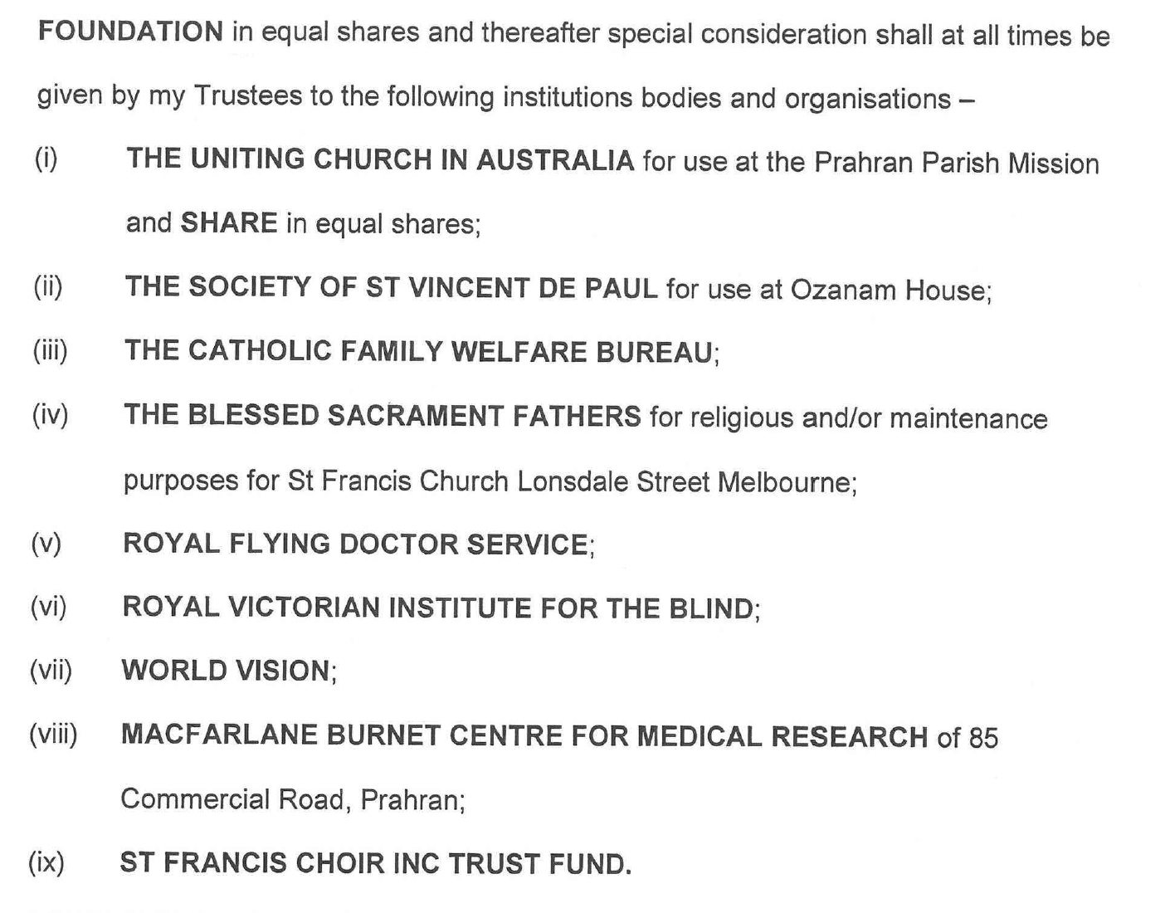


William and Georgena Bradshaw Charitable Trust
Is it discretionary? What does that mean?
Tied

Slide 10
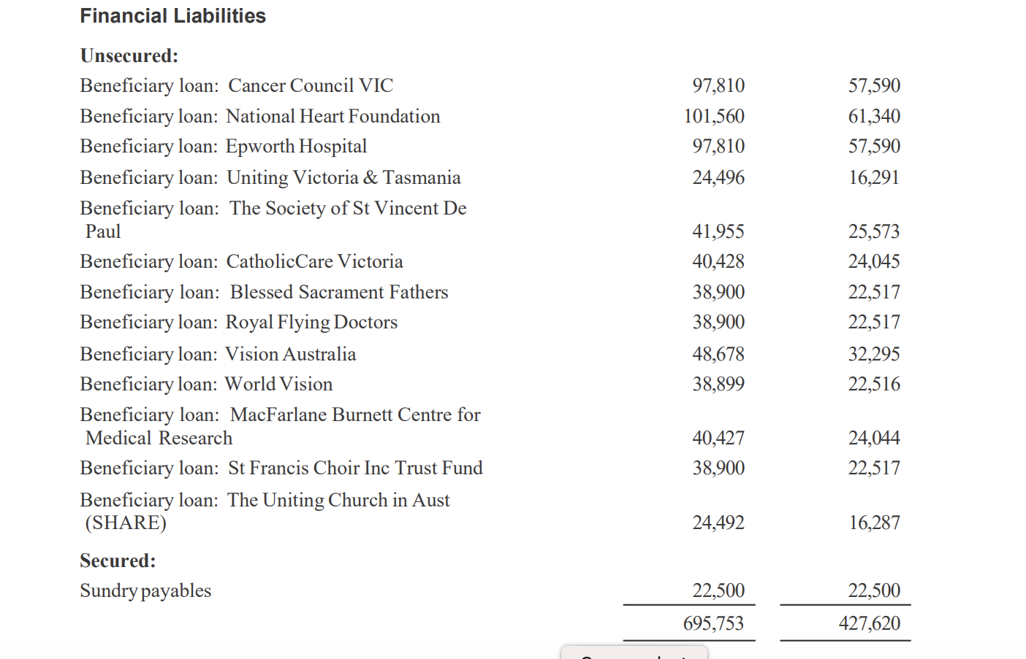


William and Georgena Bradshaw Charitable Trust
FY 2024 – Financial report on ACNC
OMG – what’s this?

Slide 11
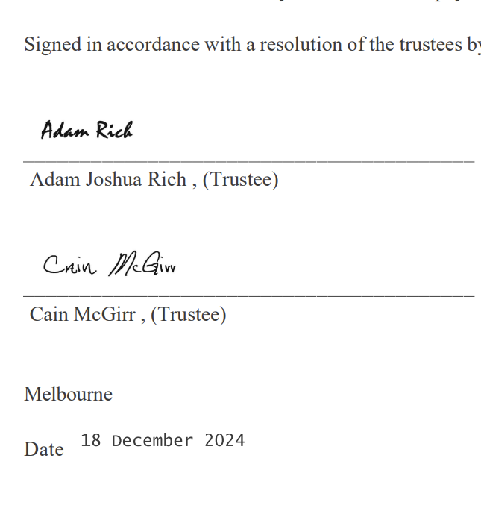

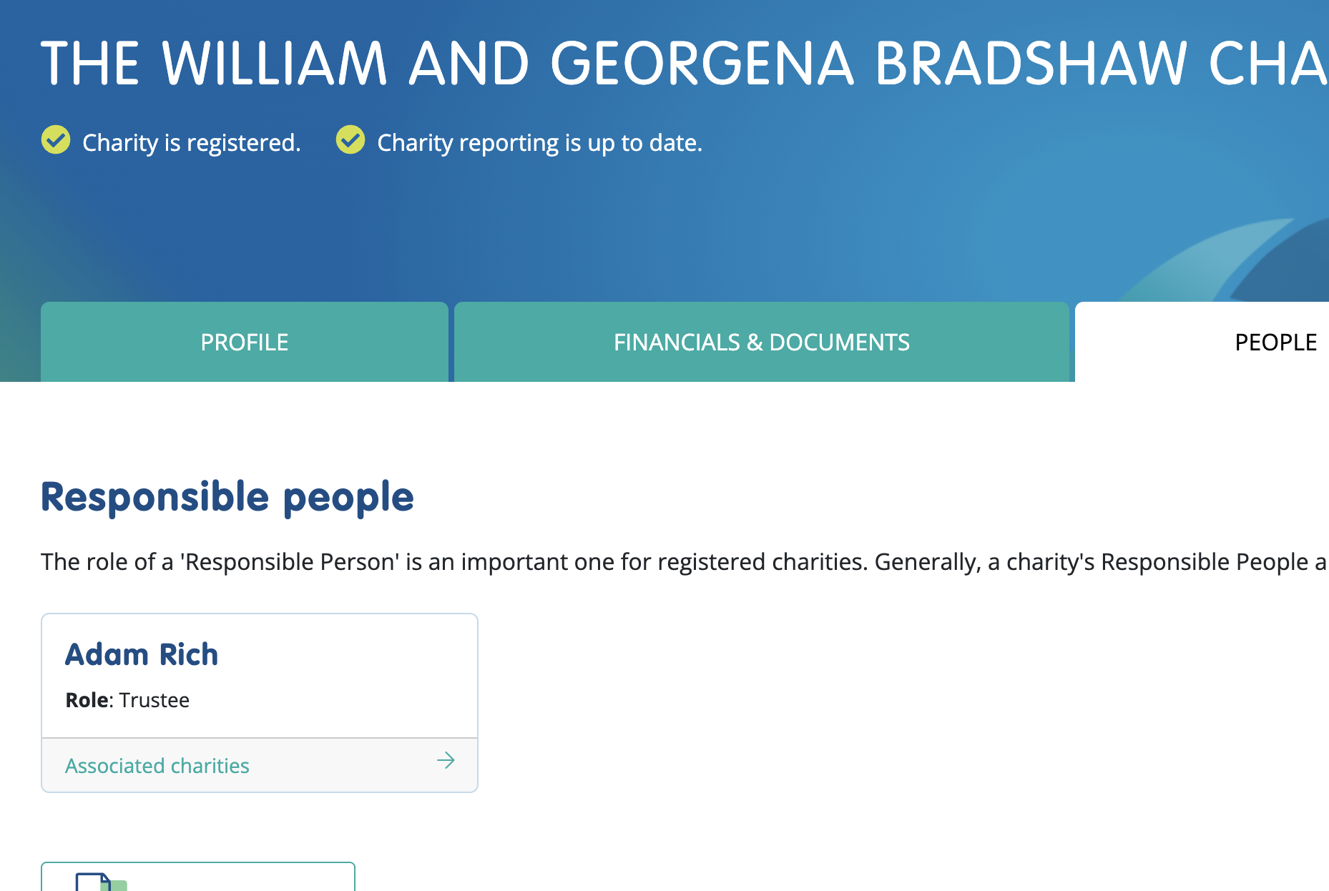
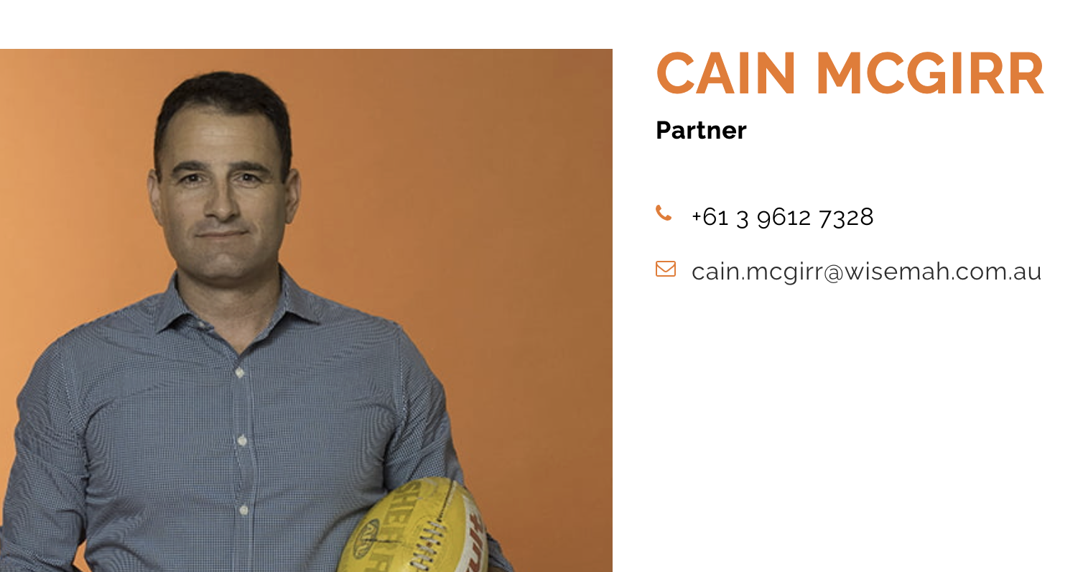

William and Georgena Bradshaw Charitable Trust
The trustees
Financial report

Slide 12
Do we spend time on this one?
Should we try for more?
What about if records don’t tally with ours?
Go back to the solicitors who instruct the Trustees?
Contact other beneficiaries to see if they're aware?
Contact the Trustees?
Thoughts?

Slide 13
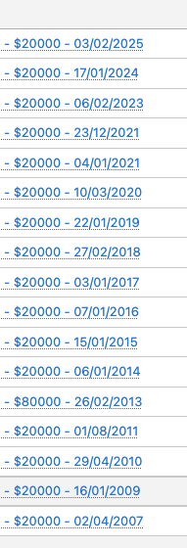
Fixed amount each year – stated in Will
Fixed Trust
A trust in which persons have fixed entitlements to all of the income and capital of the trust at all times during the income year.
That is, the trustee is bound to make a distribution to the beneficiaries in a fixed or predetermined manner, as set out in the trust deed. The fixed entitlement may be a specified fraction or a percentage. – Australian Business Register

Slide 14
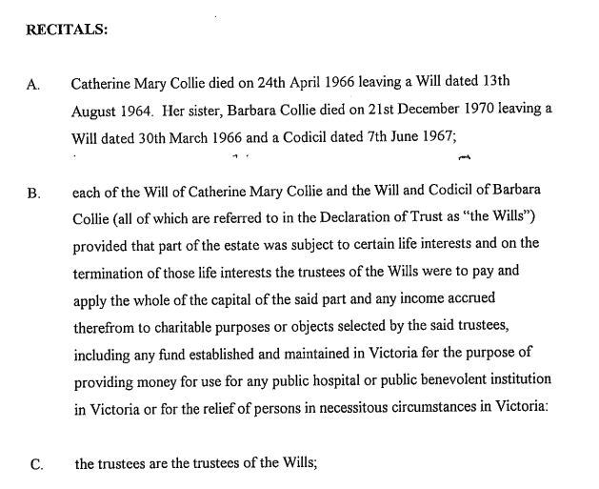
Collie Foundation
Managed by Equity Trusts
General, perpetual, charitable trust giving the Trustees wide discretion in supporting charitable organisations
Does not accept unsolicited applications.

Slide 15
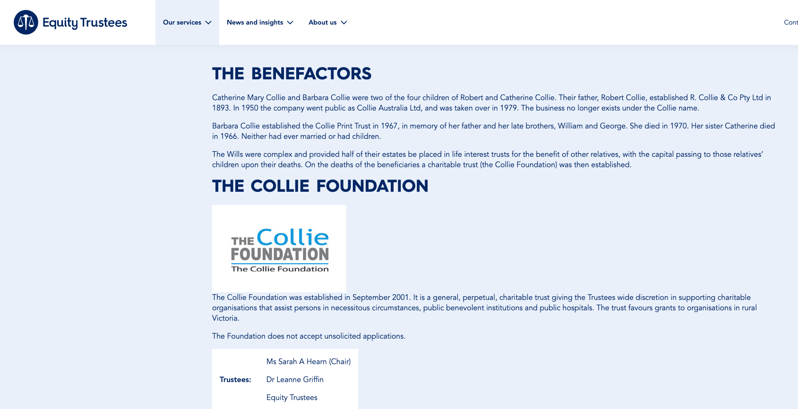

Slide 16
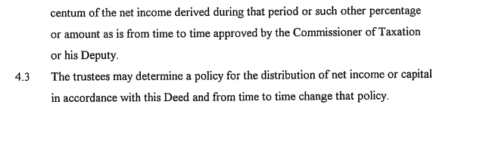
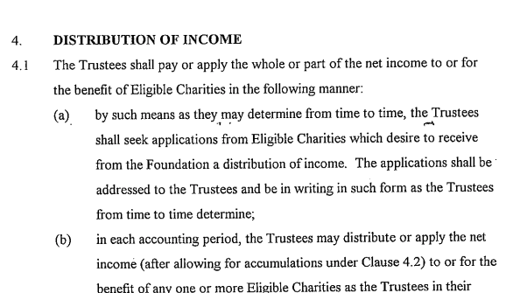
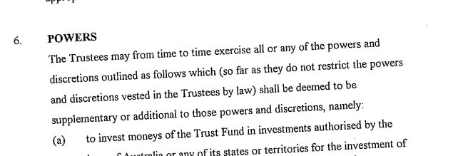



Collie Foundation
From the trust deed

Slide 17
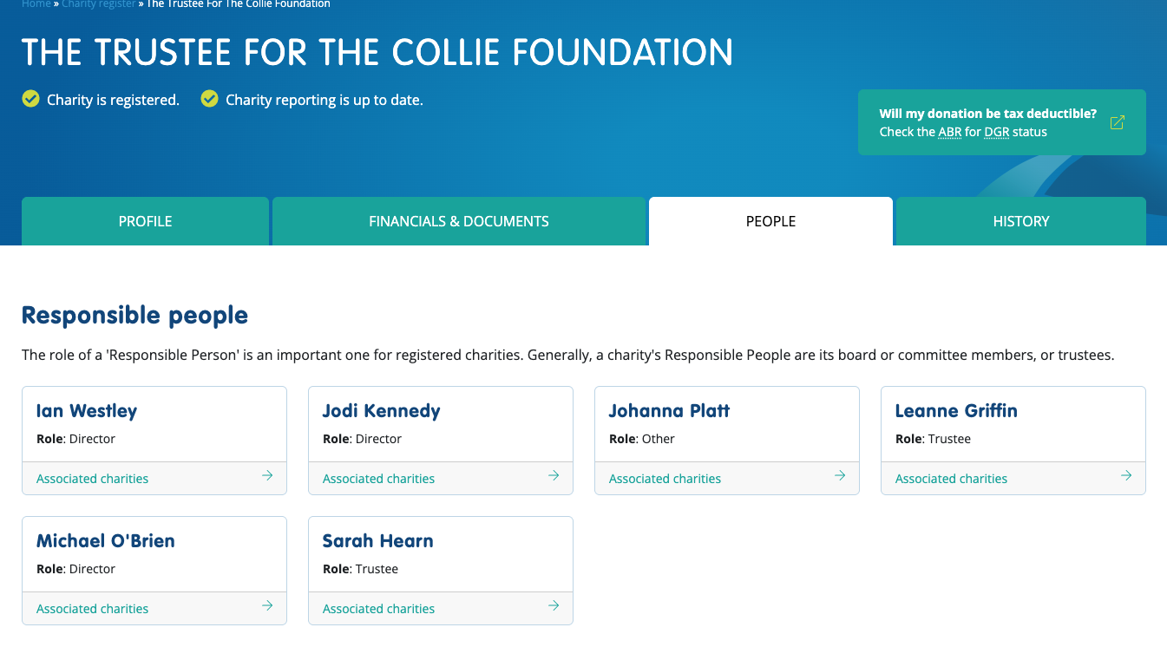

Trustees

Slide 18
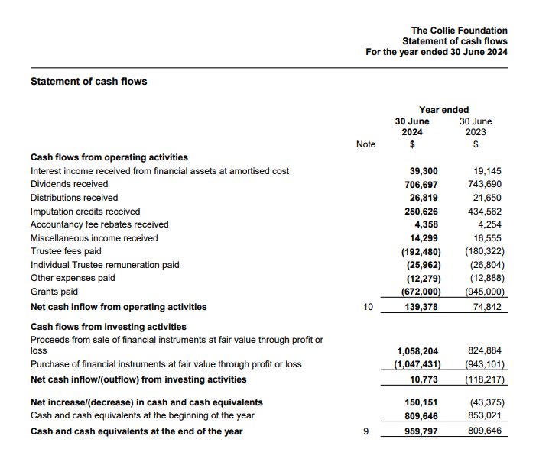

Collie Foundation
No unsolicited proposals
Talk to trustees
Proposal
Yes or no
Grants paid
Tied

Slide 19
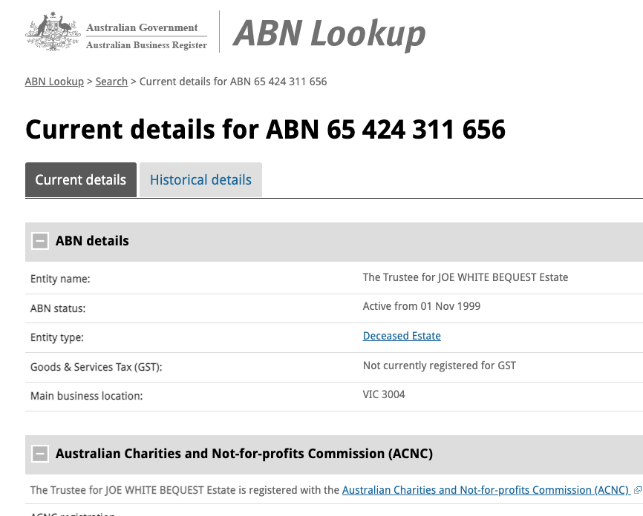

Joe White Bequest – deceased estate

Slide 20


Joe White Bequest
Apply for funding through a proposal
Public website - now
Tied

Slide 21
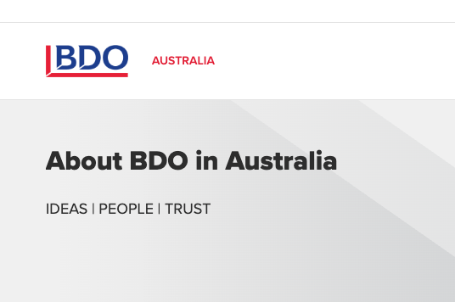
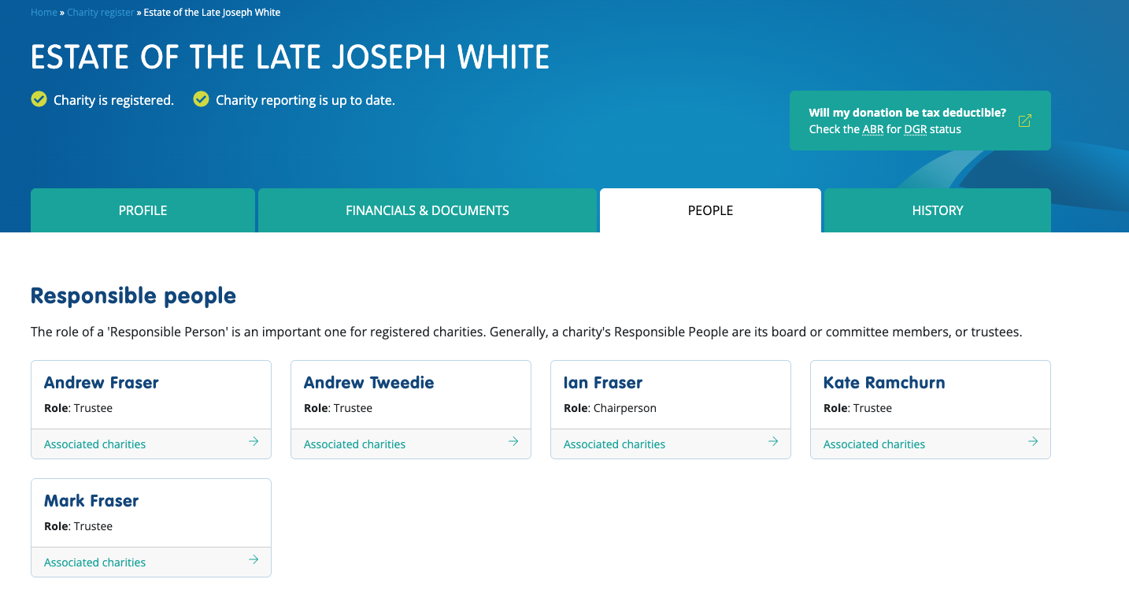
Trustees – Joe White Bequest
Audit and accounting organisation administrating it

Slide 22
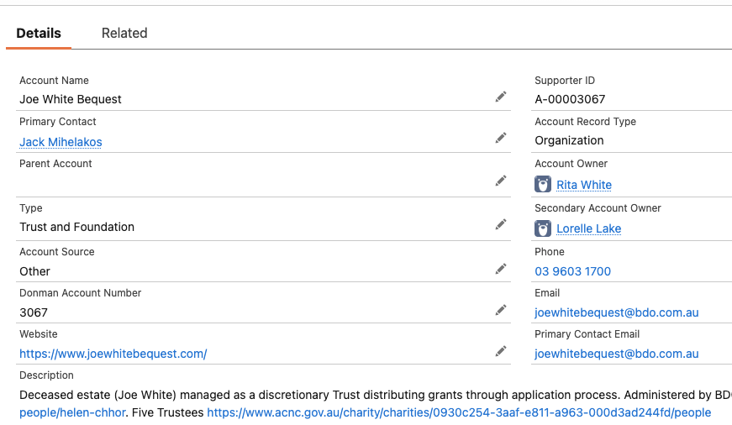

Managed by Trust and Foundation staff

Slide 23
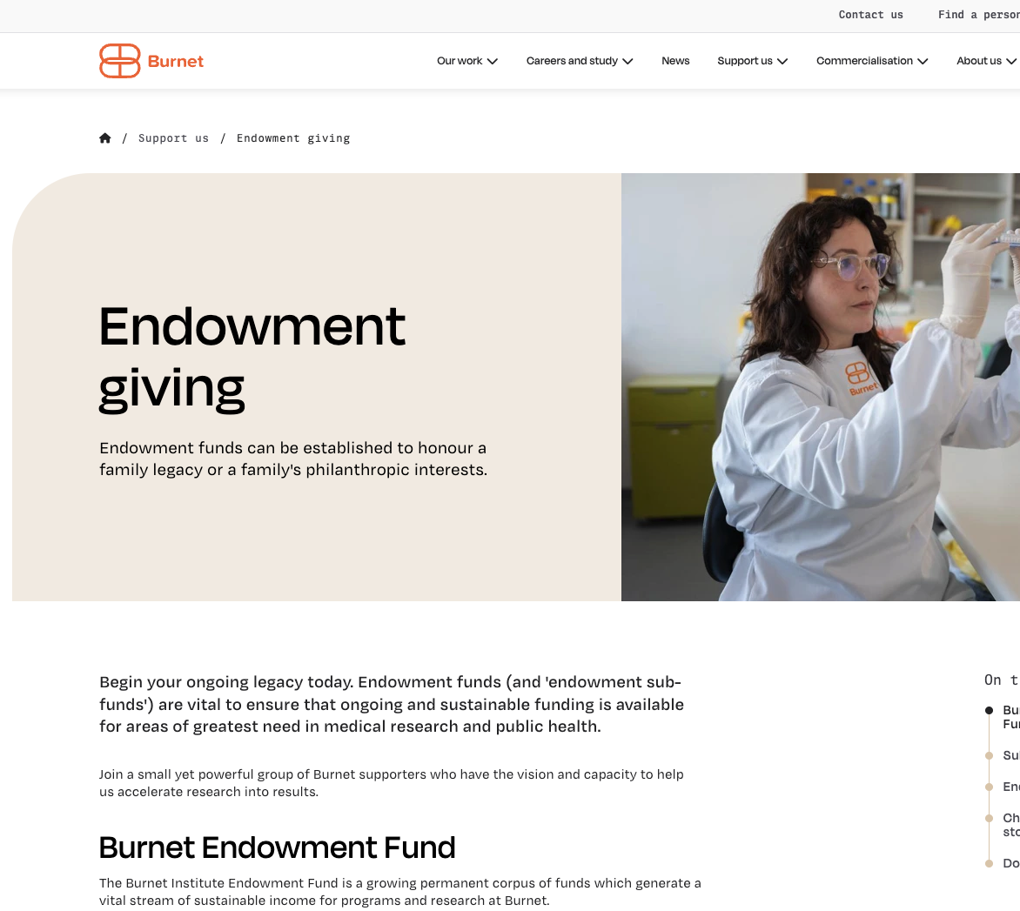
Endowments – why bother?
Money invested – distributions back into programs
Not a separate entity
Named sub funds
Major gift and GIW product
Start now
Leave later as well through GIW
WIIFM

Slide 24


Private Ancillary Funds
Ssssshhhhh – they’re private
Or are they?
Find them
Nurture them
Keep them
They’re mid value, high value, major donors
Tied, untied

Slide 25
Budgets
Do you budget for GIW?
How?
Rolling average?
Known estates coming in – had notification
In perpetuity – pretty reliable
Do you ask estate administrators to distribute at a particular time?

Slide 26
Anything you’d like to chat about / unpack?

Slide 27
Thanks ☺

