Slide 1

In the Know
A Managers and Finance special webinar
Notes:
+ Acknowledgement
+ Intro MM and BA
+ Spend a lot of time talking to GIW professionals, but they cannot do it alone

Slide 2

Disclaimer
This presentation contains general advice only. The advice contained within should not be relied upon without seeking professional advice pertaining to your unique circumstances.

Slide 3

Background: GIW for charities

Slide 4
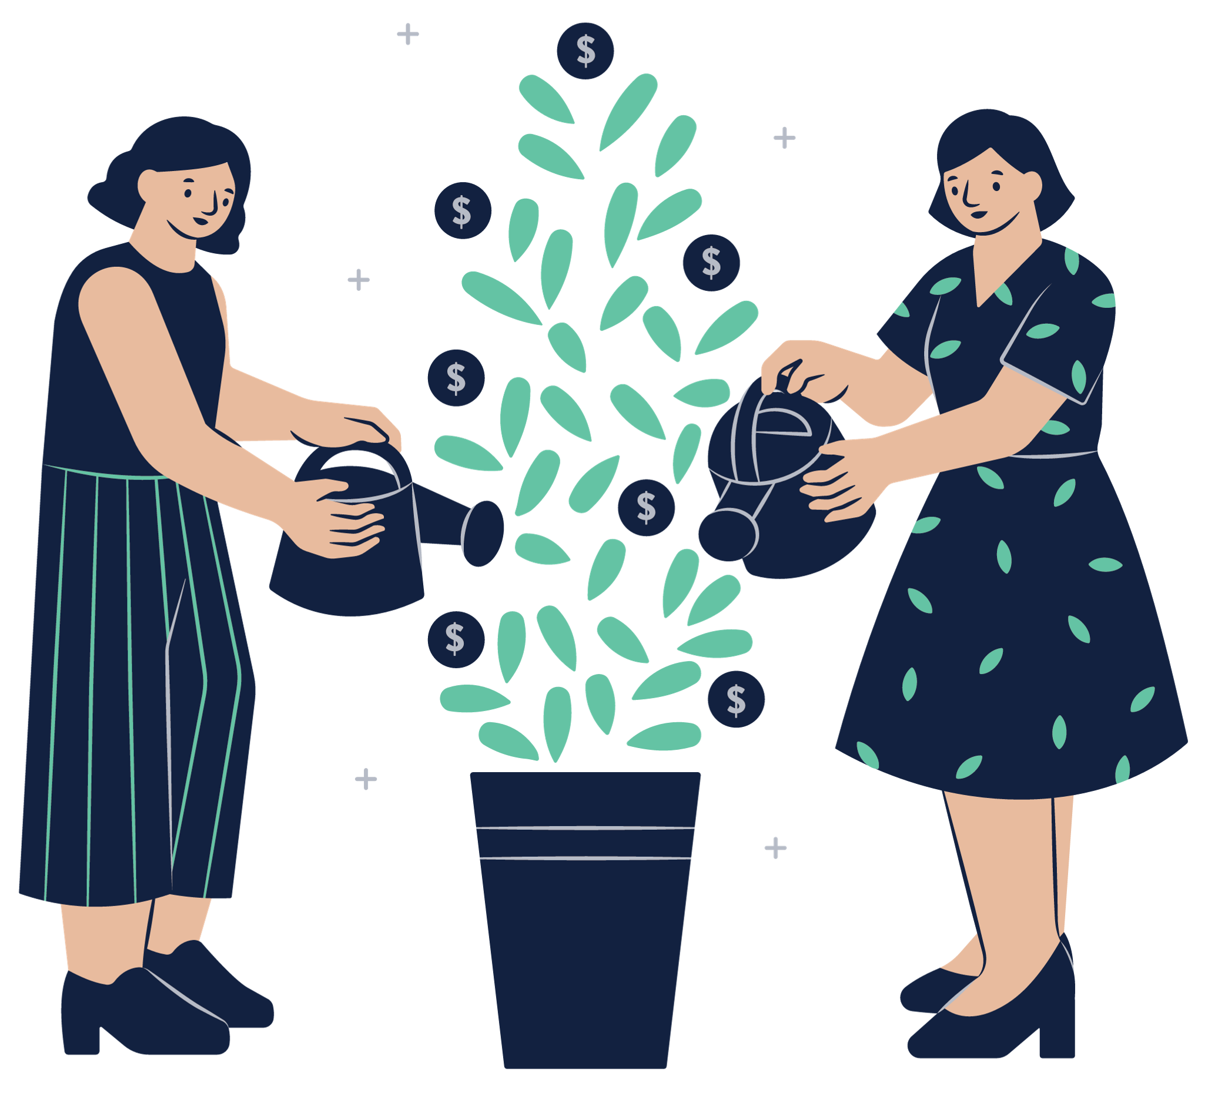
Often 20-60% of total charity income
$1.3 billion for the sector annually
Australians have a high rate of will-writing but low rate of giving
Acquisition/retention and then estate administration

Slide 5

66% of bequestors known to charity in some way
Average bequest around $135,000
Estate administration is very complex
Notes:
Hate that GIW teams get siloed

Slide 6
Why should charities proactively manage estates?
Notes:
There’s a belief that it’s just receiving a cheque and saying thanks, but that’s not the case

Slide 7
Additional Gifts in Wills income
10-15%
When moving from reactive to proactive estate management.
Notes:
Today I’m talking about changes you can make to your estate administration practices to increase your GIW income

Slide 8

Annual Gifts in Wills income of $500,000 = an extra $50,000-$75,000
Annual Gifts in Wills income of $1 million = an extra $100,000-$150,000
Annual Gifts in Wills income of $5 million = an extra $500,000-$750,000
Annual Gifts in Wills income of $15 million = an extra $1.5 million -$2.25 million
Notes:
To put that in perspective for different size charities. So hopefully this demonstrates the value of investing in improving estate administration practices.

Slide 9

Time
Tool
Knowledge
Notes:
Everything we talked about today requires that your estate administrator has:
Time: can’t happen between other responsibilities – otherwise living donors will always take priority. We estimate that less than 20 bequests per year = 1 day per week, 20-50 = 2-3 days per week and 50+ is moving towards 4-5 days per week.
Tool: a system (excel or CRM)
Knowledge: it’s not really administration. Requires knowledge of law, taxation and skills in pushing back on solicitors. May not be the same person who works with living donors and people might need training.

Slide 10

GIW are the responsibility of the whole fundraising team
Acquisition and administration might not be same person
Finance and legal support
Agreed procedures: eg releases, shares
Pre-approval
Notes:
What else other than time, tool, knowledge

Slide 11

How can finance teams help?
Notes:
There’s a belief that it’s just receiving a cheque and saying thanks, but that’s not the case

Slide 12

Understand forecasting challenges
Reading final statements
Share transfers, present and specific entitlement (Capital Gains Tax)
Franking credits

Slide 13
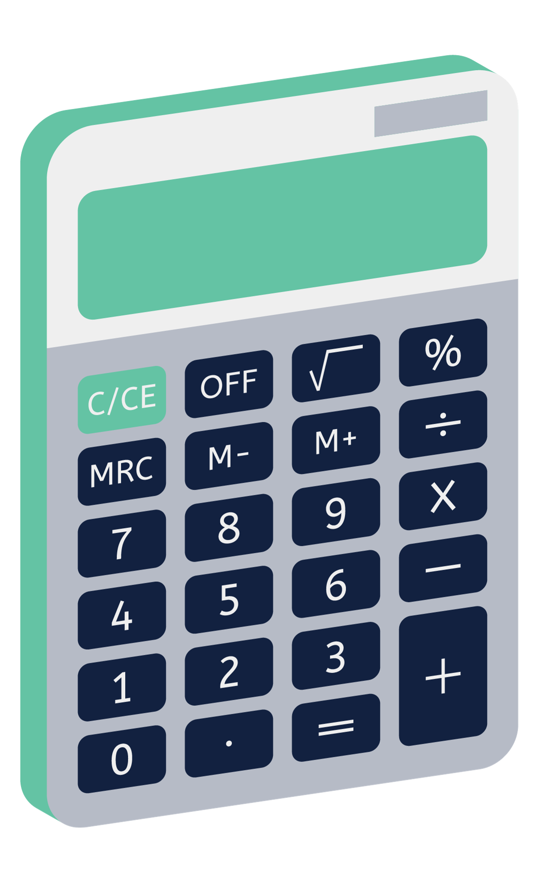
Tax exempt status of charities
Impacts shares and real estate
Solicitors and accountants often not aware

Slide 14

Case studies:
Sold shares without first speaking with charities = $350,000 in CGT
Sold holiday house without making charities presently entitled = $199,000 in CGT
Notes:
You might not realise you are missing out on funds unless you are thoroughly checking final statements to see what was paid to the ATO. It’s not like the solicitor announces the payment of CGT.

Slide 15
1. Shares
2. Non-primary residence properties
3. Primary residence not sold within 2 years of date of death
Notes:
Three main circumstances – also applies to boats and expensive artwork
But it’s complicated – eg bought before CGT existed. This is why you need to get an expert involved.

Slide 16

Why is forecasting so hard?

Slide 17

Very small number of records, very large size
7% of gifts make up 60% of income
Significant variation in time to administer estate
No firm rules on notification timeline

Slide 18

5. 50% of bequsts are ‘unanticipated’ - about 38% of income
6. Very limited control of process for charities
7. Most solicitors are not specialists

Slide 19

What DO we know?
Don’t rely on transformational gifts ($500k+)
Slight uptick in payments in Jun, Nov and Dec
Do not use bequest pipeline as a forecasting tool

Slide 20

Can we rely on our pipeline as accurate?

Slide 21
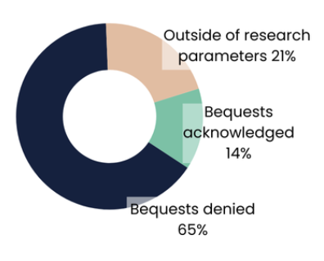

Slide 22
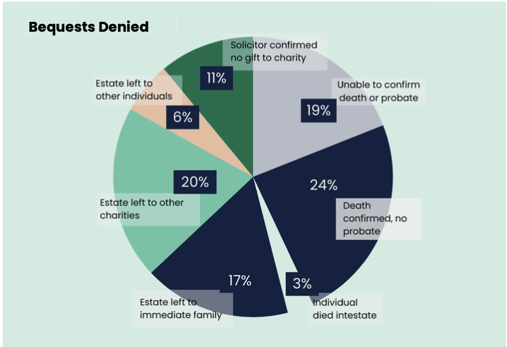
Notes:
Solicitor confirmed no gift to charity = 11% (have to rely because of cost of buying wills)
Unable to confirm death or probate = 19% (maybe still alive, maybe name was wrong)
Death confirmed, no probate = 24% (spouse with joint assets or estate too small – could be missing gifts in there)
Intestate = 3% (should be zero if they are confirmed bequestors. Could will be missing?)
Left to immediate family = 17%
Left to other individuals = 6% (adding together no probate + immediate family + other individuals = 47% likely left all to individuals)
Left to other charities = 20%

Slide 23
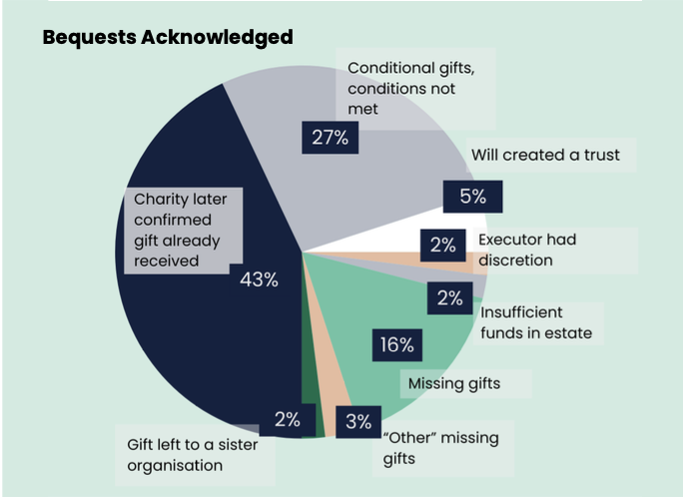
Notes:
Charity confirmed gift was received = 43% (some charities had no issue, others had lots – makes it really hard for you to track)
Conditional gifts, conditions not met = 27% (huge jump from Vic study – some charities must have been having these conversations)
Will created trust = 5%
Executor had discretion = 2% (could be seen as missing gifts)
Insufficient funds or adeemed = 2%
Gift to sister org = 2% (but no communication between them)
Missing gifts = 16%
Other missing gifts = 3%

Slide 24

20-80% of confirmed bequestors will actually leave bequests
Not all confirmations are equal
Online wills are a long game
Close the loop on your pipeline

Slide 25

Takeaways
GIW teams need more support and integration
There is additional income to be had TODAY with more resourcing
Forecasting is a wicked problem

