Slide 1
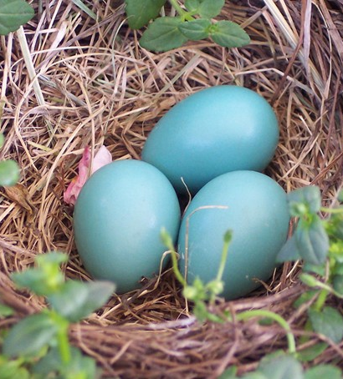

The future of gifts in wills stewardship
Dr Claire Routley
February 2026
Notes:
Run sheet to come, but I envisage:
1.30pm - Intro (HB)
1.35pm - Dan Woods/We Communications - The Future of Communication (30-40 minutes inc. Q&A) *
2.15pm - Claire Routley/Legacy Futures - Research Methodology/Findings/Outcomes (30 mins)
2.45pm - Afternoon tea break (15 mins)
Claire Routley facilitates:
3.00pm - Workshopping the research for individual contexts/breakouts for those online (20-25 mins)
3.25pm - Feedback on workshopping and discussions/Chat comments (20-25 mins)
3.50pm - Conclusion and follow ups
3.55-4pm - Close (HB)

Slide 2

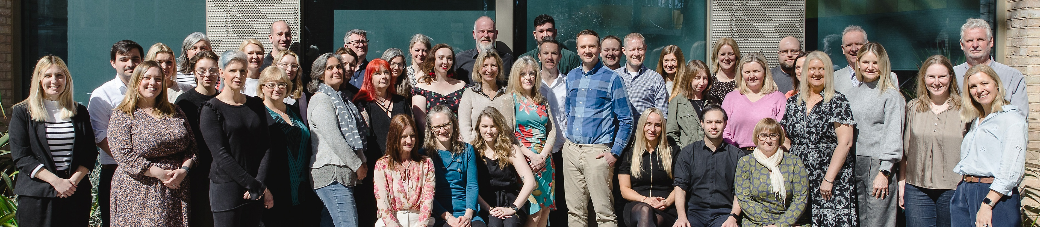
The Legacy Futures family​
Legacy Futures, together with Smee & Ford is the UK's leading charity consultancy group that specialises in gifts in wills and in-memory giving. We provide the legacy giving data and analysis services that drive the UK market. And we are trusted partner to over 1,000 charities in the UK and worldwide, supporting them to harness the transformative power of legacy giving.
  Legacy Futures is best known for research, analysis, and strategy. We work with charities large and small, UK and International, turning insight into strategy and action.
  Legacy Link is the UK's largest team of estate administration consultants, helping to maximise the gifts left to a charity, and adding value at every step of the way.
  Smee & Ford provides timely and accurate legacy notification services for administration teams to optimise their services.
February 26

Slide 3
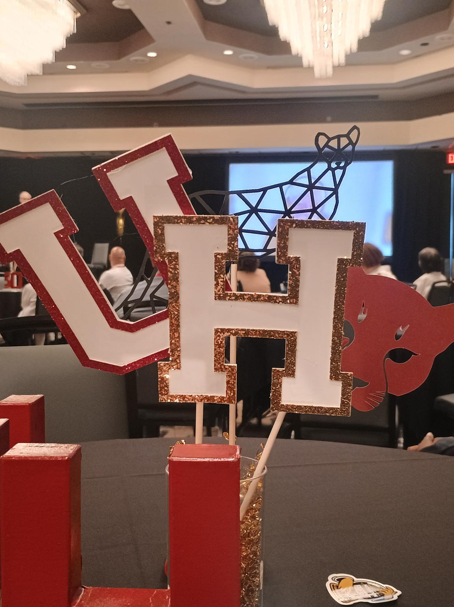
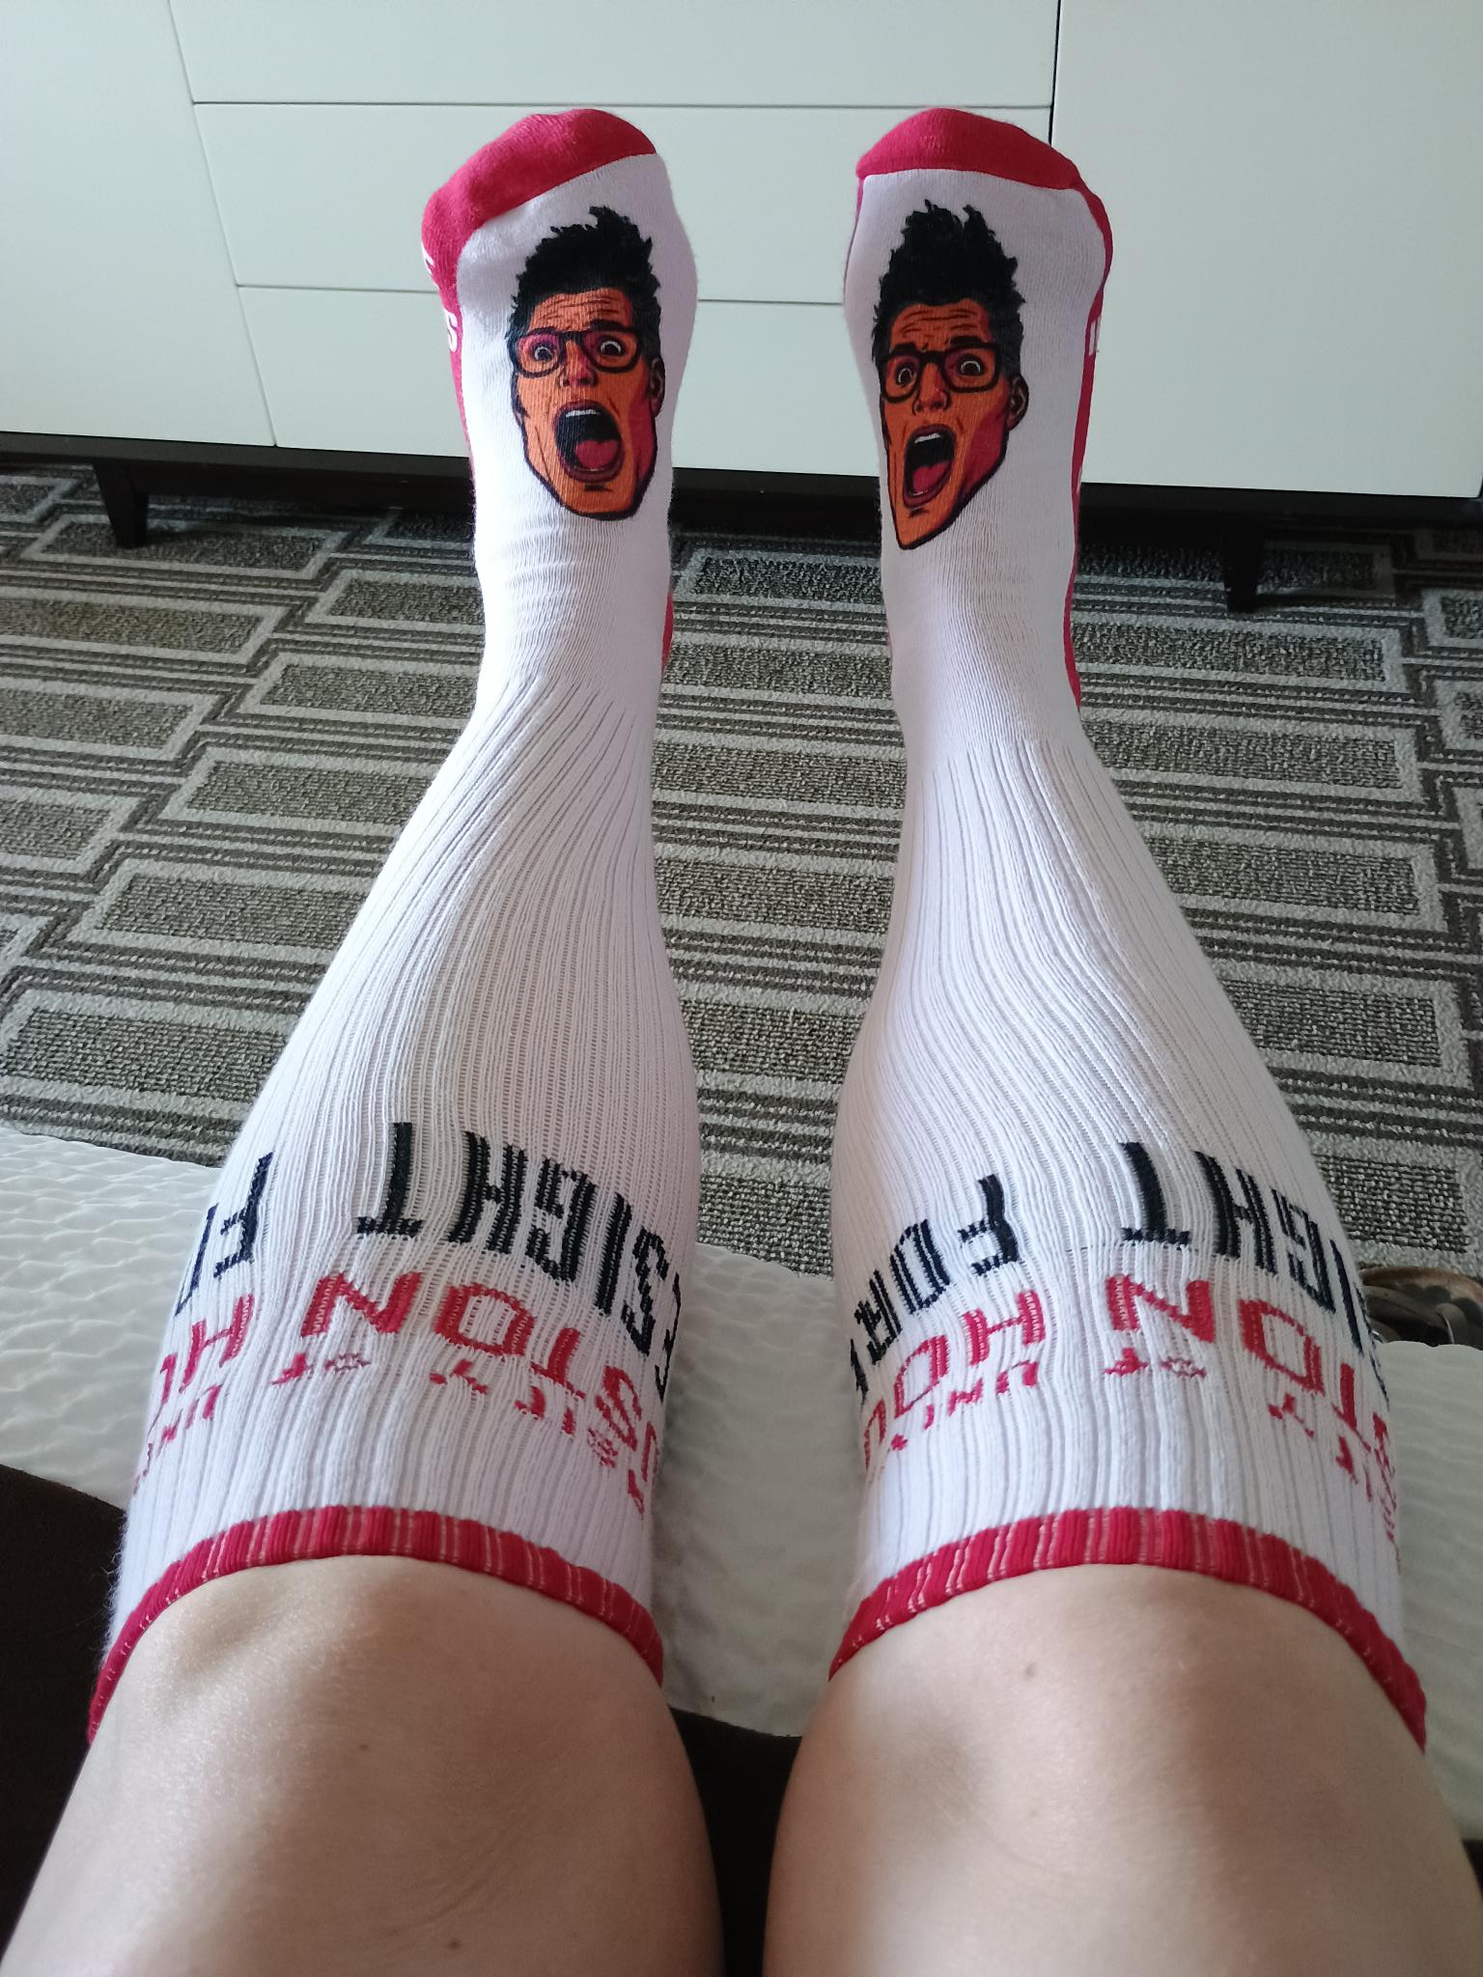
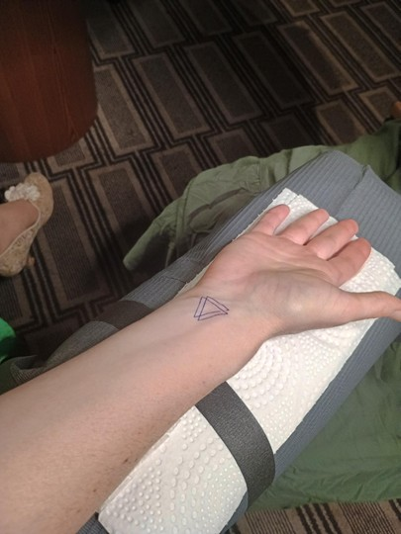
Why am I talking about this?

Slide 4
What comes to mind when you think of fundraising in the future?

Slide 5
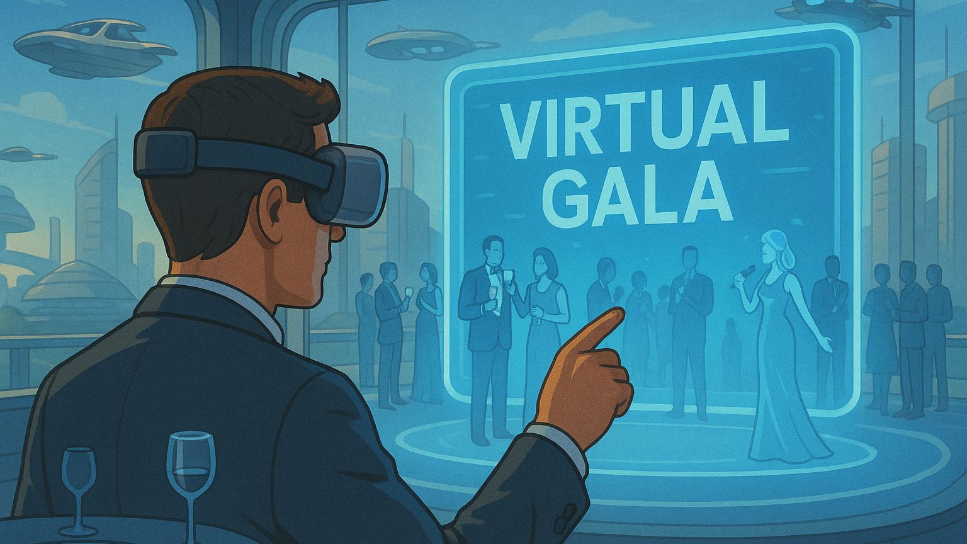
Notes:
Maybe sometime in the next 5 years, we’ll all be attending events in the metaverse

Slide 6
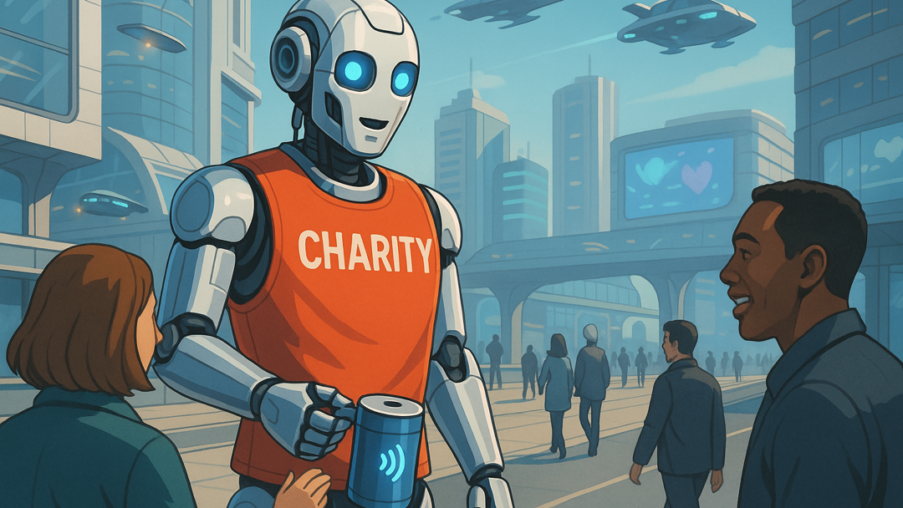
Notes:
Do you imagine street fundraising in a decade’s time… Robot looks slightly terrifying – going to get lasered if you say no

Slide 7
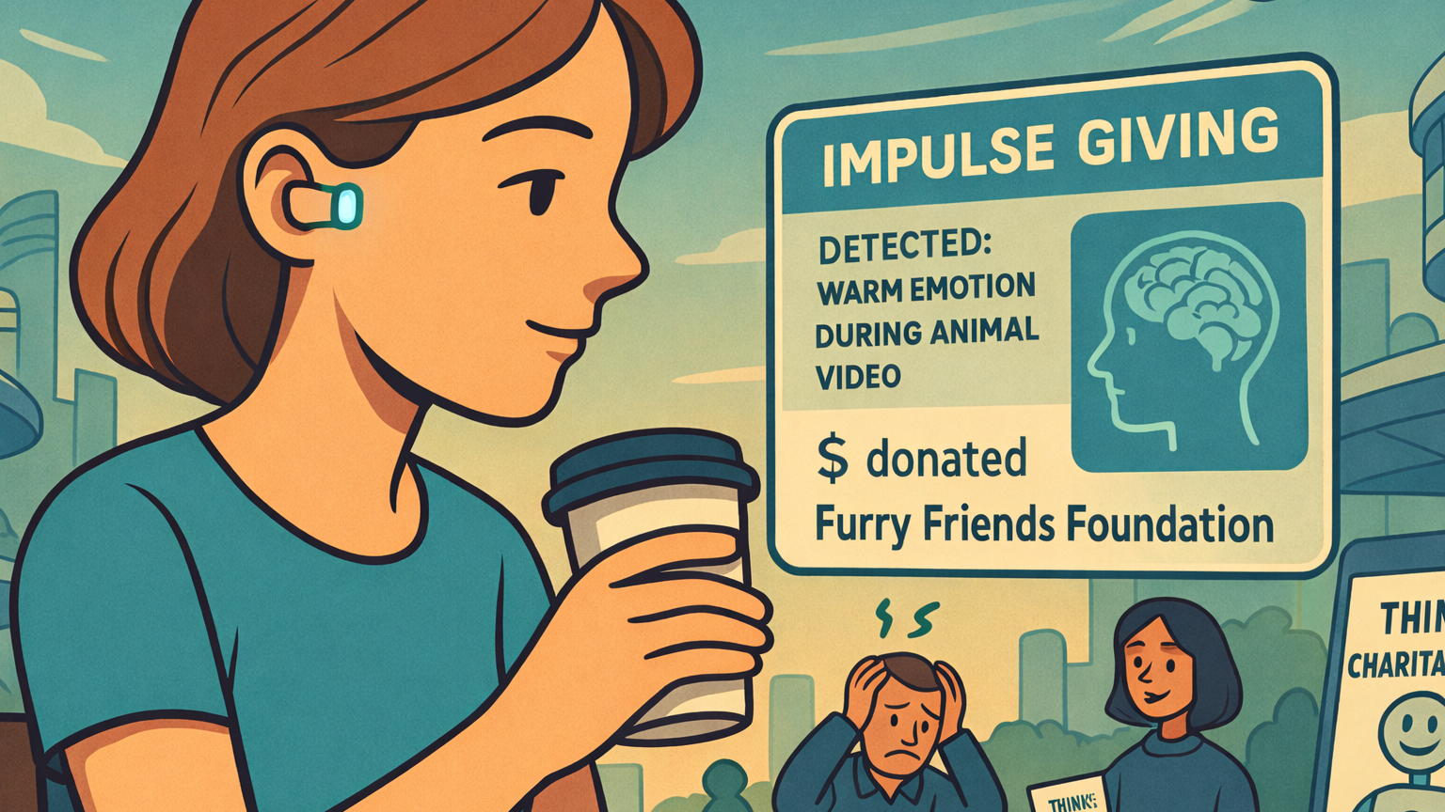
Notes:
Maybe the next 15 years – we’ll be able to donate automatically using the chips in our brains

Slide 8
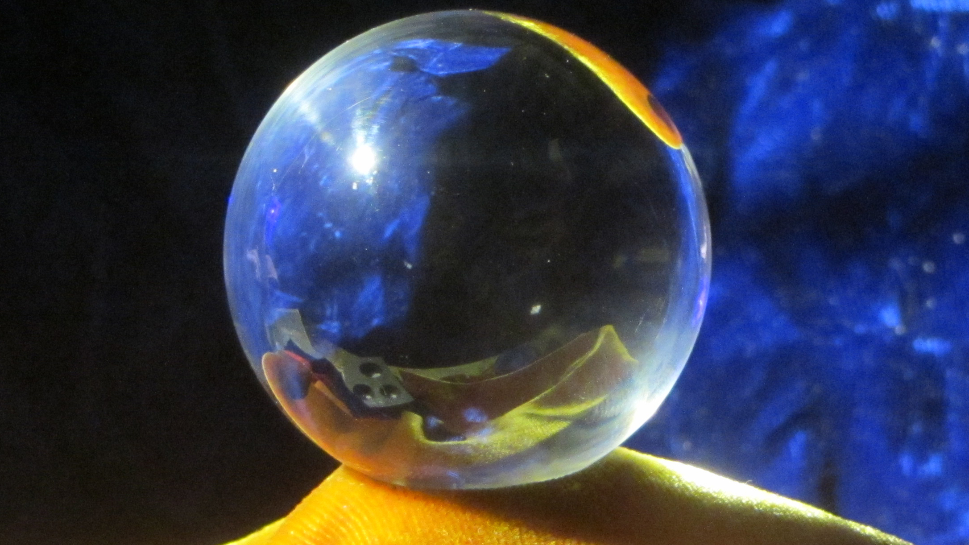
What futures thinking isn’t…

Slide 9
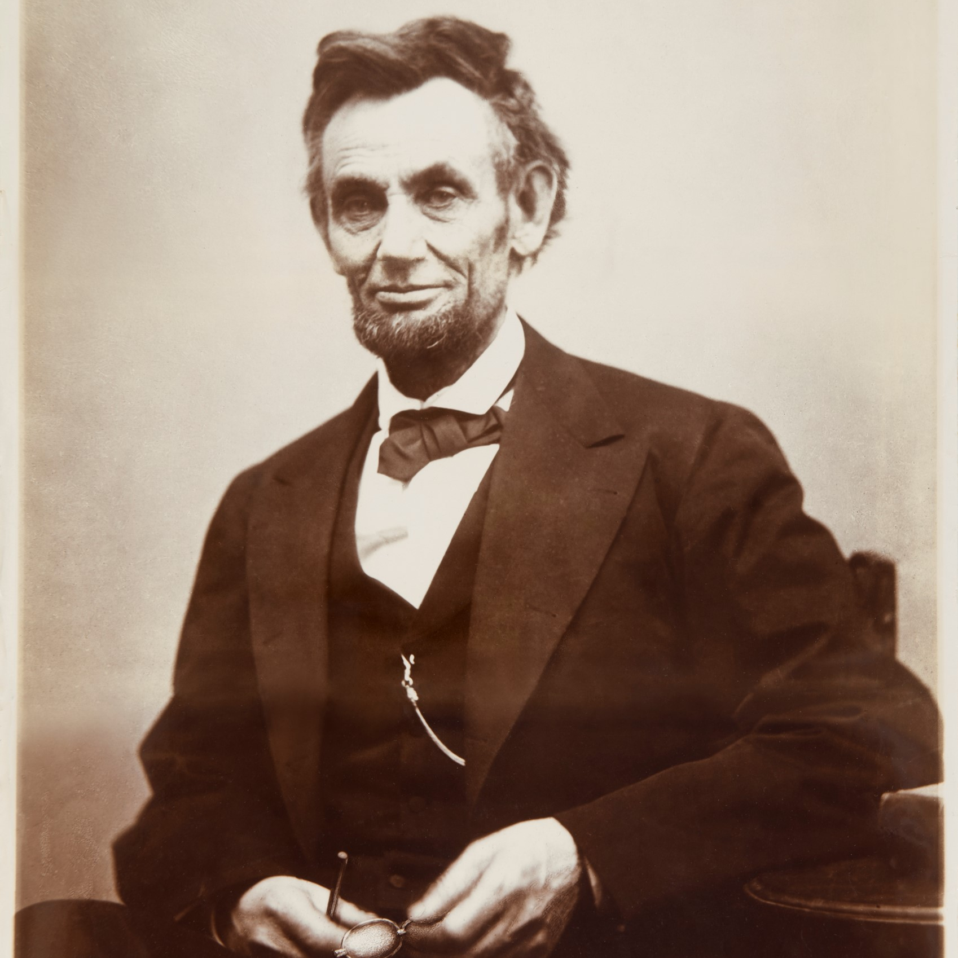

What futures thinking is…
The best way to predict your future is to create it.
Abraham Lincoln

Slide 10
We can bring futures into our strategy process
Create our scoping question “What will gifts in wills fundraising look like in 2035?”
Scan the horizon Using tools like PEST – but with a futures focus
Focus in on key drivers Assessing the likely drivers of change
Imagine plausible futures Using scenario planning
Explore practice in each future Starting from SWOT and SWOT matching

Slide 11
And use futures techniques to support our work
Think backwards through the steps to get there
Start here
Vision
Step 1
Step 2
Step 3
Then take action today
Source: Sohail Inayatullah

Slide 12
We set out to explore…
The future of
gifts in wills stewardship
to 2050

Slide 13
How did we do it?
Scan hits
Drivers
TIPPOs
Scenarios

Slide 14
How did we do it?
Scan hits
Drivers
TIPPOs
Scenarios

Slide 15
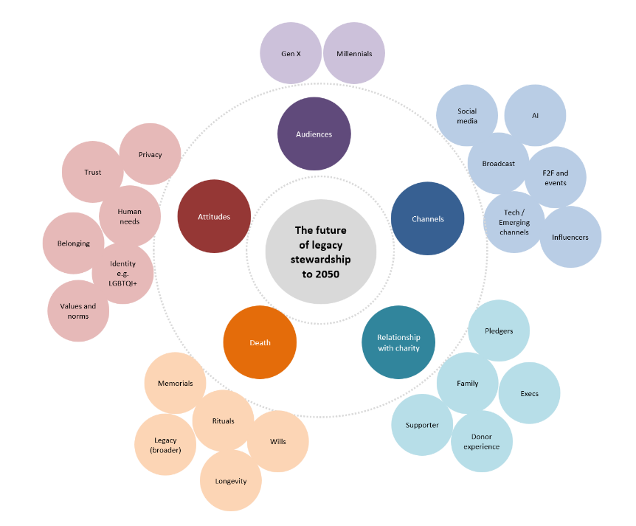
We created a domain map

Slide 16
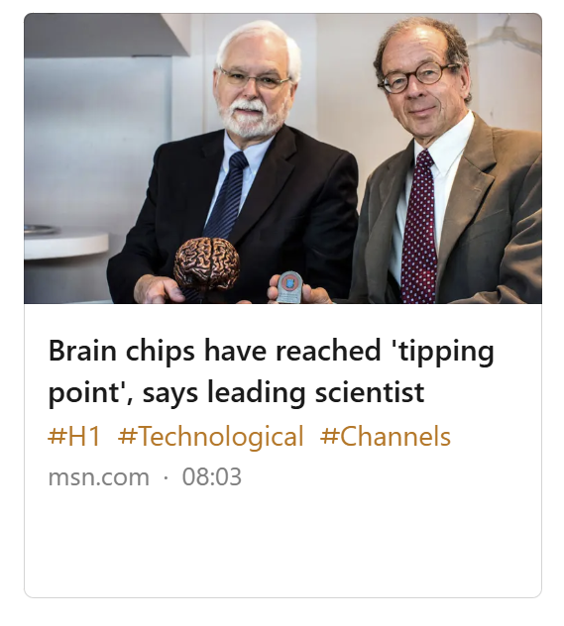
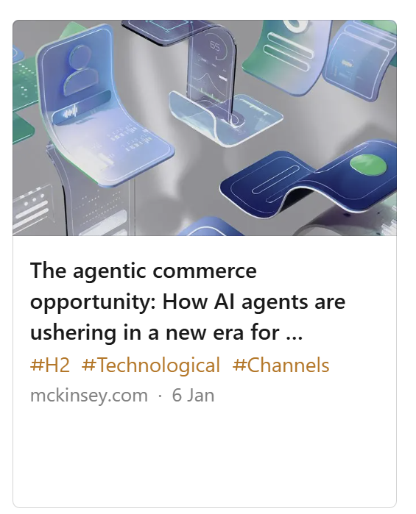
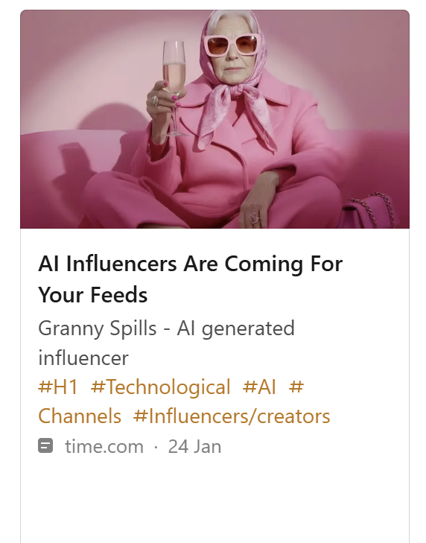
There’s a lot of technological change
Scan hits

Slide 17
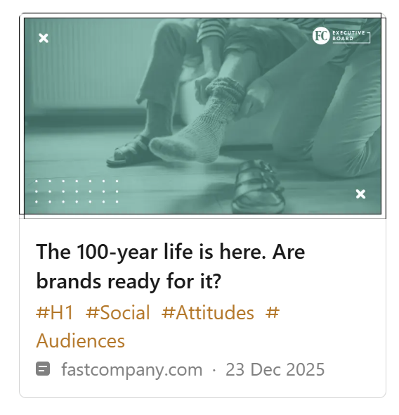
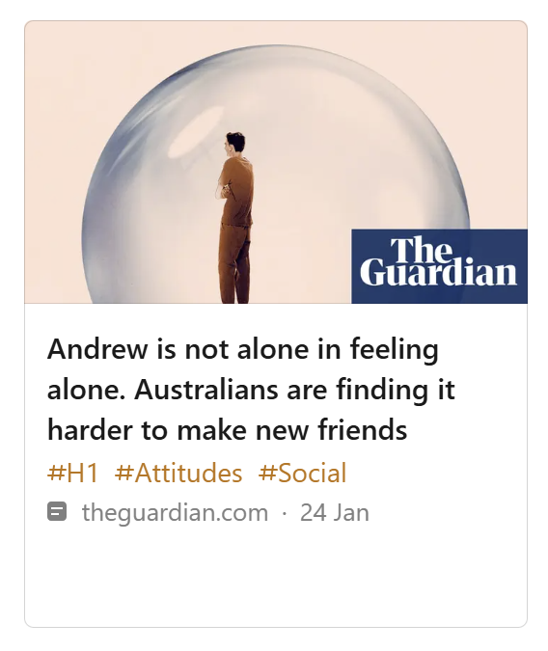
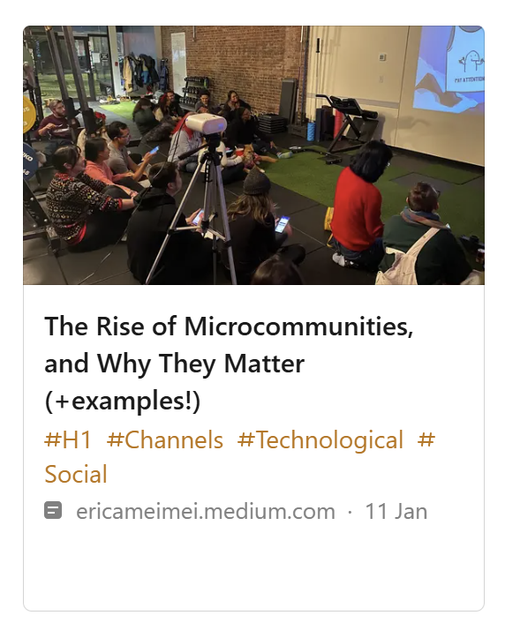
But also (related) social change
Scan hits

Slide 18
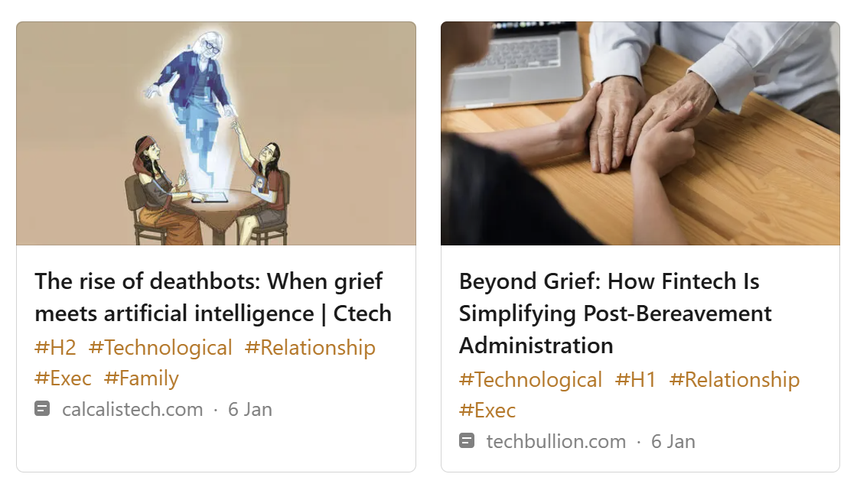
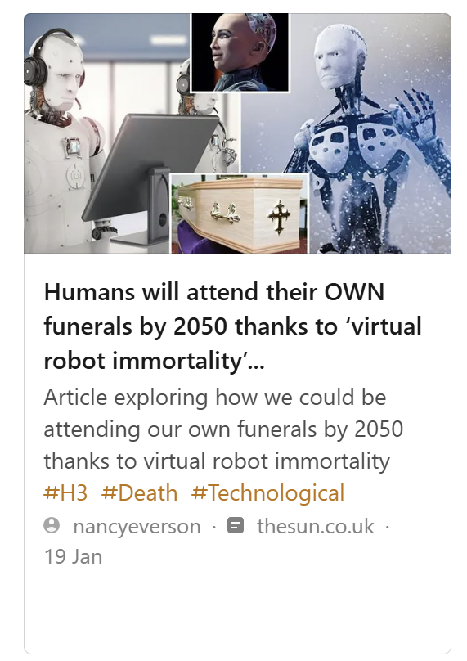
…in death as well as life
Scan hits

Slide 19
How did we do it?
Scan hits
Drivers
TIPPOs
Scenarios

Slide 20
TIPPOs
Trends
Issues
Plans
Projections
Obstacles
Rise in individualism, decline in the value of ‘mateship’, trust shifting, engagement down
Living on v letting go
Plans to grow the legacy market, and giving more generally
Increasing number of deaths, millennials to become richest generation in history
Bequest giving not yet a social norm

Slide 21
How did we do it?
Scan hits
Drivers
TIPPOs
Scenarios

Slide 22






Six key drivers of the future of stewardship
Changing attitudes to we v me v us
Declining trust in institutions
Growth in tech enabled lives and deaths
Changing attitudes to death
Evolving values, influenced by technology
Inheritance increasingly contested

Slide 23
How did we do it?
Scan hits
Drivers
TIPPOs
Scenarios

Slide 24


Some benefits of using scenarios
Creativity
Collaboration
Open-mindedness
Preparedness
Notes:
Open-mindedness – generally when planning out strategies, people think the future will be the same as today. Need to open our minds to the previously inconceivable
Collaboration – safe place to discuss plausible visions of the future, acknowledge uncertainty. At Shell ‘they encouraged strategic conversations that went beyond the incremental, comfortable, and familiar progression customary in a consensus culture.’ Surfaced assumptions about the future

Slide 25
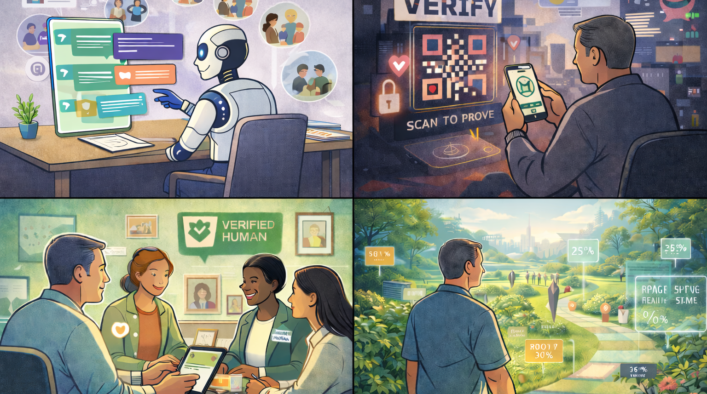
Islands of belonging
Everyone for themselves
The rebalanced society
The long horizon

Slide 26
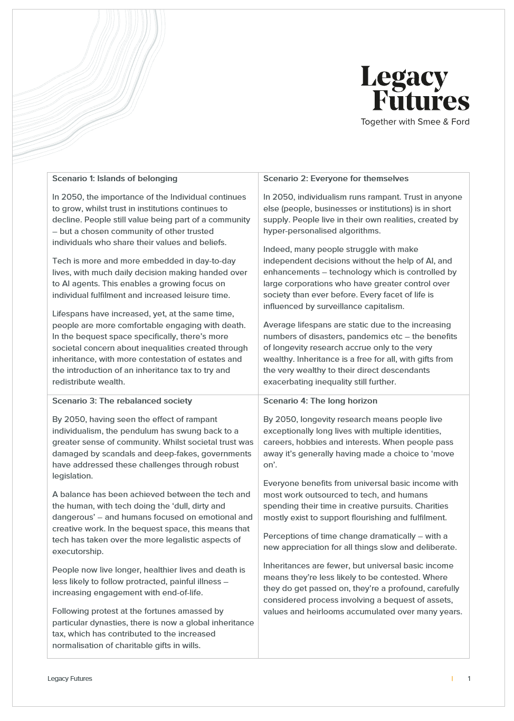
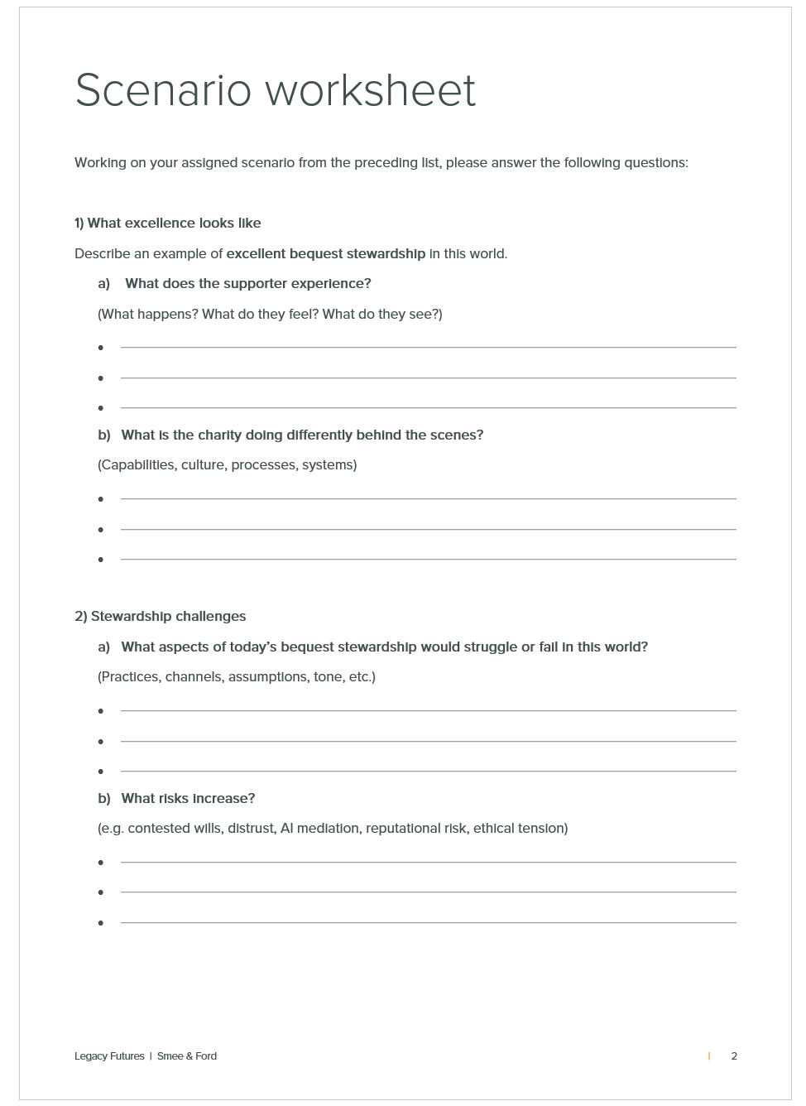
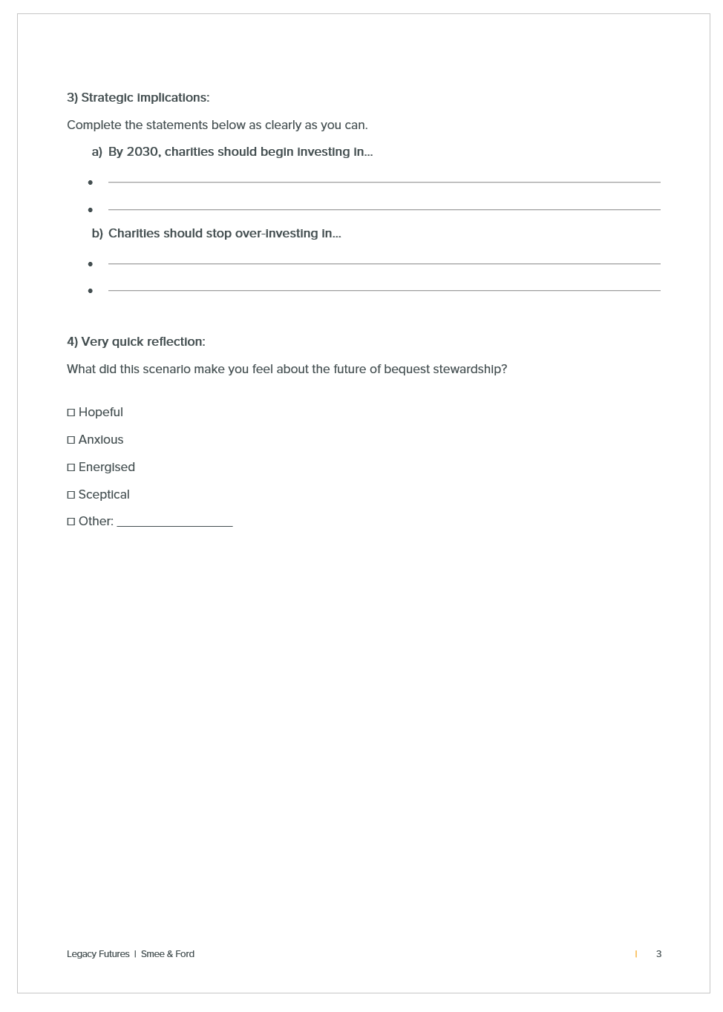
Over to you…

Slide 27
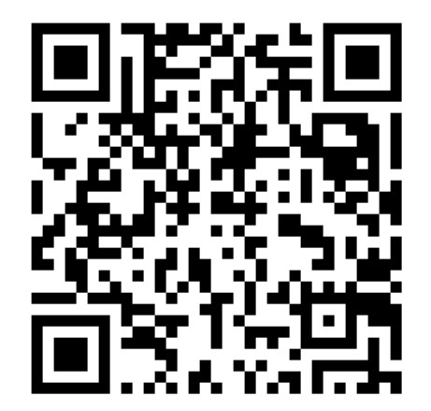
Thank you
Dr Claire Routley
Consultancy Director
claire.routley@legacyfutures.com

